Slide 1
Ways to Wellbeing
Aaron Jarden
aaron.jarden@openpolytechnic.ac.nz
6th April

Slide 2
Four Projects
The International Wellbeing Study (www.wellbeingstudy.com)
The Tuesday Program (www.thetuesdayprogram.com)
The International Journal of Wellbeing (www.internationaljournalofwellbeing.org)
The New Zealand Association of Positive Psychology (www.positivepsychology.org.nz)

Slide 3
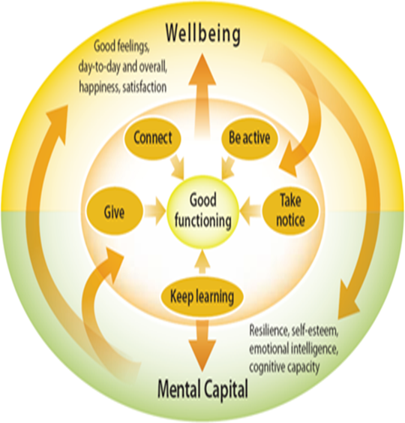
Exercise
Find someone you don’t know – each spend ONE minute describing to the other person a time when you were at your best in a work environment.

Slide 4
The International Wellbeing Study www.wellbeingstudy.com
Paul Jose
Todd Kashdan
Ormond Simpson
Kennedy McLachlan
Alexander Mackenzie
+72 others
collaborators

Slide 5
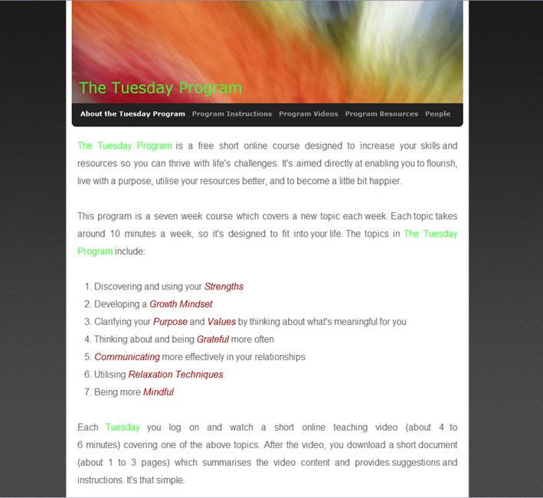
The Tuesday Program www.thetuesdayprogram.com
Aaron Jarden
Jo Mitchell
Alexander MacKenzie
Jacolyn Norrish
Ravi Iyer
Kennedy McLachlan
Kathryn Page
Chelsea Todd
Denise Quinlan

Slide 6
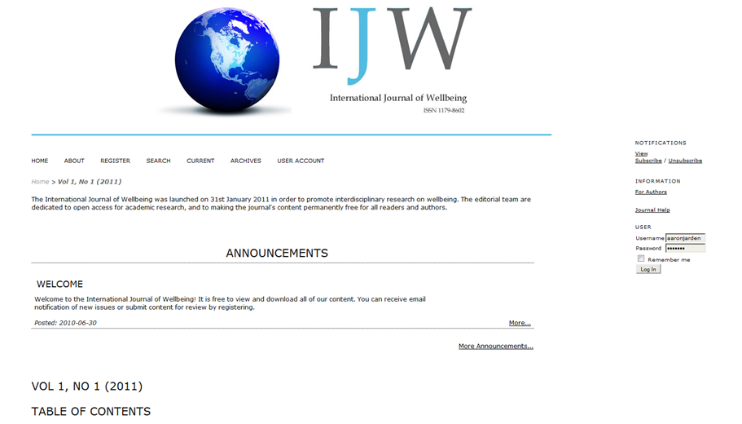
The International Journal of Wellbeing www.internationaljournalofwellbeing.org
Aaron Jarden
Dan Weijers
Nattavudh Powdthavee
+ 52 Editorial Board

Slide 7
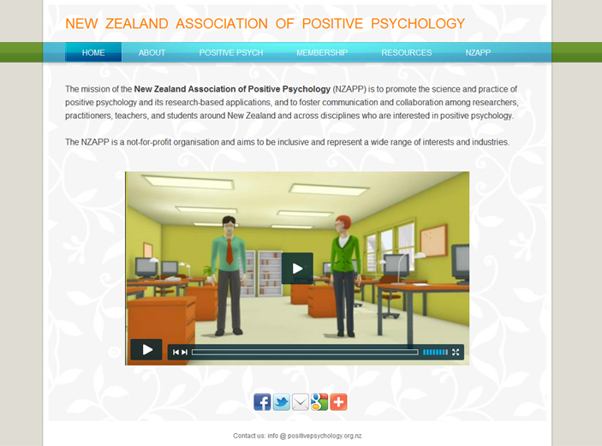
The New Zealand Association of Positive Psychology www.positivepsychology.org.nz
Aaron Jarden
Denise Quinlan
Alison McCormick
Ace Simpson
Charmaine Bright
Erica Chadwick
Lucy Hone
Maree Roche
Alison Ogier-Price
Bee Lim
Christoph Huelsmann
Paul Jose
Dianne Vella-Brodrick

Slide 8
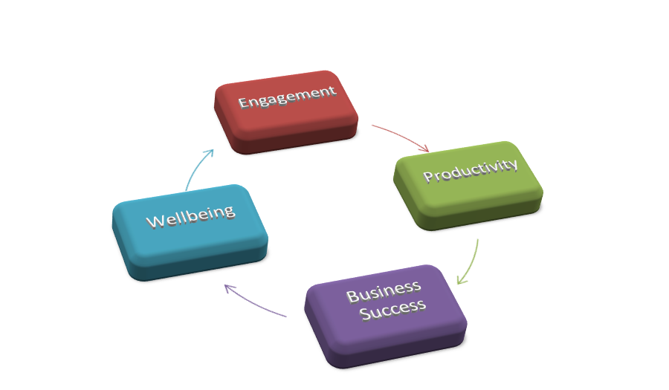
Take Home Messages
There are two psychological keys to a good business, both of which point towards providing the enabling conditions for employees to thrive, then for businesses to flourish.
Enable employee strengths. Find out what your employees are good at and empower them to use what they are good at more (strong link to productivity via engagement).
For a business to thrive, it must cultivate relationships and create meaning for employees (strong link to productivity via engagement).
“optimal performance is tied to good well-being; the higher the positive morale, the better the performance”
– from Flourish.

Slide 9
Thank You
Aaron Jarden
aaron.jarden@openpolytechnic.ac.nz
“Success is not the key to happiness.
Happiness is the key to success.
If you love what you are doing,
you will be successful”
Albert Schweitzer, 1875-1965
Notes:
9

