Slide 1
Emergency Wellbeing Skills
Associate Professor Aaron Jarden
29th October 2020

Slide 2
4 skills
The Geelong three breaths exercise.
Gratitude.
Decision making for wellbeing.
Plan for wellbeing.

Slide 3
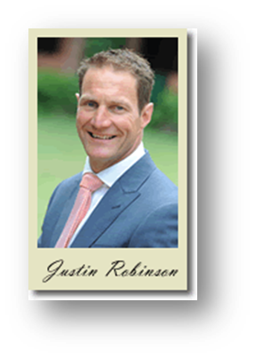
1. Geelong three breaths
Breath One. Take a deep breath. Notice your physical body and any points of pain or tension. Breath out slowly and release any tension away.
Breath Two. Take a deep breath. As you breathe out think about what you are grateful for right at this very moment. Say to yourself “Right now I am grateful for...”.
Breath Three. Take a deep breath. As you breathe out think what intentional state you want to be in right now. Say to yourself “My intention right now is to be (kind, open minded, relaxed, critical, curious etc)...”.
Developed by Justin Robinson at Geelong Grammar.

Slide 4
2. Gratitude
Gratitude is strongly related to wellbeing, so increase gratitude by focusing on good things that happen each day.
Each day think of three things you are thankful for.
These can be big things, such as good health, supportive relationships, and career successes, or little things such as a perfect cup of coffee or hearing your favourite song on the radio.
Write down three things at the end of each day for a week, and aim to write new items each time.

Slide 5
3. Decision making for wellbeing
Increase your decision-making skills which in turn impact your wellbeing.
The skill of decision making helps negative complex, uncertain, and multiple decisions and frees up valuable cognitive resources.
Two types of decision making:
Maximisers: Individuals who maximise consider all possibilities comprehensively and strive to select the best option. These individuals search out information to ensure they are exposed to the best alternatives.
Satisficers: Individuals who satisfice seek an alternative that exceeds some criterion of acceptability. Once they identify an acceptable option, they discontinue their search and choose that option. These individuals do not pursue the goal to optimise every decision.
Not all decisions need to be maximised! Choosing a life partner (yes), choosing between different brands of detergent or from appetisers on a menu (no). Can you satisfice more?

Slide 6
4. Plan for wellbeing
Wellbeing is not likely to “just happen”. If you plan for it, it is more likely to happen.
Ask yourself:
What does a great day look like?
Only once you have a clear picture of this in your mind can you:
Think about when over the day you can get the level and quality of connection that YOU need.
Think about what activities you can infuse into your day that fule your purpose.
Think about when you will get the rest and recouperation periods.
Think about when you will be able to use your personal strengths.
All of these things build up you sense of wellbeing…

