Slide 1
Innovative and cutting-edge wellbeing promoting activities
Alexandra Johnson & Aaron Jarden
Centre for Positive Psychology – University of Melbourne
19th September 2018
PESA Victoria
www.PESA.edu.au © PESA 2018

Slide 2
Speed Wellbeing: 6 Positive Psychological Interventions in 6 minutes 1. 3 breaths 2. Win a strength (strengths literacy) 3. Cognitive model 4. Eye gazing 5. Secret handshake 6. Slow stretch
www.PESA.edu.au © PESA 2018

Slide 3
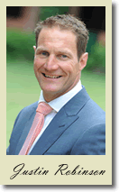
The Geelong Three Breaths
Breath One. Take a deep breath. Notice your physical body and any points of pain or tension. Breath out slowly and release any tension away.
Breath Two. Take a deep breath. As you breathe out think about what you are grateful for right at this very moment. Say to yourself “Right now I am grateful for...”.
Breath Three. Take a deep breath. As you breathe out think what intentional state you want to be in right now. Say to yourself “My intention right now is to be (kind, open minded, relaxed, critical, curious etc)...”.
Developed by Justin Robinson at Geelong Grammar.
Notes:
This bar timer, will start when anywhere on the slide is clicked. The bar will move from left to right and the word ‘End’ will appear at the end, accompanied by a ‘Deep Gong’ sound. It is possible to change the duration of this timer to any time, by entering the animation settings, and changing the timing for ‘rectangle 3’. Note the time has to be entered as a number of seconds – so if you want 2mins & 30secs – this is entered as 150 (60X2 + 30 = 150).

Slide 4
Win a Strength
https://www.workonwellbeing.com/strengths
Look at your day through the lens of this strength…
Notes:
This bar timer, will start when anywhere on the slide is clicked. The bar will move from left to right and the word ‘End’ will appear at the end, accompanied by a ‘Deep Gong’ sound. It is possible to change the duration of this timer to any time, by entering the animation settings, and changing the timing for ‘rectangle 3’. Note the time has to be entered as a number of seconds – so if you want 2mins & 30secs – this is entered as 150 (60X2 + 30 = 150).

Slide 5
Cognitive Model
Imagine someone punches you in the arm…
Imagine someone gives you a hug…
Notes:
This bar timer, will start when anywhere on the slide is clicked. The bar will move from left to right and the word ‘End’ will appear at the end, accompanied by a ‘Deep Gong’ sound. It is possible to change the duration of this timer to any time, by entering the animation settings, and changing the timing for ‘rectangle 3’. Note the time has to be entered as a number of seconds – so if you want 2mins & 30secs – this is entered as 150 (60X2 + 30 = 150).

Slide 6
Eye Gazing
Sit directly facing your partner. Spend the next minute staring directly into your partners eyes.
This is the only instruction. Try not to gaze away, talk, or do any other movements – just sit still and stare into their eyes.
Aron, A., Melinat, E., Aron, E. N., Vallone, R. D., & Bator, R. J. (1997). The experimental generation of interpersonal closeness: A procedure and some preliminary findings. Personality and Social Psychology Bulletin, 23(4), 363-377.
Notes:
This bar timer, will start when anywhere on the slide is clicked. The bar will move from left to right and the word ‘End’ will appear at the end, accompanied by a ‘Deep Gong’ sound. It is possible to change the duration of this timer to any time, by entering the animation settings, and changing the timing for ‘rectangle 3’. Note the time has to be entered as a number of seconds – so if you want 2mins & 30secs – this is entered as 150 (60X2 + 30 = 150).

Slide 7
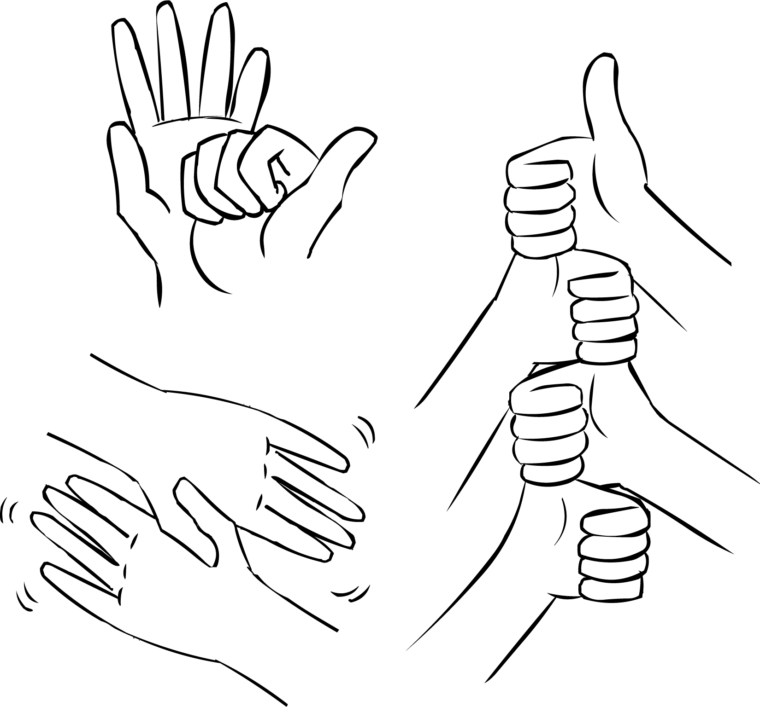
Secret Handshake
Shared knowledge increases social bonds. Within one minute, create a secret handshake with the person next to you.
Notes:
This bar timer, will start when anywhere on the slide is clicked. The bar will move from left to right and the word ‘End’ will appear at the end, accompanied by a ‘Deep Gong’ sound. It is possible to change the duration of this timer to any time, by entering the animation settings, and changing the timing for ‘rectangle 3’. Note the time has to be entered as a number of seconds – so if you want 2mins & 30secs – this is entered as 150 (60X2 + 30 = 150).

Slide 8
Slow Stretch
Stand up and stretch at 50% of the pace that you would usually stretch. Like you are on the moon…
Honoré, C. (2004). In praise of slowness: How a world wide movement is challenging the cult of speed. London: Orion Books.
Notes:
This bar timer, will start when anywhere on the slide is clicked. The bar will move from left to right and the word ‘End’ will appear at the end, accompanied by a ‘Deep Gong’ sound. It is possible to change the duration of this timer to any time, by entering the animation settings, and changing the timing for ‘rectangle 3’. Note the time has to be entered as a number of seconds – so if you want 2mins & 30secs – this is entered as 150 (60X2 + 30 = 150).

Slide 9
Go well!
www.PESA.edu.au © PESA 2018

