Slide 1
WELLBEING 101: MAKING WELLBEING PROGRAMS SUCCESSFUL
Dr Aaron Jarden
aaron.jarden@sahmri.com
4th April 2017
Corporate Health and Wellbeing Summit
Auckland
Copy of these slides at: www.aaronjarden.com
www.aaronjarden.com
www.wellbeingandresilience.com

Slide 3
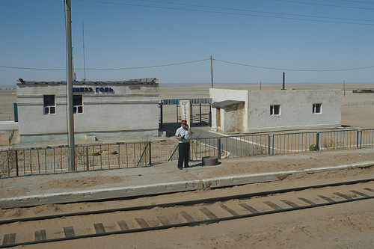

Slide 6
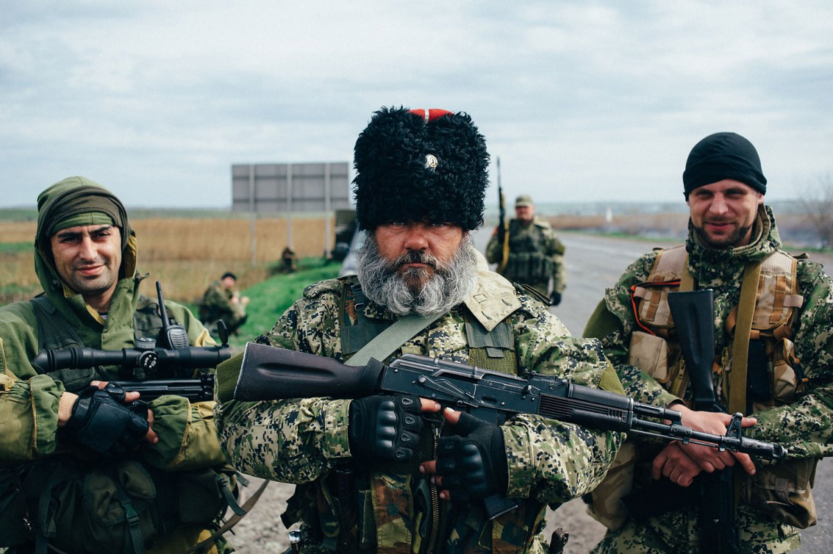

Slide 7
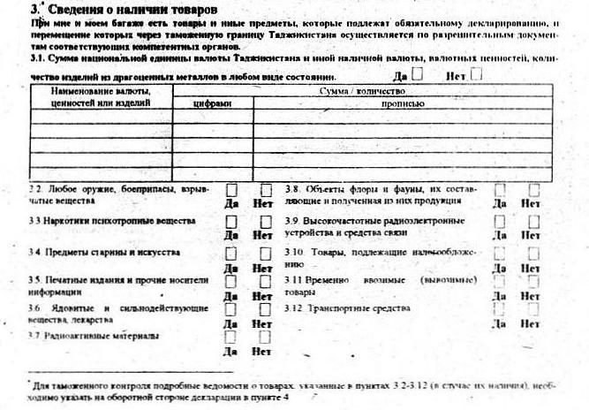

Slide 8
Perspectives
My goal
“My goal is simple. It is complete understanding of human wellbeing, why it is as it is and how it can be improved.”
Within an organisational setting, it’s to enable organisations to invest in creating more rewarding, happier jobs for their people. To create positive workplaces where people are able to do meaningful and enjoyable work that taps into their greatest strengths and their most important goals. To capitalise on the unique intellectual and personal strengths of each employee by focusing less on getting employees to do their work and fixing problems and into promoting excellence by enabling them to do good work; their best work.
Wellbeing ⇨ Engagement ⇨ Productivity ⇨ Business success
Wellness 
Your goal
What’s your goal?
Do you need to focus more on what success looks like for your organisation at an employee level?

Slide 9
Overview
Overview
Positive psychology and wellbeing science.
Some essential ingredients to a successful wellbeing program.
Case studies.

Slide 10
Positive psychology & wellbeing science
Positive psychology and wellbeing science
Positive psychology is a branch of psychology that conducts scientific inquiry into the factors that help individuals, communities and organisations thrive by building on their strengths and virtues.
Positive psychology is the study of topics as diverse as happiness, optimism, hope, flow, meaning, subjective wellbeing and personal growth.
Positive psychology aims to expand psychology from its focus on repairing the negatives in life to also promoting the positives in life.

Slide 11
Positive psychology & wellbeing science
What is optimal human functioning?

Slide 12
The good life
Aaron on wellbeing science
The good life is best construed as a matrix that includes happiness, occasional sadness, a sense of purpose, playfulness, and psychological flexibility, as well autonomy, mastery, and belonging/connection.
For me it’s not just about learning to be more positive – it’s about using scientifically-informed tools and strategies to make my thinking more flexible, accurate, clear, and expansive. This thinking (I hope) leads to happiness and more healthy behaviours.

Slide 13
Progress to date
Wellbeing science to date
Progress
Positive neuroscience
Positive education
Positive health
Military
Positive organisations
National accounts of wellbeing
Culture and wellbeing
New areas emerging
Discomfort
Strategic laziness
Play
Slowness
Nature
Wellbeing technology
The most disadvantaged (little samples)
Physical health and wellbeing
Positive failure

Slide 14
Positive introduction
First up, let’s taste it
Step 1: Pair up.
Step 2: In 2 minutes (1 minute each), tell a story – a thoughtful narrative with a beginning, middle and end – that illustrates when you are at your best at work.
Note: Swap when you hear the bell the first time after 1 minute, stop completely when you hear the bell the second time after 2 minutes.

Slide 15
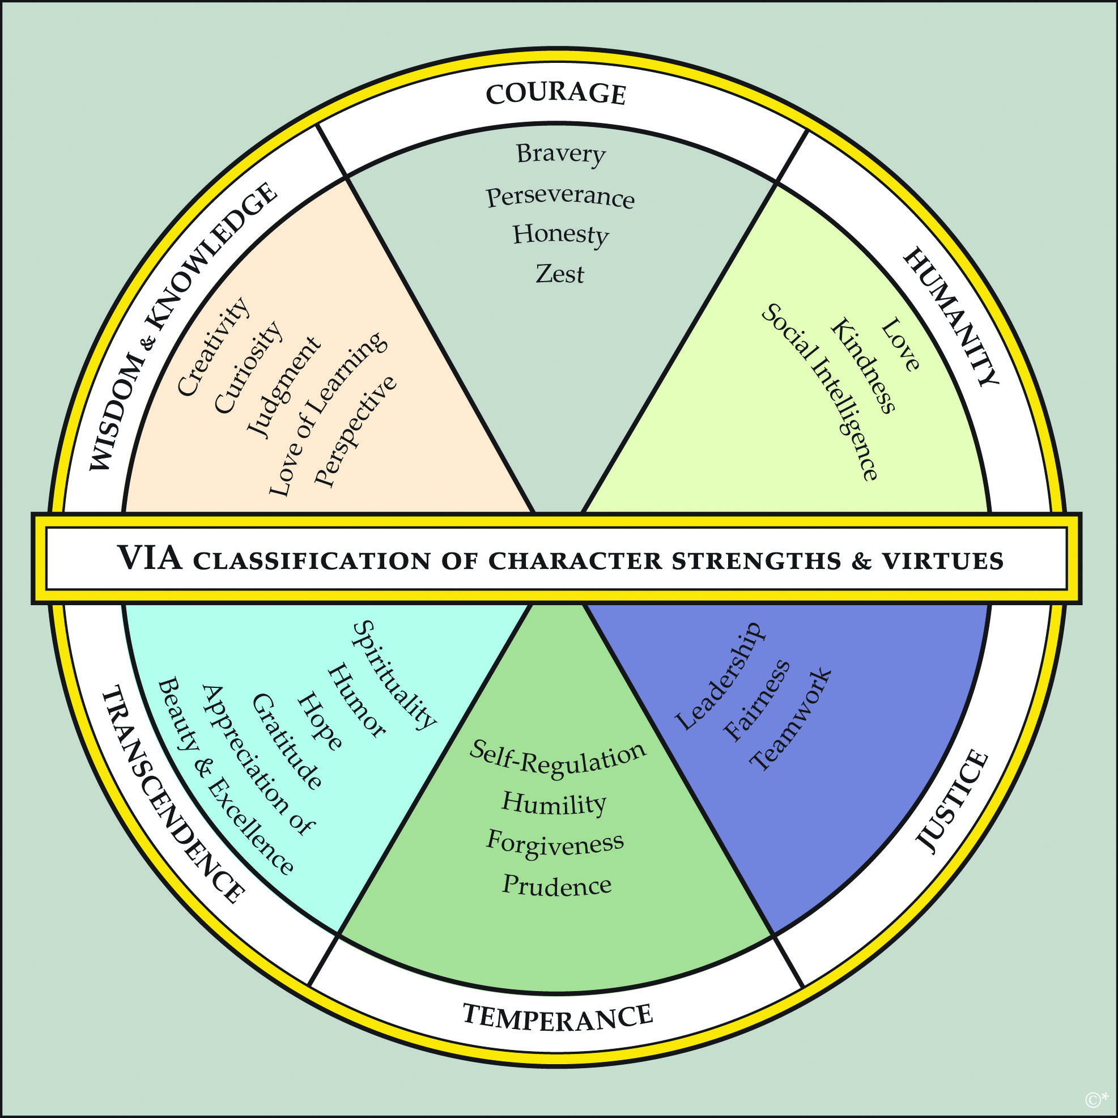
Positive introduction
Key point:
Wield your strengths at work – they are paths to engagement and enjoyment.

Slide 16
Essential ingredients
Recipe of essential ingredients to a successful wellbeing program
Beautiful questions.
Wellbeing assessment and evaluation.
A wellbeing framework and models.
Positive leadership and champions.
Tools and programs.
Risks.
A whole bunch of other stuff, like:
Onboarding and communications and simplifying messages.
Time and money.
Timing and readiness for change – wellbeing is hard work and takes time.
Program scope and focus.

Slide 17
Essential ingredients
Beautiful questions
What’s working?
What has already been embedded within the organisation?
Why is it working?
What (or more likely who) has sustained this embedding?
What are the positive processes? How did they happen?
What has failed?
Why?
Disengaged health & safety?
How will you know wellbeing has worked?
Types of evidence and triangulating information.
Measuring IV’s and DV’s - indicators of change.
Pre – post and longer term assessment.
Is the organisation ready and willing for wellbeing? (or more likely ‘who’ in the organisation is ready?).
Is the organisation connected to wellbeing people, expertise and knowledge? (support)
Why are the employees working there? What do they want out of work? What does a good day at work look like?
Is there much point increasing wellbeing, when illbeing is bad or getting worse?
How will the organisation capitalise on other opportunities during the wellbeing change?
How do you celebrate success?

Slide 18
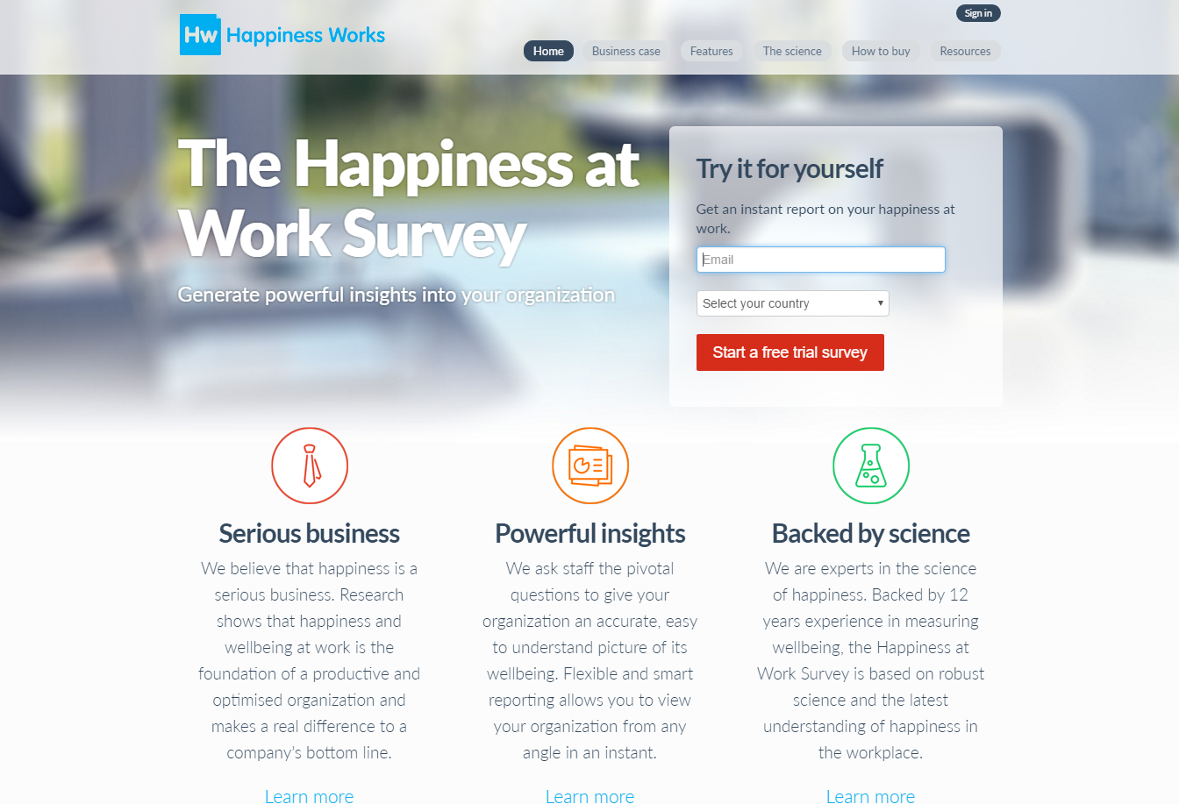
Essential ingredients
Wellbeing assessment and evaluation
Assessments create opportunities for conversations, conversations improve wellbeing (also use existing events, and create new wellbeing events to do so).
Assessments also data-driven decision making.
www.workonwellbeing.com & www.happinessatworksurvey.com

Slide 19
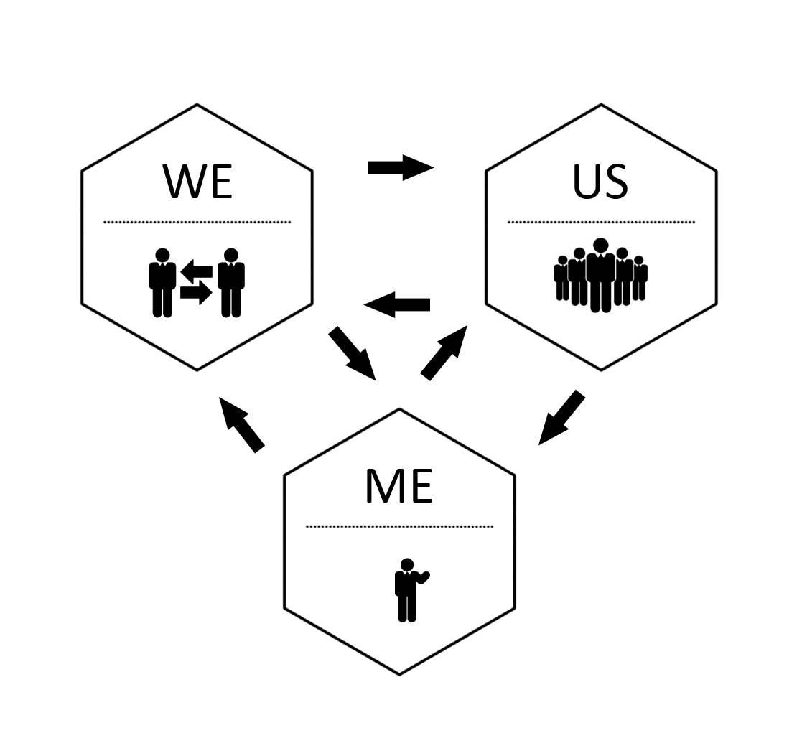
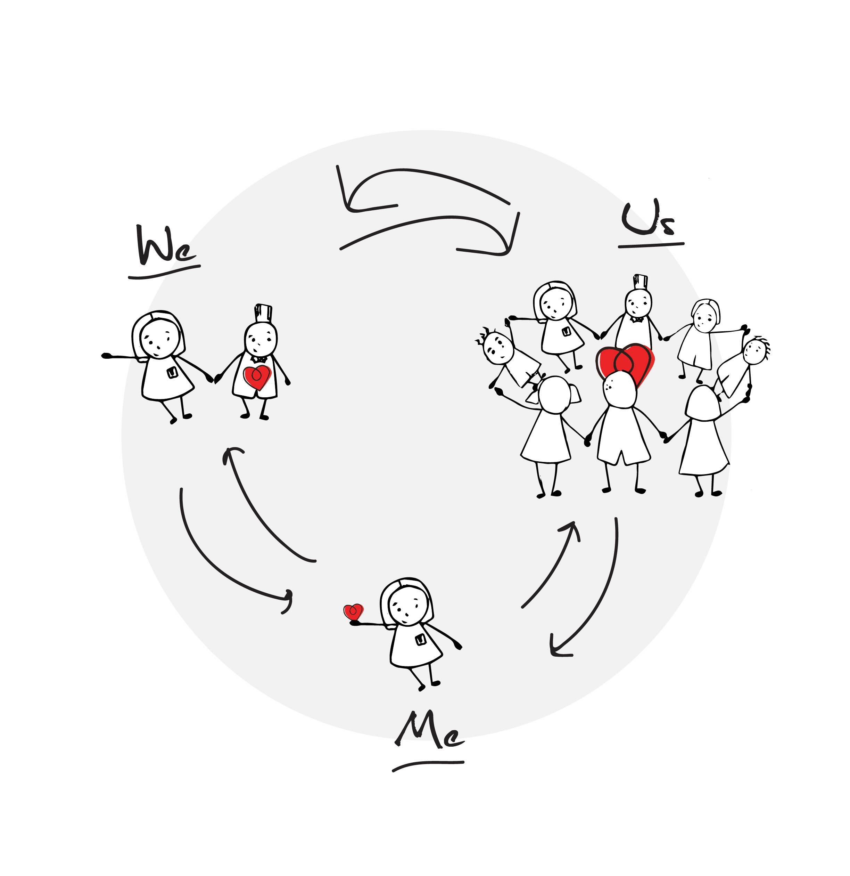
Essential ingredients
A wellbeing framework and models
Me, we, us
Embedding change must be holistic and systemic. All organizations are complex and dynamic systems, not simple and linear. As a result, a simple cause-and-effect approach to embedding change will not work.

Slide 20
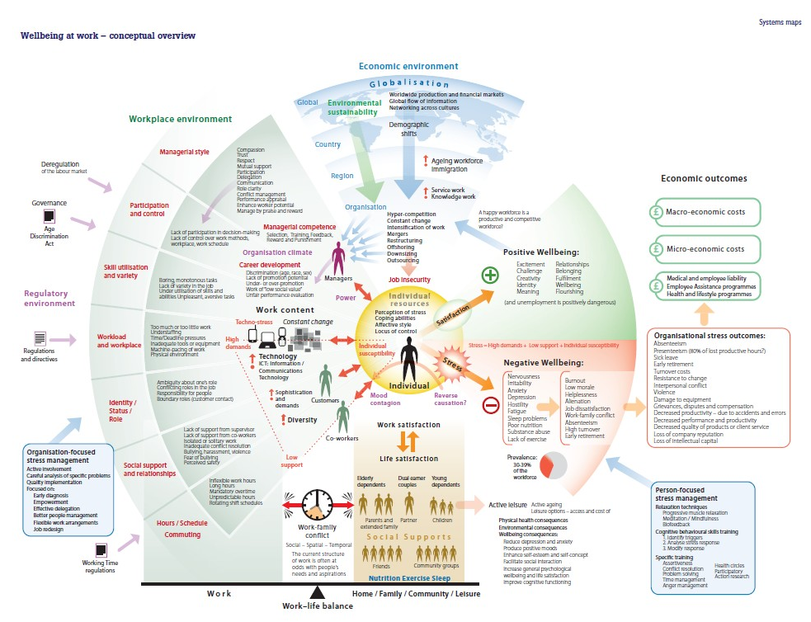
Essential ingredients
A wellbeing framework and models
Work wellbeing

Slide 21
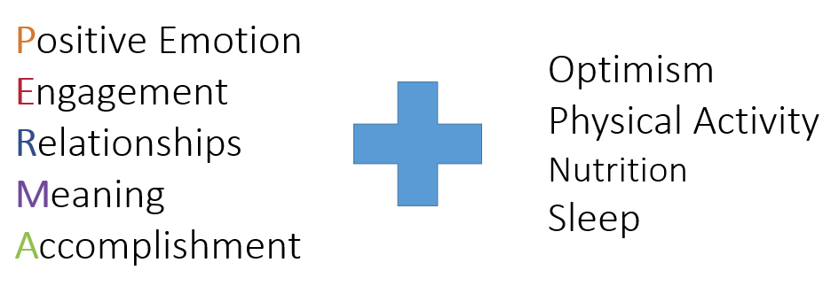
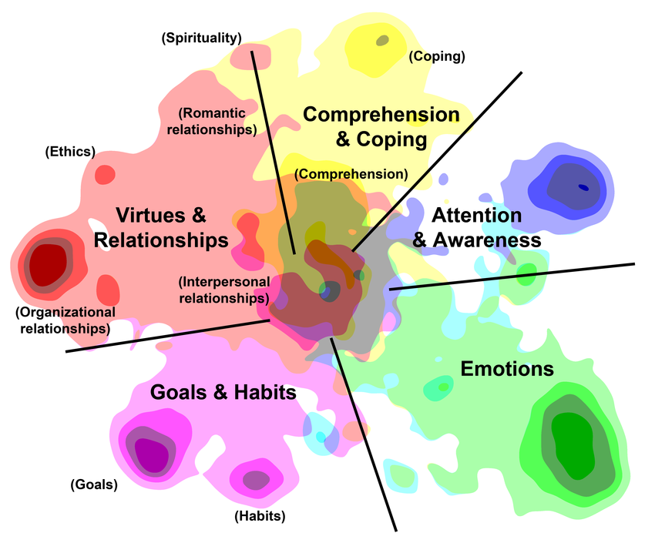
Essential ingredients
A wellbeing framework and models
PERMA+
5 Ways to Wellbeing
5 domains of functioning

Slide 22
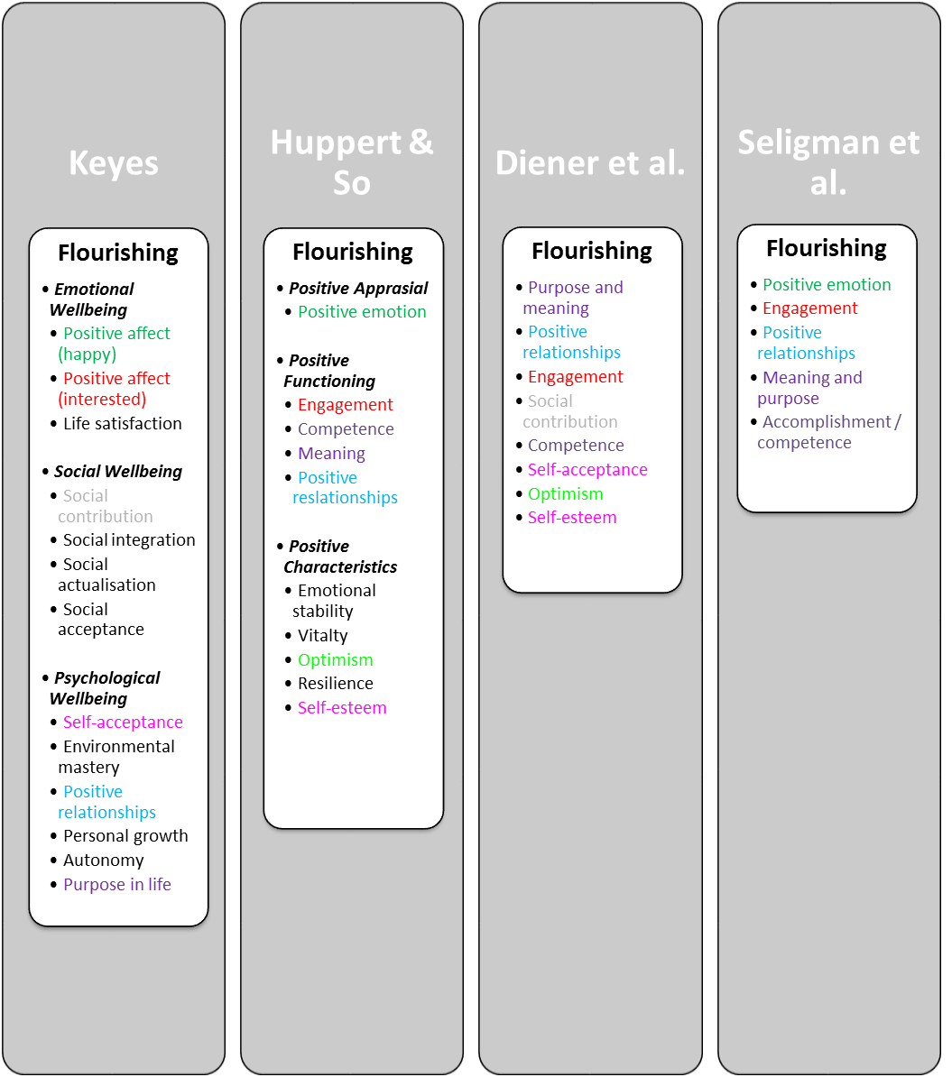
Essential ingredients
Wellbeing frameworks and models
Comparing models

Slide 23
Quick break
Geelong Breathing
Breath One. Take a deep breath in through your nose and fill your lungs with as much air as possible. As you are doing so, notice your physical body and any points of pain or tension. As you breath out slowly through your mouth, imagine you are pushing or releasing any tension away. Feel yourself sink into your chair or the floor if you are standing
Breath Two. Take a deep breath in through your nose and fill your lungs with as much air as possible. Now as you breathe out think about what you are grateful for right at this very moment. Not what you are grateful for that has happened in the past, or looking towards the future, but right in this very moment think about one thing you are grateful for and exhale slowly. Say to yourself “Right now I am grateful for...”.
Breath Three. Take a deep breath in through your nose and fill your lungs with as much air as possible. Now as you breathe out think about your frame of reference and what intentional state you want to be in right now. Do you intend to be kind? Do you intend to be open minded? Do you intend to be peaceful? Whatever intention you wish to have at this present moment, cultivate it when you exhale by saying to yourself “My intention right now is to be …”.
Credit: This exercise was developed by Justin Robinson, Head of Positive Education at Geelong Grammer School in Australia

Slide 24
Essential ingredients
Positive leadership and champions
Champions start wellbeing programs and keep them going. You want them championing the change from the bottom up and inside out.
Positive leaders have a simple clear co-developed vision that is idealist, visual, long-term, challenging and realistic.
Change must have a clear strategic mandate and be linked to a compelling rationale.
Positive leadership is crucial:
Leadership involvement was cited as the most effective factor for a successful wellbeing program by 59 percent of employer respondents. (State of Workplace Wellbeing Survey).

Slide 25
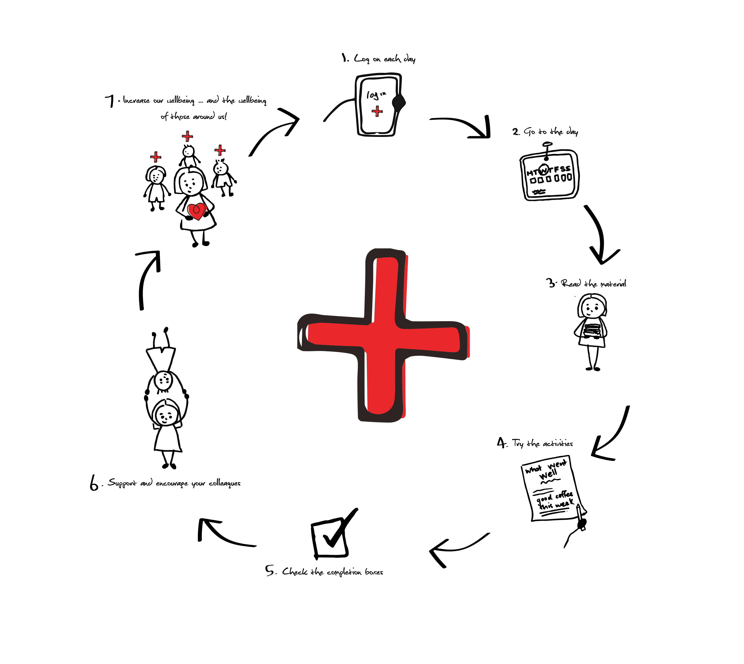
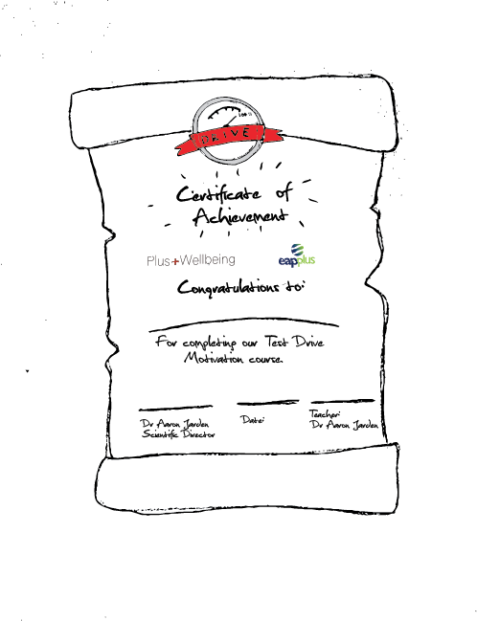
Essential ingredients
Wellbeing tools: Apps and e-learning
Make a distinction between “wellbeing skill building tools” and tools that “increase wellbeing”.

Slide 26
Essential ingredients
Risks
Overpromise, under deliver – selling false hope.
Bad advice, poor program logic.
Low ROI, look bad to those above.
Bad apples and win-lose power struggles.
Expecting fast change – wellbeing is hard work.
A vision alone is not sufficient to capture the hearts and minds of everyone but it is a good start. People must be able to make the link with what is important to them personally.
Be prepared to ‘course correct’. Very few change programmes end up exactly where they predicted at the outset, for many reasons. Ensure you have checkpoints.
A lack of leadership and top level support is the main reason for the failure to sustain changes in an organisation.

Slide 27
More essentials
Other stuff:
Clear, minimal, transparent, communication (no long docs, less email) – builds trust.
Sense of meaning, being autonomy supportive, and job-crafting.
Endorse things officially.
No one-size model – scientifically informed practice, trial and error.
Create time and space for wellbeing, and timing important (when to introduce, when to embed).
Play is much underrated. As is simplification.
Use of strengths.
Have an implementation plan.
Linking wellbeing metrics to KPI’s.
Pull people into a better future, rather than push them from the past.

Slide 28
Checklists help focus
Create your own checklist, like this:
The workplace has to ‘feel’ good.
Play to everyone's strengths.
Encourage risk and failure.
Build social capital.
Be grateful, authentic and appreciative at all levels.
Create the conditions for change.
Create positive practices.

Slide 29
Now
“Wellbeing is measurable, teachable and learnable”

Slide 30
Positive mental health and wellbeing for a resilient society.
Position South Australia as the State of Wellbeing
Measure the wellbeing of all South Australians and beyond
Teach, build and embed wellbeing science
Generate and publish research on how to build wellbeing efficiently, at scale, across the life course
LEAD
MEASURE
BUILD ➔ EMBED
RESEARCH
Organisations, Government, Schools, Ageing, Youth, Community

Slide 31
RESULTS Auto-manufacturing industry
Notes:
Projected that between 14 000 to 25000 will be lost from the departure of the car industry. Our economy is transforming and is creating significant unemployment. It is our belief that the LMBE Model of teaching resilience skills could be useful to manufacturing workers in anticipation of the unemployment tsunami.

Slide 32
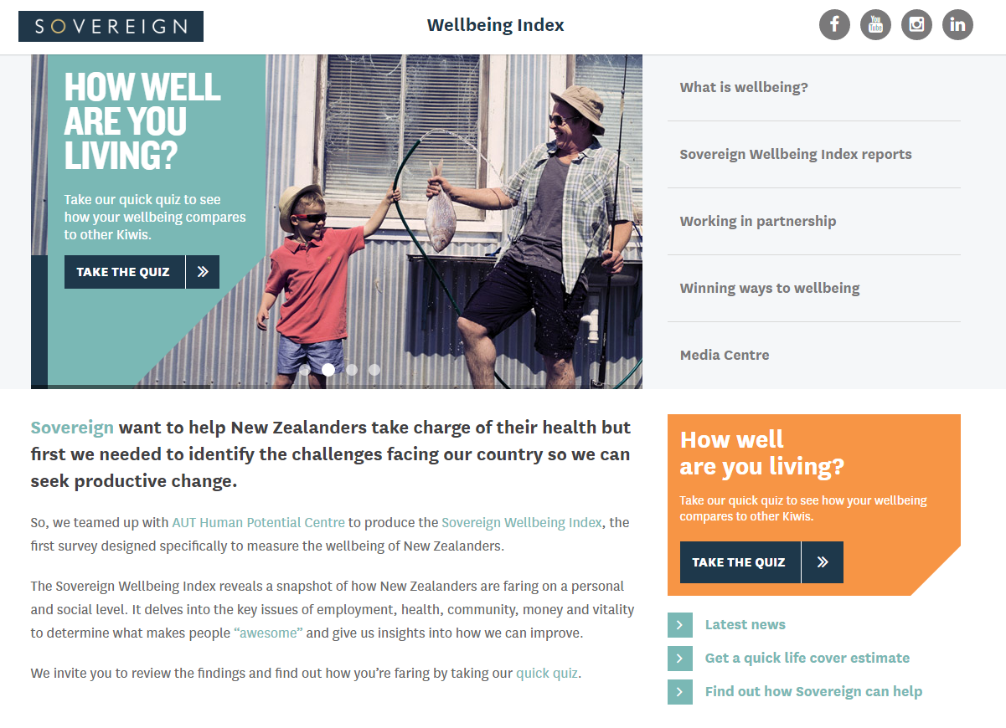
Franchise Businesses Limited
Green Acres, Hire a Hubby, etc

Slide 33
Case studies
Some good examples
CEO Friday lunch.
10/2 rule - Ritz-Carlton.
Cape of awesomeness.
Gratitude walls.
Entrance door activities and messaging.
Team meetings – start with ‘what went well?’, walking meetings.
Gamification (leader boards, points, etc.).
Visual things

Slide 34
Recap
Some key points
Be careful filling in customs forms.
When you are at your best, you’re deploying your strengths.
Geelong three breaths is portable.
Select tools wisely, and place them in a framework / model.
Assessment and leadership are crucial to longer term change.
Ask people: “What does a great day at work look like?”

Slide 35
Dr Aaron Jarden
aaron.jarden@sahmri.com
www.aaronjarden.com
Copy of these slides at: www.aaronjarden.com

