Slide 1
Evaluating Wellbeing in School Settings Aaron Jarden & Mike Parker
Friday 10th March 2017
www.awesomeschools.com

Slide 2
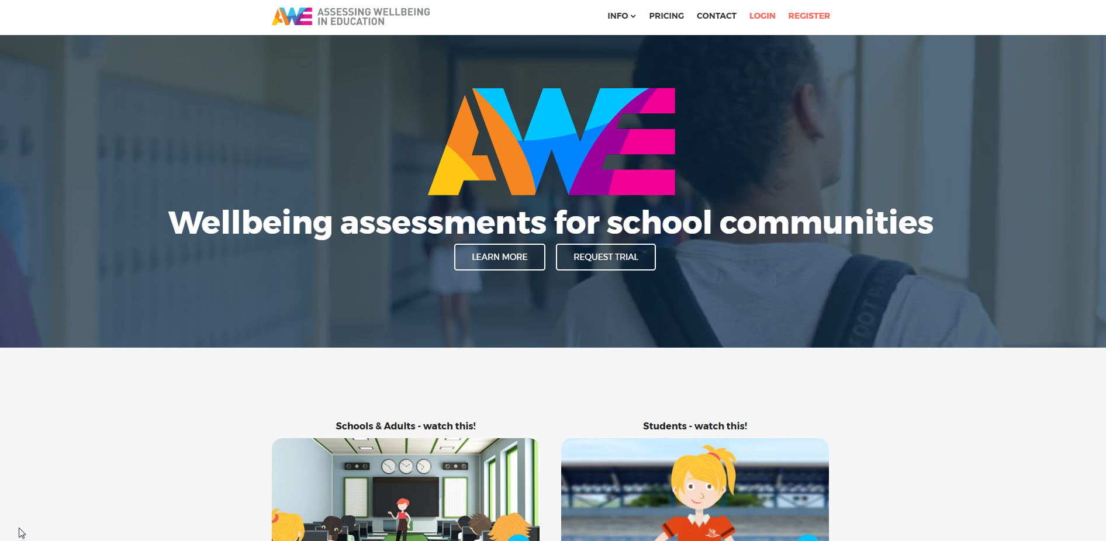
Overview
What is ‘Assessing Wellbeing in Education’?
History & development.
Assessment content.
Assessment process and usability.
Cool features.
Reports and data.
Ethical issues.
Feedback to date.
Wellbeing activities.
Live demonstration, Q&A, Lollies

Slide 3
AWE: Assessment Objectives
Timeline:
4th October 2013 – Aaron email’s Mike with an idea.
30th November 2013 – Business plan drafted.
11th February 2014 – Development of the ‘student assessment’ to complement WoW assessment.
16th March 2014 – Employed an IT company to build AWE (originally called APE).
April – September 2014 – Build, testing, refinement.
28th October 2014 – Frist school registration.
1st October 2016 – Partnership with Plus Wellbeing (wellbeing for teachers).
15th January 2017 – AWE Junior (8-12 year olds) added.
Team expanding over time: Aaron, Mike, Sarah and Denise.

Slide 4
AWE: History and Development
Aim:
The aims in developing the AWE assessment were to utilise current assessment science to empirically measure, track and report on school community wellbeing (students, school staff, and parents).
Methods:
In creating this assessment tool, best practice online measurement guidelines and recommendations for online psychometric testing were adhered to (i.e., American Psychological Association Internet Task Force guidelines: Naglieri, Drasgow, Schmit, Handler, Prifitera, Margolis, & Velasquez, 2004).

Slide 5
AWE: Assessment Content
Questions:
 | Adult Assessment (Staff, Parents) | AWE Junior (8-11 years) | AWE Senior (12-18 years)
Global Wellbeing | 14 questions | 3 questions | 5 questions
Domain Wellbeing | 10 questions | - | 5 questions
School / Work Wellbeing | 19 questions – work wellbeing | 7 questions – school wellbeing | 10 questions – school wellbeing
Component Wellbeing | 9 questions (up to) | 2 questions | 9 questions (up to)
Total questions | 52 questions | 12 questions | 29 questions

Slide 6
AWE: Assessment Content
Example Questions: Adults
How satisfied are you with your workplace relationships?
How much control over the important aspects of your job do you have?
To what extent are you using your strengths in your job?
In general, how rushed and pressured for time do you feel in your job?
In general, how satisfied are you that your school supports and enables student wellbeing?

Slide 7
AWE: Assessment Content
Example Questions: Students
Senior
My relationships with other students at school are fantastic.
I fell like I fit in at my school.
I get bullied by students at my school.
I am able to deal with my problem at school.
The teachers at my school care about me.
Junior
Which face best describes how you fell about your school?
Which face best describes how you fell about your health?

Slide 8
AWE: Assessment Content
Qualitative Questions - Both Adults and Senior Students:
What one thing, more than anything else, makes your school a great place?
What one thing, more than anything else, needs to change to make your school a great place?

Slide 9
AWE: Assessment Process
Importance of Process:
A focus on usability: Mean = 4 ½ minutes for senior students, 9 minutes for adults.

Slide 10
AWE: Cool Features
Some Features:
Bullying, key word, and low-wellbeing warnings.
Add questions (free-text, scale, grid).
Add measures (50 of the best).
Research consent form.
Full technical manual on website – fully transparent.
Raw results to all questions in report appendix.

Slide 11
AWE: Cool Features
Some Features:
Upload users.
Free-text reports.
Sub-group reporting.
Flexible assessments scheduling.
Overtime graphs.
School logos on all reports.

Slide 12
AWE: Reports
Example Report Pages:
School Report Adult Report Student Report

Slide 13
AWE: Data and Dashboards
Data and Dashboards:

Slide 14
AWE: Ethical Issues
Ethical Issues:
Privacy protected.
Consent to share reports and warnings.
Schools wellbeing contact person put on student reports.
Key word notifications to school – “kill”, “suicide”, “die”.
Prominent disclaimers.

Slide 15
Feedback to Date - Schools
AWE: Feedback to Date - Schools
“Mercedes College used the AWE survey in 2016 to measure the wellbeing of our staff and students, to assist with both understanding and monitoring any changes in the wellbeing of our school community. The data we received from AWE has been used most recently in a presentation to our whole staff about the importance of our wellbeing, and will be also used to review any changes when we re-test in 2017. The features of AWE that have been particularly useful are: the easy to understand online survey format; questions being based on psychological research; the opportunity to add our own questions to the survey; receiving all of the raw data enabling more in-depth analysis; the individual reports sent to the participants that include suggestions for improving wellbeing; and the student alert system that enabled us to monitor our more vulnerable students. I would recommend the AWE survey to any educational organisation that wants to make community wellbeing a priority."
Tanya Kadak – College Psychologist and AWE Administrator - Mercedes College - June 2016.

Slide 16
Feedback to Date - Schools
AWE: Feedback to Date - Schools
“We used AWE here in the Kristin Middle School starting in 2015 as we felt that it was important to have a clear measure of how our student body is feeling and as a gage of the impact of our increasing wellbeing offerings. We chose AWE as it has New Zealand based support who are readily available and due to the flexibility it provides to tailor the survey to our individual setting. The students find it easy to register and the reports that are generated allow us to make meaningful changes for the betterment of the programmes we offer”.
Kate Pollard - Assistant Principal, Kristen Middle School.

Slide 17
Feedback to Date - Students
AWE: Feedback to Date - Students
“I really appreciate these types of surveys the school does. it makes me feel important”.
“This survey has helped me understand my life and where I am at. It has made me more courageous to accomplish big things in life”.
“This was a very helpful quiz to help understand more about me and to reflect”.
“I thought this was a great test ad really made me think about my life”.

Slide 18
Wellbeing Activities

Slide 19
Live Demonstration

Slide 20
Lollies

Slide 21
Dr Aaron Jarden
aaron.jarden@awesomeschools.com
Mike Parker
michael.parker@awesomeschools.com
www.awesomeschools.com
Copy of these slides at: www.aaronjarden.com

