Slide 1
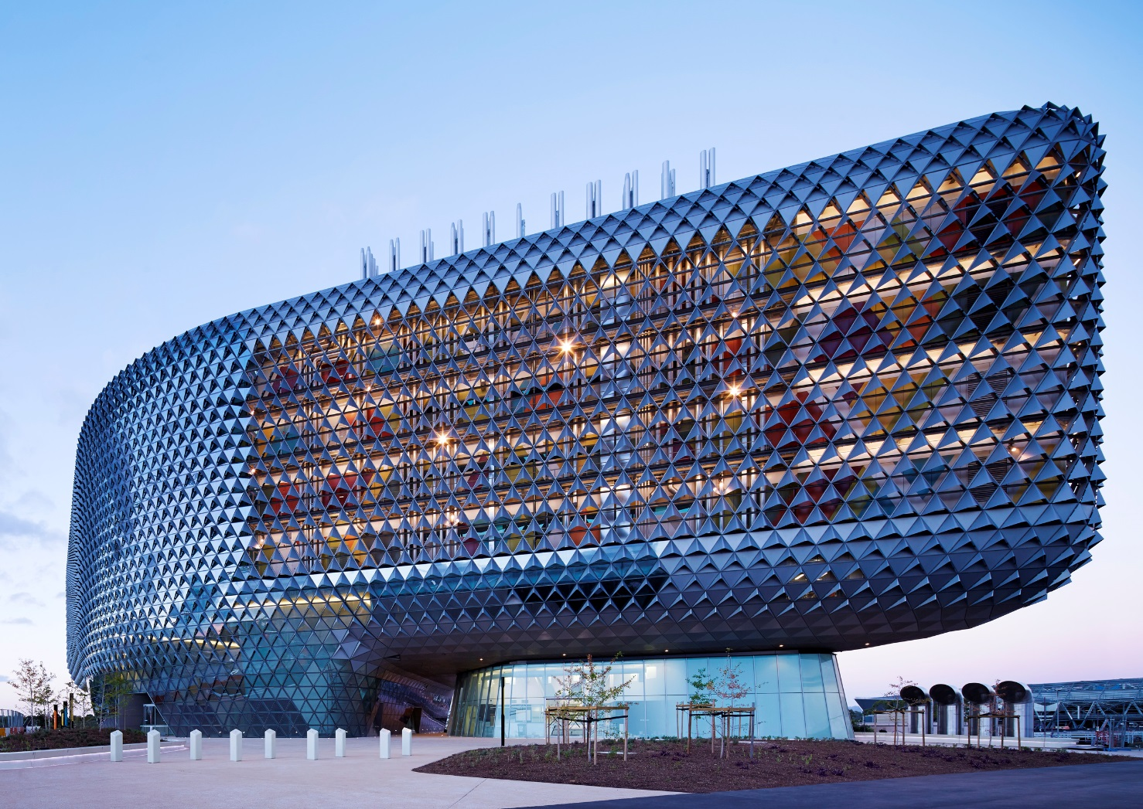
Cross-cultural conceptions of ‘wellbeing’
Dr Aaron Jarden
aaron.jarden@sahmri.com
14th July 2017
5th World Congress on Positive Psychology, Canada
Copy of these slides at: www.aaronjarden.com

Slide 2
Overview
Intended talk
What is “wellbeing” from a cross-cultural perspective? More specifically, how is wellbeing conceived of across cultures and contexts? The developing field of positive psychology needs greater insight into how people with different nationalities and ethnicities understand the concept of wellbeing in order to appreciate the commonalities and differences in conceptions of wellbeing around the globe. We also need to know how well cross-cultural lay conceptions of wellbeing match the conceptions used by philosophers, psychologists, sociologists and economists.
These such questions are engaged with utilising new data and a Prototype Analysis (Rosch, 1975) approach. To date we know that lay conceptions of wellbeing differ from academic models (Hone, Schofied, & Jarden, 2016). For example, New Zealand workers are less likely than academic researchers to consider the presence of achievement, engagement, and optimism as important for wellbeing, and in contrast to academics, workers view physical health, work-life balance, and feeling valued as central components of wellbeing. We also know that while it is clear from various population wellbeing surveys that wellbeing varies cross-culturally and across nations (Cheng et al., 2104; Delle Fave et al., 2016; Diener, 2009; Diener & Suh, 2000; Dezhu, Yew-Kwang, & Yujun, 2015; Lau, White, & Schnall, 2013; Lomas, 2016; Tafarodi et al., 1012; Tamir et al., 2015; Uchida, & Ogihara, 2012; Uchida, Norasakkunkit, & Kitayama, 2013; Veenhoven, 2012), the glut of distinctly different understandings of wellbeing in this research makes this literature based challenging to assimilate (especially given that wellbeing is a multidimensional concept).
This talk will present results that extends the above work to an international context with cross-cultural lay samples. In doing so it will provide greater conceptual and definitional clarity on what wellbeing is across cultures, and provide a richer understanding of ‘wellbeing’.

Slide 3
Intended overview
Results indicated that New Zealand workers are less likely than academic researchers to consider the presence of achievement, engagement, and optimism as important for wellbeing.
In contrast to current popular academic models, New Zealand workers viewed physical health, work-life balance, and feeling valued as central components of wellbeing.

Slide 4
Intended overview
Hamling, K., Jarden, A., & Schofield, G. (2016). Recipes for occupational wellbeing: An investigation of the associations with wellbeing in New Zealand workers. New Zealand Journal of Human Resource Management, 12(2), 151-173.
This cross sectional study sought to investigate if workers in eight distinct occupational groups in New Zealand experienced wellbeing in the same way or if there were unique recipes for wellbeing according to occupational context. We first examined and compared the prevalence of flourishing (a global wellbeing outcome) and job satisfaction (a specific contextual wellbeing outcome) amongst the occupational groups. We then investigated if there were differences in the factors associated with flourishing and job satisfaction for each group of workers. Results of nonparametric testing revealed that the prevalence of flourishing and job satisfaction varied significantly between occupational groups, in particular, between higher and lower status occupations. Multiple regression analysis revealed that although there were unique factors associated with flourishing and job satisfaction scores across occupational groups, meaning and purpose was most strongly associated with flourishing scores while work life balance was most strongly associated with job satisfaction scores. The findings are discussed in the context of current workplace wellbeing initiatives.

Slide 6
What is wellbeing?
What is wellbeing
Humans have always struggled to define ‘happiness’.
Also no consensus on ‘wellbeing’ (or ‘flourishing’ – high levels of wellbeing).
Across countries, the term varies: happiness, wellbeing, welfare, quality of life, etc.
For example, what does flourishing mean?

Slide 7
Cross-cultural wellbeing
Actual overview
Disabato, D. J., Goodman, F. R., Kashdan, T. B., Short, J. L., & Jarden, A. (2015, September 7). Different Types of Well-Being? A Cross-Cultural Examination of Hedonic and Eudaimonic Well-Being. Psychological Assessment.
A large international sample was used to test whether hedonia (the experience of positive emotional states and satisfaction of desires) and eudaimonia (the presence of meaning and development of one’s potentials) represent 1 overarching well-being construct or 2 related dimensions. A latent correlation of .96 presents negligible evidence for the discriminant validity between Diener’s (1984) subjective well-being model of hedonia and Ryff’s (1989) psychological well-being model of eudaimonia. When compared with known correlates of well-being (e.g., curiosity, gratitude), eudaimonia and hedonia showed very similar relationships, save goal-directed will and ways (i.e., hope), a meaning orientation to happiness, and grit. Identical analyses in subsamples of 7 geographical world regions revealed similar results around the globe. A single overarching construct more accurately reflects hedonia and eudaimonia when measured as self-reported subjective and psychological well-being. Nevertheless, measures of eudaimonia may contain aspects of meaningful goal-directedness unique from hedonia.

Slide 8
Study
An understanding of ‘wellbeing’ is critical for both research and interventions.
Before executives and policymakers allocate resources toward improving human wellbeing, a more comprehensive, scientifically based understanding of what exactly humans are striving for is needed.
We assessed the extent to which hedonia, operationalized as subjective wellbeing, and eudaimonia, operationalized as psychological wellbeing, represent distinct types of wellbeing, globally.
International Wellbeing Study: www.wellbeingstudy.com
N = 7, 617, community sample, 109 countries, 6 of 7 world regions, 16 languages
We tested the discriminant validity between two proposed types of well-being - hedonia and eudaimonia.
The international sample allowed us to test whether measurement models of well-being differed across world regions.

Slide 9
Results
CFA: Not much difference between models – near complete overlap.
Hedonia and Eudaimonia showed little evidence of discriminant validity, but instead were highly correlated (r = .96) (so estimated 92% of the variance) and similarly related to other well-being variables (r|=.07).
So different international samples displayed largely the same results.
Although poorer model fit indices were obtained for East and South Asia and Southeast Asia.
The two world regions with the largest correlations were Oceania and the Anglo nations and Northern Europe; the regions with the smallest correlations were Latin America and Southeast Asia.

