Slide 1
Ethical Guidelines for Positive Psychology Practitioners
Dr Tim Lomas
Associate Professor Aaron Jarden
9th European Conference on Positive Psychology
Budapest, Hungary
June 27-30, 2018

Slide 2
Overview
How these guidelines came about
The rationale and benefits of ethics guidelines
What we have done to date
What we are planning on doing
What the draft guidelines currently are

Slide 3
The impetus for the project
Observations on the emergent ‘professionalization’ of PP:
Becoming a profession; being conducted with increasing professionalization
Lomas, T., & Ivtzan, I. (2016). Professionalising positive psychology: Developing guidelines for training and regulation. International Journal of Wellbeing, 6(3), 96-112.
Reflections from teaching MAPP course at UEL:
Students practising in applied contexts
The need for ethical guidelines to assist students (and practitioners generally)
Ongoing dialogue in the field:
Vella-Brodrick, D. A. (2011). The moral of the story: The importance of applying an ethics lens to the teaching of positive psychology. The Journal of Positive Psychology, 6(4), 320-325.
Vella‐Brodrick, D. A. (2014). Dovetailing ethical practice and positive psychology to promote integrity, industriousness, innovation, and impact. In A. C. Parks, & S. M. Schueller (Eds.), The Wiley Blackwell handbook of positive psychological interventions (pp. 416-432). New York, NY: Wiley Blackwell.

Slide 4
Emergent professionalisation
PP initially not conceived as a distinct specialty:
Initially conceived more as an ethos, a “collective identity,” unifying researchers interested in “the brighter sides of human nature”
Linley, P. A., & Joseph, S. (2004). Applied positive psychology: A new perspective for professional practice. In P. A. Linley & S. Joseph (Eds.), Positive Psychology in Practice (pp. 3-12). Hoboken, New Jersey: John Wiley and Sons.
Gradual emergence of a professional identity:
Some scholars, and MAPP graduates, identifying as “positive psychologists” or “positive psychology practitioners” (even if issues of legality, e.g., around professional titles)
A complicated picture:
Many people ‘aligned with’ PP are affiliated to other professions (e.g., education)
Hybrid fields, such as ‘positive clinical psychology’
Many such people are already affiliated to, and guided/regulated by, professional bodies
Questions remain about how best to guide/regulate those unaffiliated

Slide 5
Elements of professionalisation
PP is on a ‘journey’ towards professionalization:
Multiple complementary initiatives
E.g., ENPP initiative around accreditation
Recognition that professionalization will have many components (each with issues needing much thought):
Training (e.g., by whom, to what standard?)
Accreditation (e.g., awarded, monitored, and regulated by whom?)
On-going professional development and maintenance of standards (e.g., supervision process?)
Development of ethical guidelines (e.g., generation of formal and mandated codes eventually?)
Our project: Specific focus on developing ethical guidelines:
Feed into this wider process

Slide 6
What are ethics
What are ethics:
Norms shared by a group. Derives from ethikos (custom or usage).
Overlap with morals:
Morals = notions of right and wrong; bridging is and ought
Morals can be individual/subjective, and may also be only implicit/unarticulated
Ethics are usually explicit/articulated, and communally agreed
Often domain-specific:
Tailored for specific endeavours and practices (e.g., consumption of food)
Most fields of endeavor have ethical guidelines, and even formal codes:
Guidelines: Help practitioners regulate their conduct and achieve best practice
Codes: ‘Rules and standards of conduct recognized as binding in a professional body or an association’

Slide 7
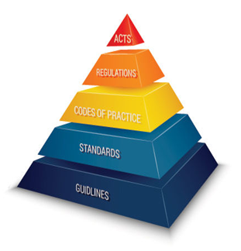
The rationale for ethical guidelines
Most fields of endeavor have ethical guidelines (and often codes):
Aspirational aspect: Help practitioners regulate their conduct and achieve best practice
Corrective aspect: Facilitate the detection and correction of unethical (or generally poor) practices
Many people practising PP – unaffiliated to other professions – will lack such guidelines:
Not to suggest that they are necessarily unethical
Applied work is challenging, and everyone could use guidance
Multiple benefits:
Helps to ensure best practice (e.g., professional development)
Guidance for handling tricky situations
Sense of community / identity
Can feed into credentialing and general professionalization

Slide 8
Ethos of the project: collaboration
Learning from related fields:
Many fields share deep kinship with PP (e.g., psychotherapy): applied focus on people’s wellbeing
Such fields = comparable journeys over past 50 years to that PP currently embarking upon
We can learn from their cultivated expertise (don’t have to re-invent the wheel)
Can emulate and take inspiration from their own ethical guidelines/frameworks
Learning from stakeholders within PP – drawing on expertise of:
Key organizations within PP (e.g., IPPA, ENPP, MAPP programs)
Various fields/professions affiliated to PP (e.g., coaching, clinical psychology)
Academics, practitioners, and students
An iterative process:
Draw up provisional guidelines; get feedback; amend; and repeat

Slide 9
Progress to date
Timeline of key actions:
IJW article:
Lomas, T., & Ivtzan, I. (2016). Professionalising positive psychology: Developing guidelines for training and regulation. International Journal of Wellbeing, 6(3), 96-112.
Debate on article suggesting a need for a meeting
5th World Congress on Positive Psychology 2017 conversation hour session in Montreal:
“Professionalising Positive Psychology: Is there a need to develop guidelines for training and regulation?”
Working group established from conversation hour, lead by Aaron, Tim, and Tayyab
First virtual meeting to discuss scope, process and timelines
Including representatives of IPPA, ENPP, and directors of MAPP programs – all key stakeholders, as well practitioners and as some perspectives on non-western practice perspectives

Slide 10
Progress to date
Timeline of key actions:
6. Background research on guidelines in other fields of practice
“the objective here is to investigate the similarity and differences between main international (USA, UK, Australia, Canada, NZ, and non-western countries) ethical practice guidelines, from various practice fields (e.g., counselling, clinical psych, org psych, nursing, etc), in order to both learn from them, not reinvent, and move towards replicating the most appropriate and flexible approach / framework for an international context.”
7. First draft assembled, discussed and initial feedback obtained
Aim: “The best outcome is a set of easily readable, relatively short, memorable and understandable ethical practice guidelines that will assist positive psychology practitioners to practice in an ethical way (i.e., we want guidelines that people can remember and are practically useful)”
8. ENPP conference presentation 2018

Slide 11
Next steps
Some challenges with the guidelines to date:
Selection process: We need a solid rationale as how and why the specific attributes are selected
Personal qualities: We have dropped the word “moral” from moral personal qualities as phrased in other codes as we think it may evoke prescriptive connotations…
Operationalization: All attributes (principles) are aspirational… Theoretically most practitioners will agree with these, however the challenge is how these principles trickle down to standards. In other words, how to operationalise these principles.
Do we need a field specific additional subset in addition to general guidelines? – i.e., guidelines for individuals applying positive psychology in certain domains (e.g., therapy settings) or to certain individuals (e.g., children)?
Obtaining copyright wavers

Slide 12
Next steps
Likely next steps:
Refinement of Draft Guidelines and new draft produced post this meeting (Draft2)
Obtain feedback and expertise from a few applied ethicists with a specific content knowledge and expertise in ethical guidelines
Circulate new draft (Draft3), and update new draft in view of feedback (Draft4)
Circulate Draft 4 to wider groups (i.e., heads of all MAPP programs, other PP associations, IPPA Divisions, those who have registered interest in being involved in this process at the recent IPPA conference for further consultation and input. In particular will be a focus on gaining feedback from practitioners
Incorporate feedback and create new draft (Draft5), and next stakeholder meeting to discuss Draft 5
Circulate Draft 5 (with any necessary amendments) to the wider positive psychology community for comment
Create final version of guidelines, and obtain support and endorsement from key stakeholders
Publish guidelines in an open access journal

Slide 13
The current draft guidelines

Slide 14
Next steps
Values:
Respecting human rights and dignity
Protecting the safety of clients
Ensuring the integrity of practitioner-client relationships
Enhancing the quality of professional knowledge and its application
Alleviating personal distress and suffering
Fostering a sense of self that is meaningful to the person(s) concerned
Increasing personal effectiveness
Enhancing the quality of relationships between people
Appreciating the variety of human experience and culture
Striving for the fair and adequate provision of counselling and psychotherapy services

Slide 15
Next steps
Personal qualities:
Empathy and compassion
Sincerity
Integrity
Resilience
Respect
Humility
Competence
Fairness
Wisdom
Courage
Authenticity

Slide 16
Next steps
Principles:
Trustworthiness
Autonomy
Beneficence / Non-maleficence
Justice
Respect for People’s Rights and Dignity
Responsible Caring

Slide 17
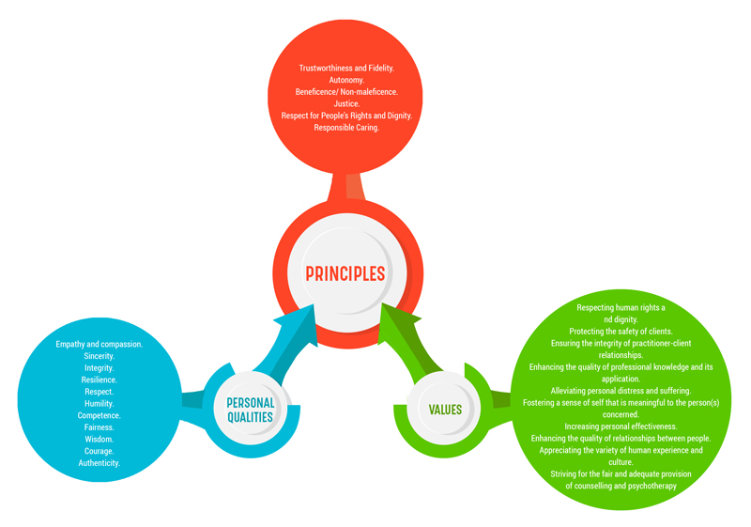
The current draft guidelines

Slide 18
Thanks
Questions?
You can get in touch be emailing myself, Tim, or Tayyab:
aaron.jarden@unimelb.edu.au
t.Lomas@uel.ac.uk
tayyabrashid@gmail.com
A copy of these slides @ www.aaronjarden.com

