Slide 1
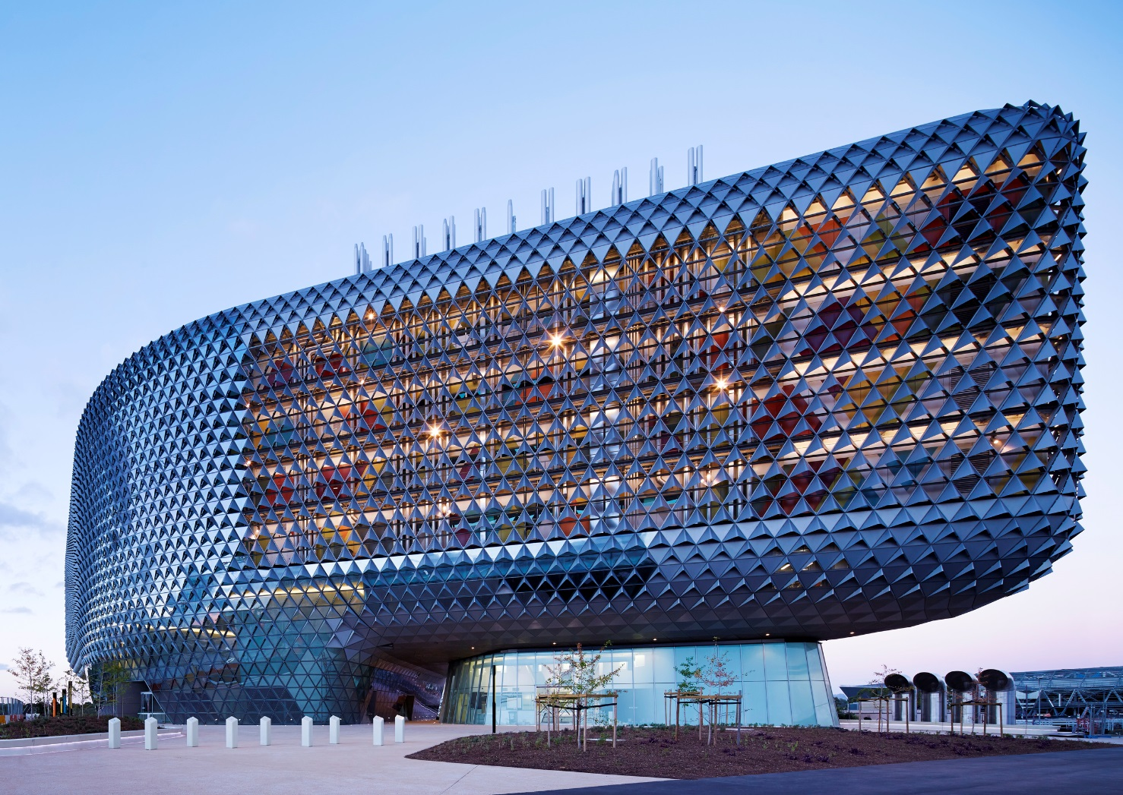
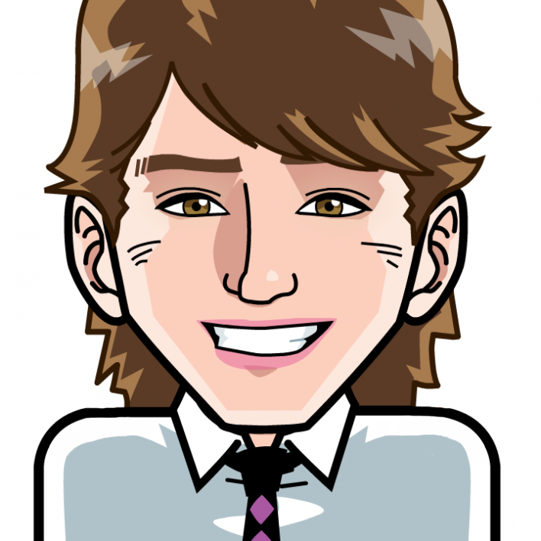
Lesser Known Positive Psychological Interventions
Dr Aaron Jarden
aaron.jarden@sahmri.com
3rd August 2017
Copy of these slides at: www.aaronjarden.com

Slide 2
Overview
Aims
This workshop provides opportunities to engage and explore wellbeing science knowledge and practices, and to discuss, attempt, debate and reflect together on how specifically the principles of positive psychology and wellbeing science can be integrated into our lives, others lives, and into our work.
To have fun, relax, be creative, learn and share ideas.
To facilitate and empower the development of personal wellbeing development plans.
To learn how to disseminate and teach some lesser known positive psychological interventions.
Skills: add tools to your toolkit.
Knowledge.
Fun.
Do no harm.
Two frameworks
Context and processes
16 Interventions
Questions and applause / ridicule
38 slides, 120 minutes, you do the math!

Slide 3
Definitions
Definitions
Positive Psychological Interventions are strategies, exercises and activities designed to promote happiness and wellbeing.
Positive Psychology Interventions vs. Positive Psychological Interventions
Positive Psychology Intervention = (Bolier et al., 2013; Sin & Lyubomirsky, 2009)
Since the start of the Positive Psychology movement.
Positive Psychological Intervention = (Schueller, Kashdan, & Parks, 2014)
Include studies that use the same intervention strategies and target the same outcomes but do not explicitly reference “positive psychology”.

Slide 4
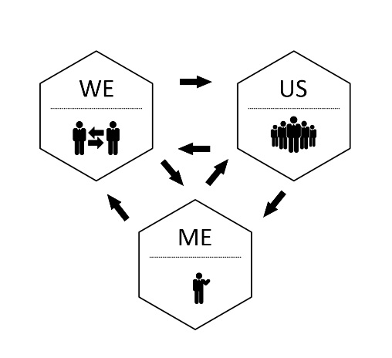
Framework 1: Me, We, Us
A framework to locate interventions
The individual level (Me)
The group level (We)
The organisational level (Us)
Jarden, A., & Jarden, R. (2016). Positive psychological assessment for the workplace. In L Oades et al. (Eds.), The Wiley-Blackwell Handbook of Positive Psychology at Work, pp. 415-437. Published Online: 19 Nov 2016: DOI: 10.1002/9781118977620.ch22

Slide 5
Framework 1: Me, We, Us
Individual level wellbeing initiatives include strategies and tasks that employees can do by themselves, such as learning about and utilising their strengths mindfully (Niemiec, 2013), or undertaking a mindfulness program (Kabat-Zinn, 2005). Such ‘Me’ initiatives do not require the involvement of others within the organisation. Group level wellbeing initiatives include strategies and tasks that involve an employee working on their wellbeing with either their manager, their direct team, or other employees who they are in frequent contact with in the work setting. These activities either have influence on a small group or are undertaken in a group format, and cannot be undertaken by employees themselves as they require the cooperation and input from others - such as the employee’s manager or team members. Examples of ‘We’ initiatives include strategies and tasks such as job crafting (Wrzesniewski, 2014) or building high quality connections (Dutton & Heaphy, 2003). Organisational level wellbeing initiatives include strategies and tasks that have an impact over the whole of the organisation, or are designed to trickle down from the top of the organisation - ideally to all employees. Examples of ‘Us’ initiatives include strategies and tasks such as creating organisational wellbeing policy (HAPIA, 2009), directing resources towards one-off or smaller scale wellbeing initiatives, or whole of organisation wellbeing assessments or workplace wellbeing programmes such as Appreciative Inquiry summits (Cooperrider & Whitney, 2005).
On the whole, at all levels of Me, We and Us, high wellbeing from a positive psychology perspective is about employees and organisations shifting their perspective from predominately focusing on what is wrong, to building on what is going right and working – to capitalising on the good and building and seeding the enabling conditions for high wellbeing (Jarden & Jarden, 2015; Lewis, 2011). Workplace wellbeing programmes across these three levels are about helping employees to use their strengths, enhance their relationships, and find more meaning and engagement at work so that both employees and the organisation as a whole can achieve their, and its, true potential .

Slide 6
Framework 2: The Cognitive Model
The Cognitive Model.
The fundamental interconnectedness of all things holistic.

Slide 7
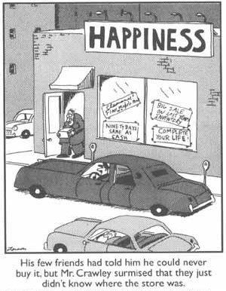
Context and processes
Some random points
Humans cannot truly achieve long-lasting happiness simply by watching from the side-lines. They actually have to get down onto the pitch and participate! Happiness is not something out there that people find just by looking, instead it is dependent on doing something, on joining in, on trying things out.
Chris Peterson – “Happiness is not a spectator sport”.

Slide 8
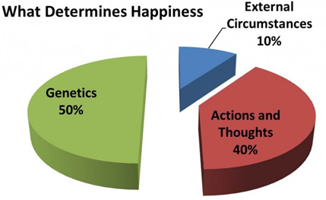
Context and processes
Some random points
I’m no expert in your wellbeing and wellbeing improvement is hard work – like losing weight. This is not therapy, and i'm no longer a practicing psychologist.
I usually say: “This is an opportunity to make some changes, get renewed, re-energized, revitalized! It’s time to create change here in your own life – but realise that all change is hard and stressful, even positive change”.
It’s not just about learning to be more positive – it’s about using scientifically-informed tools and strategies to make your thinking more flexible, accurate, clear, and expansive. This thinking will lead to more healthy behaviours.
It’s not all about the positive and happiness, joy, joy... Accept the negative; it’s functional.
40% within your control, 10% circumstance, 50% genetic - so it is about choice.

Slide 9
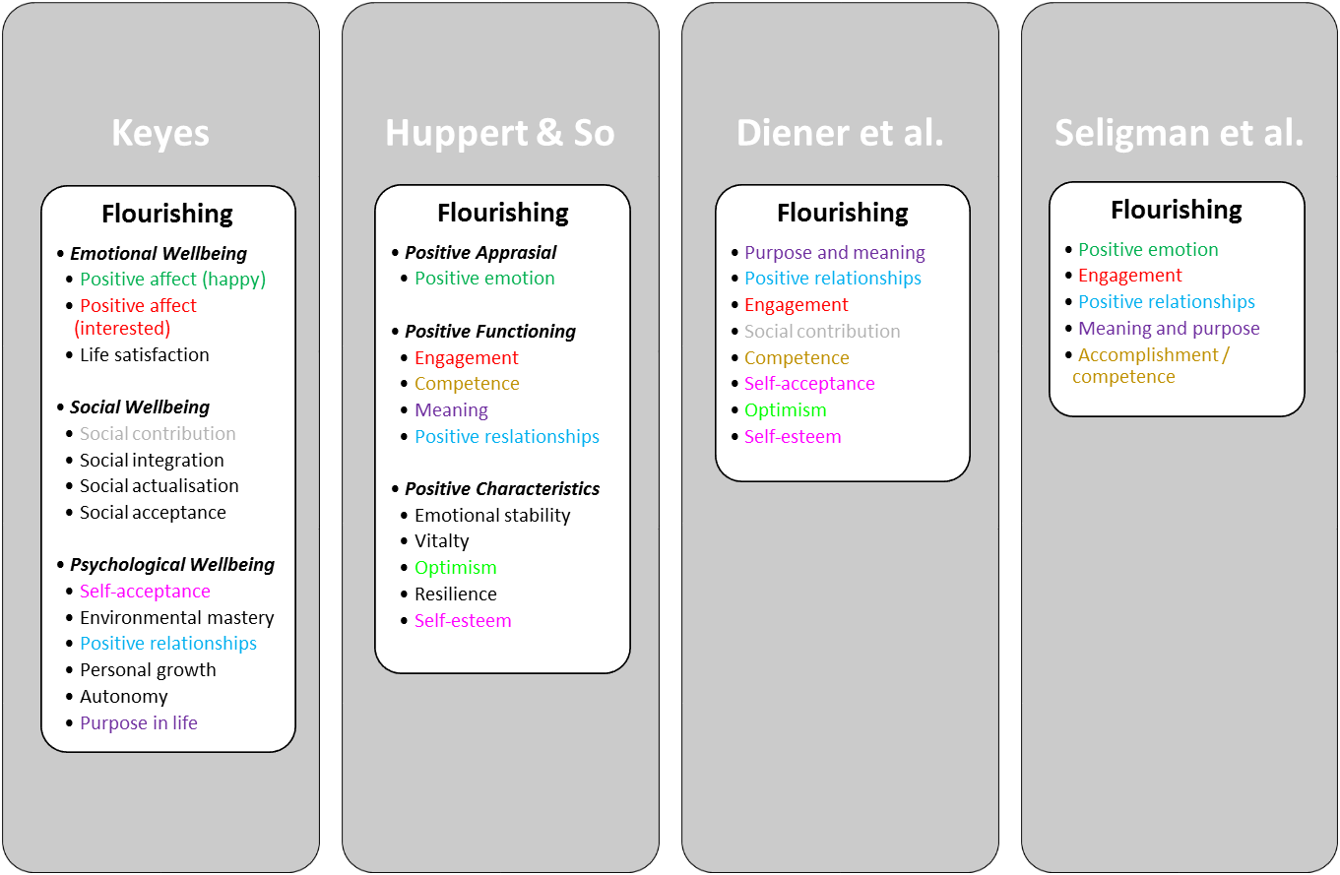
Context and processes
Some random points
Wellbeing spreads through social networks:
About 15%.
To 3 degrees of separation.
What is optimal human functioning?
We need to understand the context, not individual behaviour alone.
Different theories and recipes of wellbeing, flow into different public health messages.

Slide 10
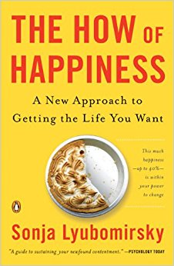
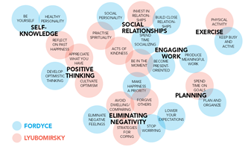
Context and processes
Some random points
Fordyce lists 14 techniques as fundamentals:
Keep busy and be more active.
Spend more time socializing.
Be productive at meaningful work.
Get better organized and plan things out.
Stop worrying.
Lower your expectations and aspirations.
Develop positive, optimistic thinking.
Become present oriented.
Work on a healthy personality.
Develop an outgoing, social personality.
Be yourself.
Eliminate negative feelings and problems.
Close relationships are the number one source of happiness.
Put happiness as your most important priority.

Slide 11
Context and processes
Relationships

Slide 12
Counting
Warm up: Let’s count
Pair up
Count up to 3 repeatedly, taking turns. Once mastered:
Then for every “1”, instead of saying “1”, clap.
Then for every “2”, instead of saying “2”, click.
Then for every “3”, instead of saying “3”, hi-five.
Now see how fast you can go…

Slide 13
Yes and
Warm up: Yes and, yes but
Set a seen of a party.
Start a conversation (“let’s have a party next Friday night?”), and every sentence needs to start with “Yes, but…”
Now have the conversation again, but every sentence needs to start with “Yes, and…”

Slide 14
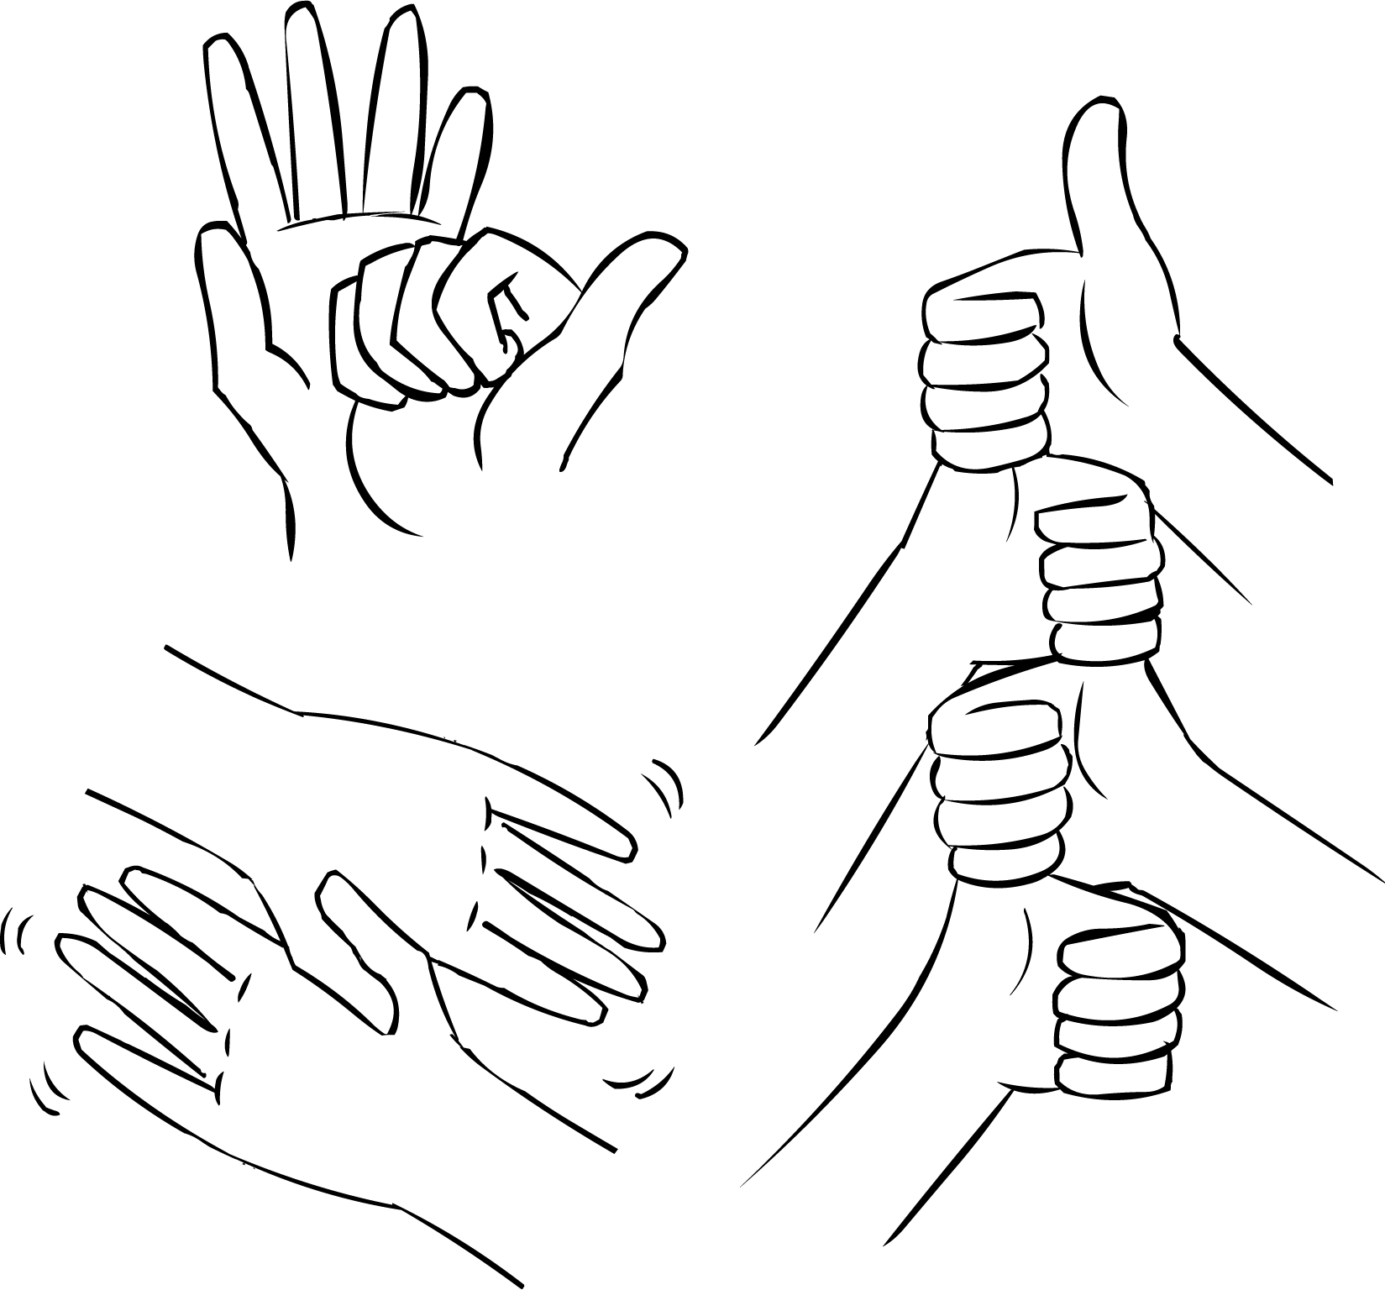
Handshake
Warm up: Novel connections
Pair up
Create a secret handshake

Slide 15
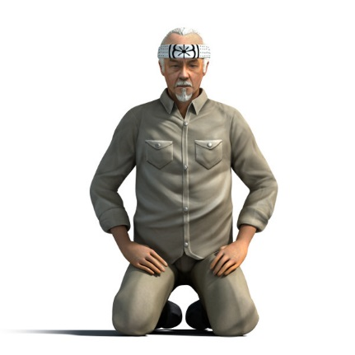
Questions
Questions
What's the best thing that has happened today?
“Answer not important, unless ask the right question”
What questions are you asking?
What's right?
What's good?
What works? What doesn’t?
What should I focus on? (what we focus on, grows…)
In which ways do I accept myself, and which ways don’t I accept myself?
What are my greatest strengths and competencies?, and how do I use them?
Who are my most cherished relationships? How do they support me?
What would I like to learn?
What would I like to accomplish?

Slide 16
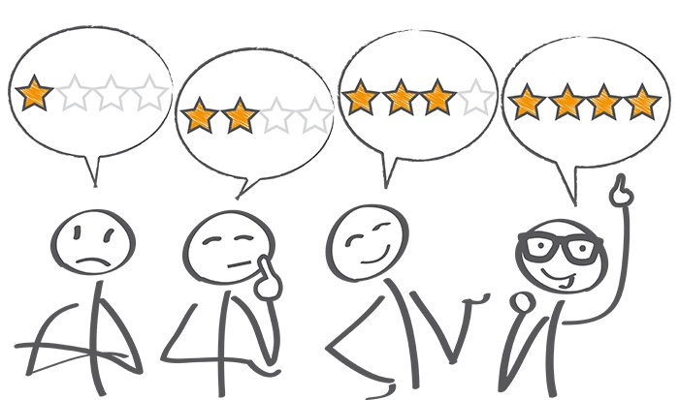
Assessment
Assessment
How happy are you right now?
What would you pay / give / do / sacrifice / commit to in order to be, on average, one point happier?
10 - Extremely happy
9 - Very happy
8 - Pretty happy
7 - Mildly happy
6 - Slightly happy
5 - Neutral
4 - Slightly unhappy
3 - Mildly unhappy
2 - Pretty unhappy
1 - Very unhappy
0 - Extremely unhappy

Slide 17
Usage

Slide 18
Interventions
Three good things
Use your strengths
Flow
Gratitude visit
Forgiveness letter
Cultivate optimism
Savouring
Kindness
Mindfulness
Compassion
Resilience
Purpose and meaning

Slide 19
Efficacy vs effectiveness
In the real world…
Hone et al (2015) – “…synthesizing efficacy trials of PPIs reveals little evidence that these interventions translate into sustained programmes of behaviour change when applied beyond the tightly controlled conditions of the laboratory or psychology classroom setting”.
Parks et al (2012) - “...researchers have yet to offer persuasive evidence that happiness activities, as they are actually used in real-world settings, are beneficial”.
Hone, L., Jarden, A., & Schofield, G. (2015). An evaluation of positive psychology intervention effectiveness trials using the re-aim framework: A practice-friendly review. Journal of Positive Psychology, 10(4), 303-322.

Slide 20
Interventions
Positive introductions
Playfulness
Three breaths
Five ways to wellbeing
DEAR communication (HO)
Flow (HO)
Closer connections (HO)
Job crafting (HO)
Slowness (HO)
Savouring
Active constructive responding
Positive expressive writing (HO)
A great day at work
High quality connections
Closed and open doors (HO)
Maximising and satisficing (HO)
Your challenge is it place each one we cover into the me, we, us framework. Think about if it is targeting cognitions, emotions or behaviours or a combo?

Slide 21
Positive Introductions
Let’s make friends…
Pair up
In 4 minutes (2 minutes each), tell a story – a thoughtful narrative with a beginning, middle and end – that illustrates when you are at your best - in general, in your job, in your studies.
Note: Swap when you hear the bell the first time after 2 minutes, stop completely when you hear the bell the second time after 4 minutes.
Ref: Rashid, 2008; Magyar-Moe, 2009

Slide 22
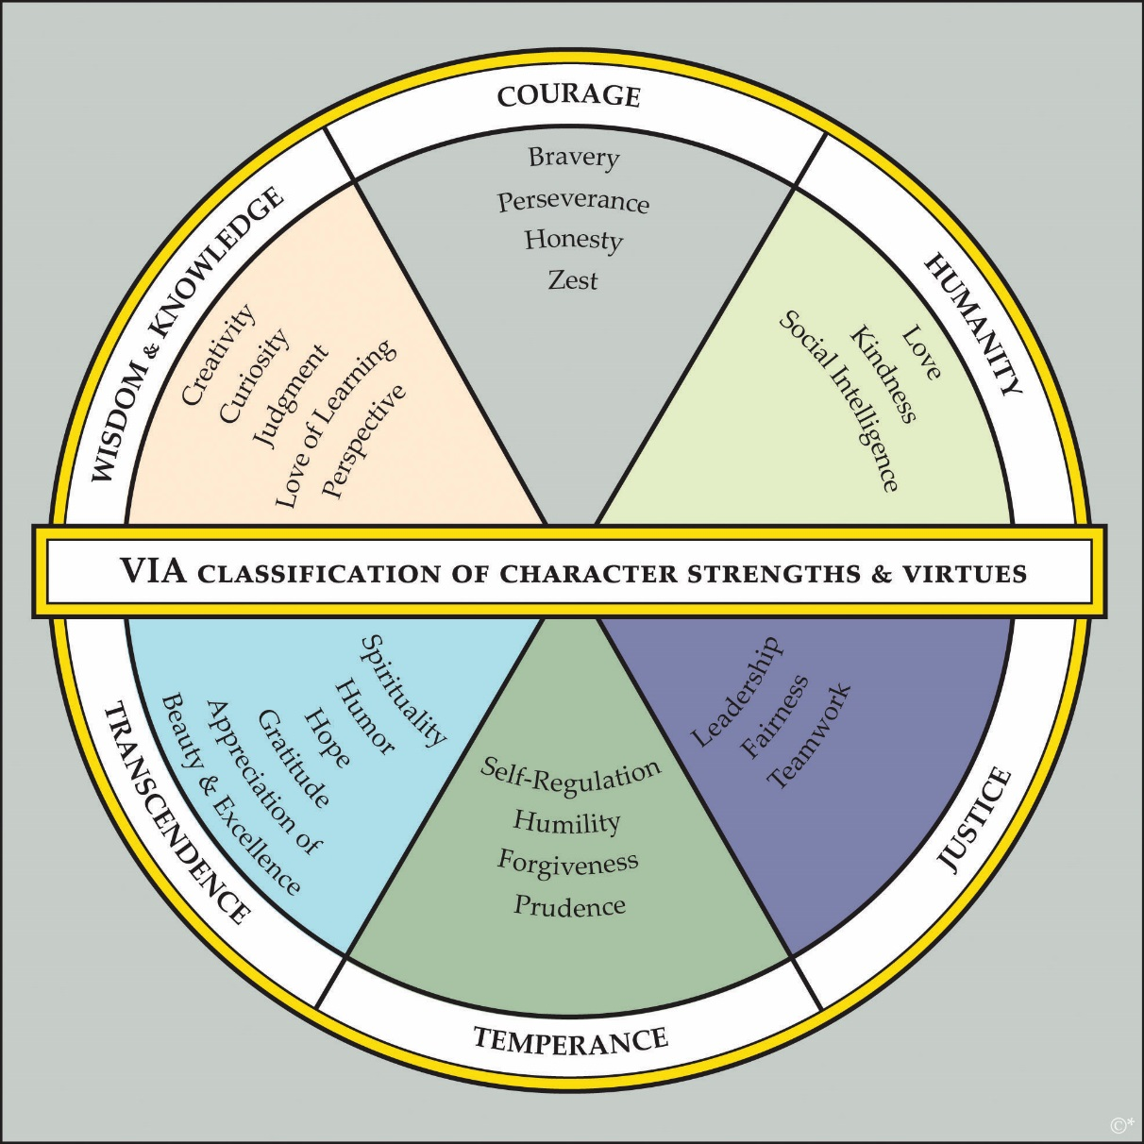
Positive Introductions
Key point: Wield your strengths – they are paths to engagement and enjoyment.

Slide 23
Playfulness
You have 3 minutes to create a paper plane using one of your two top strengths.
Ref: Brown, 2009

Slide 24
Three breaths
The Geelong Three Breaths Exercise
Breath One. Take a deep breath. Notice your physical body and any points of pain or tension. Breath out slowly and release any tension away.
Breath Two. Take a deep breath. As you breathe out think about what you are grateful for right at this very moment. Say to yourself "Right now I am grateful for... ".
Breath Three. Take a deep breath. As you breathe out think what intentional state you want to be in right now. Say to yourself "My intention right now is to be (kind, open minded, relaxed, critical, curious etc)... ".
Developed by Justin Robinson at Geelong Grammar.

Slide 25
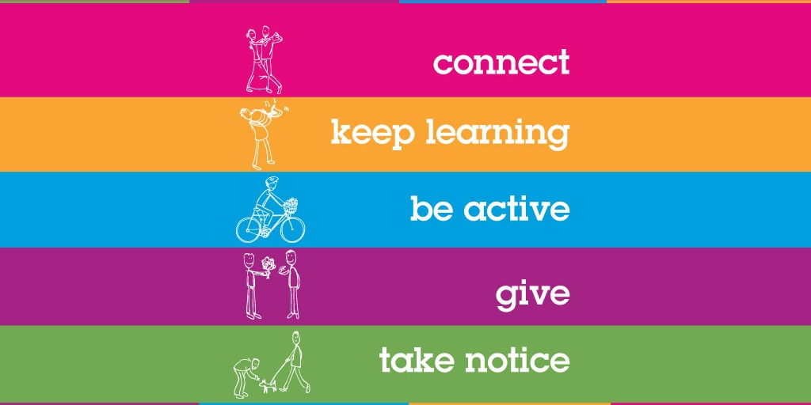
Ways to wellbeing
Pathways to wellbeing
Step 1: Pair up with a different partner, get a pen ready, as well as a blank A4 page…
Step 2: Raise a hand in the air when you're ready…
Step 3: Without looking down at your blank page, and ONLY looking at your partner’s face, you have 1 minute to draw a portrait of your partner, starting on the bell!
Step 4: After the bell, when finished, sign your name, date it, and swap pictures with your partner…

Slide 26
DEAR communication
DEAR
From Marsha M. Linehan’s - Dialectical Behaviour Therapy (DBT).
Describe the situation.
Express an Emotion.
Request an Action.
Reinforce the consequences of the action happening.

Slide 27
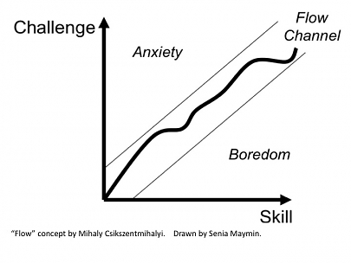
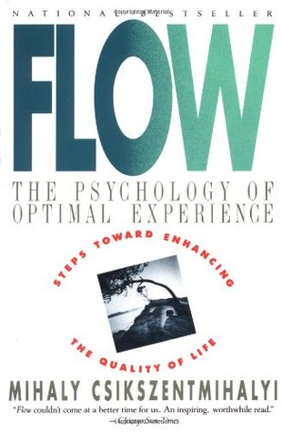
Flow
Flow
Mihaly Csikszentmihalyi
Chick-sent-me-hi-ly

Slide 28
Closer connections
Connections
The idea behind this activity is that mutual vulnerability fosters greater closeness.
1. Given the choice of anyone in the world, whom would you want as a dinner guest?
2. Would you like to be famous? In what way?
3. Before making a telephone call, do you ever rehearse what you are going to say? Why?
Now that question time is over, sit directly facing your partner and set a countdown timer for four minutes. Spend the next four minutes staring directly into your partners eyes. This is the only instruction. Try not to gaze away, talk, or do any other movements – just sit still and stare into their eyes.

Slide 29
Job crafting
Crafting
It’s a bottom-up, employee led, approach about redesigning your job to better suit your values, strengths, and passions.
Objective is a more optimal fit between you and your job, boosting your happiness and effectiveness at work.
Connections go up, self-image goes up, sense of autonomy goes up (SDT).
Work with your manager:
What tasks can you change in your job? – add some, take some away?
What relationships can you change in your job?
Can you change the perception of your job and the tasks you do? – create meaning?
Think about your values, strengths, and passions in your job specifically and the tasks you do. How can you change your tasks to better reflect your values, strengths, and passions?
Pair up, one person be a line manager and the other person initiate a conversation about job crafting during a performance appraisal.

Slide 30
Slowness
Slow down
A slow stretch, a slow moon walk.
Ted talk: Carl Honore

Slide 31
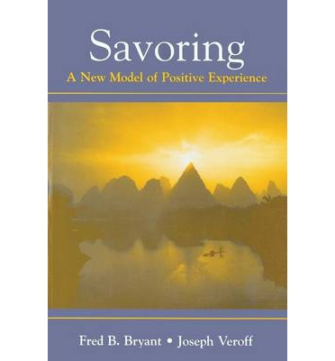
Savouring
Savour
Savouring involves being “in the moment” and “taking in” all that an experience has to offer. I think of it as wringing the pleasure juice out of life by giving attention to the pleasures of the moment.
Savouring can be used in a wide variety of circumstances – one can savour a sensory experience, a social experience, a feeling, or even a memory.
There are ten different types of savouring strategies - sharing with others, memory building, self-congratulation, sensory-perceptual sharpening, comparing, absorption, behavioural expression, temporal awareness, counting blessings, and kill-joy thinking.
We are going to try a combo of “sensory-perceptual sharpening” and “absorption”.

Slide 32
Savouring
Savour
Step 1: Hold your almond.
Step 2: Take a close look at it – inspect it, examine it! What does it look like? Is it symmetrical?
Step 3: Close your eyes for the rest of this experience and feel it in your hand – what does the texture feel like?
Step 4: Smell it. What does it smell like?
Step 5: Put the almond into your mouth but do not bite or suck it – just let it rest on your tongue. Explore the almond with your tongue and teeth, noticing as much as you can.
Step 6: Bite slowly into it and focus on the taste. Swirl the contents of the almond around in your mouth.
Step 7: Swallow the almond and open your eyes.
Was it easy to stay focused as you tapped your senses and became absorbed in the sensory experience?
What was it like to pay attention to each individual detail of the experience?

Slide 33
Active Constructive Responding
ACR
There are four ways of responding, and active constructive responding has been shown to build solid, strong and lasting relationships the best.
Using active constructive responding is a good way to convey understanding, validation and caring, and to increase the wellbeing of your existing friends, as well as to make new friends and to encourage closer, more trusting relationships with them.
Active Constructive Response involves expressing enthusiastic positive support = “That’s really great. Your wife will be pretty proud of you. I know how important that promotion was to you. We should go out and celebrate”. During such communication the person is maintaining eye contact and displaying positive emotion, such as laughing or smiling.
Active Destructive Response involves expressing a derogatory or critical response = “That sounds like a lot of responsibility to take on. There will probably be more stress involved in the new position and potentially longer hours at the office”. The person is displaying negative emotions, such as frowning or anxiety.
Passive Constructive Response involves showing benign disinterest = “That’s good news”. The person is displaying little nonverbal communication.
Passive Destructive Response involves distancing or failing to respond = “What are we doing Friday afternoon? ” The person does not acknowledge the good news, is not in eye contact, and may be turning away or leaving the room.

Slide 34
Positive expressive writing
Expressive writing
Write for 10 minutes through the lens of a positive emotion reflecting on your day yesterday. Instructions as follows:
Choose just one emotion. Love, joy, interest, awe, inspiration, gratitude, hope, serenity, amusement and pride.
Think about how the emotion feels to you.
Reflect on the emotion as you write.
Be detailed; describe the emotion.
Choose to see any negative events or thoughts through the lens of your chosen emotion.

Slide 35
A great day at work
Design
Design a good day, including a standard work day, from when you wake up to go to sleep in 60 minute intervals. Focus on building in psychological and physical wellbeing, and strengths.
7am-8am – Wake and breakfast, ready for work.
Strengths: Creativity (dressing), Bravery (new route to work)
Wellbeing: Connect (partner), Be active (walk around house)
Physical: Whole foods
8am-9am

Slide 36
High quality connections
HQC
When was the last interaction at work that “lit you up” – that was a HQC.
People feel attuned and a sense of worth.
Benefits of HQC form page 12 of positive leadership book.
Type of actions or pathways to HQC’s:
Respect others – show them they are important. A good way is through being present. Effective listening – micro skills. Empathy.
Task enable others – facilitate others successes. Encourage, guide, support.
Trust others – don’t over monitor and control.
Play – team building, volunteering.
Let’s talk about exemplars of the above 4 types of actions you have seen?
What can you do?

Slide 37
Questions
Questions and applause / ridicule

