Slide 1
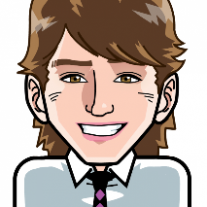
Positive Psychology: The past or the future?
aaronjarden.com
1st Eurasian Congress on Positive Psychology
April 28-30, 2016,Uskudar University, Istanbul, Turkey

Slide 2
The future! Nice choice

Slide 3
The Geelong Three Breaths Exercise
Positive Psychology: The past or the future?
Breath One. Take a deep breath in through your nose and fill your lungs with as much air as possible. As you are doing so, notice your physical body and any points of pain or tension. As you breath out slowly through your mouth, imagine you are pushing or releasing any tension away. Feel yourself sink into your seat.
Breath Two. Take a deep breath in through your nose and fill your lungs with as much air as possible. Now as you breathe out think about what you are grateful for right at this very moment. Not what you are grateful for that has happened in the past, or looking towards the future, but right in this very moment think about one thing you are grateful for and exhale slowly. Say to yourself "Right now I am grateful for... ".
Breath Three. Take a deep breath in through your nose and fill your lungs with as much air as possible. Now as you breathe out think about your frame of reference and what intentional state you want to be in right now. Do you intend to be kind? Do you intend to be open minded? Do you intend to be peaceful? Whatever intention you wish to have at this present moment, cultivate it when you exhale by saying to yourself "My intention right now is to be... ".
Credit: This exercise is based on one developed by Justin Robinson, Director of the Institute of Positive Education, Geelong Grammar
School, Australia.

Slide 4
Agenda
1
Challenges of the present.
2
What the future holds.
3
Where is positive psychology going? – What is positive psychology's future?
4
How is it going to get there? – Who, how, when?

Slide 5
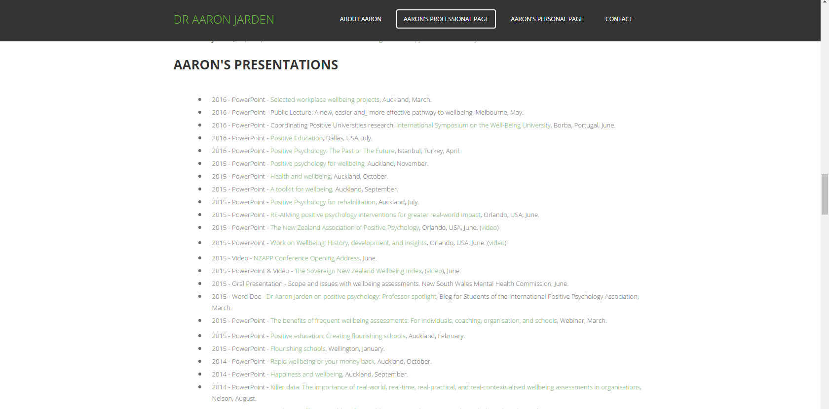
Presentation Slides
Positive Psychology: The past or the future?
aaronjarden.com

Slide 6
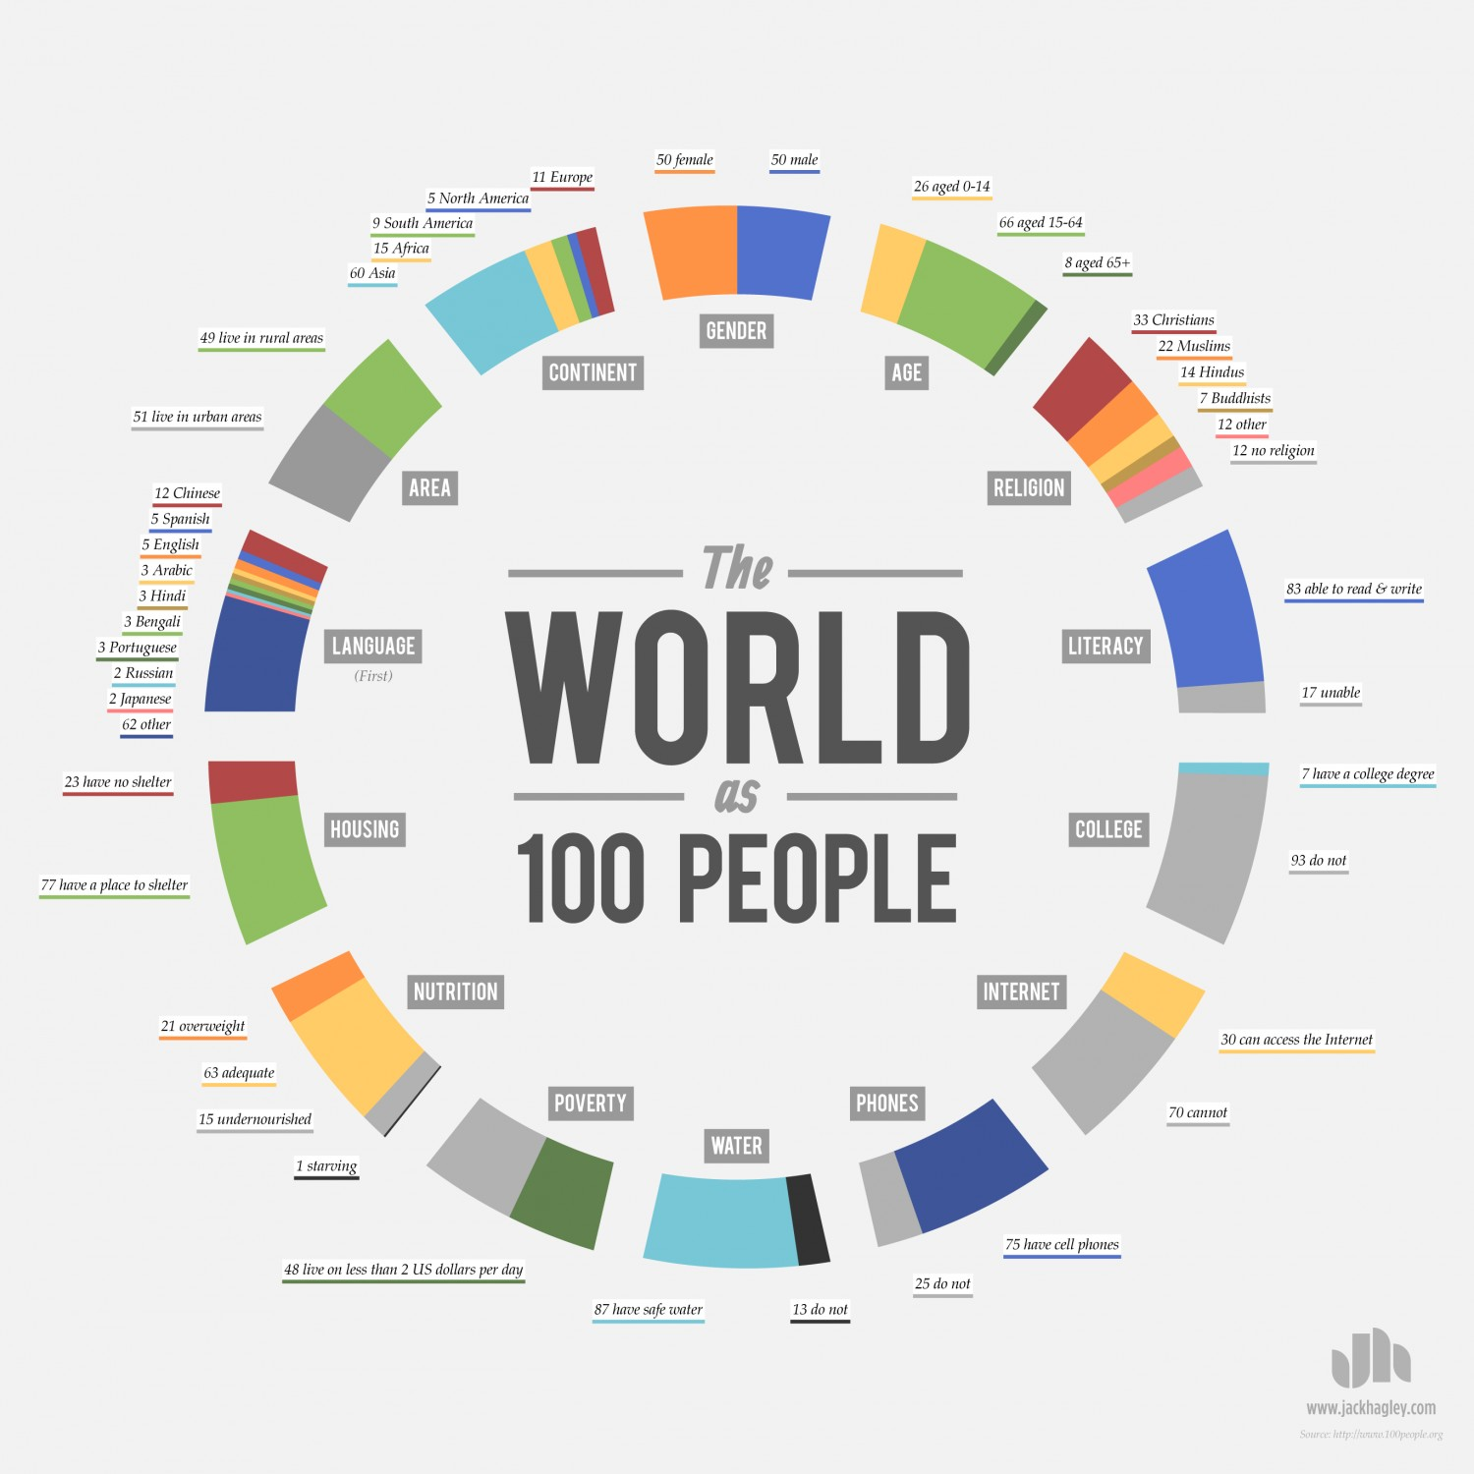
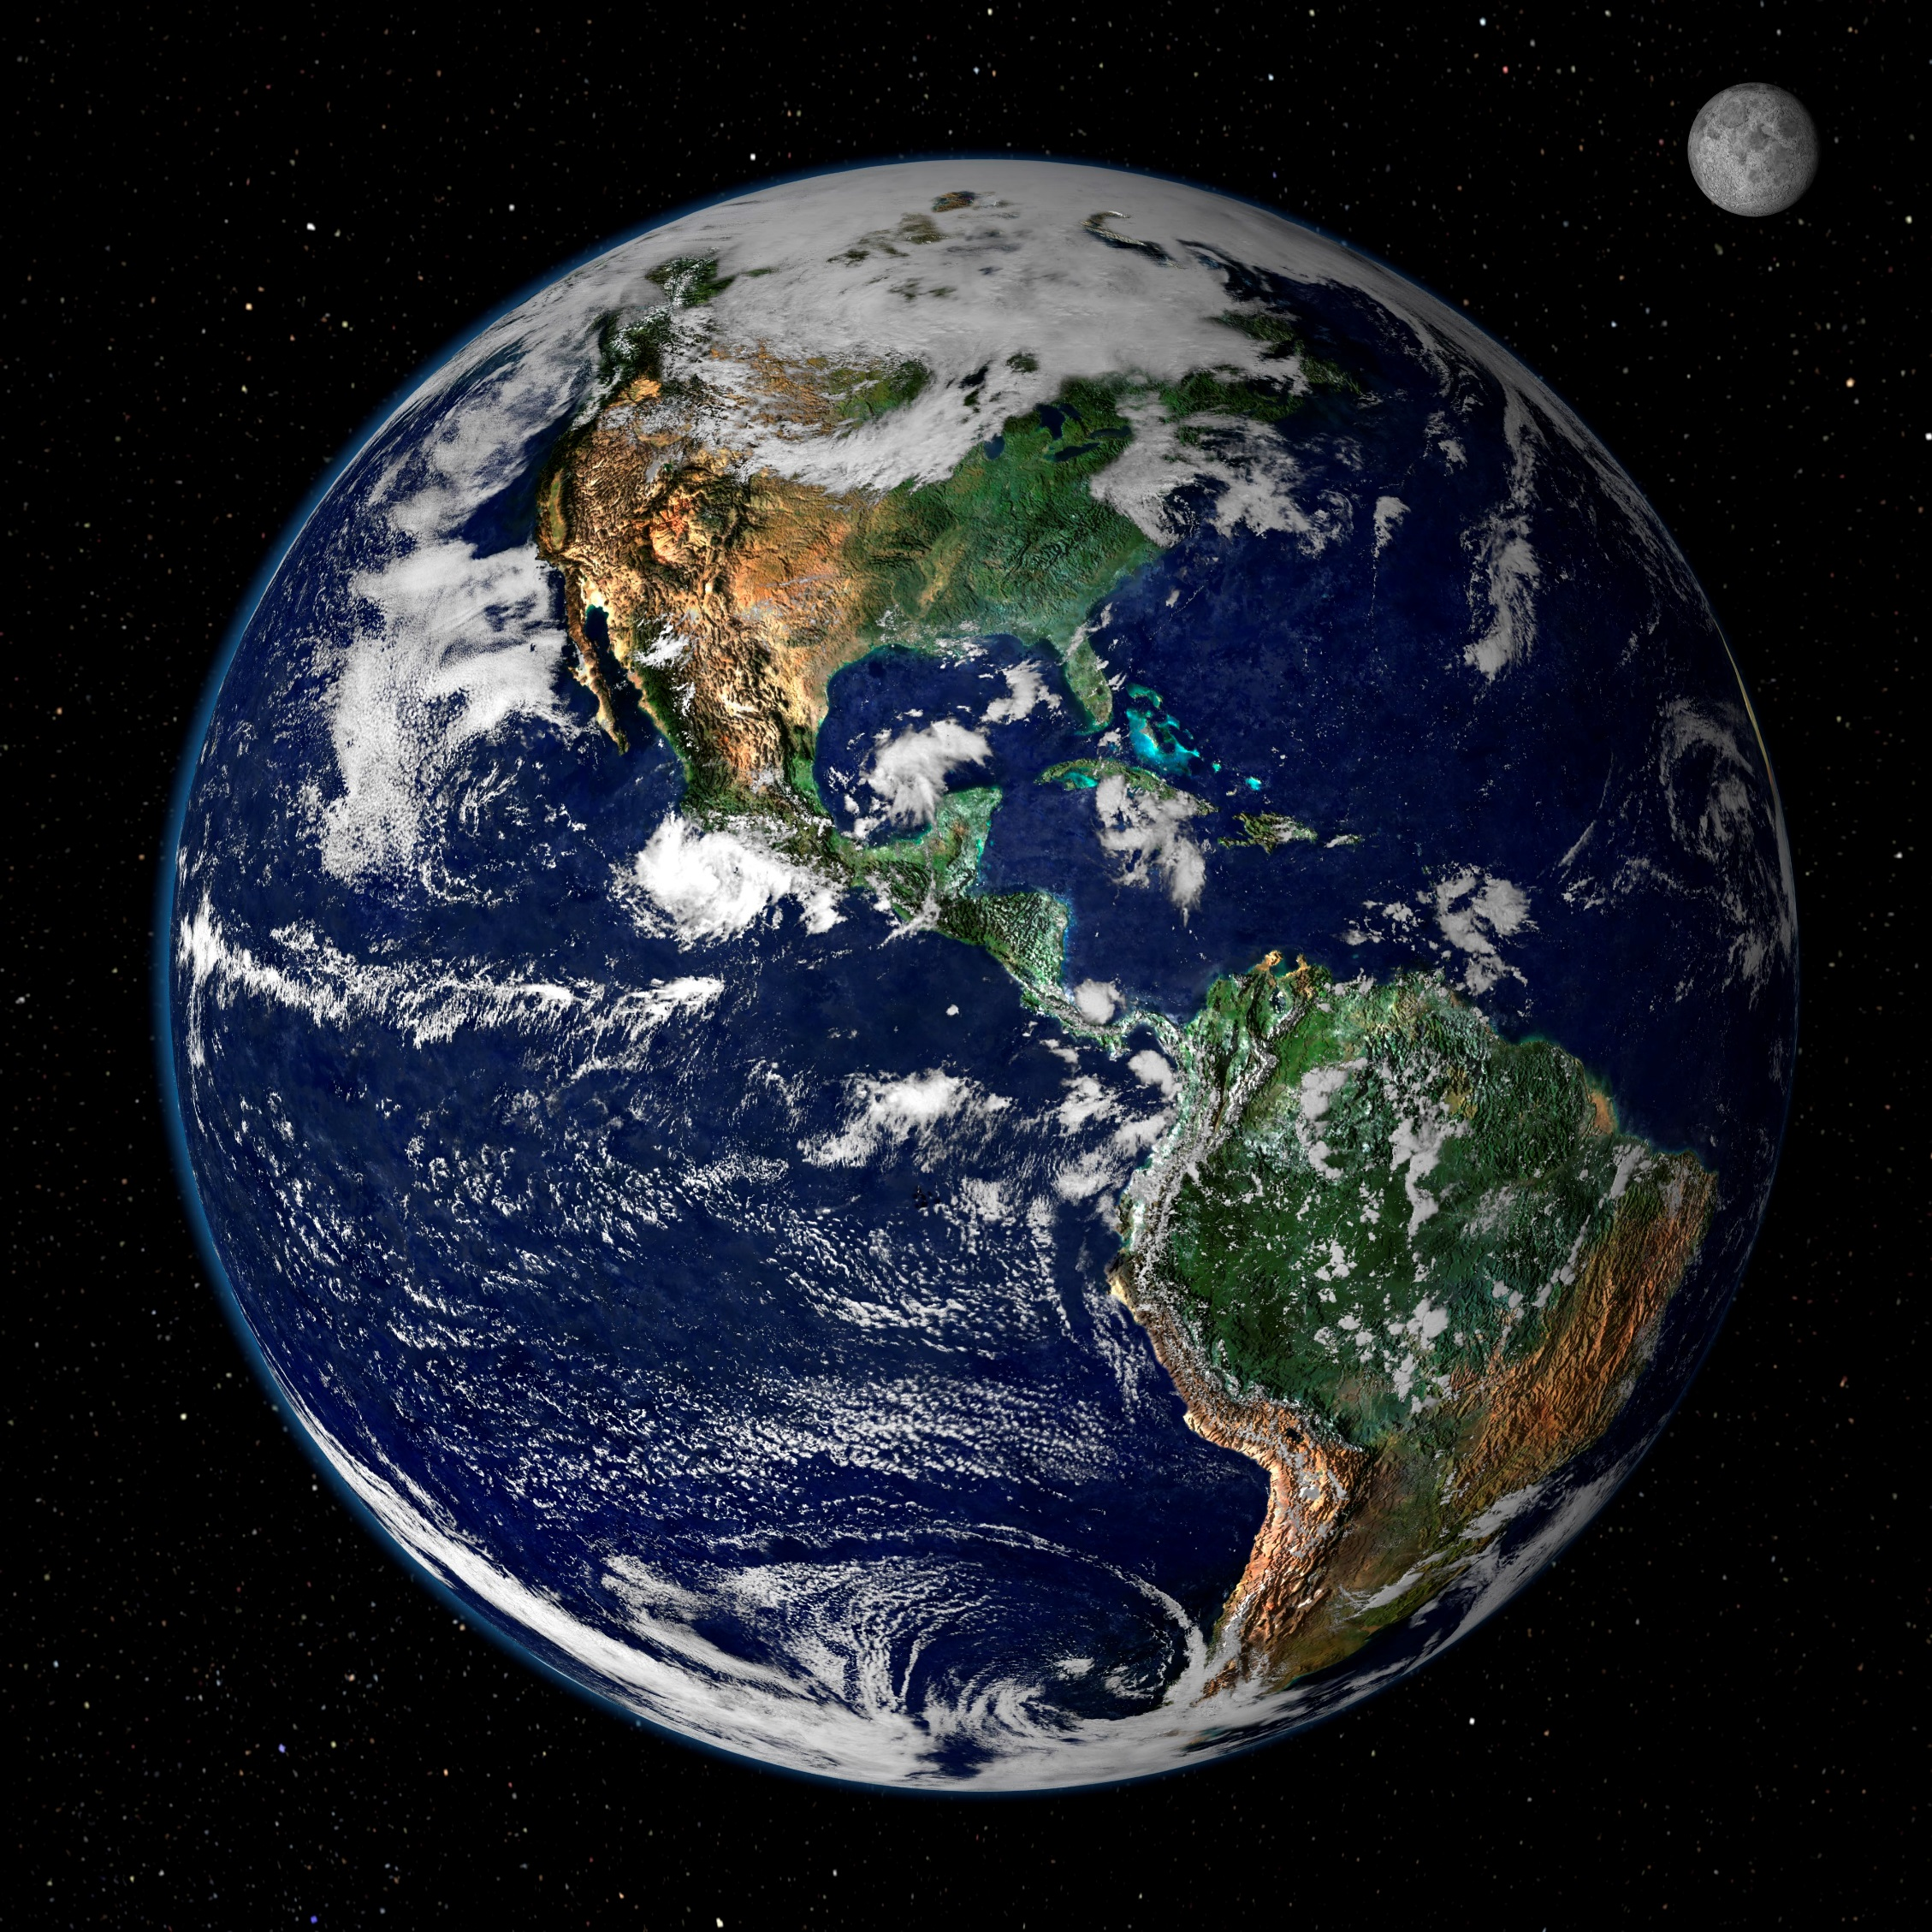
1
7,417,419,032

Slide 7
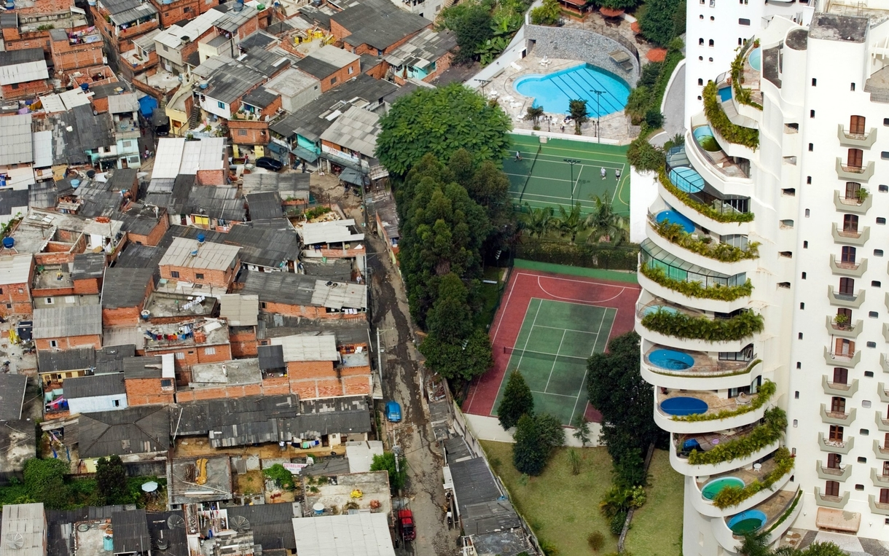
Challenges Of The Present
1
Inequality.
Gender
Racial
Political
Global
Social
Economic
Educational
Technological
Of resources
Of opportunity

Slide 8
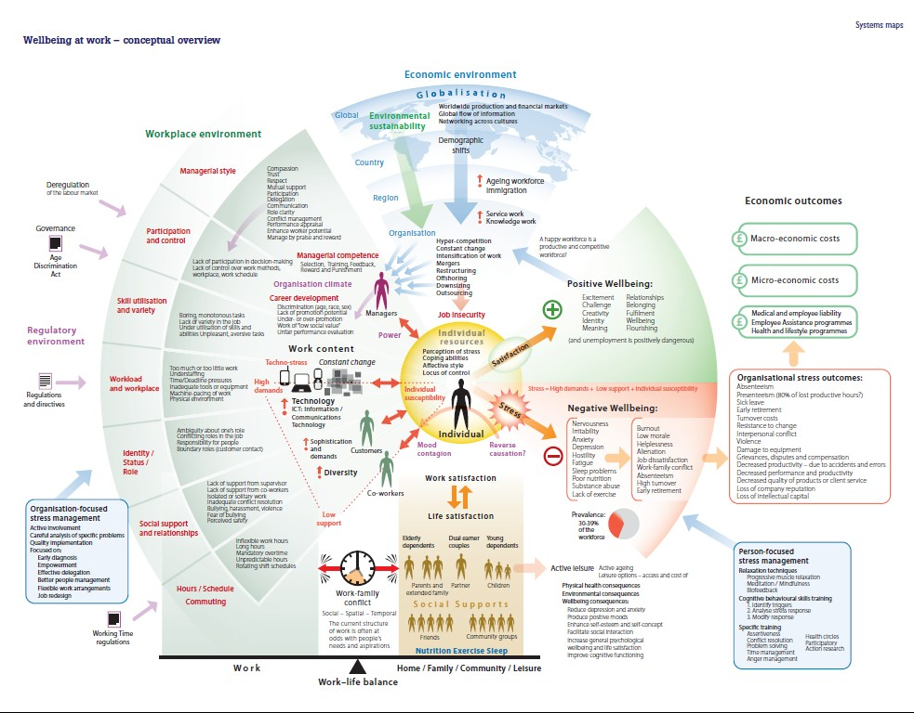
Challenges Of The Present
1
Complexity.
At work
Health (mental illness)
Social
Systems (refugees)
Dark web
Rocket science
Rate of change
The world is moving so fast these days that the man who says it can't be done is generally interrupted by someone doing it – Harry Fosdick

Slide 9
Challenges Of The Present
1
Earth.
Global warming
Air quality and pollution
Population control
Famine and food wastage
Clean water
Species extinction
Re-coding life (messing with viruses)
Global peace (war, terrorism, democracy - UN)

Slide 10
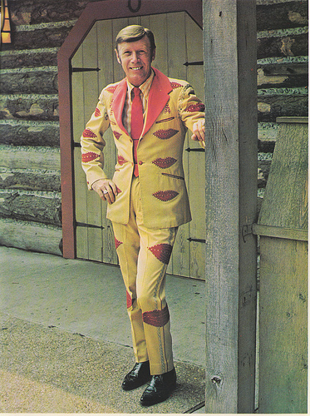
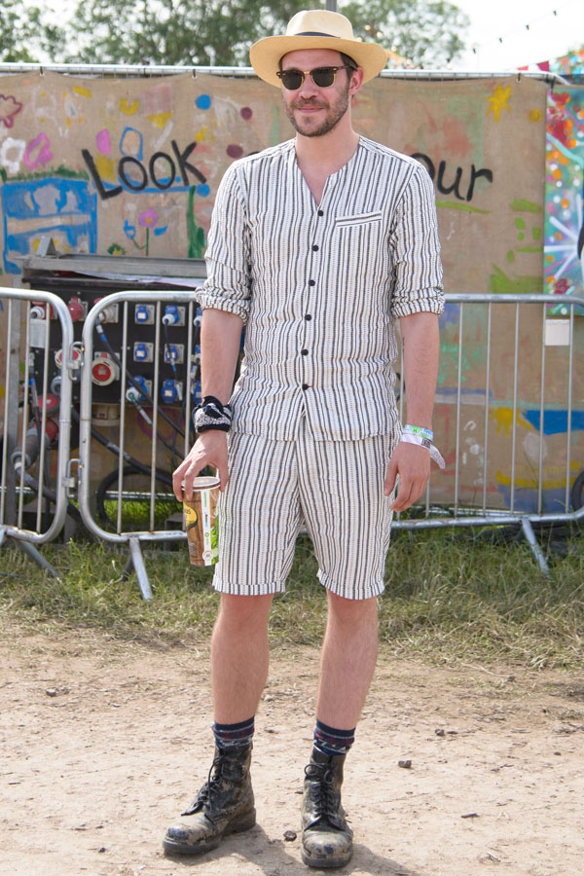
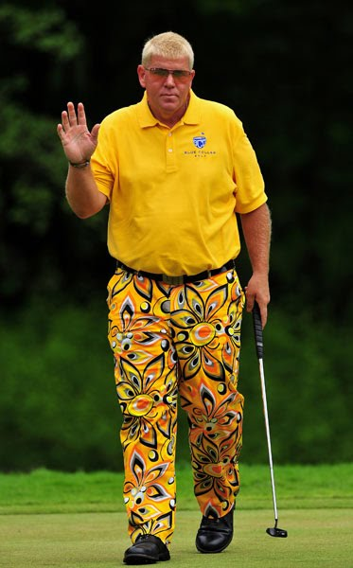
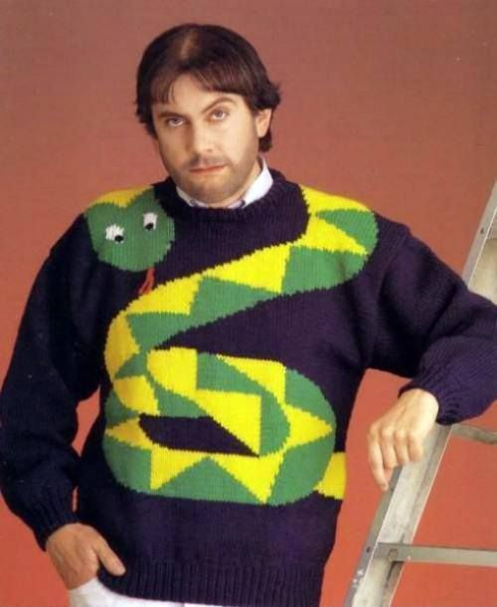
Bad fashion sense
Challenges Of The Present
1

Slide 11
Challenges Of The Present
1
So to recap, we live in a world which has major issues with:
Increasing inequality
Increasing complexity
Keeping the earth healthy
International cooperation
Messing with evolution
and bad fashion sense…

Slide 12
I did not fly half way around the world to make you feel dispondant!
Challenges Of The Present
1

Slide 13
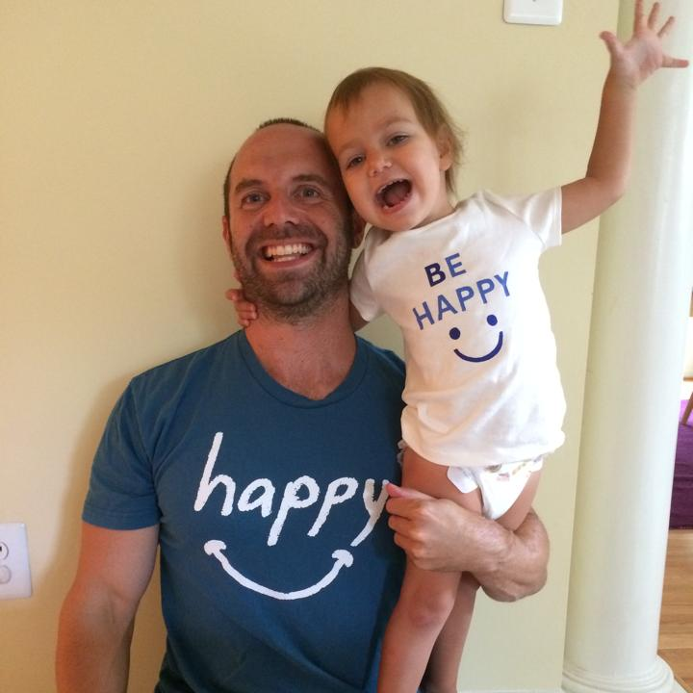
Challenges Of The Present
1
It’s not all doom and gloom - good stuff is also happening:
Remarkable declines in global poverty over the last 40 years…
Most people are happy…
75% have phones, 83% can read and write…
Medical science is impressive…
Population is growing rather than declining…
There are 200 million people less dying of starvation compared to 25 years ago…
Season 6 of Game of Thrones is one a week away – Winter is coming…

Slide 14
1

Slide 15
?
What The Future Holds
2

Slide 16
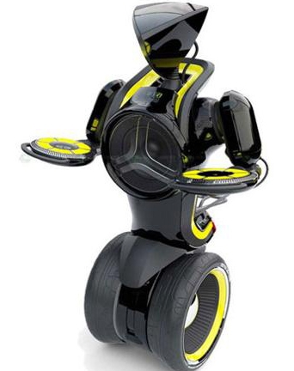
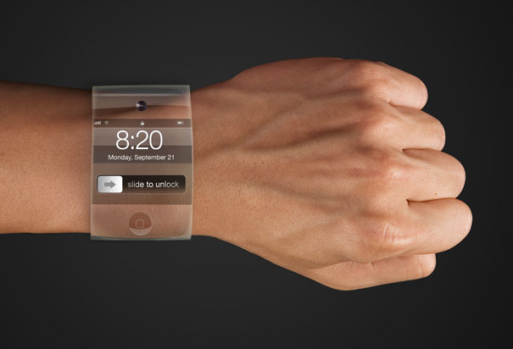
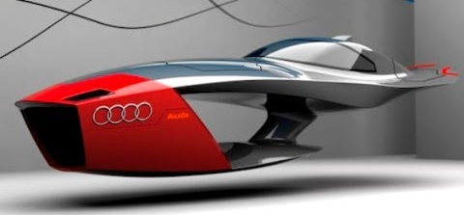
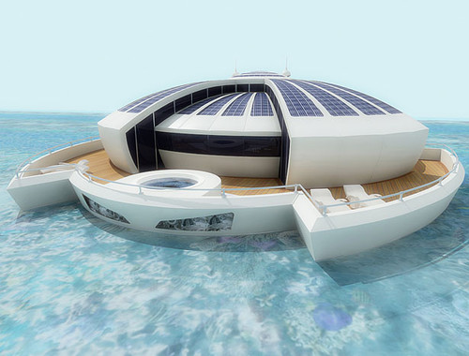
The Future

Slide 17
What The Future Holds
2
Some good stuff and some bad stuff – a little bit of both.
New technologies
New ways of working (e.g., flexibly, remotely, many jobs)
New ways of getting around (driverless cars, space travel)
New ways of getting along (electronic voting, transparency of crime)
Are you excited about our future?
Given what we can reasonably expect to happen in the future, what role can positive psychology play in shaping this future for the better?

Slide 18
Where Is Positive Psychology Going?
3
Or address the question: “What is positive psychology's future?”
What is positive psychology?
Positive psychology is a branch of psychology that conducts scientific inquiry into the factors that help individuals, communities and organisations thrive by building on their strengths and virtues.
Positive psychology aims to expand psychology from its focus on repairing the negatives in life to also promoting the positives in life: From what is wrong with individuals to what is right with them.

Slide 19
Where Is Positive Psychology Going?
3
Positive psychology is the study of topics as diverse as happiness, optimism, hope, flow, strengths, meaning, subjective wellbeing and personal growth…
Positive psychology interventions (empirically validated techniques and strategies to increase wellbeing) have been used effectively in schools to improve academic outcomes, in businesses to improve work relationships and engagement, and in communities to improve health…
What is optimal human functioning?

Slide 20
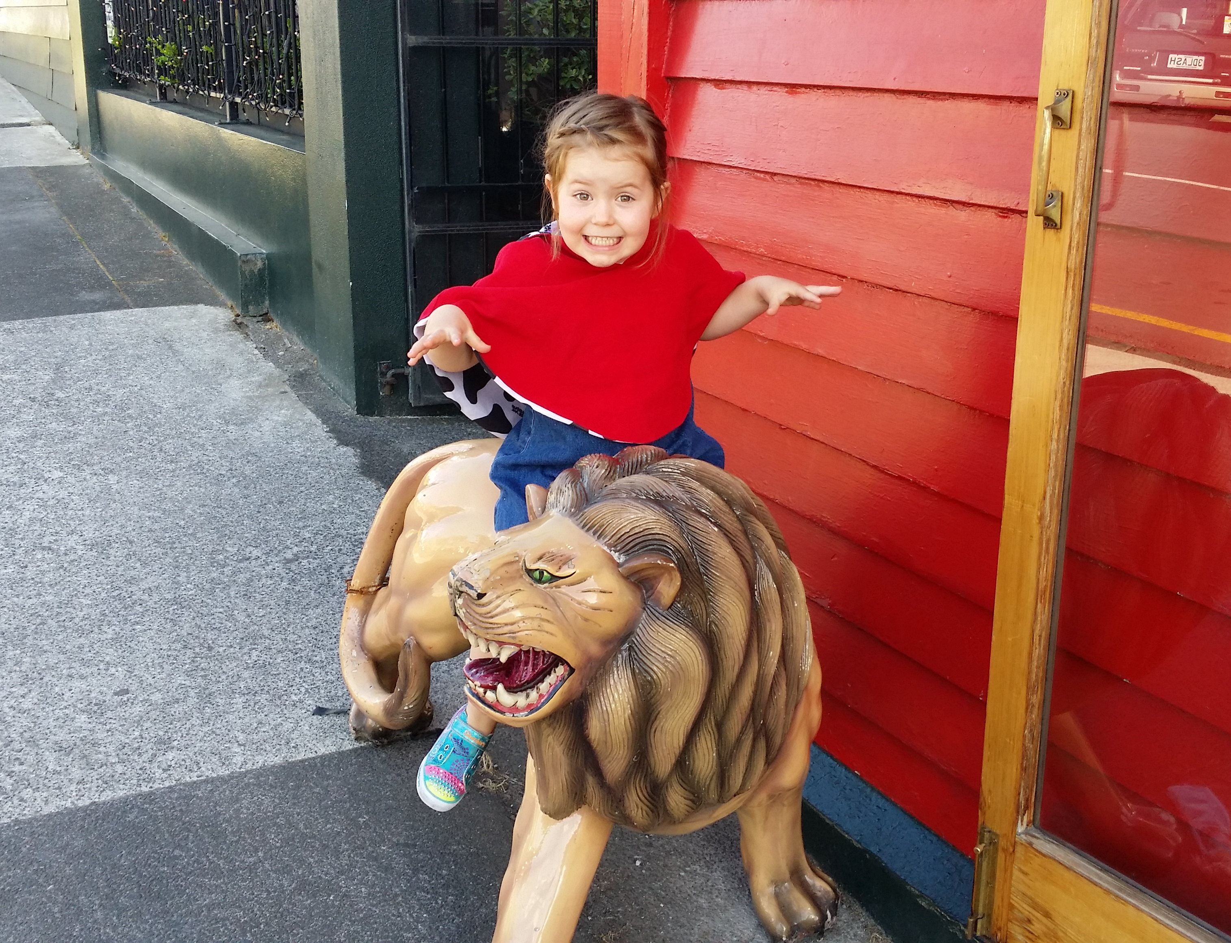
Passion Enthusiasm People
“What is optimal human functioning?”
4

Slide 21
Where Is Positive Psychology Going?
3

Slide 22
Where Is Positive Psychology Going?
3
What is the purpose of positive psychology?
Martin Seligman’s view
Chris Peterson’s view
Ask other key influential positive psychologists
Look at journal publications for trends and recommendations
Aaron’s 10 speculations…

Slide 23
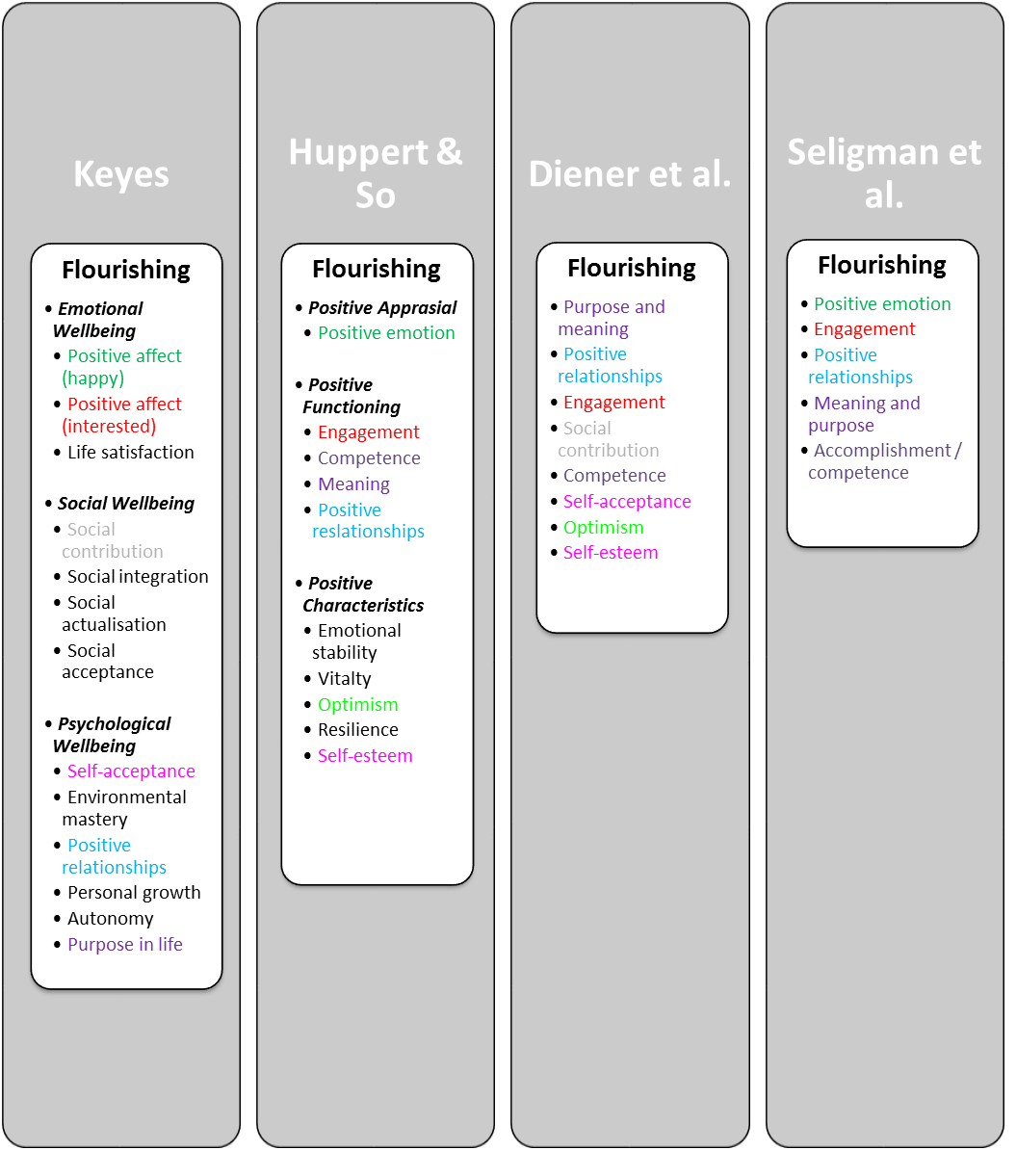
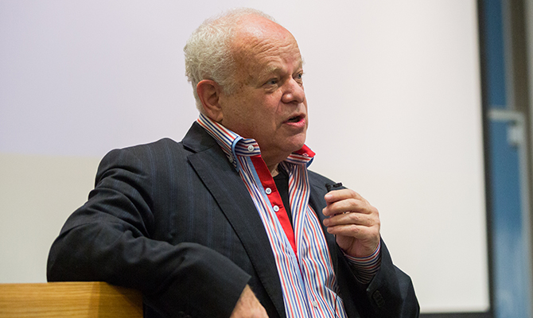
Where Is Positive Psychology Going?
3
Seligman: “Positive Psychology is founded on the belief that people want to lead meaningful and fulfilling lives, to cultivate what is best within themselves, and to enhance their experiences of love, work, and play.”
51 percent of the world could be flourishing by 2051
What is optimal human functioning?

Slide 24
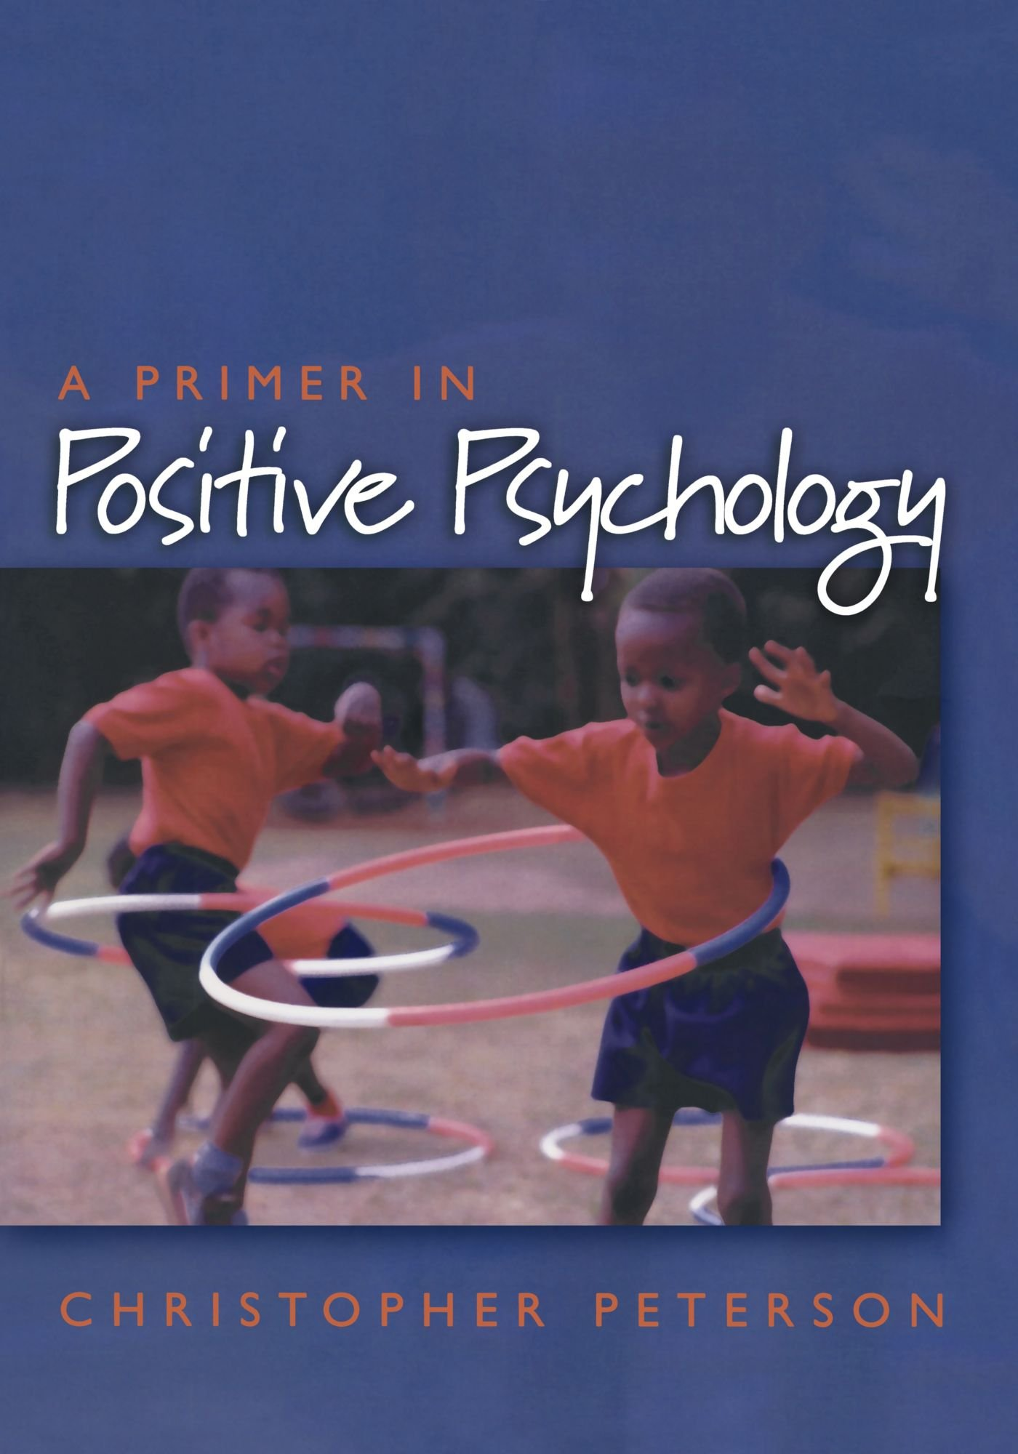
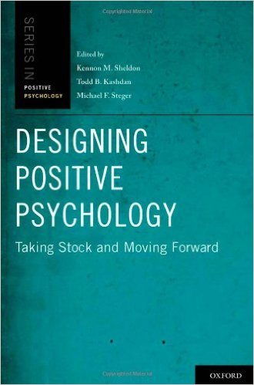
Where Is Positive Psychology Going?
3
Chris Peterson 2006 chapter “The future of positive psychology”:
Positive psychology will fuse into psychology
The negative will always be appealing
Clarity over hedonic set-points
The components of the good life exist in degrees
Better longitudinal studies needed
How well will interventions generalise and scale
Happy pills are only a matter of time
Social settings that will enable the good life

Slide 25
Where Is Positive Psychology Going?
3
Ask other positive psychologists:
Book series: Positive Psychologists on Positive Psychology (Vol 1, 2, & 3)
Free at https://www.workonwellbeing.com/pponpp3/
44 interview in total, a selection of 4 from each book:
Mihaly Csikszentmihalyi
Ed Diener
Todd Kashdan
Barbara Fredrickson
Robert Biswas-Diener
Paul Wong
Ken Sheldon
James Pawelski
Jane Dutton
Felicia Huppert
Veronika Huta
Lea Waters

Slide 26
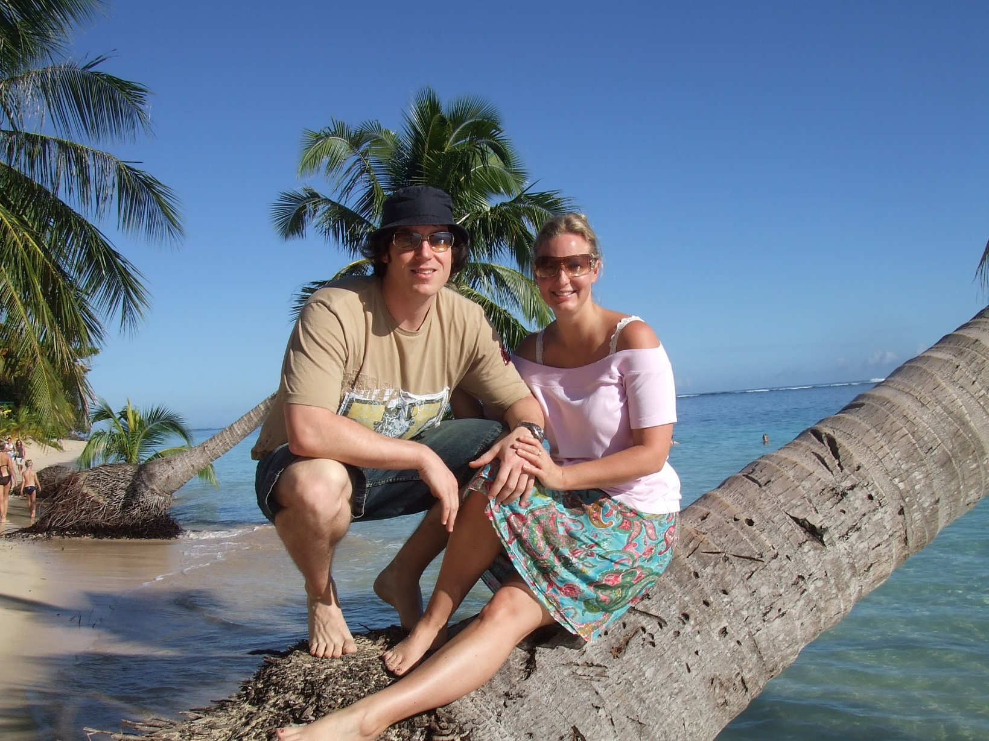
Where Is Positive Psychology Going?
3
So what did they say?
Themes:
Importance of interdisciplinary collaboration
Training and enabling the young scientists
Some cool new topics (psychological flexibility, positive parenting, time perspective)
Some topics are getting too much attention (e.g., strengths) at the expense of others
Focusing on funding streams
Very high quality science needed.

Slide 27
Where Is Positive Psychology Going?
3
What do the publications focus on and recommend?
Other than introductions (‘Positive psychology: An introduction’ cited 10,000+ times) and discussion of the field:
Positive emotions and the broaden-and-build theory
Positive psychology interventions
Strengths
All recommend more research needed.

Slide 28
Where Is Positive Psychology Going?
3
My view of the adventures in store for positive psychology.
10 New-ish areas of focus for the future:
Discomfort
Laziness
Play
Sex
Slowness
Nature
Wellbeing technology
The most disadvantaged
Physical health and wellbeing
Positive parenting
Not so new-ish:
Positive neuroscience
Positive education
Positive health
Military
Positive organisations
National accounts of wellbeing
Culture and wellbeing
If could go beyond ten I would speculate at things like our attentional resources and their impact on wellbeing, the media and wellbeing, urban design and wellbeing, social detachment and wellbeing, positive therapy, sport and wellbeing, leisure centres (gyms, cafes, bars) and wellbeing, criminals and recidivism, retirement and wellbeing etc.

Slide 29
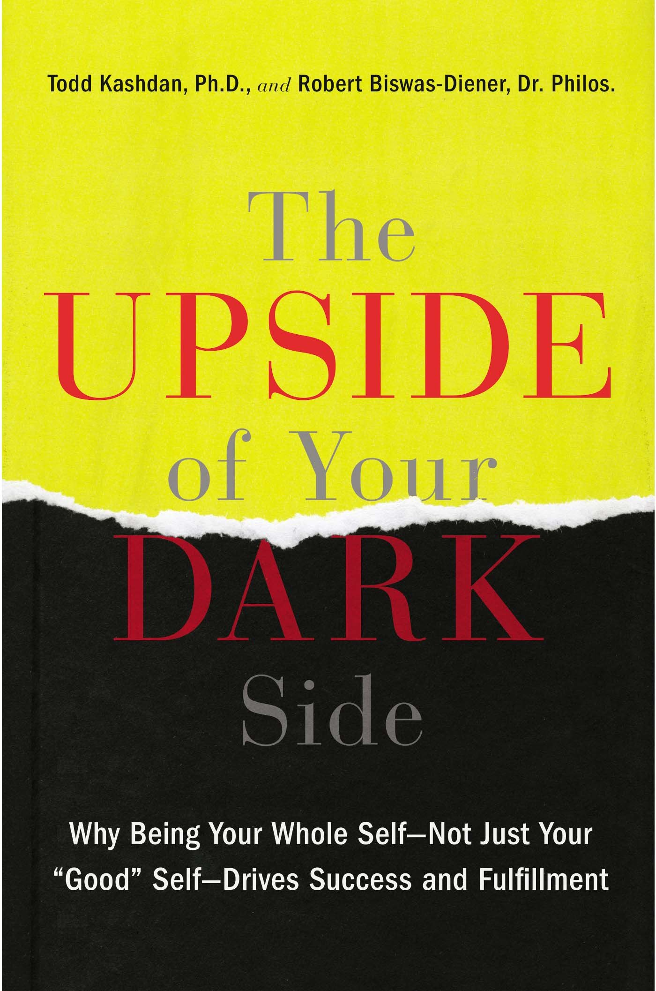
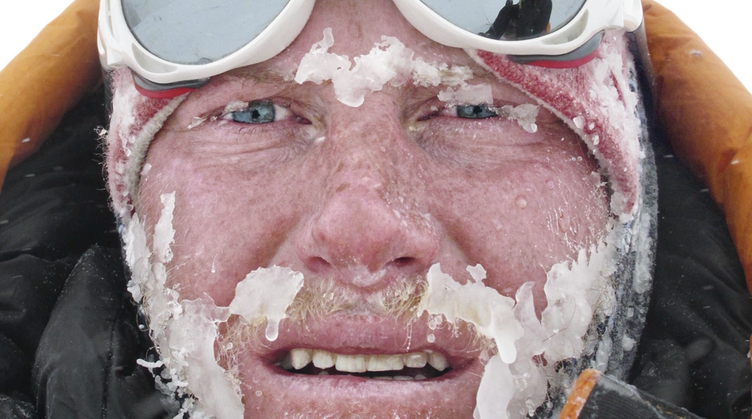
Where Is Positive Psychology Going?
3
Discomfort as a pathway to wellbeing:
Embrace and utilise negative emotions
See Robert Biswas-Diener TED talk

Slide 30
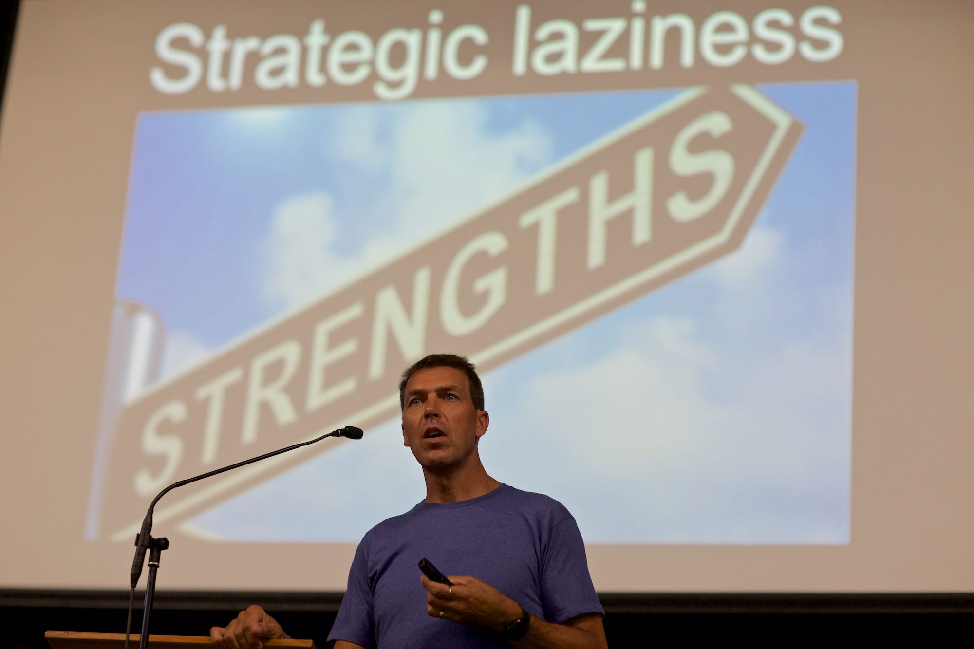
Where Is Positive Psychology Going?
3
Strategic laziness:
You can’t be good at everything and use your strengths all the time

Slide 31
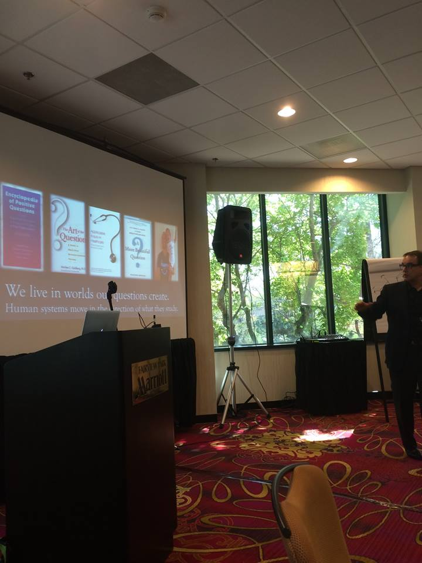
Where Is Positive Psychology Going?
3
Play:
David Cooperrider
Kids are good, adults suck

Slide 33
Where Is Positive Psychology Going?
3
Sex:
We can’t ignore the link between sex and wellbeing
Positive emotions as the glue for social disconnect
Cue sex video

Slide 34
I did not fly half way around the world to make you feel dispondant!
Challenges Of The Present
1

Slide 35
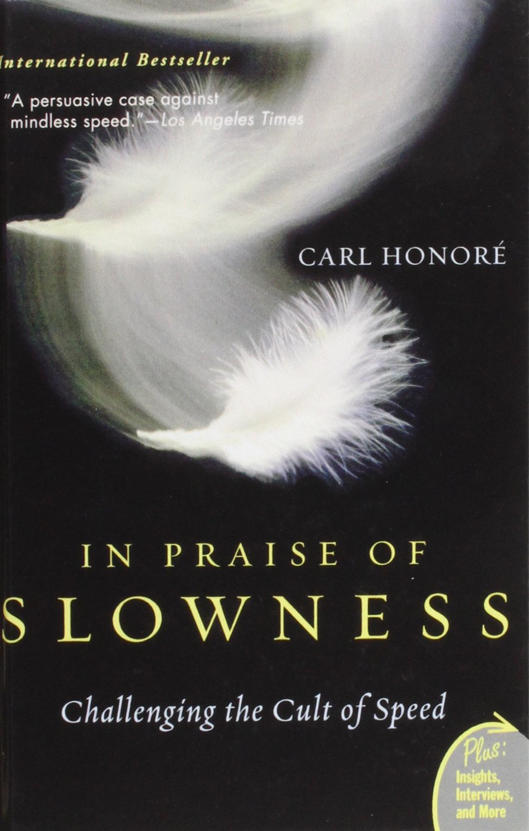
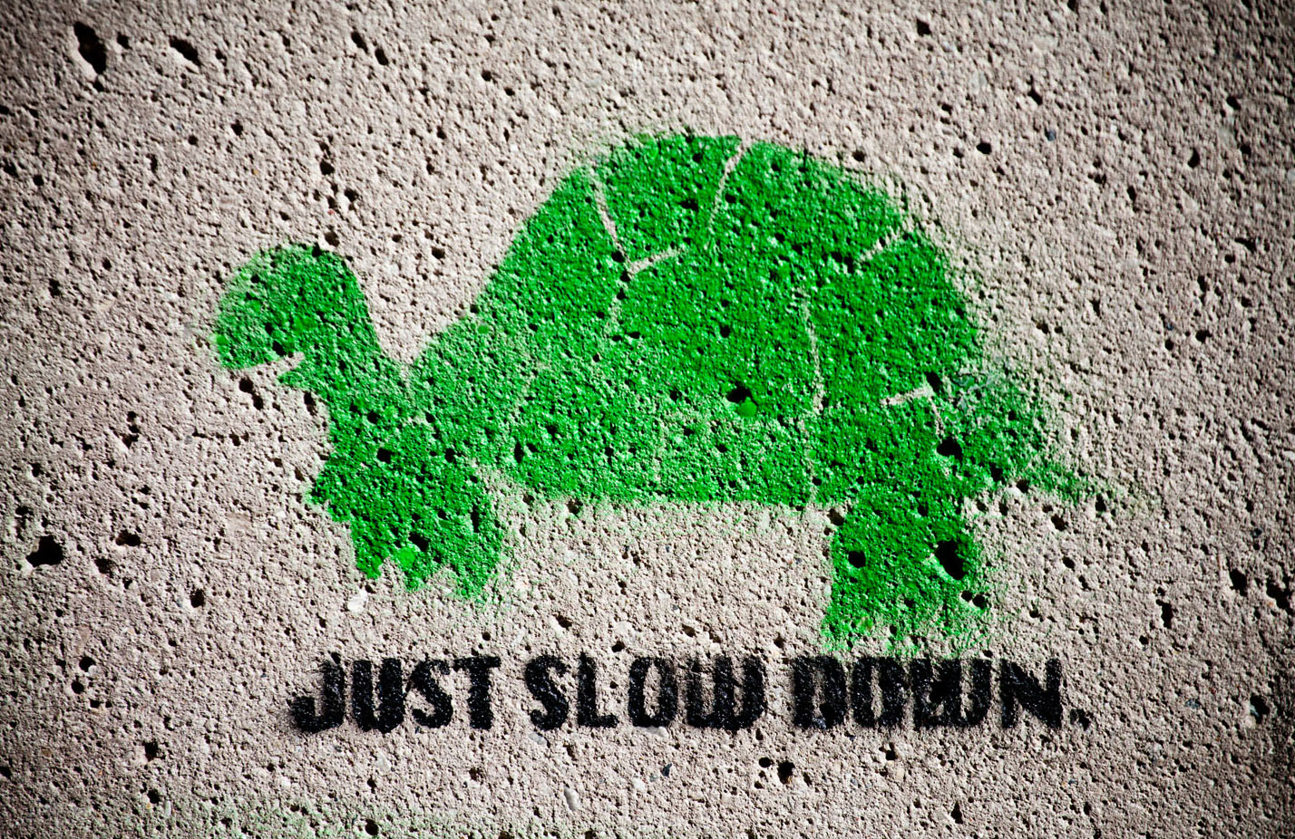
Where Is Positive Psychology Going?
3
Slowness:
Let’s experiment
Stopping stuff and doing less
“These days even instant gratification takes too long” – Carl Honore

Slide 36
Nature and wellbeing

Slide 37
Where Is Positive Psychology Going?
3
Wellbeing technology:
Remember increasing complexity – humans are the bottleneck

Slide 38
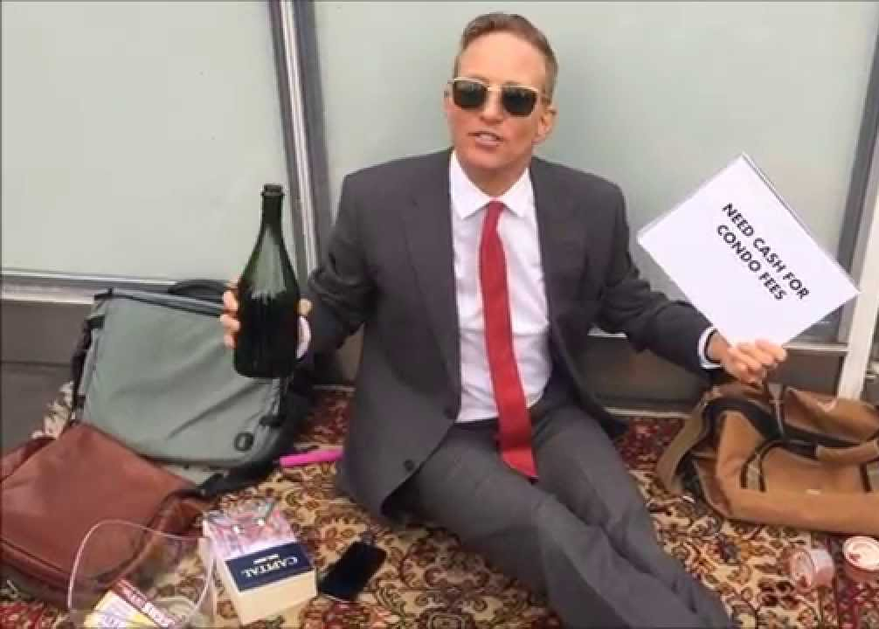
Where Is Positive Psychology Going?
3
The most disadvantaged:
To increase global wellbeing we need to target the poor and disadvantaged

Slide 39
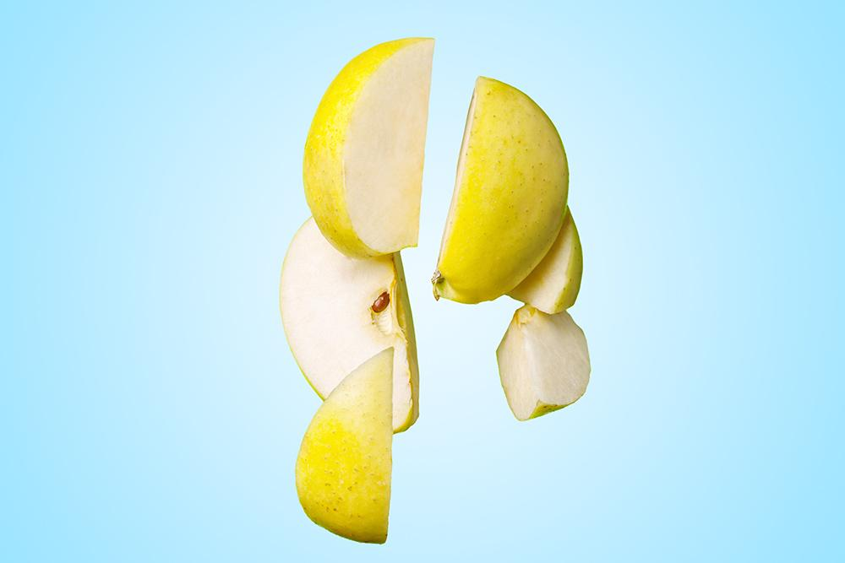
The body and food, and wellbeing

Slide 40
Where Is Positive Psychology Going?
3
Positive parenting:
Free range, risk, and encouraging failure
A wise man once told me: “Love them, keep them safe, teach them stuff…”

Slide 41
Where Is Positive Psychology Going?
3
So there are some exciting areas for future focus on the horizon:
Discomfort
Strategic laziness
Play
Sex
Slowness
Nature
Wellbeing technology
The most disadvantaged
Physical health and wellbeing
Positive parenting

Slide 42
How Is It Going To Get There?
4
Now I have painted a bit of a picture of where positive psychology is likely going, how is it going to get there?
10 (mostly new-ish) ways positive psychology can thrive and impact:
Simplifying messaging
Better studies - going beyond anecdotal evidence, and a focus on theory
Start a movement - beyond academia
More people (let’s teach it), more passion
Better dissemination: Media, public policy, organisations, schools
Tailor wellbeing interventions better: supercharge them, focus on the individual
More collaborative plan
Address the critics
Become entrepreneurial and embrace technology
Make some friends

Slide 43
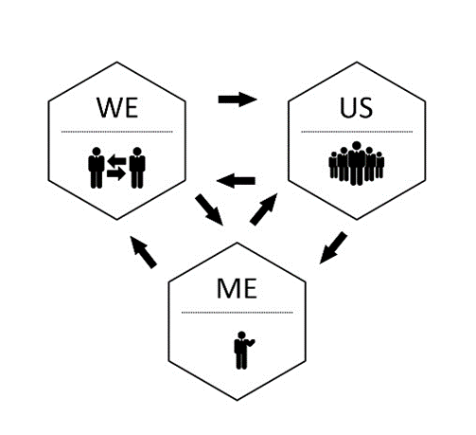
How Is It Going To Get There?
4
Simplifying messaging.

Slide 44
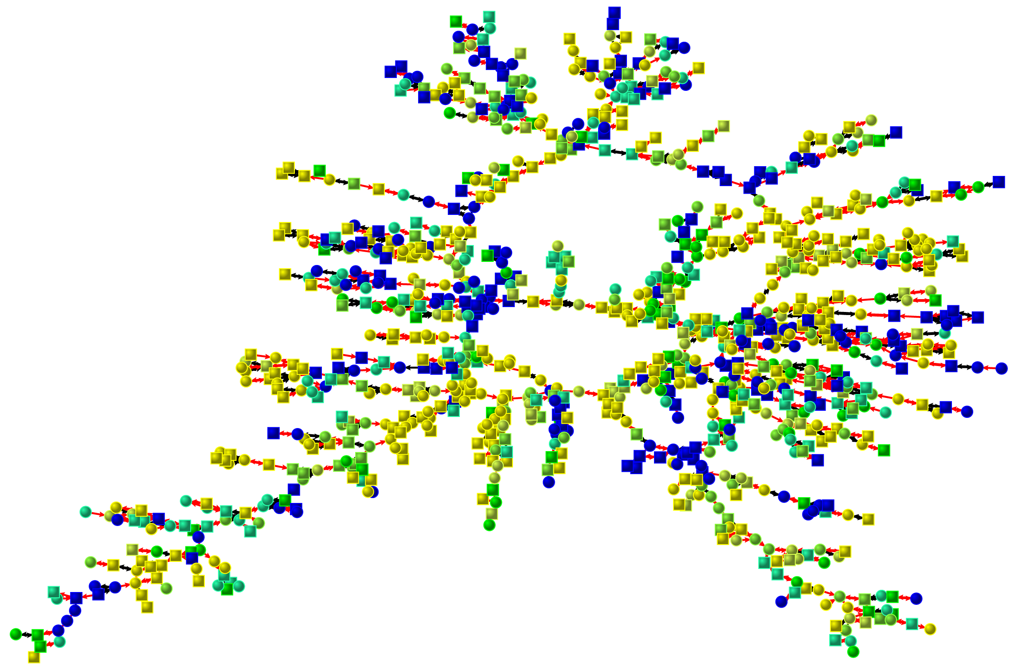
How Is It Going To Get There?
4
Better studies:
Complex research design – observational data, self-report, biological markers, behavioural data, time-series studies
Social network analysis

Slide 45
How Is It Going To Get There?
4
Start a movement – beyond academia.
Cue video

Slide 46
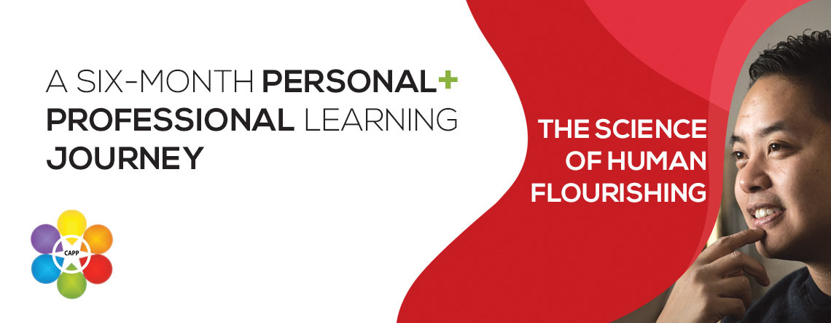
How Is It Going To Get There?
4
More people, more passion:
Let’s teach it

Slide 47
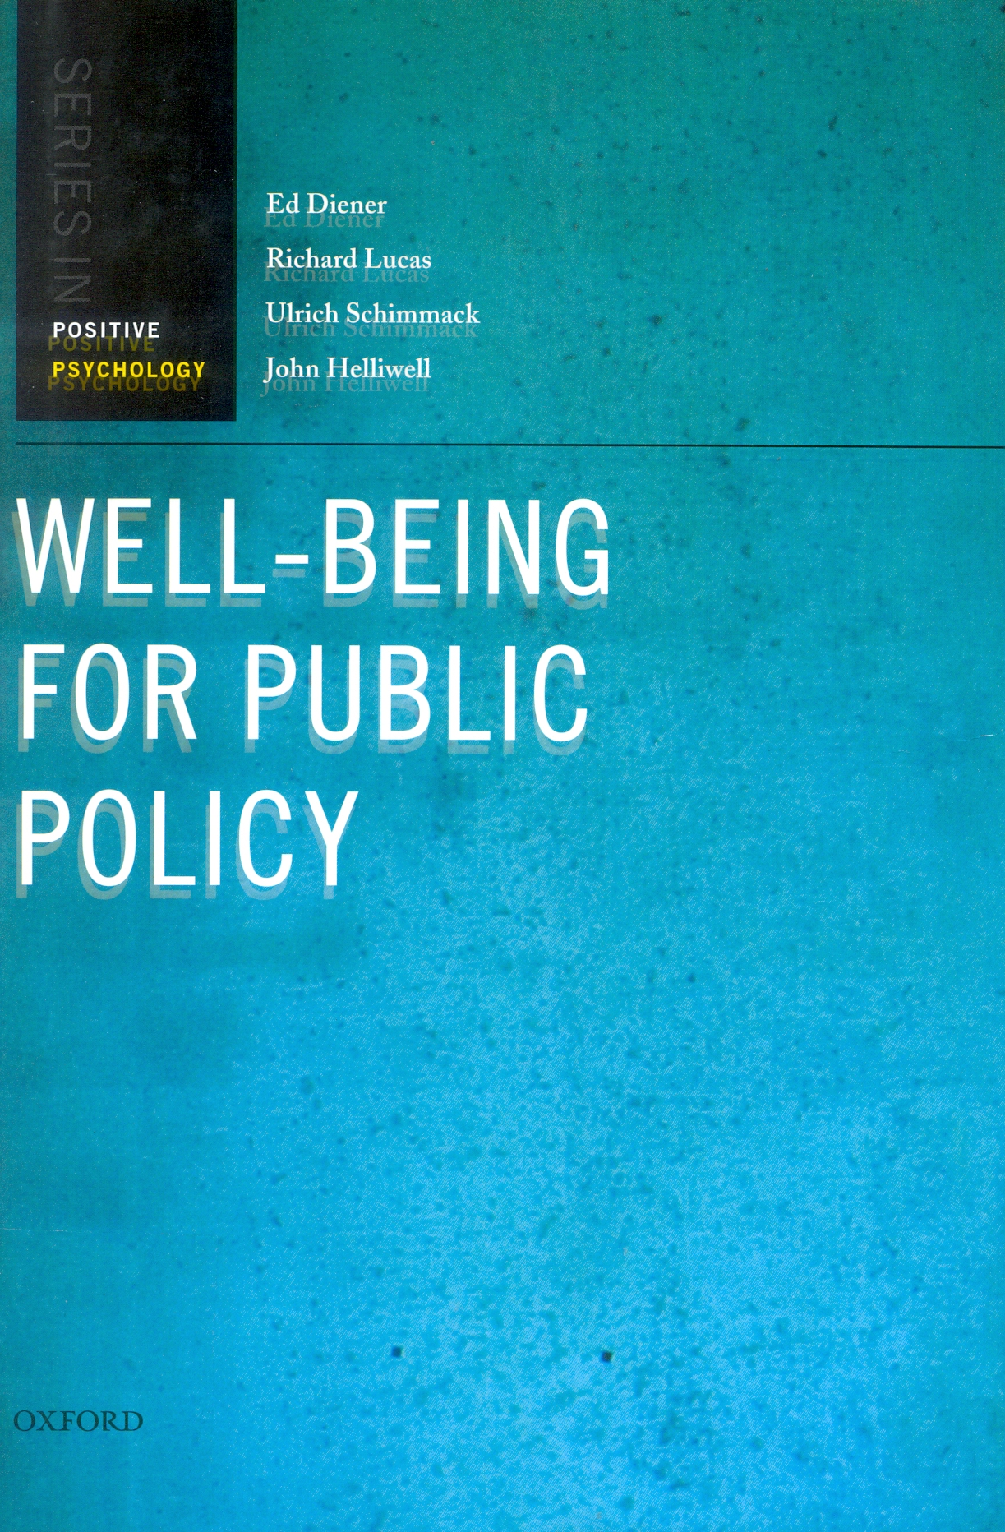
How Is It Going To Get There?
4
Better dissemination: Social media, public policy, organisations, schools.
International ‘Wellbeing and Public Policy’ conference series

Slide 48
How Is It Going To Get There?
4
Tailor wellbeing interventions better:
One-size-fits-all interventions
Authentic delivery
More experiential learning (activities)
More group based learning
Supportive environments for change
Better evaluation
Longer term impact (china)
Efficacy vs effectiveness
Selling false hope
Super charge them.

Slide 49
How Is It Going To Get There?
4
Step 1: Pair up with a partner, get a pen ready, as well as a blank A4 page…
Step 2: Raise a hand in the air when you're ready…
Step 3: Without looking down at your blank page, and ONLY looking at your partner’s face, you have 1 minute to draw a portrait of your partner, starting on the bell!
Step 4: Sign your name, date it, and swap pictures with your partner…

Slide 50
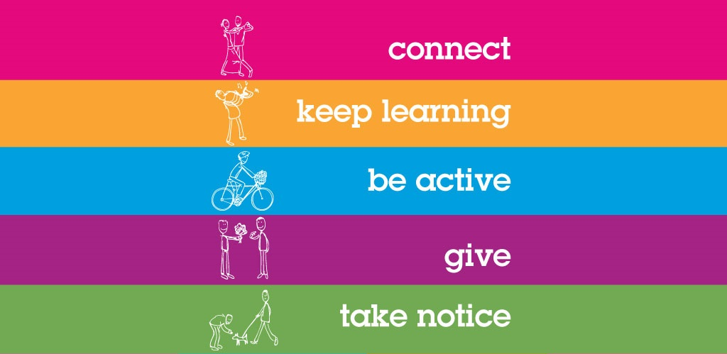
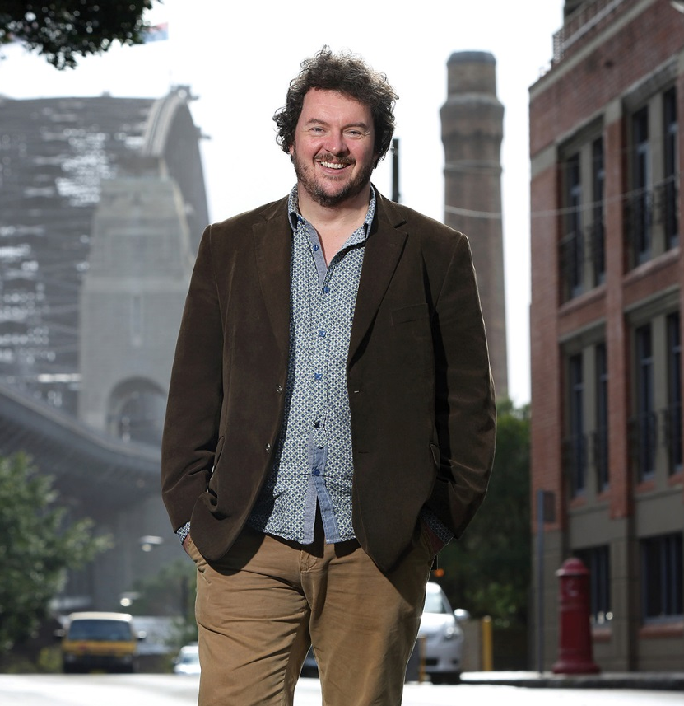
How Is It Going To Get There?
4
Credit to Nic Marks who invented this demonstration exercise.

Slide 51
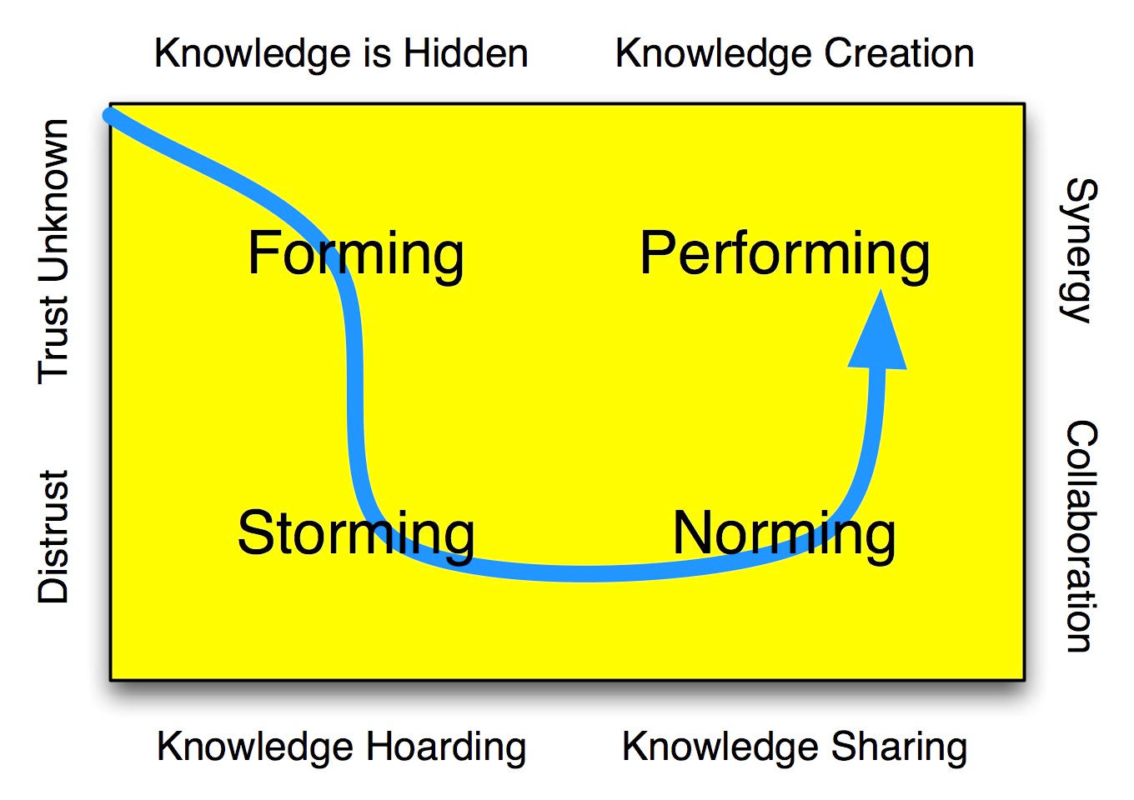
How Is It Going To Get There?
4
More collaborative plan:
We needed everyone in the room…
We need to understand how change happens - change management frameworks, and that change is always difficult, even if it is change for the better…
At the moment we have thrown things up in the air and don’t know where they are going to land…

Slide 52
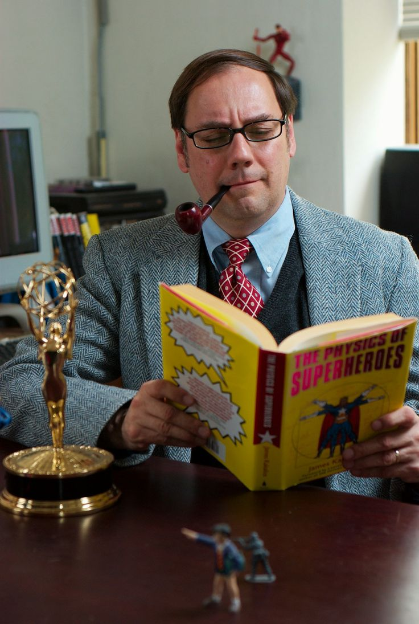
How Is It Going To Get There?
4
Address the critics, regardless of their bad fashion sense.

Slide 53
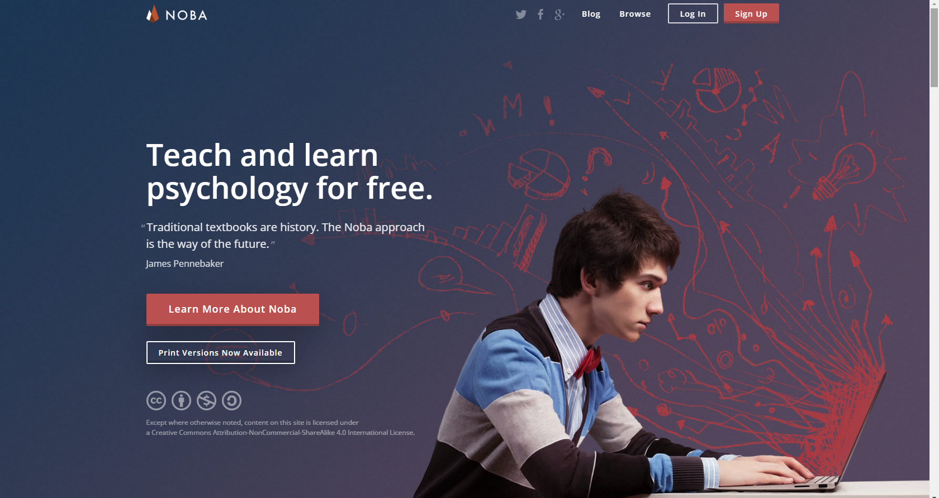
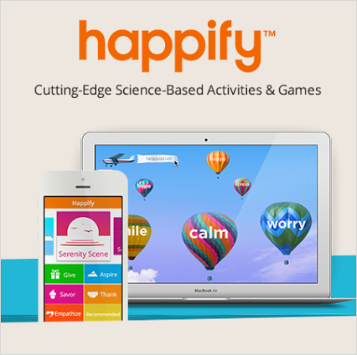
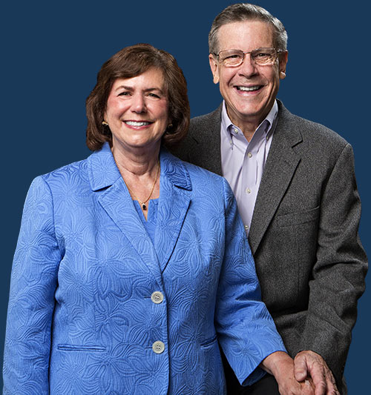
How Is It Going To Get There?
4
Become entrepreneurial and embrace technology:
E.g., Noba Project
E.g., Happify

Slide 54
How Is It Going To Get There?
4
Make some friends:
With the helping professions:
Slade, M., Oades, L., & Jarden, A. (2016). Wellbeing, recovery and mental health, Cambridge: Cambridge University Press.
Slade, Oades, and Jarden have fostered a long-overdue conversation within this book – between clinicians focusing on recovery, and positive psychologists focusing on well-being. Although the first group has traditionally focused on returning clients to baseline, the other group has tried to leave the baseline behind, for new heights of well-being. The upshot of the conversation is this: That the processes bringing recovery and the processes bringing well-being are much the same, though they have been focused on in isolation. – Ken Sheldon
With coaching psychologists:
Motivation theories can help us understand how to get the best out of ourselves and others – one of the essential goals of positive psychology.
With the social psychologists:
Just because they are fun to hang out with…
Also philosophers, sociologists and economists

Slide 55
How Is It Going To Get There?
4
So:
Simplifying messaging
Better studies - going beyond anecdotal evidence, and a focus on theory
Start a movement - beyond academia
More people (let’s teach it), more passion
Better dissemination: Media, public policy, organisations, schools
Tailor wellbeing interventions better: supercharge them, focus on the individual
More collaborative plan
Address the critics
Become entrepreneurial and embrace technology
Make some friends

Slide 56
We need to focus more on what success looks like for positive psychology
“
”

Slide 57
Summing up…
4
Peak-end theory (psychological heuristic) - Barbara Fredrickson & Daniel Kahneman
Peak-end theory states that people’s judgments of their overall experience (like of this 90 minute talk) is greatly influenced by the peak of their experience, and how it ends. It has to do with our memory of experiences…

Slide 58
Summing up…
4
About wellbeing:
The good life is best construed as a matrix that includes happiness, occasional sadness, a sense of purpose, playfulness, and psychological flexibility, as well autonomy, mastery, and belonging / connection.
It’s not just about learning to be more positive – it’s about using scientifically-informed tools and strategies to make our thinking more flexible, accurate, clear, and expansive. This thinking along with effort will lead to happiness and more healthy behaviours.

Slide 59
Summing up…
4
About wellbeing:
Zero to small correlation with happiness and life satisfaction:
Age
Gender
Social class
Income
Having children
Ethnicity
IQ
Physical attractiveness
Source: Peterson (2006)
Moderate to large correlation with happiness and life satisfaction:
Gratitude
Optimism
Being employed
Frequency of sexual intercourse
Self-esteem
Number of friends
Being married
Religiousness
Level of leisure activity
Physical health
Personality (conscientiousness, extraversion)
Internal locus of control

Slide 60
Summing up…
4
About wellbeing (my recipe):
Invest time and effort in family connections.
We are social creatures so be enmeshed in a community of friends - deep and meaningful relationships.
Know your personal values and live by them. Similarly, know your purpose and what derives meaning for you.
Know you strengths and find ways to exercise them every day.
Develop and optimistic thinking style.
Invest your money in experiences rather than things.
Be in work or study that you enjoy.
Be grateful.
Savour the now regularly – rather than the past or future.
Slow down and do less.
Be curious.
Look after your health (eat real food, exercise regularly, get sleep).

Slide 61
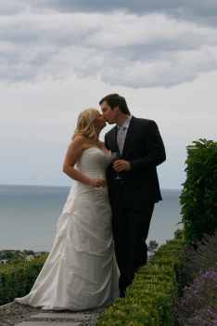
And of course good fashion sense

Slide 62
Summing up…
4
About positive psychology:
I think we have gone from “good” to “not good” to “not good enough” to “maybe, not bad”. There is still a long way to go to “awesome”.
There are many new areas of focus (the body, comfort addiction, etc.) that will come into the research agenda.
With regard to building a better future for the world and positive psychology, if we simplify our messaging, design better studies, teach about our topic more widely, go beyond academia, focus on how we disseminate our messages, tailor our interventions better, man-up to the critics, embrace technology, and make some conceptual friends, this is a good way to get there and make an impact.

Slide 63
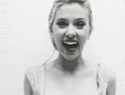
Summing up…
4
Let’s think big, be bold, be creative, be authentic, and most of all be collaborative.
Sure we all have problems, but there are a lot of things on the horizon to be optimistic about and hopeful for – both for humans and for positive psychology.
By now you are all as happy as ever and this has been a fantastic keynote – you’re as happy as Scarlett Johansson.

Slide 64
Dr Aaron Jarden aaron.jarden@aut.ac.nz www.aaronjarden.com

