Slide 1
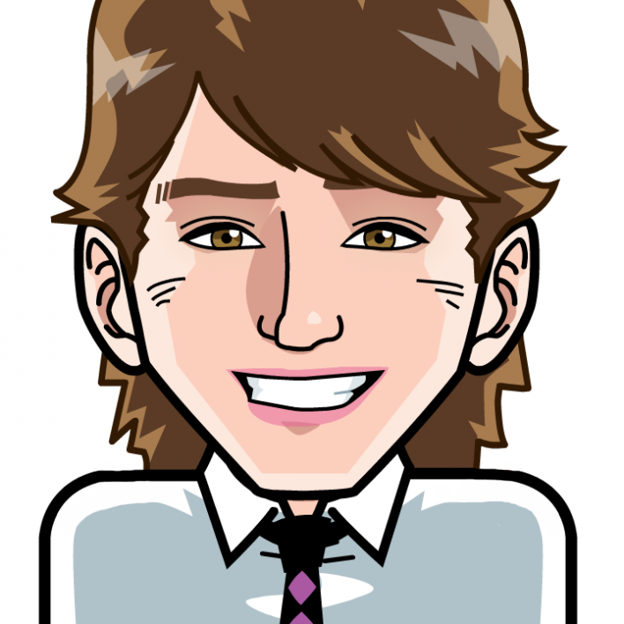
THE ESSENTIALS IN CULTIVATING A SUSTAINABLE WORKPLACE WELLBEING CULTURE
Dr Aaron Jarden
aaron.jarden@sahmri.com
29th November 2017
Corporate Health and Wellbeing Summit
Sydney
Copy of these slides at: www.aaronjarden.com
www.aaronjarden.com
www.wellbeingandresilience.com

Slide 2
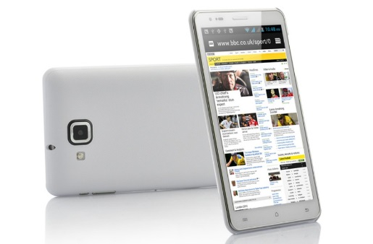
Housekeeping
Housekeeping.
Fire alarm or emergency…
Cell phones and checking email – make yourself at home…
Breaks – to the buzzer…
Respect and confidentiality…

Slide 3
Aims and expectations
Aims.
To have fun, relax, be creative, learn and share ideas and opportunities.
To facilitate and empower participants to develop and implement their wellbeing programs and plans, or be more informed when purchasing them (it may not be about a program, but infusing practices and systems).
To learn more about wellbeing science, positive psychological interventions, and positive organisational scholarship.
To provide the opportunity for relaxed networking.
Expectations.
Know stuff + do stuff (knowledge + experience).
Add tools, methods, strategies to your toolkit.
I don’t expect to get through all this content – Can’t really build a wellbeing program in one day…
I’m no expert in your wellbeing, your organisations wellbeing, and that wellbeing improvement is hard work – like losing weight. “Happiness is not a spectator sport”.
Realise that all change (even positive change) is hard and stressful.
This is not therapy, and I'm not a practicing psychologist.

Slide 4
Session 1: Background and content
Overview (90 mins).
What is wellbeing, and how is wellbeing different to wellness?
What is work wellbeing, and what are workplace wellbeing programs?
An overview of the main models and frameworks for wellbeing.
Why invest in wellbeing? Return on investment and the business case for wellbeing, including the resources and strategies you may need to convince decision makers.
Results and key findings for businesses from international workplace wellbeing research.

Slide 5
Wellbeing
What is wellbeing, and how is wellbeing different to wellness?
Always good to get clear about terms…
Mental health, mental illness, wellbeing, wellness, health.
Mental Health Commission of NSW. (2017). Wellbeing language and definitions guide 2017. Sydney, Mental Health Commission of NSW.
Some definitions emphasise feeling good, while others stress meaning, purpose or functioning well. Also flourishing (high levels of wellbeing).
The terms wellbeing, quality of life and happiness are often used interchangeably…

Slide 6
Wellbeing
What is wellbeing, and how is wellbeing different to wellness?

Slide 7
Work wellbeing
What is work wellbeing, and what are workplace wellbeing programs?
Work wellbeing is about the wellbeing of workers (employees) in a work setting.
Workplace wellbeing programs target the wellbeing of workers (although to be fair most are about “mental health”, which really means mental illness...).
What academies think vs. what people think…

Slide 8
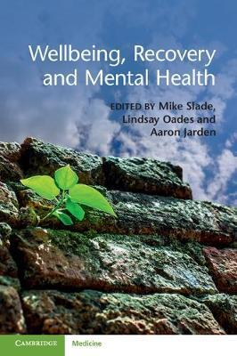
Work wellbeing
What is work wellbeing?
We are beginning to get some good research insights…

Slide 9
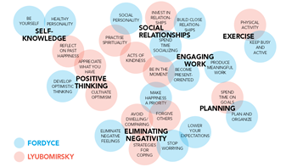
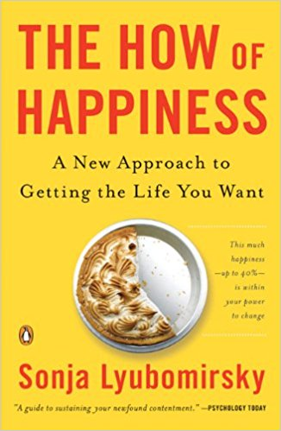
Frameworks and models
An overview of the main models and frameworks for wellbeing.
Fordyce lists 14 techniques as fundamentals:
Keep busy and be more active.
Spend more time socializing.
Be productive at meaningful work.
Get better organized and plan things out.
Stop worrying.
Lower your expectations and aspirations.
Develop positive, optimistic thinking.
Become present oriented.
Work on a healthy personality.
Develop an outgoing, social personality.
Be yourself.
Eliminate negative feelings and problems.
Close relationships are the number one source of happiness.
Put happiness as your most important priority.

Slide 10
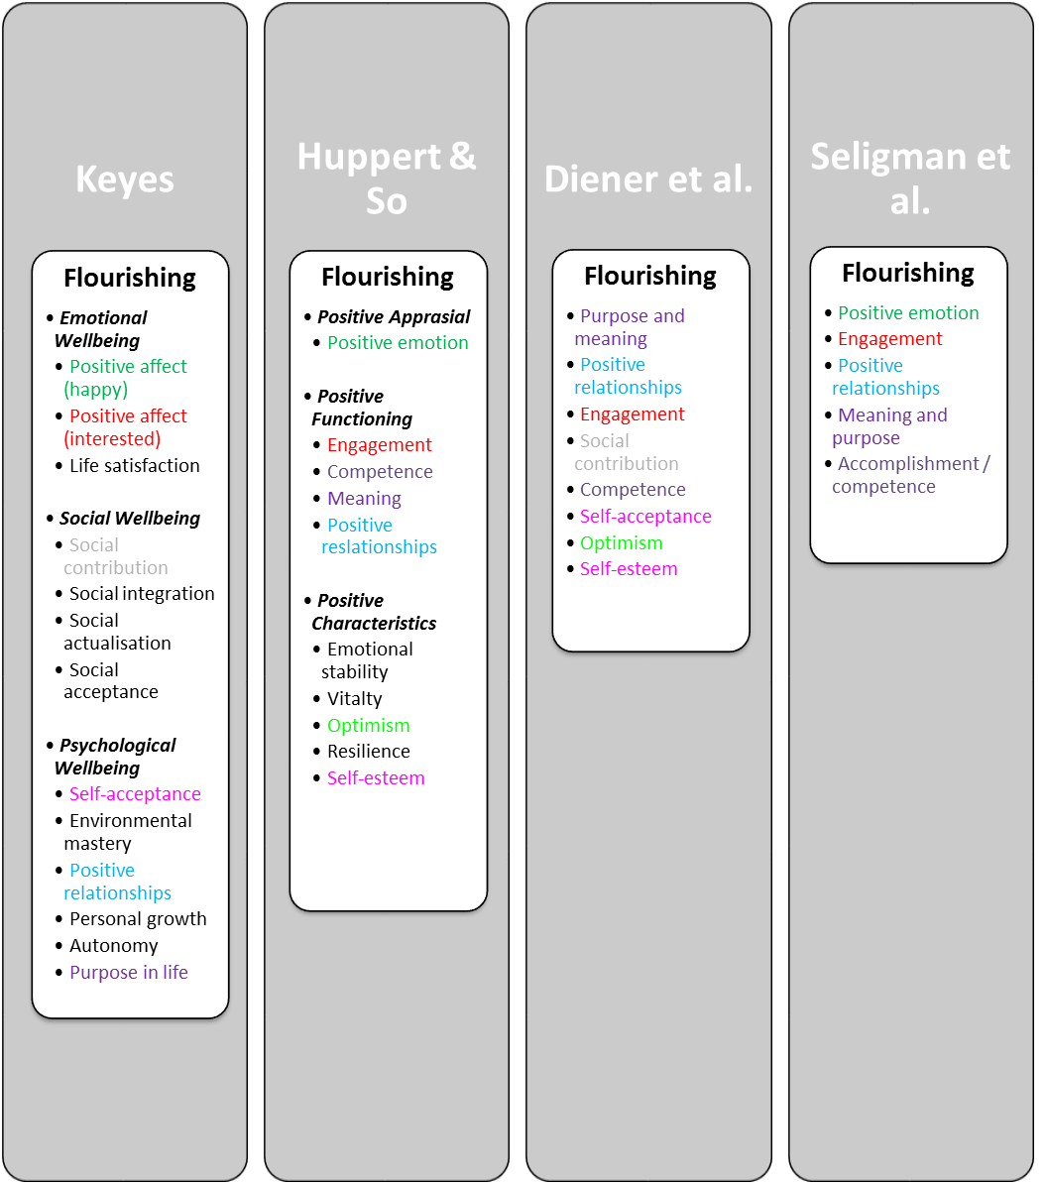
Frameworks and models
An overview of the main models and frameworks for wellbeing.
Hone, L., Jarden, A., Schofield, G. M., & Duncan, S. (2014). Measuring flourishing: The impact of operational definitions on the prevalence of high levels of wellbeing. International Journal of Wellbeing, 4(1), 62-90. doi:10.5502/ijw.v4i1.1

Slide 11
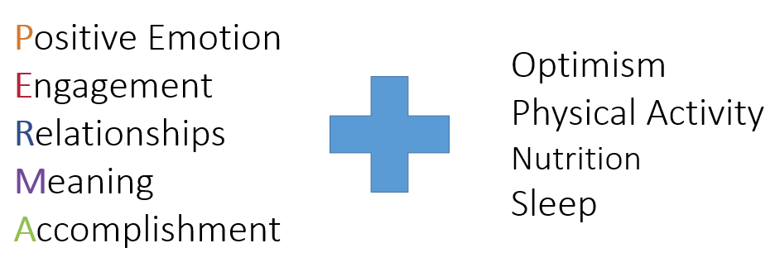
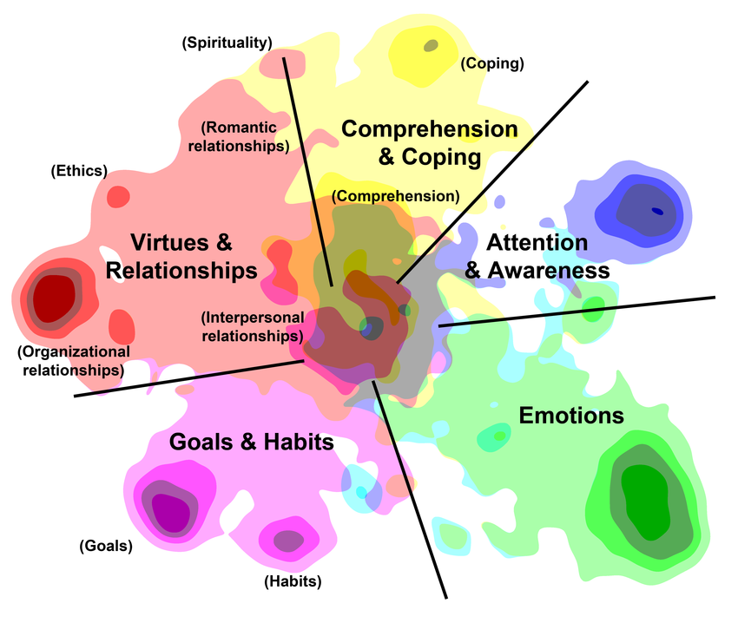
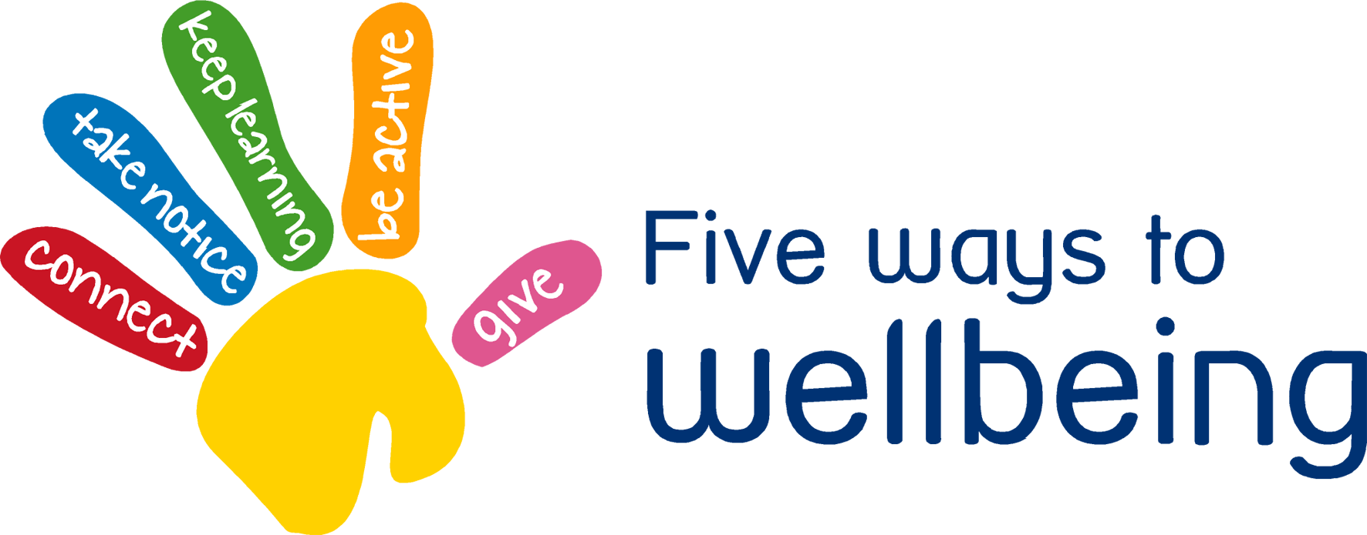
Frameworks and models
Wellbeing frameworks and models.
PERMA+
5 ways to wellbeing
Ten keys to happier living
5 domains of functioning

Slide 12
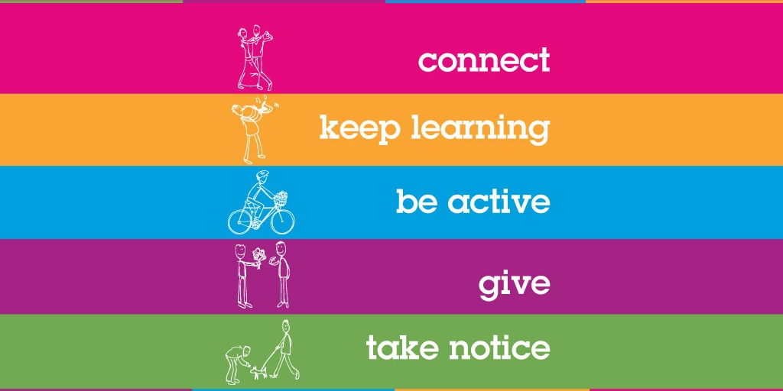
Ways to wellbeing
Pathways to wellbeing.
Step 1: Pair up with a different partner, get a pen ready, as well as a blank A4 page…
Step 2: Raise a hand in the air when you're ready…
Step 3: Without looking down at your blank page, and ONLY looking at your partner’s face, you have 1 minute to draw a portrait of your partner, starting on the bell!
Step 4: After the bell, when finished, sign your name, date it, and swap pictures with your partner…

Slide 13
Ways to wellbeing
Pathways to wellbeing.
Connect – Make connections with friends, family, colleagues and neighbours. When you build these connections they help enrich your life with new experiences and opportunities.
Be Active – Get moving. Walk, skip, run, dance – move your muscles. Exercise not only makes you feel good, it keeps you healthy. Pick a physical activity that you enjoy.
Take Notice – Be mindful. Be curious. Like a child, see the wonder and beauty of the world. Notice the things around you – the weather, the landscape, the mood and feelings of the people around you. In noticing you learn to appreciate the things that matter.
Keep Learning – We never stop learning. Keep trying something new – a new course you’ve been wanting to do or a more challenging task at work. Challenges keep us on our toes and increase our confidence and excitement in our day.
Give – Be generous with your time, your knowledge and your talents, giving to friends, family and even strangers. Be thankful, smile at people, and volunteer. Sharing to a wider audience gives you a greater reward than just doing things for yourself.

Slide 14
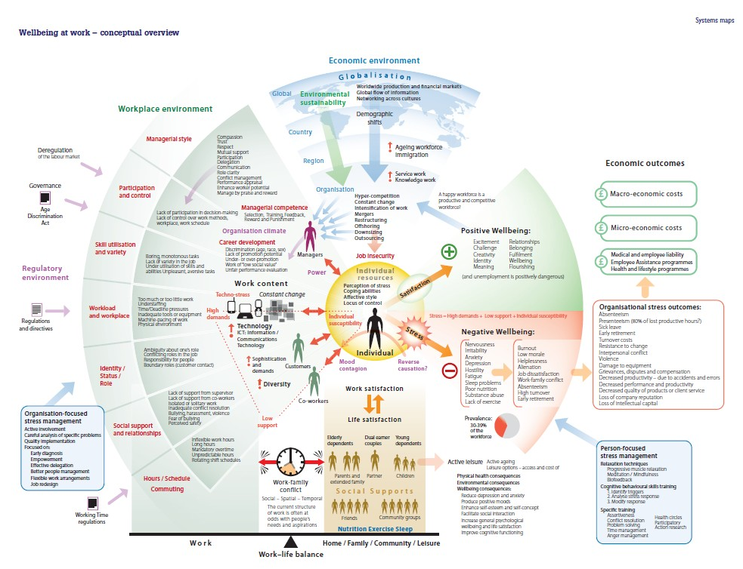
Frameworks
Wellbeing frameworks and models.
Work wellbeing.

Slide 15
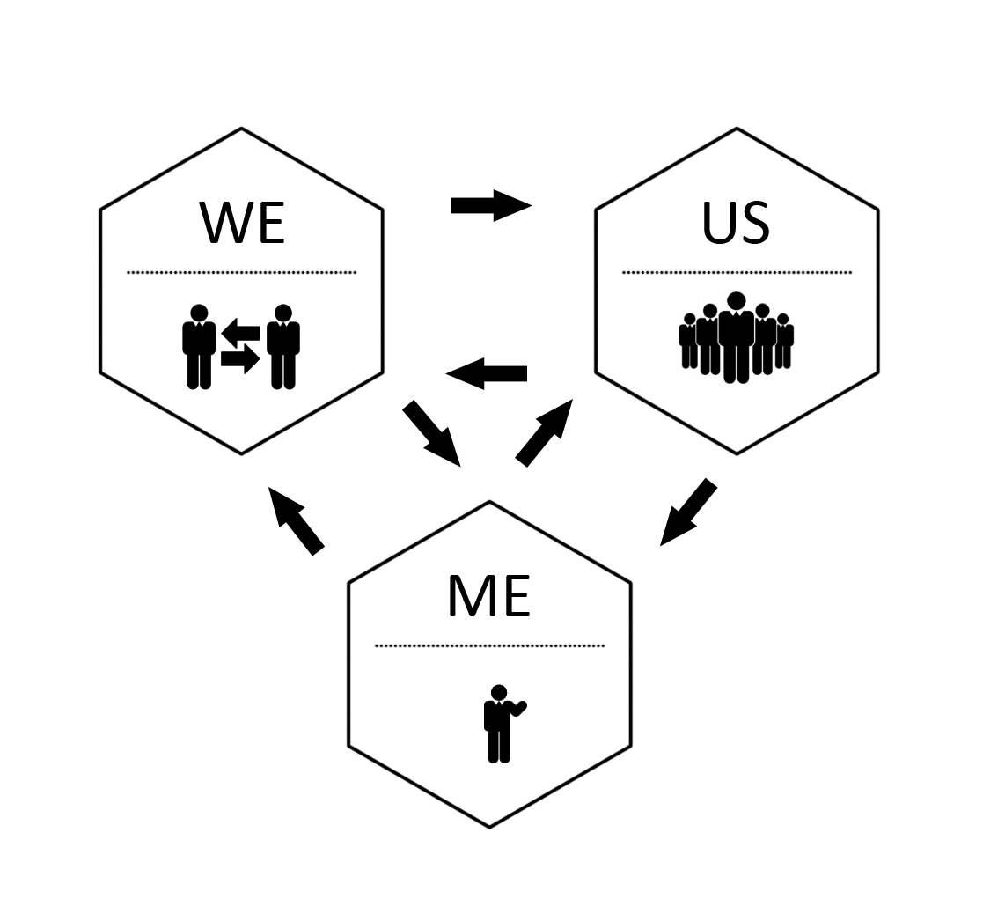
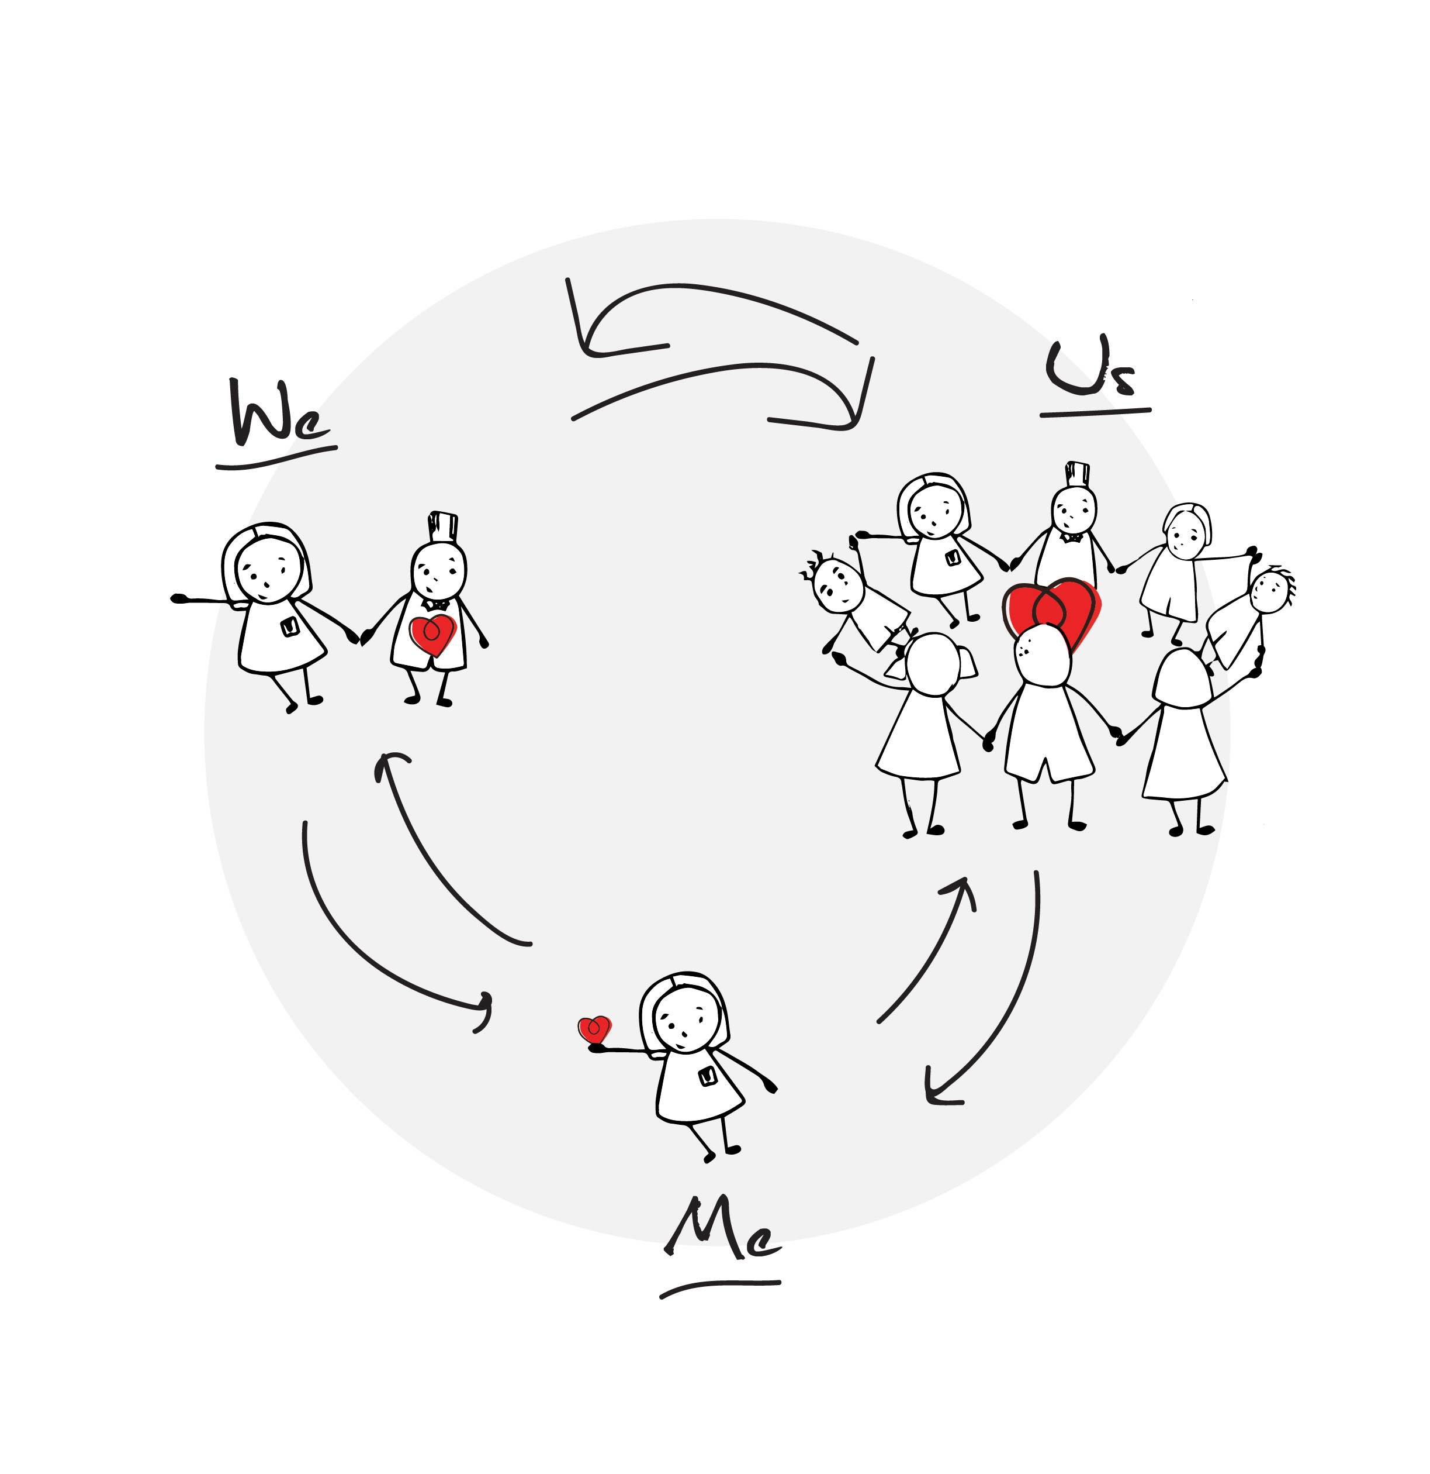
Frameworks and models
A wellbeing framework and models.
Me, We, Us.
Jarden, A., & Jarden, R. (2016). Positive psychological assessment for the workplace. In L. Oades et al. (Eds.), The Wiley-Blackwell Handbook of Positive Psychology at Work, pp. 415-437. Published Online: 19 Nov 2016: DOI: 10.1002/9781118977620.ch22
Embedding change must be holistic and systemic. All organizations are complex and dynamic systems, not simple and linear.

Slide 16
Frameworks and models
But really it’s about scientifically informed processes; not just content.
WRC LIMBER Framework.
Lead → Initiate → Measure → Build → Embed → Research
Most only build… And even then, a lot of the time this is pretty hit and miss and token…

Slide 17
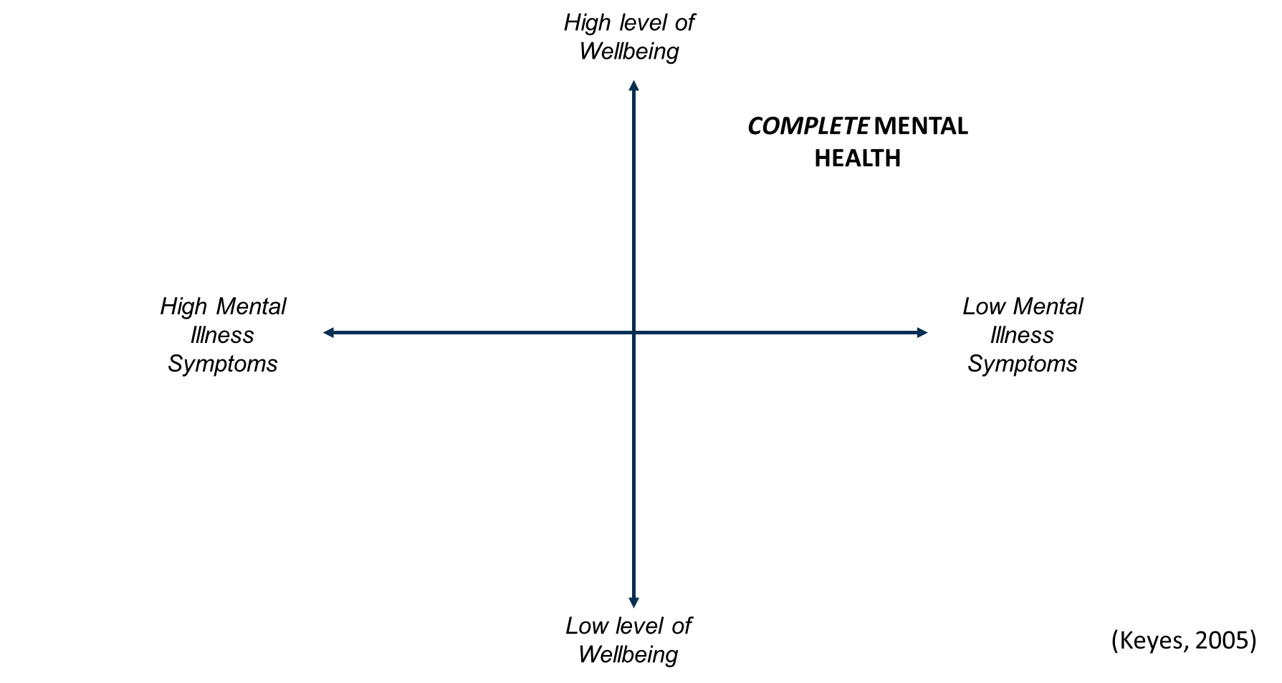
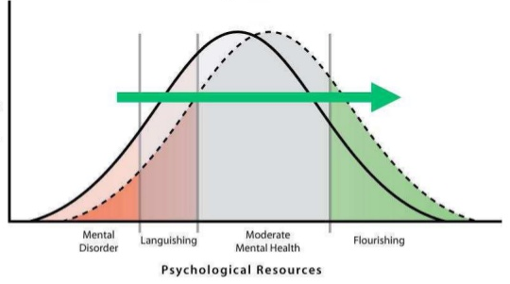
Frameworks and models
Old (current) perspective
What the data show

Slide 18
Quick break
Geelong Breathing.
Breath One. Take a deep breath in through your nose and fill your lungs with as much air as possible. As you are doing so, notice your physical body and any points of pain or tension. As you breath out slowly through your mouth, imagine you are pushing or releasing any tension away. Feel yourself sink into your chair or the floor if you are standing
Breath Two. Take a deep breath in through your nose and fill your lungs with as much air as possible. Now as you breathe out think about what you are grateful for right at this very moment. Not what you are grateful for that has happened in the past, or looking towards the future, but right in this very moment think about one thing you are grateful for and exhale slowly. Say to yourself “Right now I am grateful for...”.
Breath Three. Take a deep breath in through your nose and fill your lungs with as much air as possible. Now as you breathe out think about your frame of reference and what intentional state you want to be in right now. Do you intend to be kind? Do you intend to be open minded? Do you intend to be peaceful? Whatever intention you wish to have at this present moment, cultivate it when you exhale by saying to yourself “My intention right now is to be …”.
Credit: This exercise was developed by Justin Robinson, Head of Positive Education at Geelong Grammer School in Australia

Slide 19
Return on investment
Why invest in wellbeing? Return on investment and the business case for Wellbeing, including the resources and strategies you may need to convince decision makers.
Kavanagh, E., & Jarden, A. (September, 2017). The business case for organisational wellbeing: Literature review, (pp. 1-7). Wellbeing and Resilience Centre, South Australian Health and Medical Research Institute, Adelaide, Australia.
PricewaterhouseCoopers report that every organisational dollar invested into organisational mental health and wellbeing provides a return of approximately $2.30 – that is, for every dollar spent on successfully implementing an appropriate action towards creating a mentally healthy workplace, there is an average of $2.30 in benefits gained by the organisation (PwC, 2014).
As a rough guide, the most solid research on this issue related to wellbeing reports a range between two to nine dollars in return for every wellbeing dollar spent, with the average being about a 4-to-1 return. This return is largely through cost savings, improved productivity, and enhanced customer service.

Slide 20
Return on investment
Why invest in wellbeing? Return on investment and the business case for Wellbeing, including the resources and strategies you may need to convince decision makers.
Individual benefits:
Employees with high wellbeing display more energy at work, provide better customer service, play more effective roles in teams, are more creative, and are open to innovation, ideas and change (Lyubomirsky et al., 2005).
Organisational benefits:
Organisations with high wellbeing out compete their competitors, attract top talent, make more money than organisations with low wellbeing, and do better on the stock market than organisations without satisfied employees (Edmans, 2011).
Productivity:
A difference in productivity between high and low wellbeing employees can be as much as 30% (Page & Vella-Brodrick, 2009; Right Management, 2009). Furthermore, Oswald, Proto, and Sgroi (2009) reported a 12% increase in performance and productivity when an intervention to increase subjective wellbeing was used.
Reduce costs and manage risks:
Increasing employee wellbeing can reduce the cost of sick leave by 19% (Bertera, 1990).

Slide 21
Workplace wellbeing research
Results and key findings for businesses from international workplace wellbeing research.
Employees overall are unhappy; in western countries half of employee’s report being unhappy at work (Mercer, 2011).
In Australia, as few as 1,500 organizations (3.6% of the total workforce) provide formal, structured workplace health and wellbeing programmes (HAPIA, 2009).
Very few workplace measure wellbeing, and when it does happen, this assessment is typically superficial.
McCarthy, Almeida, and Ahrens (2011) reported that 46% of organizations implementing workplace wellbeing programs (in a sample of 319 HR professionals) did not evaluate their programs.
This is either a shocking picture or a picture of opportunity…

Slide 22
Workplace wellbeing research
Results and key findings for businesses from international workplace wellbeing research.
Indicators of a Thriving Workplace Survey, n = 5,017, April 2017
Citation: SuperFriend. Indicators of a Thriving Workplace Survey – A Work In Progress. Melbourne: SuperFriend; 2017.

Slide 23
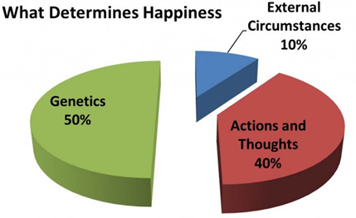
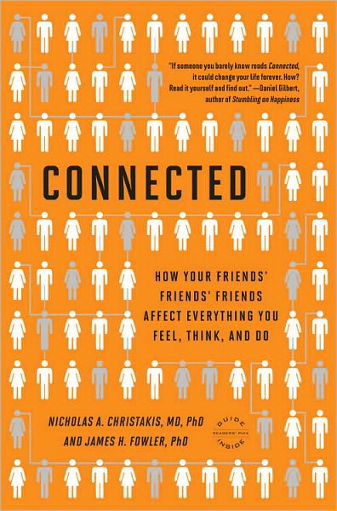
Workplace wellbeing research
Other research.
40% within your control, 10% circumstance, 50% genetic: so it is about choice.
Wellbeing spreads through social networks:
About 15%.
To 3 degrees of separation.

Slide 24
Session 1: Two key insights
Key insights.
1. _____________________________________________________________
2. _____________________________________________________________

Slide 25
Coffee

Slide 27
Session 2: Me (employee level)
Overview (90 mins).
Key strategies and skills to include at the employee level:
Character strengths.
Growth mindsets.
Gratitude.
Stress management techniques.
Useful explanatory framework – links between thoughts, feelings, and behaviours.
Encouraging individuals to take care of their own personal wellbeing and the tools to proactively arm them with.
Engaging hard to reach staff in your wellbeing program development and implementation.
Employee wellbeing across a multi-generational (including ageing), multicultural workforce.

Slide 28
Key strategies and skills for employees
Key strategies and skills to include at the employee level.
Character strengths.
Growth mindsets.
Gratitude.
Stress management techniques.

Slide 29
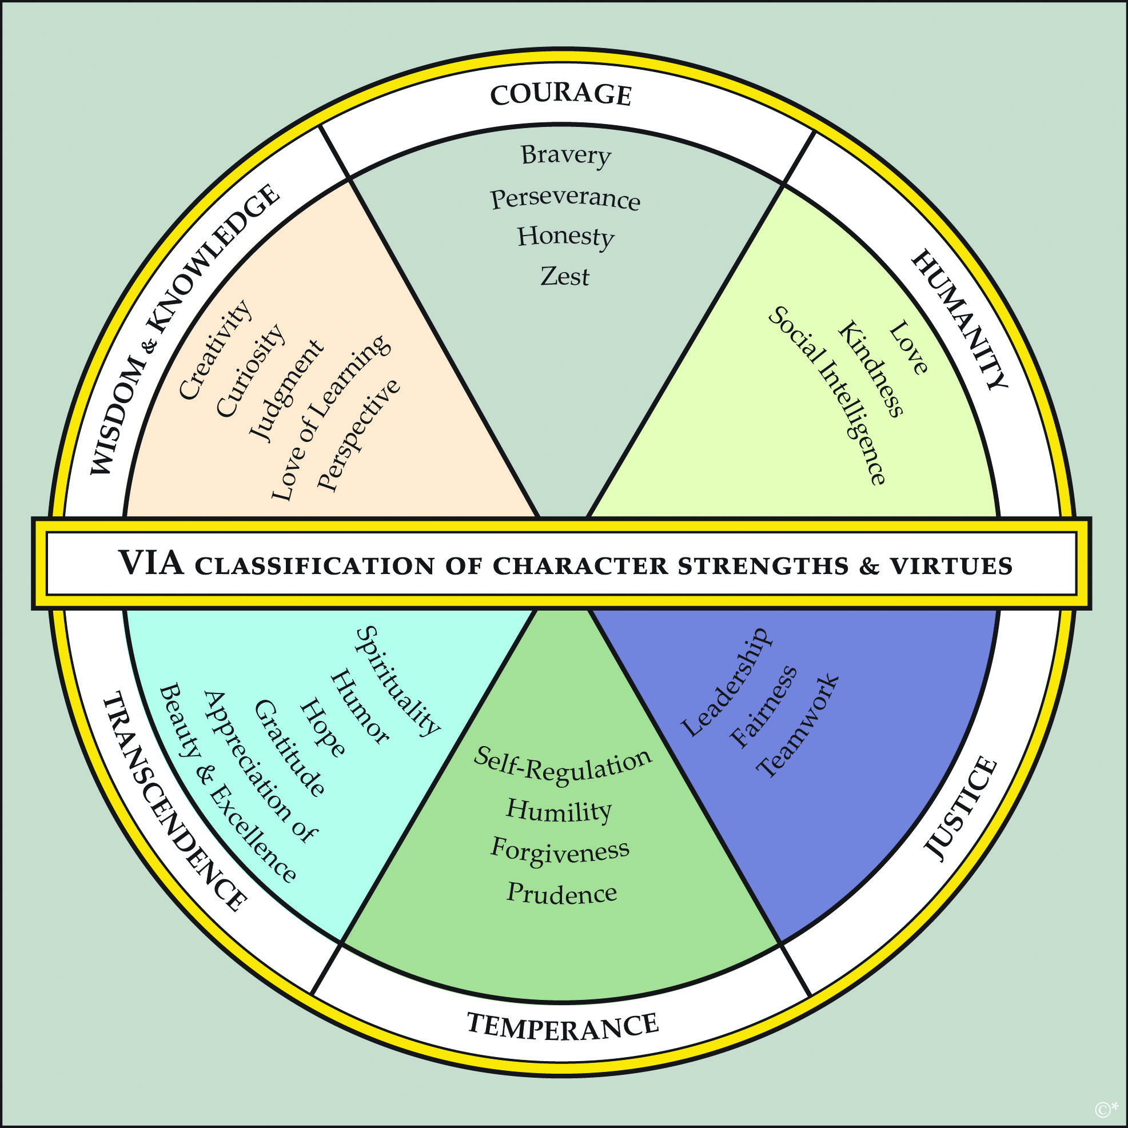
Key strategies and skills for employees
Strengths.
What are strengths?
Often we are excellent at knowing and naming our weaknesses (e.g., procrastination or spelling) but know little about our strengths (e.g., curiosity, kindness, or bravery).
Personal strengths are defined as a “natural capacity for behaving, thinking, or feeling in a way that allows optimal functioning and performance in the pursuit of valued outcomes”.
Another one is: “strengths are the things we are good at AND that energise us. This is the first mistake people make, because traditionally we have thought that strengths are simply the things we are good at”.

Slide 30
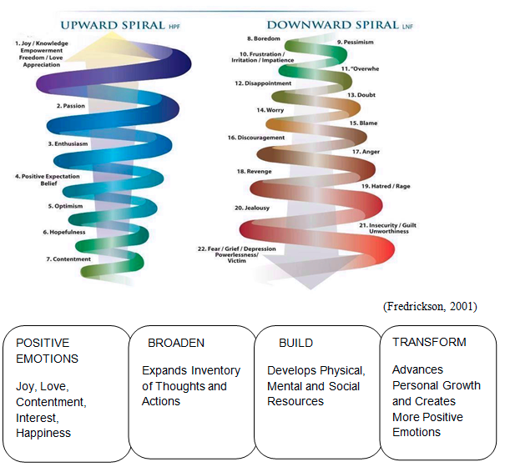
Key strategies and skills for employees
Strengths.
Benefits of strengths use. Strengths use is related to a number of beneficial outcomes for individuals and organisations, including:
Greater wellbeing.
Higher levels of energy or vitality.
Less depression and stress.
Greater achievement, and more likely to achieve goals.
Greater authenticity (i.e., the sense that I am being myself, rather than living a life that isn’t mine).
More positive emotions, which leads to a broadened mindset and building of resources.
Greater resilience and the ability to deal with the after-effects of negative events.

Slide 31
Key strategies and skills for employees
Strengths.
Prevalence of strengths.
Most common = kindness, farness, honesty, gratitude, judgment.
Least common = prudence, modesty, self-regulation.
In relation to wellbeing, curiosity, gratitude, hope, love, and zest related to life satisfaction.

Slide 32
Key strategies and skills for employees
Key strategies and skills to include at the employee level.
First measurement of character strengths. This is a 120 question survey and takes on average about 20 minutes to identify your top strengths.
https://www.viacharacter.org/www/Research/VIA-Character-Strengths-in-the-Workplace

Slide 33
Key strategies and skills for employees

Slide 34
Key strategies and skills for employees
Key strategies and skills to include at the employee level.
Strengths lens.
https://www.workonwellbeing.com/strengths
“Your task is to learn about that particular strength, and then as you go about your day, see if you can apply that particular strength more. For this exercise we want you to view your day through the lens of a new character strength each day”.

Slide 35
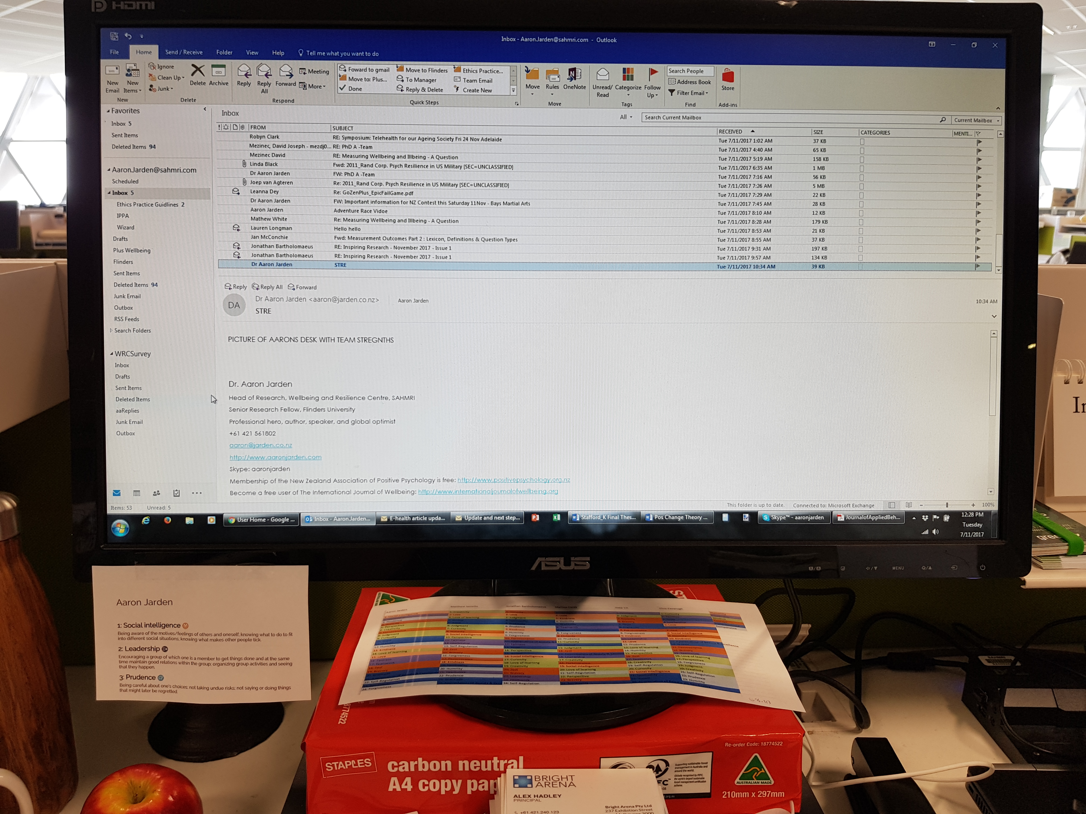
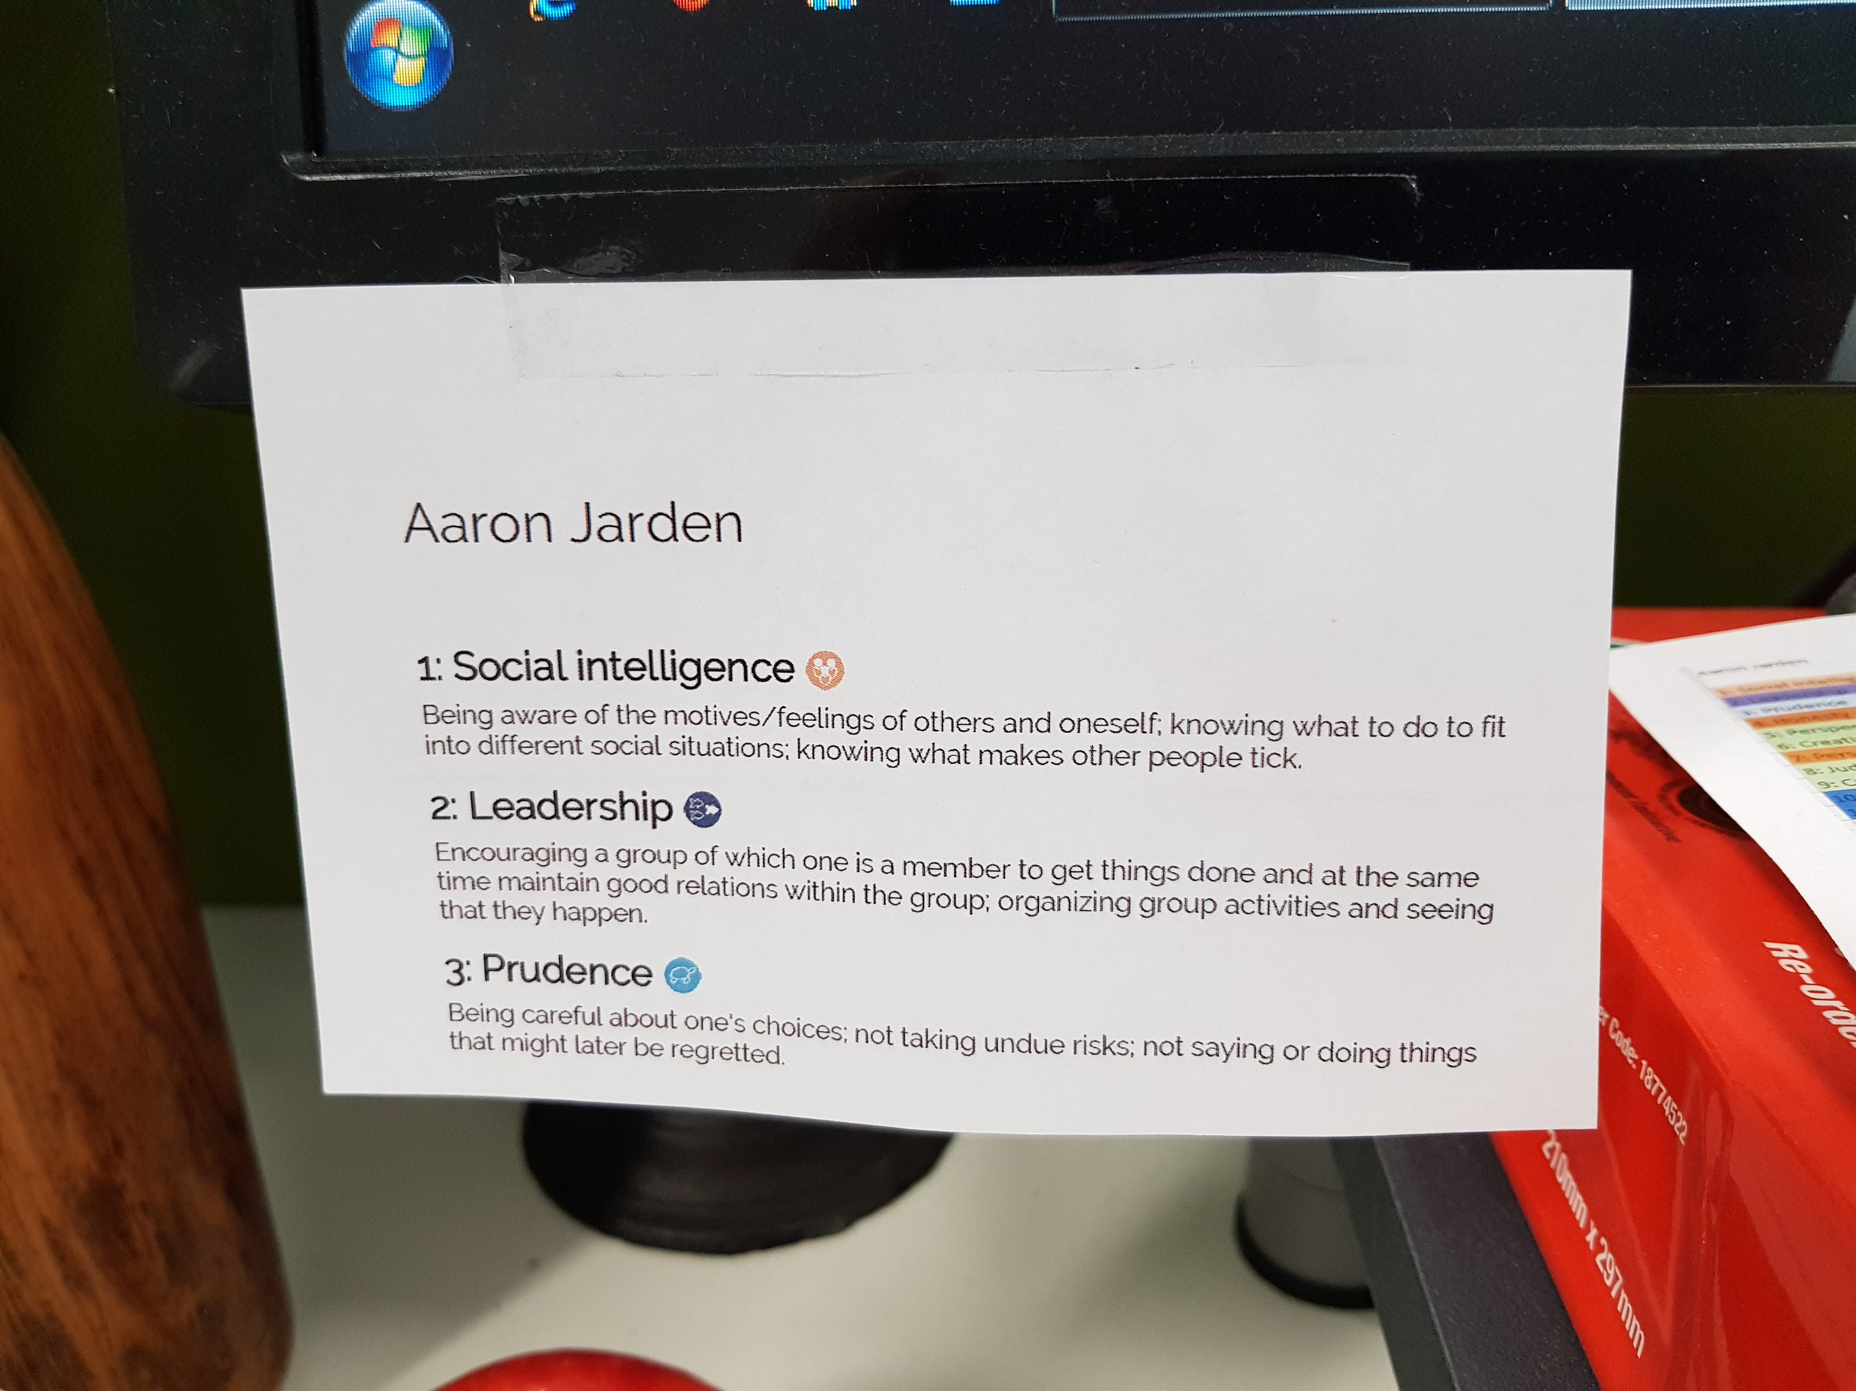
Key strategies and skills for employees
Key strategies and skills to include at the employee level.
Team strengths.

Slide 36
Key strategies and skills for employees
Key strategies and skills to include at the employee level.
Team strengths.

Slide 37
Key strategies and skills for employees
Key strategies and skills to include at the employee level.
Now that you have identified some of your signature strengths, plan to use them more and in new ways over the coming week. Think about how you can use them in different areas of your life, and with the different people you come into contact with. The aim is to use the right strength, in the right amount, in the right situation…
Bonus challenge: Focus on using the strengths of curiosity, hope and optimism, gratitude, zest and energy, and the capacity to love and be loved more. These strengths in particular have been linked to greater wellbeing.

Slide 38
Key strategies and skills for employees
Key strategies and skills to include at the employee level.
Work on Wellbeing resources.

Slide 39
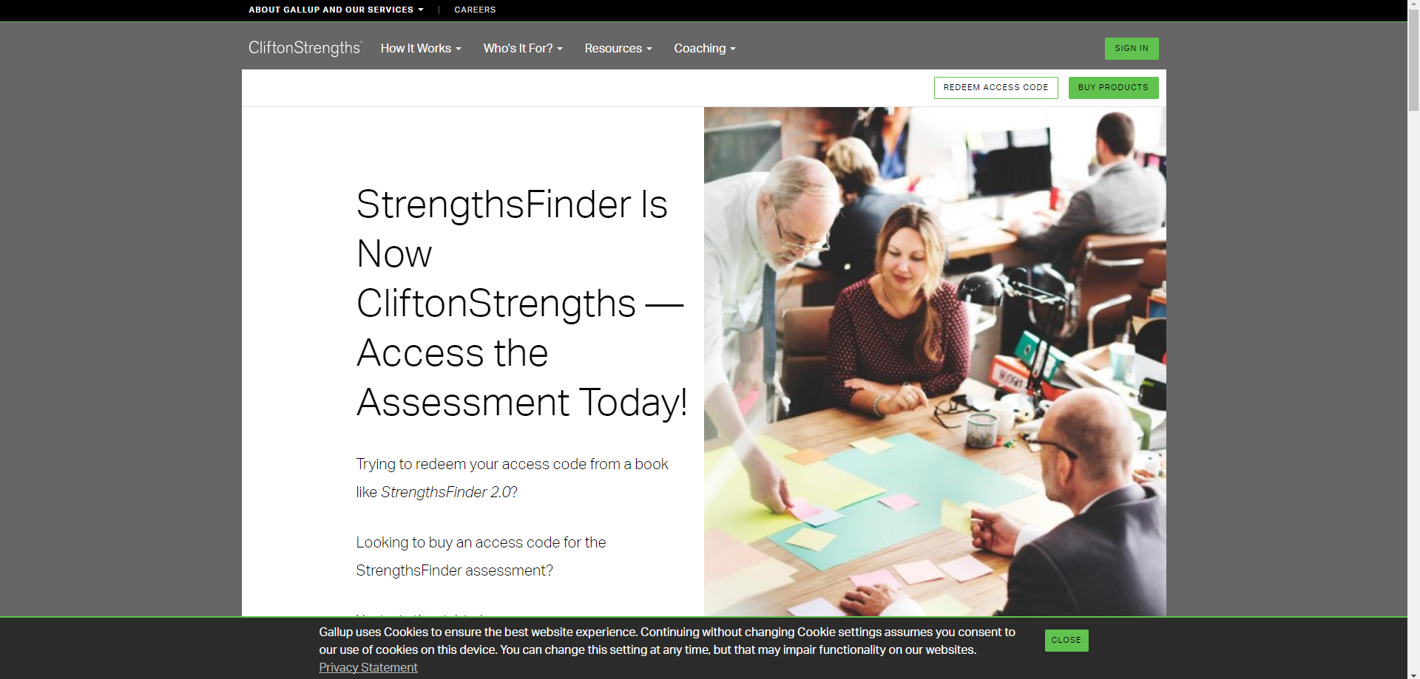
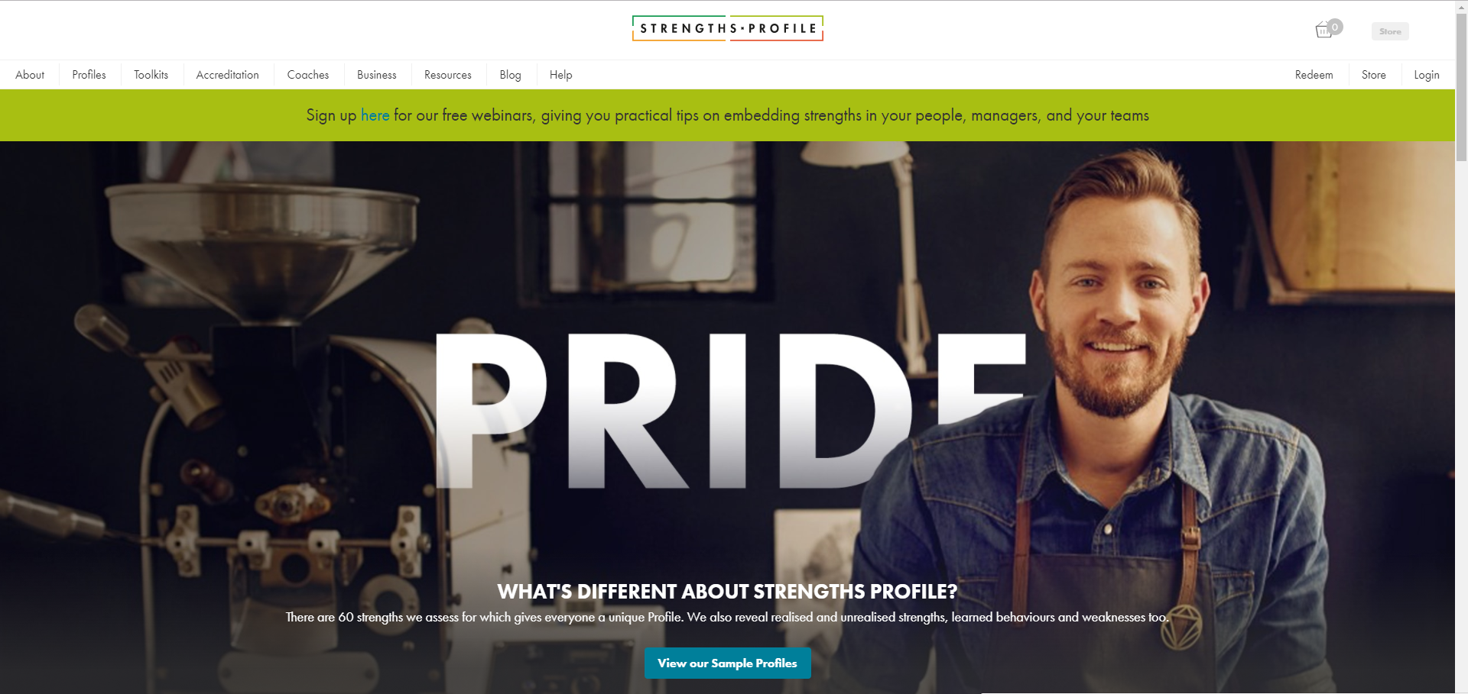
Key strategies and skills for employees
Key strategies and skills to include at the employee level.
There are other strengths models to consider… All nice and shiny, definitely expensive…
The Strengths Profiler: https://www.strengthsprofile.com
StrengthsFinder: https://www.gallupstrengthscenter.com

Slide 40
Quick break
Geelong Breathing.
Breath One. Take a deep breath in through your nose and fill your lungs with as much air as possible. As you are doing so, notice your physical body and any points of pain or tension. As you breath out slowly through your mouth, imagine you are pushing or releasing any tension away. Feel yourself sink into your chair or the floor if you are standing
Breath Two. Take a deep breath in through your nose and fill your lungs with as much air as possible. Now as you breathe out think about what you are grateful for right at this very moment. Not what you are grateful for that has happened in the past, or looking towards the future, but right in this very moment think about one thing you are grateful for and exhale slowly. Say to yourself “Right now I am grateful for...”.
Breath Three. Take a deep breath in through your nose and fill your lungs with as much air as possible. Now as you breathe out think about your frame of reference and what intentional state you want to be in right now. Do you intend to be kind? Do you intend to be open minded? Do you intend to be peaceful? Whatever intention you wish to have at this present moment, cultivate it when you exhale by saying to yourself “My intention right now is to be …”.
Credit: This exercise was developed by Justin Robinson, Head of Positive Education at Geelong Grammer School in Australia

Slide 41
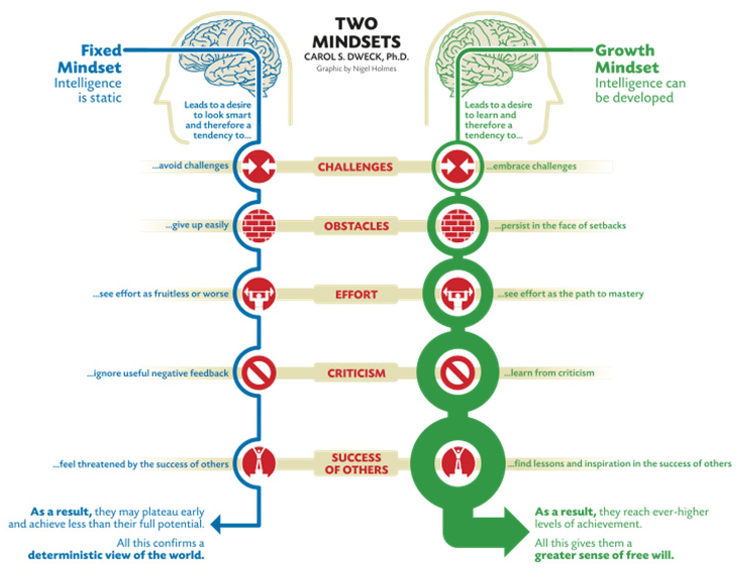
Key strategies and skills for employees
Growth mindsets
Mindsets are beliefs about yourself and your most basic qualities, such as your intelligence, talents, or personality.
Fixed Mindset individuals believe that their basic qualities, such as intelligence, talent and personality, are fixed traits that don’t and can’t change.
Growth Mindset individuals believe that their basic qualities can be cultivated and developed across the life span through dedicated effort.
One of the keys to success isn’t having greater amounts of innate intelligence, talent or ability; it’s whether you look at these qualities as things that can be developed through dedication and effort.

Slide 42
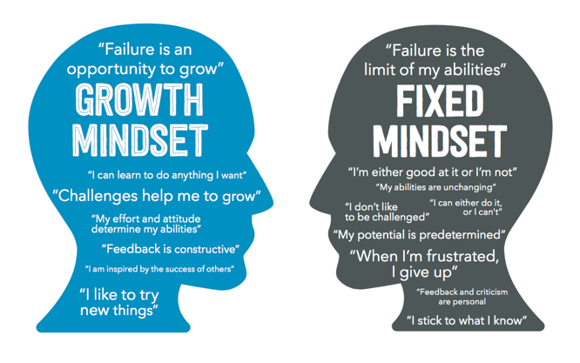
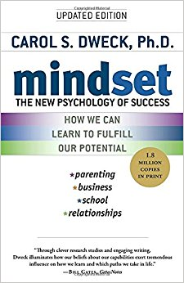
Key strategies and skills for employees
Growth mindsets.
Aim to use process-oriented praise, rather than person-oriented praise, with yourself and others:
Process-orientated praise, such as “you put in a lot of effort” or “that was a good strategy you chose”, emphasises that achievement comes from striving and the use of effective strategies. It also allows others to interpret setbacks in terms of lack of effort, or inappropriate strategies.
Person-orientated praise, such as “you are so smart”, emphasises innate talents and abilities. It assumes that success is due to personal attributes and teaches others to interpret difficulties in terms of their personal weaknesses.

Slide 43
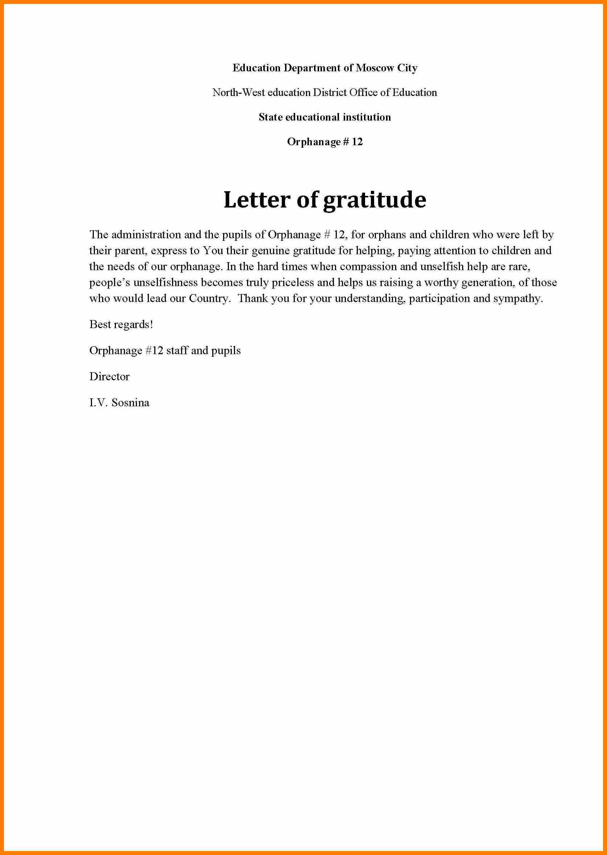
Key strategies and skills for employees
Gratitude.
A lot of research on “three good things”.
Chopik, W. J., Newton, N. J., Ryan, L. H., Kashdan, T. B., Jarden, A. (2017). Gratitude across the life span: Age differences and links to subjective well-being . Journal of Positive Psychology.
“Your task is to take some regular time each day to think of three things you are thankful for. These can be big things, such as good health, supportive relationships, and career successes, or little things such as a perfect cup of coffee or hearing your favourite song on the radio. Write down three things at the end of each day for a week, and aim to write new items each time. The aim is for you to take the time to be thankful for aspects of your life that may go unnoticed”.
Gratitude letter.

Slide 44
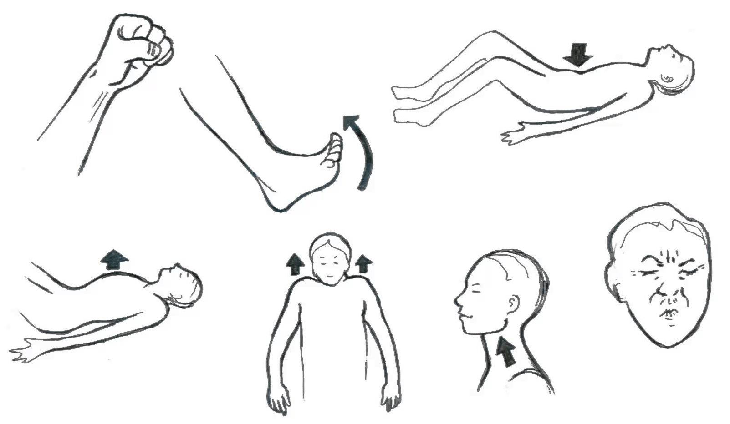
Key strategies and skills for employees
Key strategies and skills to include at the employee level.
Stress management techniques.
Progressive muscle relaxation.
Breathing exercises.
Meditations – guided imagery.
Mindfulness.
Yoga.
Exercise.
There are lots, but do people use them?

Slide 45
The cognitive model
Useful explanatory framework – links between thoughts, feelings, and behaviours.
The fundamental interconnectedness of all things holistic...

Slide 46
Proactive personal wellbeing
Encouraging individuals to take care of their own personal wellbeing and the tools to proactively arm them with.
Lead by example – senior leadership work / life balance.
Showcase examples of individuals thriving at work.
“What does a good day at work look like?”
Individuals use individual level assessment information (usually absent).
Wellbeing and resilience programs.
Wellness and mental illness programs.
Online solutions:

Slide 47
Engaging hard to reach staff
Engaging hard to reach staff in your wellbeing program development and implementation.
Co-design & co-create.
Empower others.
Building your champions…
Gamification and fun.
“What does a good day at work look like?” – particular relevant for disengaged staff.

Slide 48
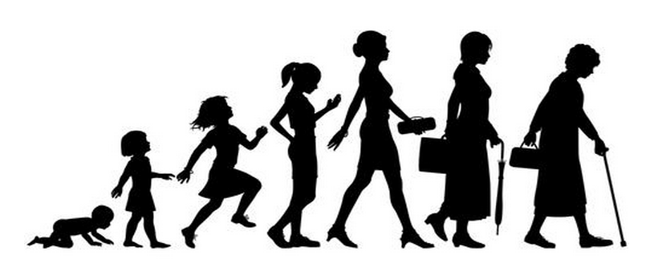
Multi-generational & multicultural workforce
Employee wellbeing across a multi-generational (including ageing), multicultural workforce.
Wellbeing is beneficial for all ages and cultures…
There are not a lot of important differences… (except some cultures more social)
Relationships and meaning/purpose have the biggest impacts…

Slide 49
Session 2: Two key insights
Key insights.
1. _____________________________________________________________
2. _____________________________________________________________

Slide 50
Lunch

Slide 52
Session 3: We (relational level)
Overview (90 mins).
Key strategies and skills to include at the relational level:
Job crafting.
Positive leadership.
High quality connections.
Positive communication (e.g., active constructive responding & techniques for challenging communication).

Slide 53
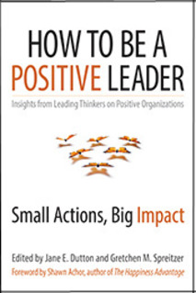
Mangers and teams
Relational level.
You and your boss… (employees and managers).
Job crafting.
Positive leadership.
You and your team… (employees and collogues).
High quality connections.
Positive communication.

Slide 54
Job crafting
Crafting.
It’s a bottom-up, employee led, approach about redesigning your job to better suit your values, strengths, and passions.
Objective is a more optimal fit between you and your job, boosting your happiness and effectiveness at work.
Connections go up, self-image goes up, sense of autonomy goes up (Self Determination Theory).
Work with your manager:
What tasks can you change in your job? – add some, take some away?
What relationships can you change in your job?
Can you change the perception of your job and the tasks you do? – create meaning?
Think about your values, strengths, and passions in your job specifically and the tasks you do. How can you change your tasks to better reflect your values, strengths, and passions?

Slide 55
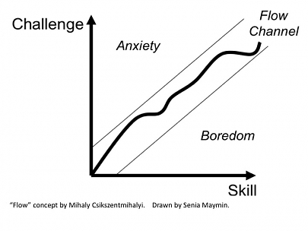
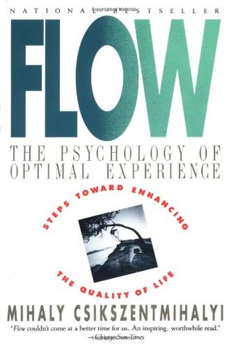
Job crafting
Crafting for flow.
Mihaly Csikszentmihalyi.

Slide 56
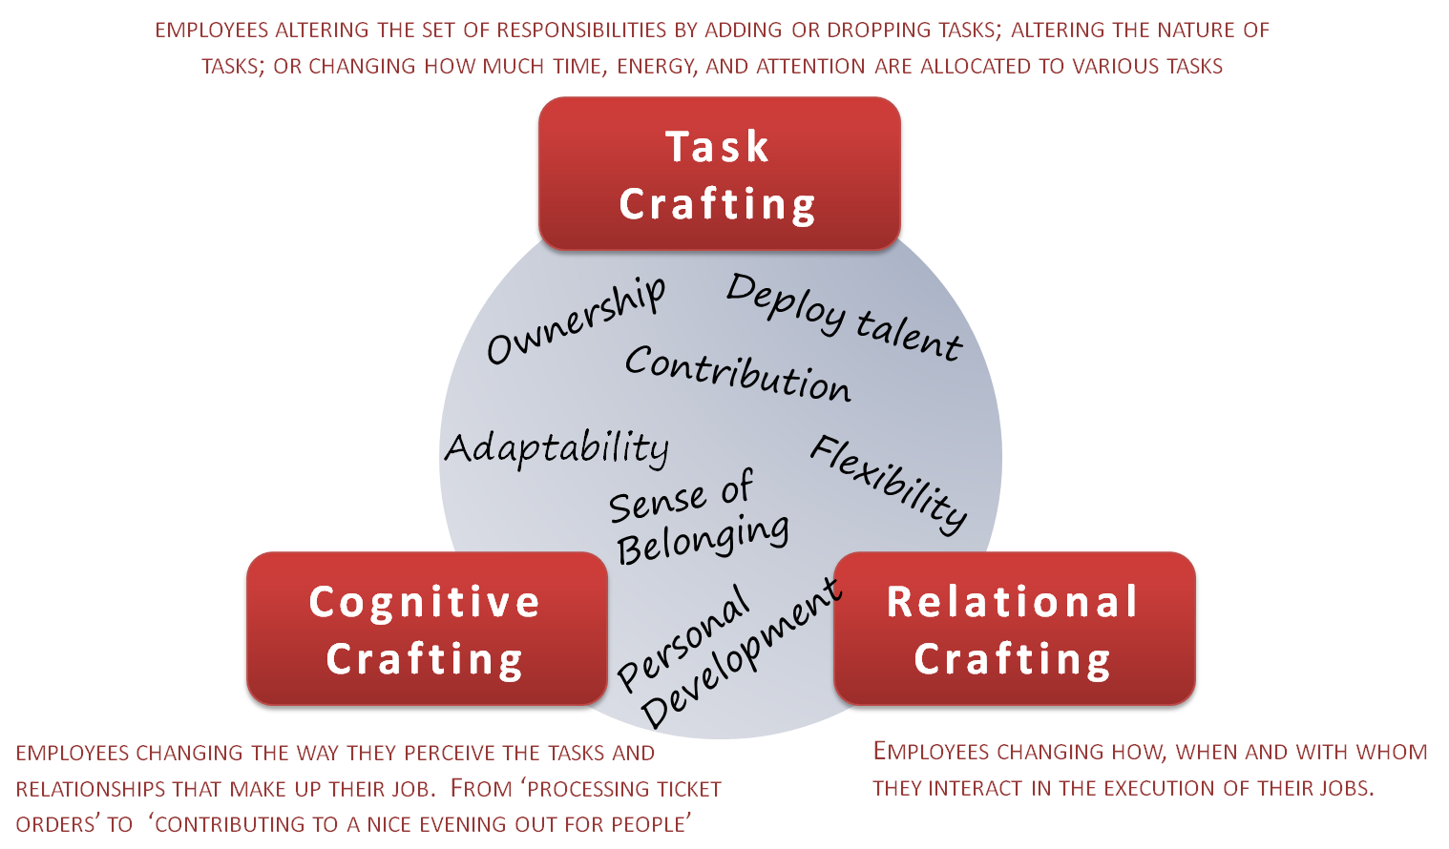
Job crafting
Crafting.
Pair up, one person be a line manager and the other person initiate a conversation about job crafting during a performance appraisal.

Slide 57
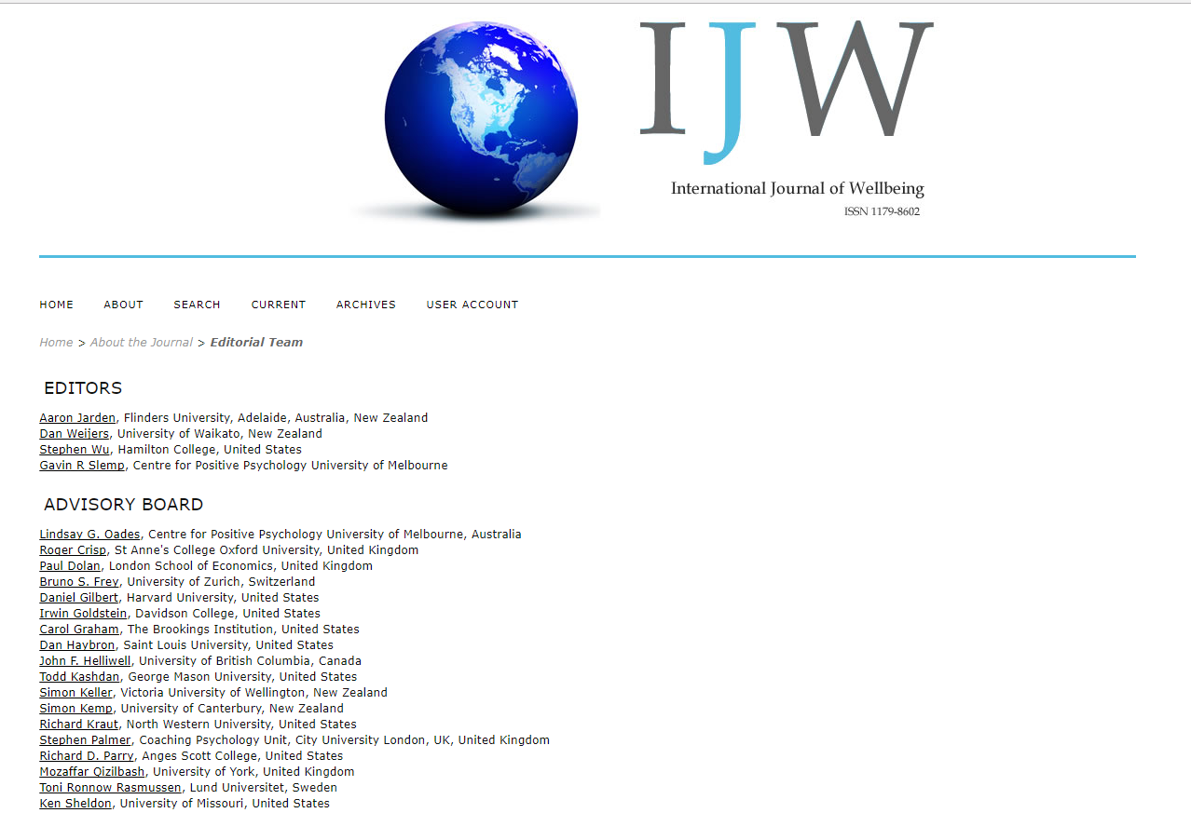
Job crafting
Crafting.
http://positiveorgs.bus.umich.edu/wp-content/uploads/What-is-Job-Crafting-and-Why-Does-it-Matter1.pdf
Also google Gavin Slemp: gavin.slemp@unimelb.edu.au

Slide 58
Quick break
Geelong Breathing.
Breath One. Take a deep breath in through your nose and fill your lungs with as much air as possible. As you are doing so, notice your physical body and any points of pain or tension. As you breath out slowly through your mouth, imagine you are pushing or releasing any tension away. Feel yourself sink into your chair or the floor if you are standing
Breath Two. Take a deep breath in through your nose and fill your lungs with as much air as possible. Now as you breathe out think about what you are grateful for right at this very moment. Not what you are grateful for that has happened in the past, or looking towards the future, but right in this very moment think about one thing you are grateful for and exhale slowly. Say to yourself “Right now I am grateful for...”.
Breath Three. Take a deep breath in through your nose and fill your lungs with as much air as possible. Now as you breathe out think about your frame of reference and what intentional state you want to be in right now. Do you intend to be kind? Do you intend to be open minded? Do you intend to be peaceful? Whatever intention you wish to have at this present moment, cultivate it when you exhale by saying to yourself “My intention right now is to be …”.
Credit: This exercise was developed by Justin Robinson, Head of Positive Education at Geelong Grammer School in Australia

Slide 59
Positive leadership
Positive leadership.
Small actions can have a big impact. A “thank you” three times more powerful than a pay rise.
A positive leader’s roll is to move people from a normal trajectory to an extraordinary trajectory. Be the best you can be...
All great leaders have High Quality Connections (HQC’s).
All align organisations purpose to the individual’s purposes…
Have a vision which is – simple, idealistic, visual, long-term, challenging, realistic.
What is positive and good leadership – exemplar stories?
Remember that every business is going through change, stress, high workload, with limited resources. The competitive advantage is employees who are positive, flexible, proactive, and can think.
Circle your top 3 leadership quotes…

Slide 60
High quality connections
High quality connections.
When was the last interaction at work that “lit you up” – that was a HQC.
People feel attuned and a sense of worth.
Benefits of HQC form page 12 of positive leadership book.
Type of actions or pathways to HQC’s:
Respect others – show them they are important. A good way is through being present. Effective listening – micro skills. Empathy.
Task enable others – facilitate others successes. Encourage, guide, support.
Trust others – don’t over monitor and control.
Play – team building (Wellbeing Adventure Race), volunteering.
Let’s talk about exemplars of the above 4 types of actions you have seen?
My own view is that listening is the source of great leadership…
Leadership failures are ‘usually’ because of a lack of listening…
Do you hear what you want to hear?
Stephen Covey said: “most people do not listen with the intent to understand; they listen with the intent to reply”.

Slide 61
Positive communication
Communication.
Active Constructive Responding:
There are four ways of responding, and active constructive responding has been shown to build solid, strong and lasting relationships the best.
Using active constructive responding is a good way to convey understanding, validation and caring, and to increase the wellbeing of your existing friends, as well as to make new friends and to encourage closer, more trusting relationships with them.
Active Constructive Response involves expressing enthusiastic positive support = “That’s really great. Your wife will be pretty proud of you. I know how important that promotion was to you. We should go out and celebrate”. During such communication the person is maintaining eye contact and displaying positive emotion, such as laughing or smiling.
Active Destructive Response involves expressing a derogatory or critical response = “That sounds like a lot of responsibility to take on. There will probably be more stress involved in the new position and potentially longer hours at the office”. The person is displaying negative emotions, such as frowning or anxiety.
Passive Constructive Response involves showing benign disinterest = “That’s good news”. The person is displaying little nonverbal communication.
Passive Destructive Response involves distancing or failing to respond = “What are we doing Friday afternoon? ” The person does not acknowledge the good news, is not in eye contact, and may be turning away or leaving the room.

Slide 62
Positive communication
Communication.
DEAR:
From Marsha M. Linehan’s - Dialectical Behaviour Therapy (DBT).
Describe the situation.
Express an Emotion.
Request an Action.
Reinforce the consequences of the action happening.

Slide 63
Session 3: Two key insights
Key insights.
1. _____________________________________________________________
2. _____________________________________________________________

Slide 64
Coffee

Slide 66
Session 4: Us (whole organization) & other
Overview (60 mins).
Appreciative enquiry.
Financing a wellbeing culture – where, when and how to invest your resources.
The policy impact of a wellbeing culture, and policies for wellbeing.
Readiness for change vs large change vs constant change.
Organisation communication - best tried-and-tested communication methods to foster greater engagement in your wellbeing program.
Aligning your wellbeing program to the overall values of your organisation.
Setting realistic expectations and communicating goals around your wellbeing program.
Developing your wellbeing team and champions – working out who to approach and engage within your business for best program success.
Common challenges around implementation and delivery.
Plan B: What to do when your wellbeing program isn’t measuring up.
Resources and early-intervention strategies to help staff cope with life’s challenges.

Slide 67
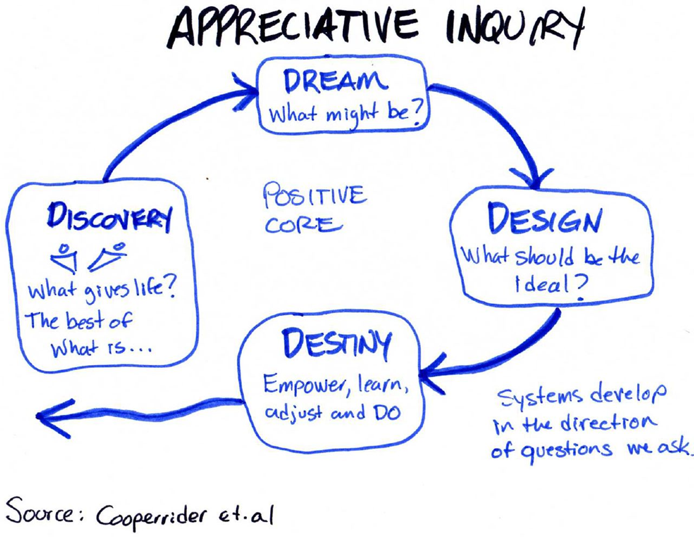
Appreciative enquiry
Appreciative enquiry.
Appreciative Inquiry (AI) is a change management approach that focuses on identifying what is working well, analysing why it is working well and then doing more of it.
The basic tenet of AI is that an organization will grow in whichever direction that people in the organization focus their attention.

Slide 68
Financing a wellbeing culture
Financing a wellbeing culture – where, when and how to invest your resources.
Have a budget relative to the priority of wellbeing to your organisation.
Lot of things build wellbeing:
Wellbeing programs.
Assessments and conversations.
Socail events.
Mental health (illness), stress reduction.
Wellness and health.
Appropriate organisational practices (flexible working policy).
Check your plan with key stakeholders – co-design, co-develop to avoid wasting time and money.
Be clear on your me, we, us plan and where and when investments will kick in to it.

Slide 69
Policy and wellbeing
The policy impact of a wellbeing culture, and policies for wellbeing.
Do you have a wellbeing policy?
Would starting with a wellbeing audit of current policies be beneficial?
What is the impact of your current policies on wellbeing?
How do your policies enable aspects of positive organisations (or do you want one?):
Job variety, intrinsic motivation, confidence, creativity, strengths work, team building, flow, participatory working practices, open climate with empowerment and self-organisation.
The above are all in contrast to a weakness, trouble shooting approach. It’s the difference between getting the most out of people vs bringing out the best in people…

Slide 70
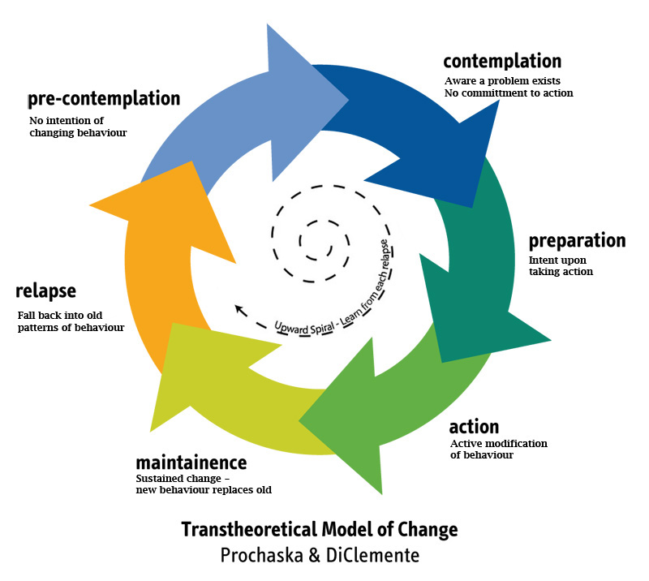
Types of change
Readiness for change vs. large change vs. constant change.
Stages of change

Slide 71
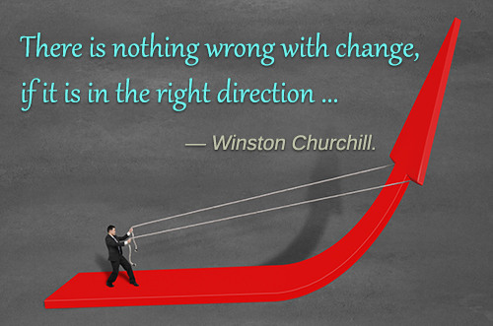
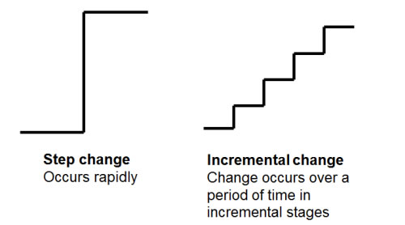
Types of change
Readiness for change vs. large change vs. constant change.
Large change vs incremental change.
Constant directional change.

Slide 72
Organisation communication
Organisation communication - Best tried-and-tested communication methods to foster greater engagement in your wellbeing program.
Regular updates (email, intranet, posters).
Regular meetings (team, larger section).
Infuse into pre-existing systems.
Use of relevant technologies…
There is no magic bullet here, other ideas?

Slide 73
Wellbeing and values alignment
Aligning your wellbeing program to the overall values of your organisation.
Assessment of values alignment…
SAHMRI culture is demonstrated through our values of:
Excellence – be the best you can be.
Courage – take initiative, be adventurous, creative and bold.
Imagination – challenge conventional thinking and pursue novel, ground breaking ideas.
Integrity – act fairly, ethically and respectfully.
Teamwork – collaborate openly and respectfully.
Equity and Diversity – embrace equity, diversity and reconciliation.
Survey values also:

Slide 74
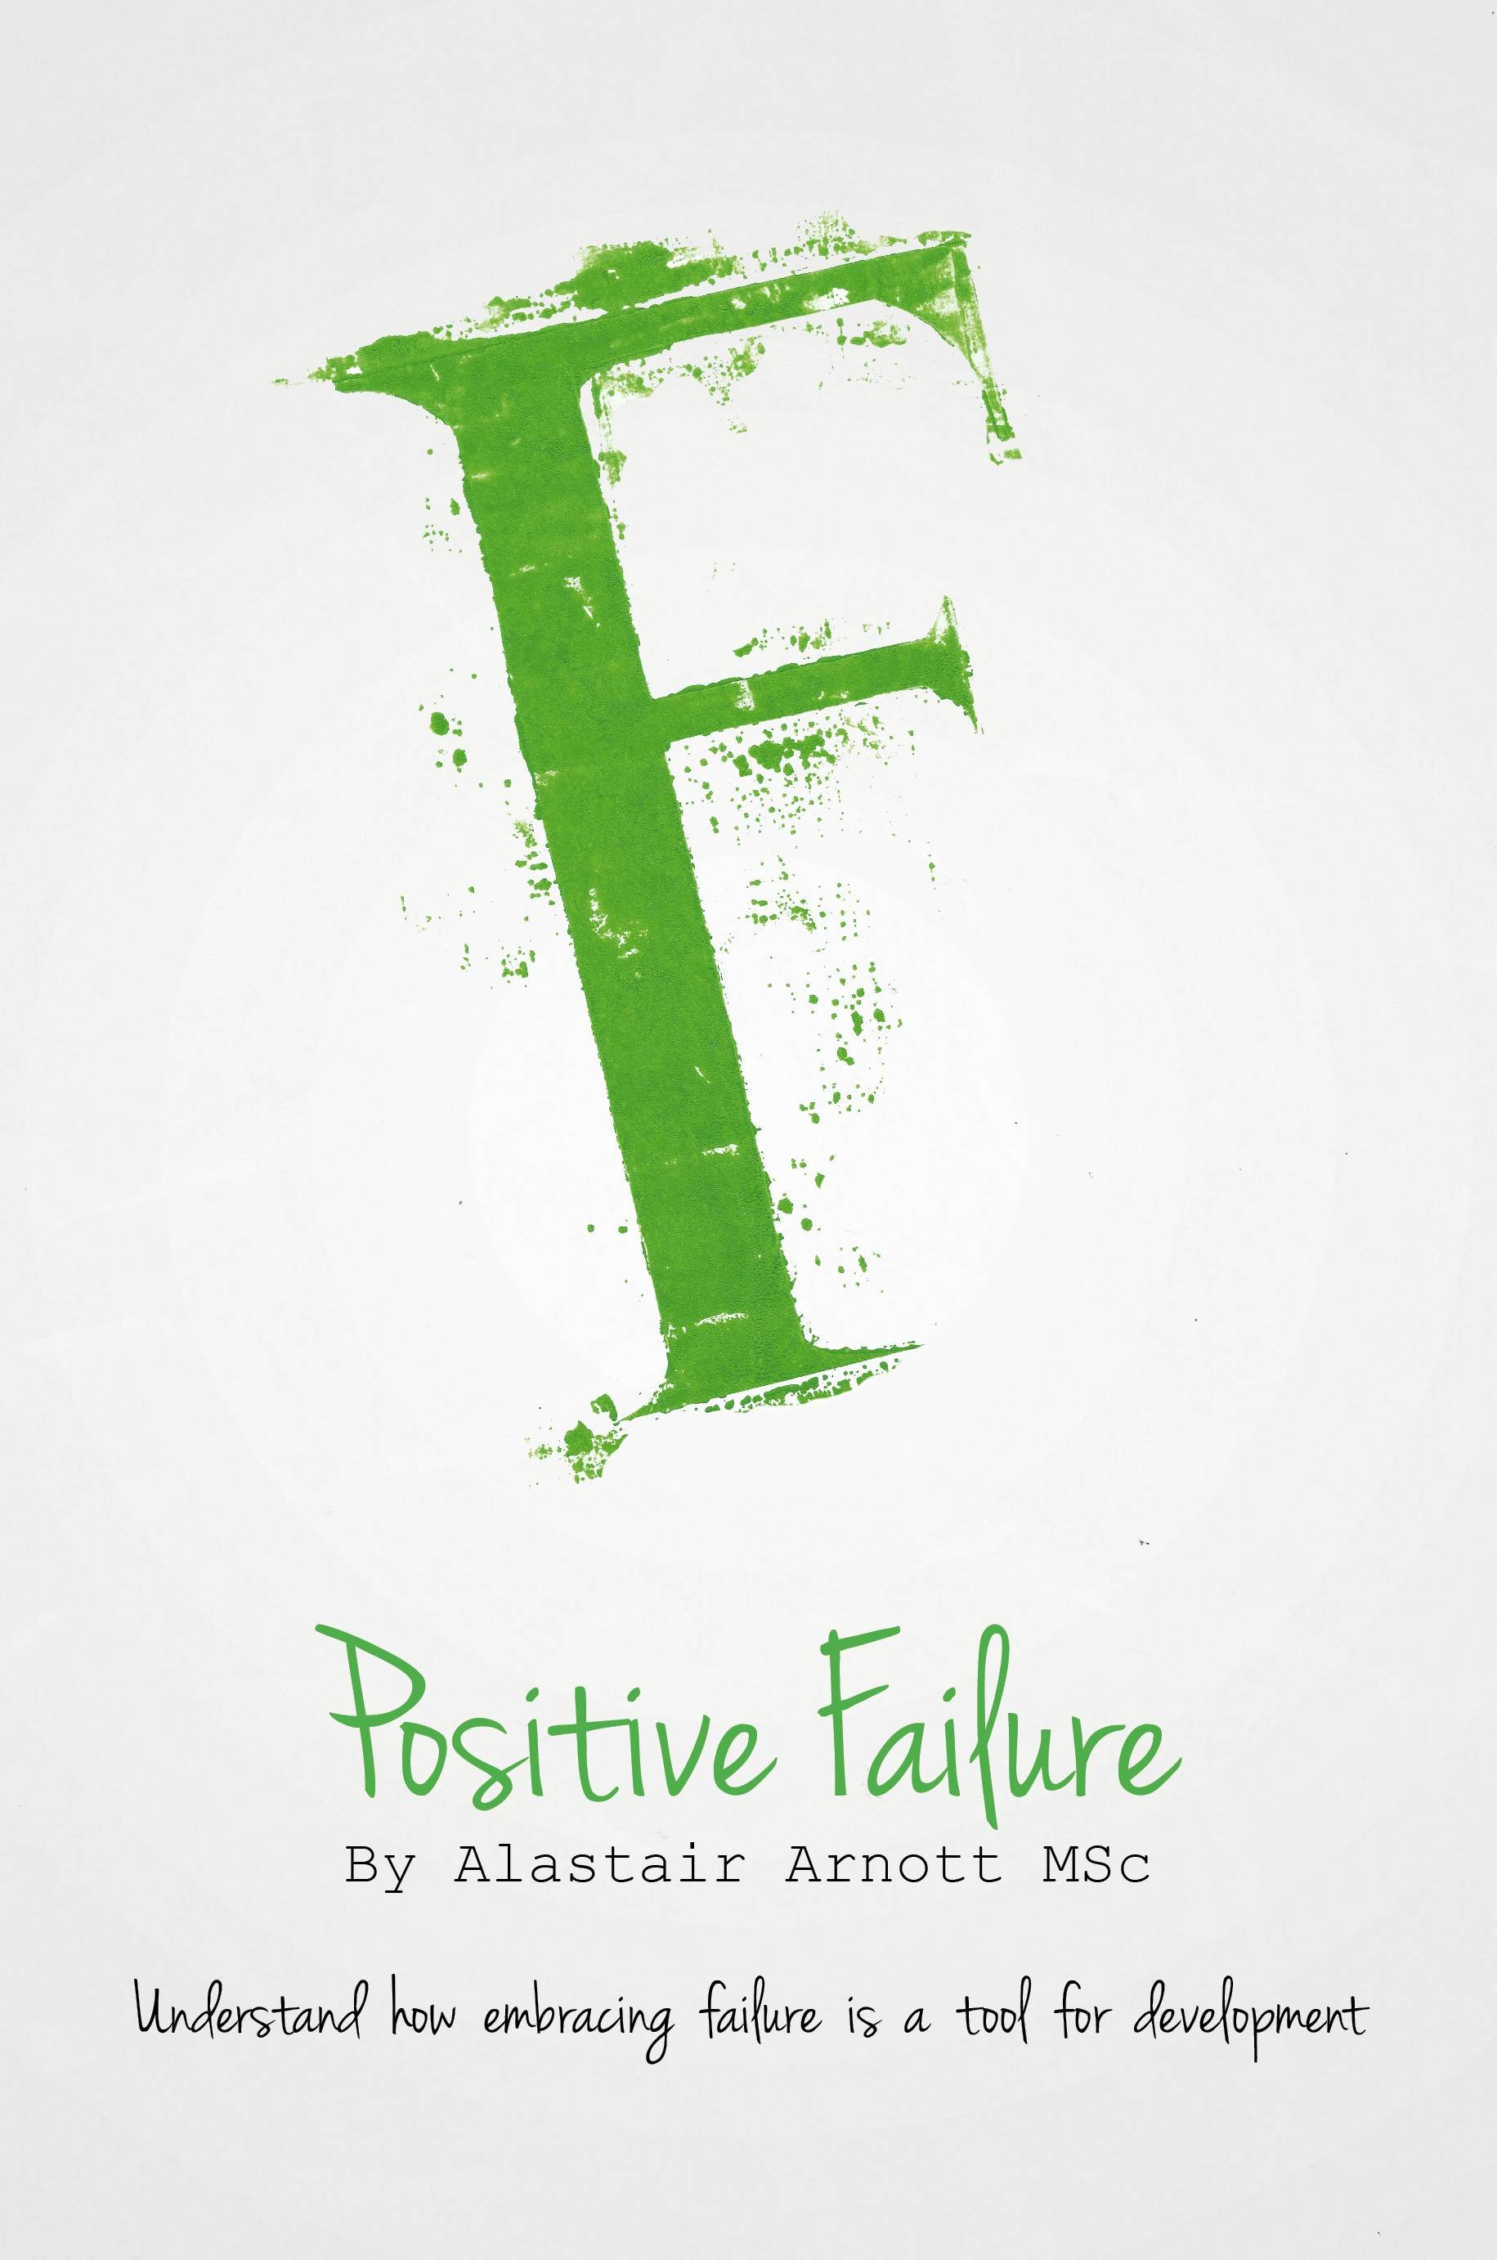
Expectations & communication
Setting realistic expectations and communicating goals around your wellbeing program.
Expectations:
Change is hard work.
Change is more likely to be incremental and staged.
Failure is to be expected and common – positive failure.
No one-size model – scientifically informed practice, trial and error.
Communication:
Clear, minimal, communication (no long docs, less email).
Transparency about what’s planned – builds trust.
Endorse things officially.
Science and data driven rationale.
On-boarding is key!

Slide 75
Developing Team & Champions
Developing your wellbeing team and champions – working out who to approach and engage within your business for best program success.
Ask for volunteers in a wellbeing survey – they self-identify.
33% always wanted wellbeing (pool of champions), 33% follow once see value, 34% disengaged…

Slide 76
Implementation and delivery
Common challenges around implementation and delivery.
Creating time and space for wellbeing vs other organisation priorities. Biggest issue.
Being autonomy supportive – relinquish control…
Choosing the right time - timing important (when to introduce, when to embed).
Be a fan of simplification.
Not capitalising on strengths to implement…
Not having commitment to an implementation plan.
Not taking a data driven approach, based on wellbeing assessment information…
Only targeting the ‘me’ level… (2nd biggest)
Not clearly linking wellbeing to key KPI metrics (long term sustainability).
Not informing all stakeholders of the wellbeing change – so they know what is, and has changed.
Use a checklist for a frame of reference (how will you identify success?), e.g.:
The workplace has to ‘feel’ good.
Play to everyone's strengths.
Encourage risk and failure.
Build social capital.
Be grateful and appreciative at all levels.
Be authentic at all levels.
Create the conditions for change.
Create positive practices.

Slide 77
Plan B
Plan B: What to do when your wellbeing program isn’t measuring up.
Have a ‘Plan B’ to start with…
Before you change, realise it will not all go to plan anyway…
Continually ask questions of your stakeholders throughout the process… What’s working, what’s not, what’s important…
Revaluate your risks:
Overpromise, under deliver – selling false hope.
Obtaining bad advice.
Low ROI = look bad to those above.
Bad apples and win-lose power struggles.
Fear of enabling the lower ranks = look bad.
Expecting fast change – wellbeing is hard work.
A lack of leadership and top level support is the main reason for the failure to sustain changes in an organisation.

Slide 78
Resources & strategies
Resources and early-intervention strategies to help staff cope with life’s challenges.
EAP.
Metal health resources.
Stress in particular.
Resilience in particular.
Prepare for Post Traumatic Growth.

Slide 79
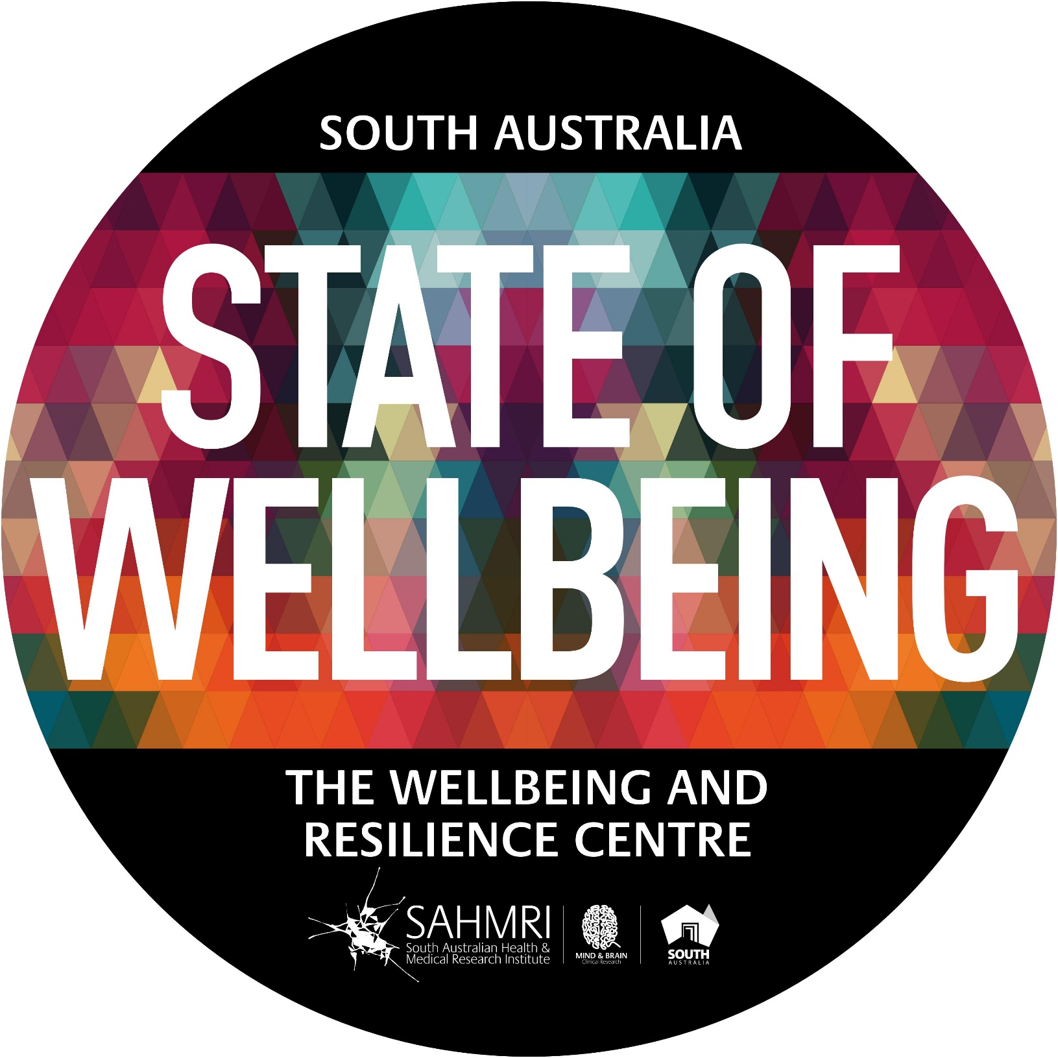
WRC
Wellbeing and Resilience Centre.
Wellbeing and resilience training: http://www.wellbeingandresilience.com/

Slide 80
XXXXX PERMA vs South Australian and Global Norms

Slide 81
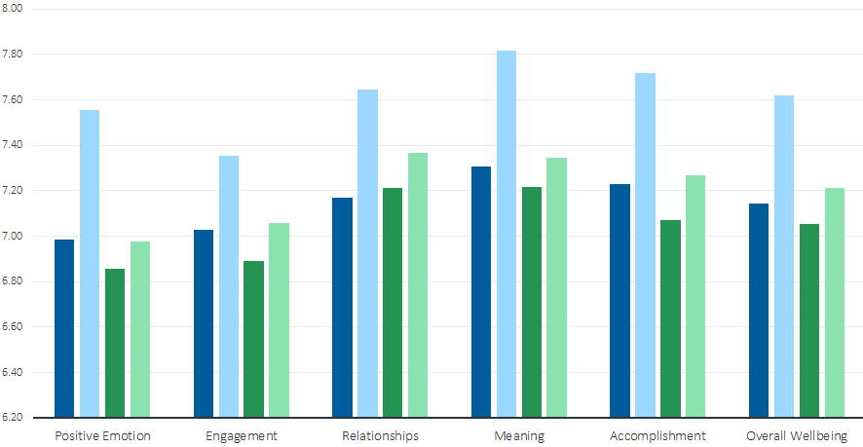
Those who received training increased by a greater extent than those who did not

Slide 82
Workplace Wellbeing:
Training Group had more favourable work wellbeing scores than non-Training group
Non-training Group
Training Group

Slide 83
People who do wellbeing programs well…
More good people to follow up with…
www.themindroom.com.au (Melbourne)
http://www.thepositivityinstitute.com.au/ (Sydney)
http://langleygroup.com.au/ (Sydney)
https://www.michellemcquaid.com/ (Melbourne)

Slide 84
Ending…
Peak-end theory.
Peak-end theory states that people’s judgments of their overall experience (like of this workshop) is greatly influenced by the peak of their experience, and how it ends (I should really be giving out free drinks at this point).
The research indicates that we judge our past experiences almost entirely on how they were at their peak and how they ended…
It has to do with our memory of experiences.

Slide 85
Session 4: Two key insights
Key insights
1. _____________________________________________________________
2. _____________________________________________________________

Slide 86
A quick personal overview
Invest time and effort in family connections.
We are social creatures so be enmeshed in a community of friends - deep and meaningful relationships.
Know your personal values and live by them. Similarly, know your purpose and what derives meaning for you.
Know you personal strengths and find ways to exercise them every day.
Develop and optimistic thinking style.
Invest your money in experiences rather than things.
Be in work, and work that you enjoy.
Be grateful.
Savour the now regularly – rather than the past or future.
Slow down – perhaps meditate?
Be curious.
Look after your health (the below 5 can make approximately 14 years difference to your life expectancy - the quality of both your current life and those extra 14 years):
Eat real food – not too much, and mostly plants.
Exercise regularly – and different types: aerobic, resistance, flexibility, balance.
Drink alcohol in moderation.
Don’t smoke.
Get enough quality sleep.

Slide 87
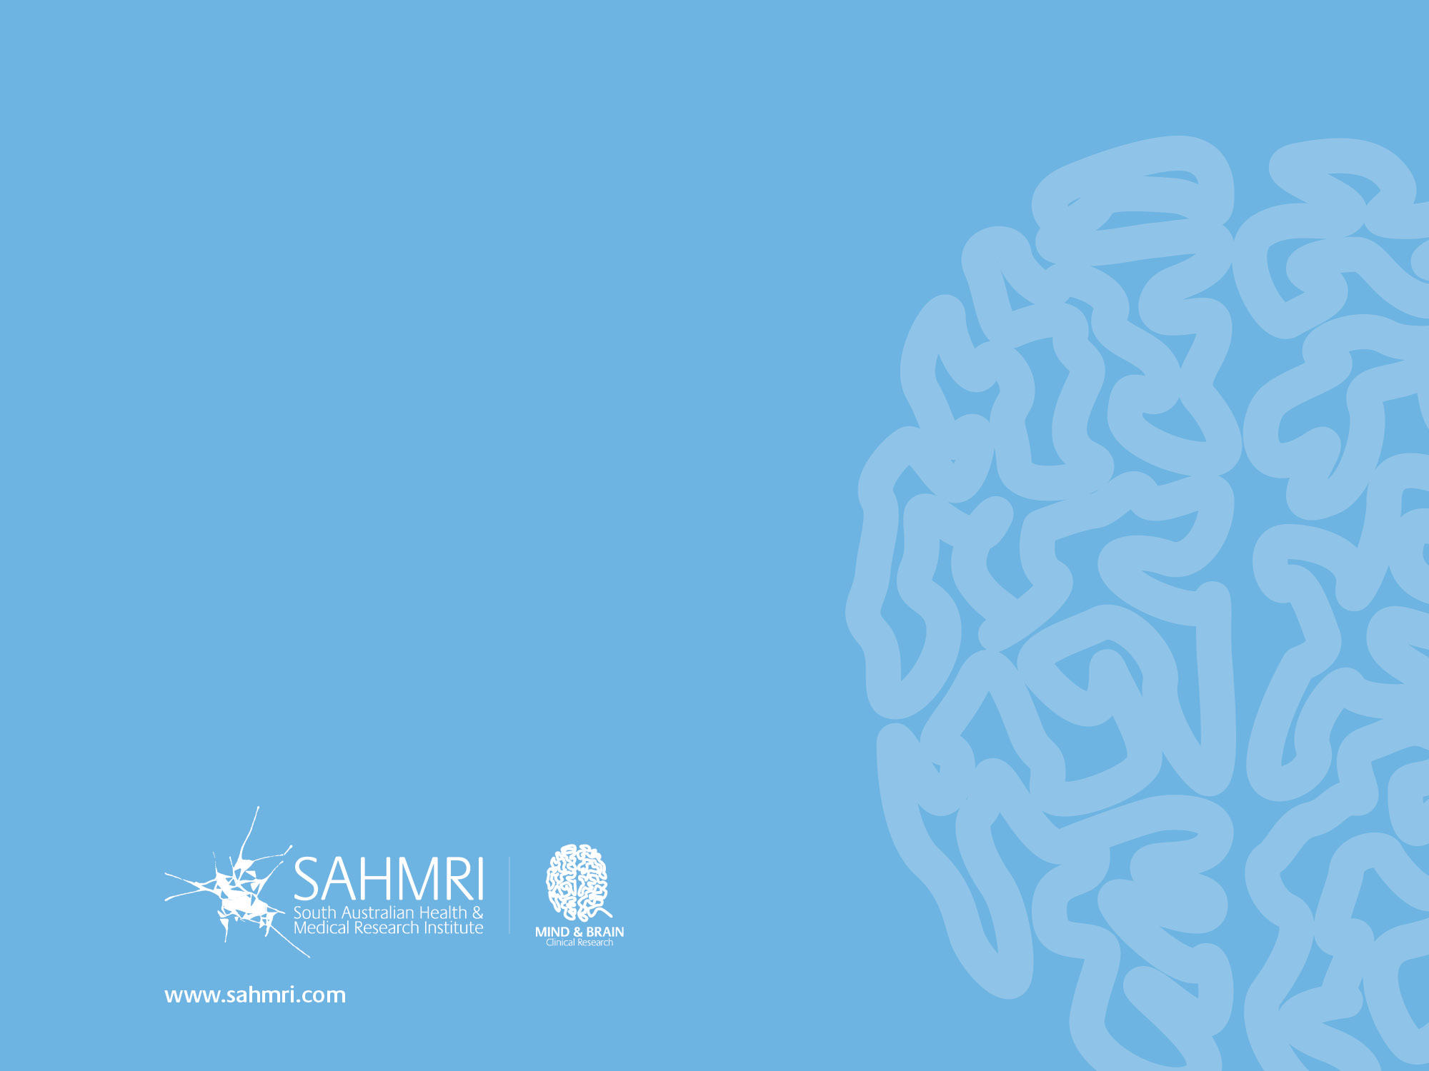
Dr Aaron Jarden
aaron.jarden@sahmri.com
www.aaronjarden.com
Copy of these slides at: www.aaronjarden.com

