Slide 1



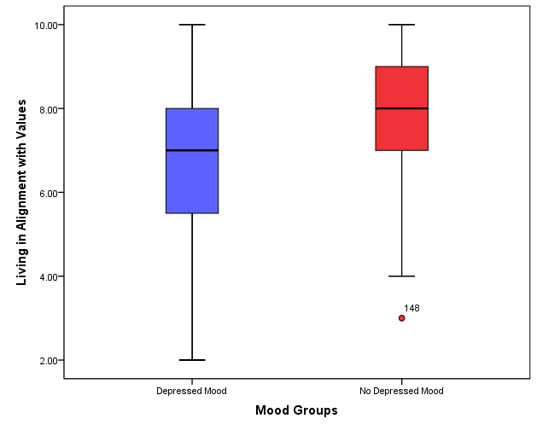
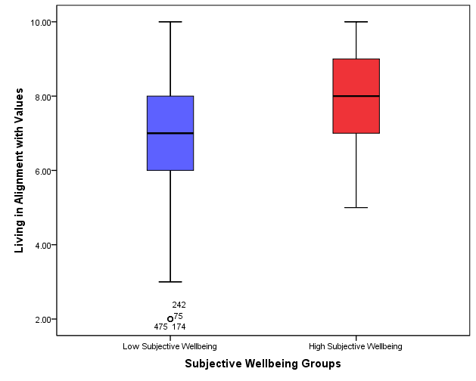
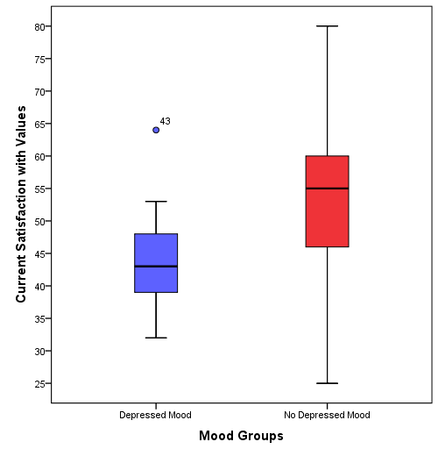
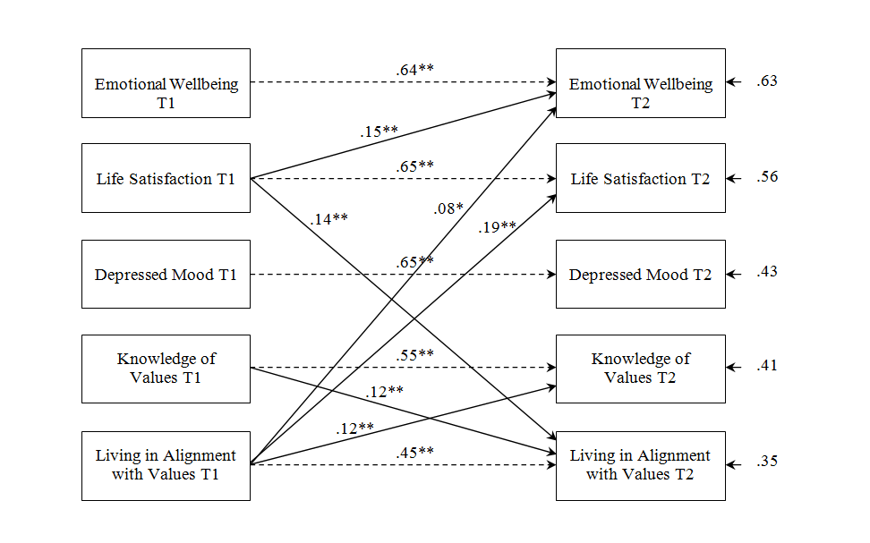
The value in values: Relationships between personal values, and depressed mood and subjective wellbeing
Aaron Jarden
aaron @ jarden.co.nz
Research Goal
The goal of this research was to identify possible relationships between values and depressed mood, and values and subjective wellbeing.
The Problem
Contemporary discourse, usage and endorsement of values is easily detectable in academic domains and applied disciplines. However, the study of values is almost non-existent within psychology, especially in the areas of clinical and positive psychology.
Leading theorists have asserted that psychology has had much difficulty engaging with values (Davis, 2001; Kasser, 2002; Rohan, 2000), with very little known about what values are or their influence.
The developing field of positive psychology has showed an interest in values, however the current status regarding values is one of confusion, uncertainty, and ambiguity.
The Research
Three empirical studies used Schwartz’s model of values (Schwartz, 1992) to
investigate relationships between personal values, depressed mood and subjective wellbeing.
Pilot Study
Procedure and Participants
  A 25 minute in-person survey (n = 103).
  Measured depressed mood (BDI - II: Beck et al., 1996), life satisfaction (SwLS: Diener et al., 1985), emotional wellbeing (HM: Fordyce, 1988), global subjective happiness (SHS: Lyubomirsky & Lepper, 1999), personal values (SVS: Schwartz, 1992; SSVS: Lindeman & Verkasalo, 2005; PVQ: Schwartz et al., 2001) and current satisfaction with personal values (CS-SSVS: new scale).
Sample of key findings
The three different ways of measuring person values (SVS, SSVS, & PVQ) are highly
correlated, and all reflect Schwartz's model in the data.
Greater current satisfaction with values as a whole was associated with lower
depressed mood:
  Moderate negative correlation between total BDI-II scores and
  total CS-SSVS scores, r = -.34, p < .01.
  Statistically significant independent samples t-test between current satisfaction with
  values and those with depressed mood (M = 44.14, SD = 8.12) and those without
  depressed mood (M = 53.20, SD = 13.55, t(97) = 2.423, p = .017, d = .81)
Greater current satisfaction with values as a whole associated with higher
SwLS scores (r = .25, p < .05) and SHS scores (r = .33, p < .01).
The importance of values as a whole was not associated with depressed mood or subjective wellbeing.
Study 1
Procedure and Participants
  A 20 minute online survey (n = 492).
  Measured depressed mood (CES-DS: Radloff, 1977), life satisfaction (SwLS), emotional wellbeing (HM), personal values (PVQ) and relational values questions (knowledge of values, living in alignment with values).
Sample of key findings
The importance of values as a whole not associated with depressed mood, but greater importance associated with greater life satisfaction and emotional wellbeing.
Greater depressed mood was associated with lesser importance of Stimulation, Self-Direction and Hedonism.
Greater subjective wellbeing was associated with greater importance of Stimulation, Self-Direction, Hedonism and Benevolence.
The coherence of values systems not related to mood or subjective wellbeing – assessed with multidimensional scaling.
Greater depressed mood was moderately associated with lower knowledge of values and strongly associated with lower living in alignment with values:
  Moderate negative correlation between knowledge of values scores and
  total CES-DS scores, r = -.21, p < .01, and a strong negative correlation between
  living in alignment with values scores and total CES-DS scores, r = -.45, p < .01.
  Statistically significant independent samples t-test between living in alignment
  with values and those with depressed mood (M = 44.14, SD = 8.12) and those
  without depressed mood (M = 53.20, SD = 13.55, t(490) = 2.423, p = .017, d = .81)
Greater subjective wellbeing was moderately associated with greater knowledge of values
and strongly associated with greater living in alignment with values:
  Moderate positive correlations between knowledge of values scores and SwLS
  scores, r = .26, p < .01, and knowledge of values scores and HM scores,
  r = .17, p < .01.
  Moderate positive correlations between living in alignment with values and SwLS
  scores, r = .48, p < .01, and living in alignment with values and HM scores,
  r = .41, p < .01.
  Statistically significant independent samples t-test between knowledge of values
  and those with low subjective wellbeing (M = 7.86, SD = 1.35) and those with high
  subjective wellbeing (M = 8.40, SD = 1.16, t(490) = -4.456, p = .001, d = .43).
  Statistically significant independent samples t-test between living in alignment with
  values and those with low subjective wellbeing (M = 7.17, SD = 1.70) and those with
  high subjective wellbeing (M = 8.08, SD = 1.09, t(490) = -6.288, p = .001, d = .64).
Study 2
This study explored how relational aspects of values (knowledge of values, living in alignment with values) relate to changes in depressed mood and subjective wellbeing over time.
Procedure and Participants
  A 15 minute online survey of participants from Study 1 six months later (n = 173).
  Measured depressed mood (CES-DS), life satisfaction (SwLS), emotional wellbeing (HM), personal values (PVQ) and relational values (knowledge of values, living in alignment with values).
Sample of key findings
The direction of effect model showed that reciprocal relationships were
observed between living in alignment with values and knowledge of values, and
between living in alignment with values and life satisfaction.
Emotional wellbeing was predicted by both living in alignment with values and life
satisfaction.
Knowledge of values at time one did not predict either life satisfaction or
emotional wellbeing at time two.
Depressed mood at time two was not predicted by either knowledge of values
or living in alignment with values at time one.
Openness to Change
Self-Direction
Self-Transcendence
Stimulation
Universalism
Benevolence
Hedonism
Conformity
Tradition
Achievement
Power
Security
Self-Enhancement
Conservation
IPPA abstract reference number: A-351-1300-00420

