Slide 2
Research team
Professor Grant Schofield
Dr. Aaron Jarden
Lisa Mackay
Dr. Mikki Williden
Kate White
Julia McPhee
Dr. Scott Duncan
Dee Holdsworth-Perks
Lucy Hone
Acknowledgment
Thank you to the 10,000+ New Zealanders who participated in the first & second round of the Sovereign Wellbeing Index
Sovereign Wellbeing Index Website
www.mywellbeing.co.nz

Slide 3
Study details
Purpose: to better understand the wellbeing of New Zealanders and how this is changing
Specific Aims:
develop an overall index of New Zealanders wellbeing
determine the prevalence of wellbeing among different geographic locations and various demographic groups
investigating the predictors and moderators of wellbeing among New Zealanders, and how these compare to internationally comparative samples

Slide 4
Study details
Outline:
a six year longitudinal study – three assessment points
September 2012 & 2014 - a nationally representative sample of 10,000 (18+ years) individuals completed the survey
online survey
145 questions, about 19 minutes (median)
Assesses psychological wellbeing, health and lifestyle, and socio-demographics
“The particular strength of the SWI is its capturing of how society is functioning as a whole, overtime, by focusing on the relationship between psychological wellbeing, and on health and lifestyle factors and outcomes”
Questions were primarily drawn from Round 6 of the European Social Survey Personal and Social Wellbeing module, but additionally included scales such as the Flourishing Scale and strengths use scale

Slide 5
development

Slide 6
Challenges / strengths
Funding
Team
Design
Sample
Ambition

Slide 7
Initial findings
The SWI is currently the largest, most detailed, and wholly representative wellbeing dataset on the New Zealand population
We have time 1 and time 2 data at this stage, but have only conducted analysis on each separate dataset at this stage.
4,435 from T1 at T2
reports available online

Slide 9
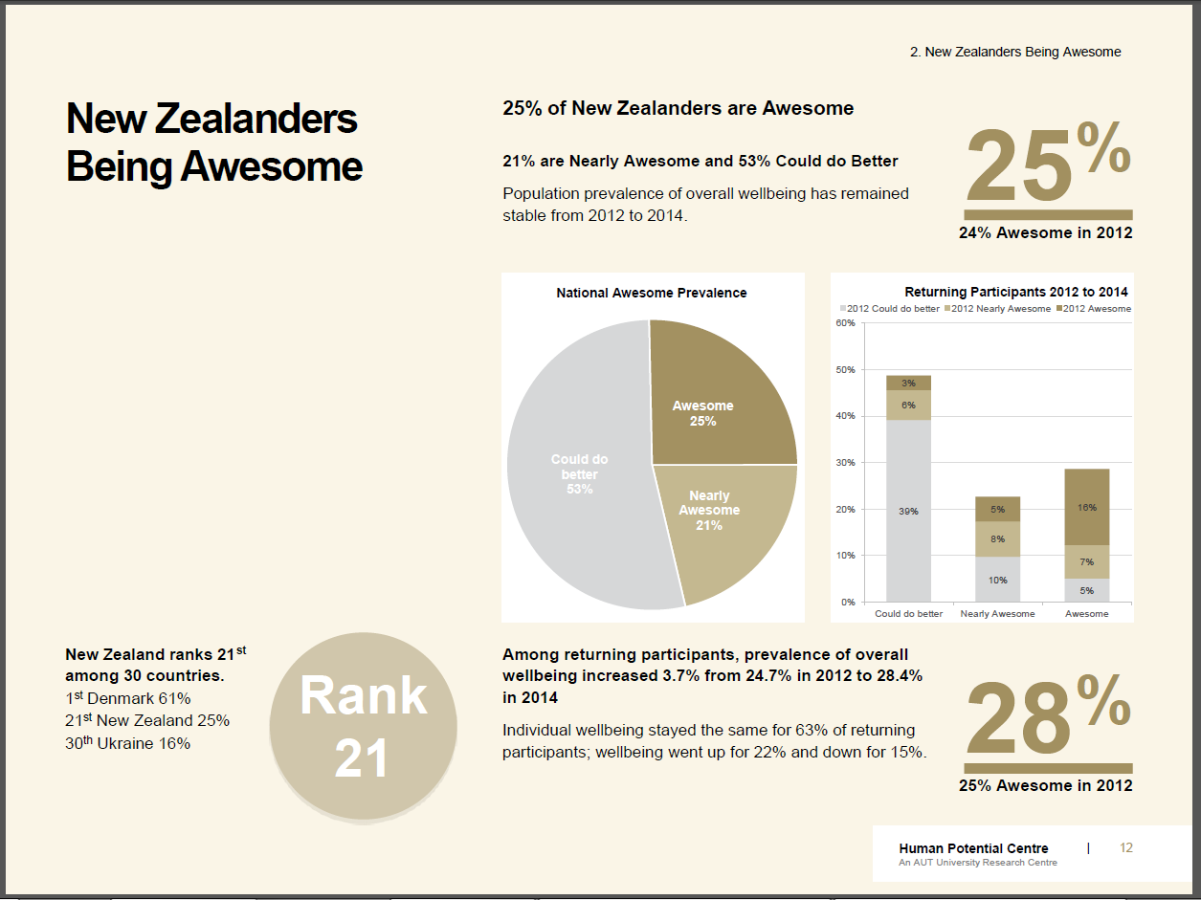

Slide 11
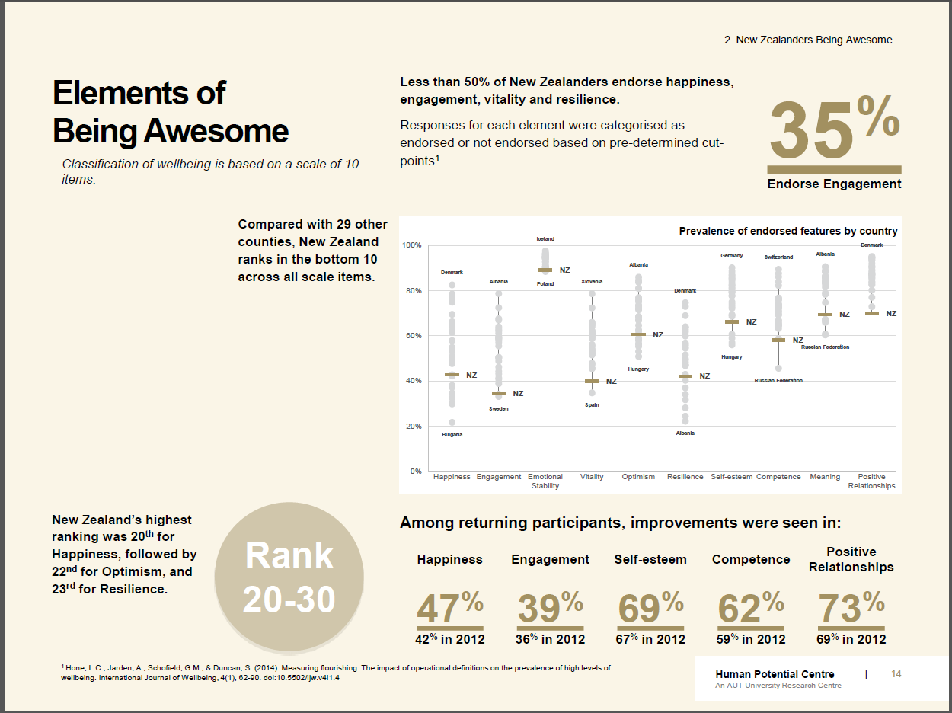

Slide 13
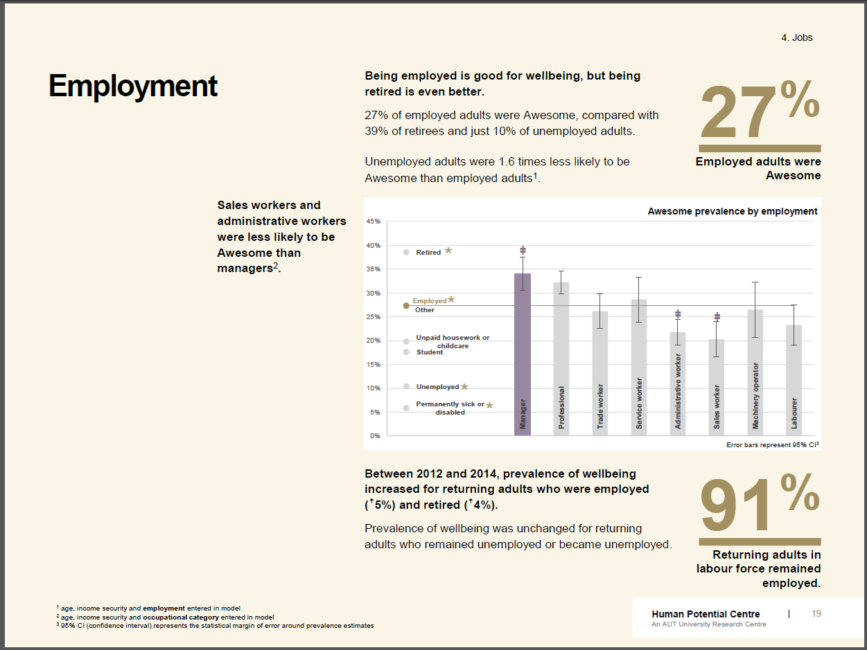

Slide 14
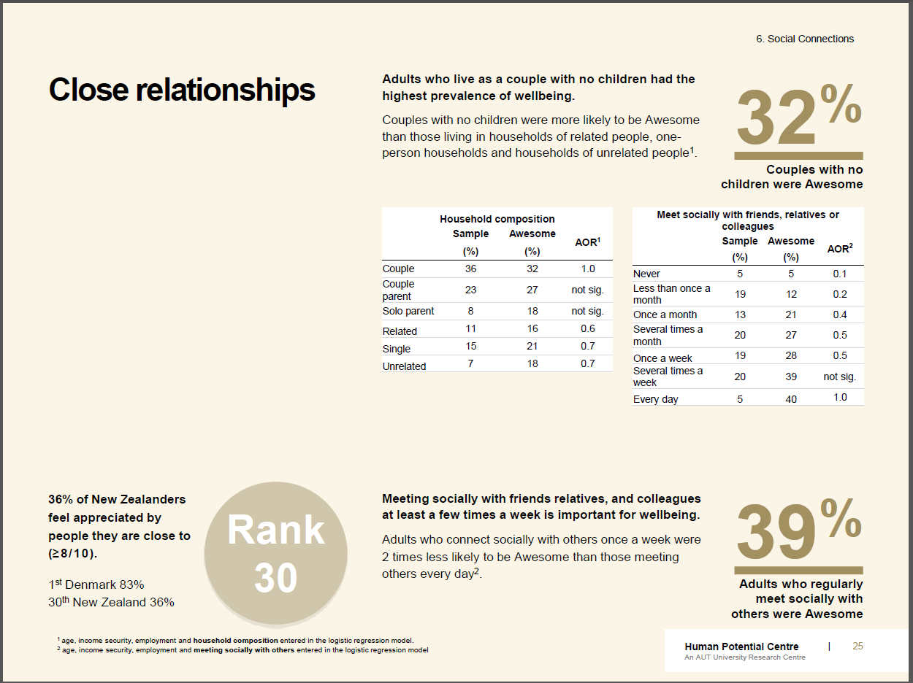

Slide 15
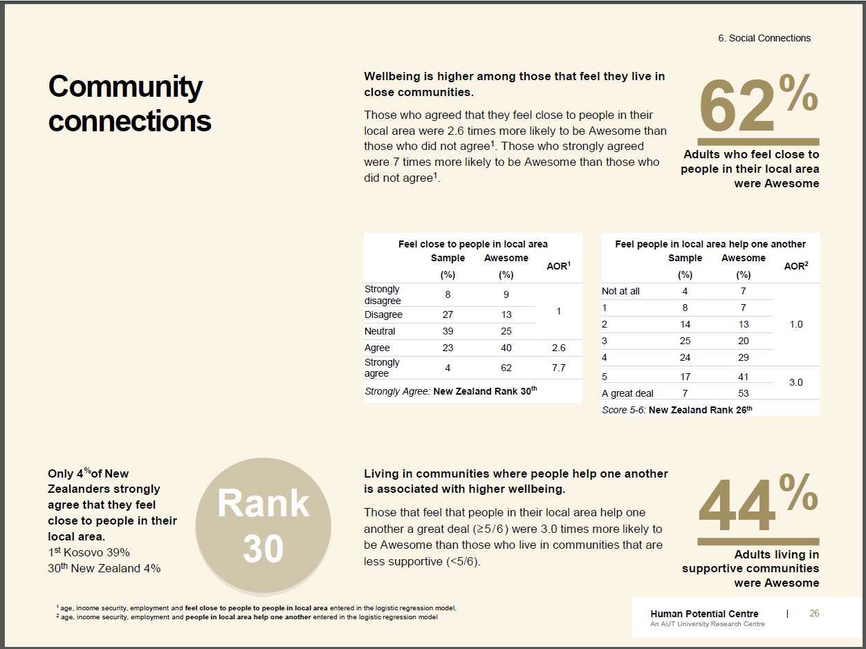

Slide 16
Future directions
New Zealanders make choices everyday about their wellbeing. These are both personal choices as well as democratic choices about public policy and action at local and national levels. It is our vision that this index can help frame both personal choices and public policy and action in New Zealand.
If it isn’t wellbeing for ourselves and others we are ultimately striving for, then what is it?

Slide 17
Thank you
Dr Aaron Jarden and the SWI research team

