Slide 1
Selected Workplace wellbeing projects
Dr Aaron Jarden
aaron.jarden@aut.ac.nz
14th March 2016
Wellbeing and Performance Research Group, AUT

Slide 2
Research
Hone, L., Schofied, G., & Jarden, A. (2016). Conceptualizations of wellbeing: Insights from a prototype analysis on New Zealand workers. New Zealand Journal of Human Resource Management, 12(2), 97-118.
We were interested in how workers conceptualized wellbeing and what sorts of activities workers currently engage in to promote their individual wellbeing.
Results indicated that New Zealand workers are less likely than academic researchers to consider the presence of achievement, engagement, and optimism as important for wellbeing. In contrast to current popular academic models, New Zealand workers viewed physical health, work-life balance, and feeling valued as central components of wellbeing.
Physical activity/regular exercise, nurturing relationships, participating in hobbies/interests, and healthy eating were identified as the most popular ways to promote personal wellbeing.

Slide 3
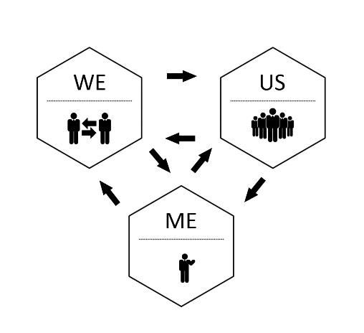
Research
Jarden, A. (2016). Introducing workplace wellbeing to organizations: The “Me, We, Us” model. Positive Work and Organizations: Research and Practice.
When focusing on organizational wellbeing, wellbeing assessments and workplace wellbeing programs can happen at three distinct levels regardless of organization structure or size – at the employee level (Me), at group level (We), and at the organizational level (Us) – as depicted in Figure 1.

Slide 4
Research
Hamling, K., Jarden, A., & Schofield, G. (2016). Recipes for occupational wellbeing: An investigation of the associations with wellbeing in New Zealand workers. New Zealand Journal of Human Resource Management, 12(2), 151-173.
Investigate if workers in eight distinct occupational groups in New Zealand experienced wellbeing in the same way or if there were unique recipes for wellbeing according to occupational context.
The prevalence of flourishing and job satisfaction varied significantly between occupational groups, in particular, between higher and lower status occupations.
Meaning and purpose was most strongly associated with flourishing scores while work-life balance was most strongly associated with job satisfaction scores.

Slide 5
Research
Hone, L., Jarden, A., Schofield, G. M., & Duncan, S. (2015). Flourishing in New Zealand workers: Associations with lifestyle behaviours, physical health, psychosocial, and work-related indicators. Journal of Occupational and Environmental Medicine, 57(9), pp. 973-983.
One in four New Zealand workers (n = 5549) were categorized as flourishing. Being older and married, reporting greater income, financial security, physical health, autonomy, strengths awareness and use, work-life balance, job satisfaction, participation in the Five Ways to Well-being, volunteering, and feeling appreciated by others were all positively associated with worker flourishing independent of sociodemographics.

Slide 6
Projects
Work on Wellbeing

Slide 7
Projects
Assessing Wellbeing in Education

Slide 8
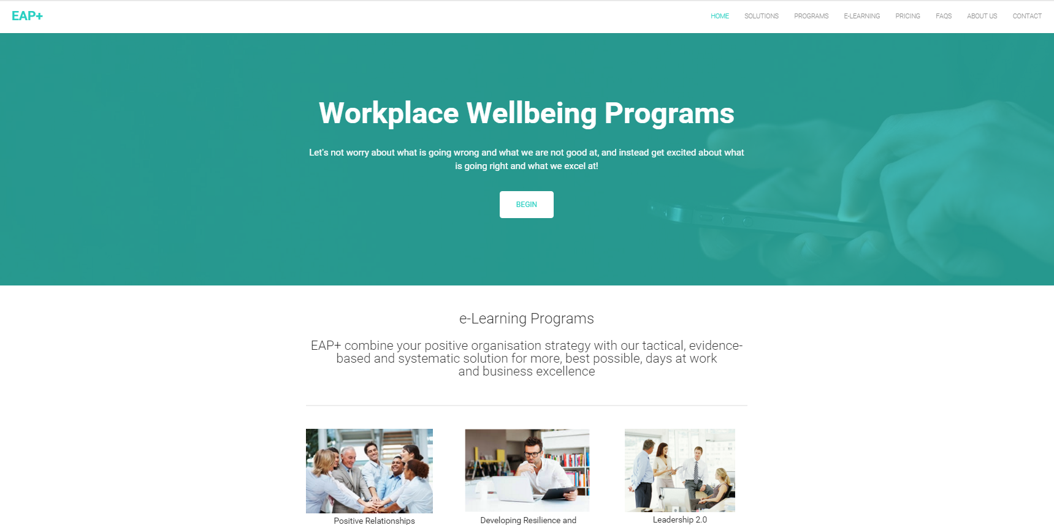
Projects
EAP+

Slide 9
Projects
Course: PSYC803 Positive Organisations
PRESCRIPTOR: Provides specialised knowledge in the emerging fields of positive organisational scholarship and positive organisational behaviour - the scientific study of optimal wellbeing in organisational contexts.

