Slide 1
Academic Wellbeing: “What does a good day at work look like for an academic?”
Dr Aaron Jarden
Wellbeing and Resilience Centre, SAHMRI
27th October 2017

Slide 2
Objectives and Aims
Objectives:
Networking opportunity.
Space to share knowledge / experiences.
Aims:
This workshop provides opportunities to engage and explore wellbeing science knowledge and practices, and to discuss, attempt, debate and reflect together on how specifically the principles of positive psychology and wellbeing science can be integrated into our lives as academics, others lives, and into our work.
We are aiming for a fun, relaxing, and creative experience, where participants can learn and share ideas.

Slide 3
Outcomes
Outcomes:
To facilitate and empower the development of personal wellbeing development plans.
To try some positive psychological interventions so you can add tools to your toolkit.
Increased knowledge and positive psychology and wellbeing science.
To think about how wellbeing science could benefit UTS.
So really:
End game / take home = Know stuff + do stuff (knowledge + experience).
Wellbeing science + positive psychological interventions.
Slides:
http://www.aaronjarden.com/aarons-professional-page.html

Slide 4
Outline
Introduction:
Objectives, aims, outcomes.
Positive introductions.
What UTS are doing via HR.
Session 1 – 1 hour
What is wellbeing, wellbeing science, positive psychology?
Frameworks and models of wellbeing.
Wellbeing assessment.
Context, processes, and key guiding questions.
State of the research and some interesting findings.
Wellbeing intervention 1 & 2.
Lunch (30 minutes)
Session 2 – 1 hour
Wellbeing interventions 3 & 4.
Importance of embedding and sustainable behaviour change, and risks.
General discussion.
Session 3 – 30 mins
How plants can improve your wellbeing and mental health.
Wind-up and applause.

Slide 5
Positive Introductions
Let’s make friends…
Pair up.
In 4 minutes (2 minutes each), tell a story – a thoughtful narrative with a beginning, middle and end – that illustrates when you are at your best at work.
Note: Swap when you hear the alarm the first time after 2 minutes, stop completely when you hear the alarm the second time after 4 minutes.
Ref: Rashid, 2008; Magyar-Moe, 2009.

Slide 6
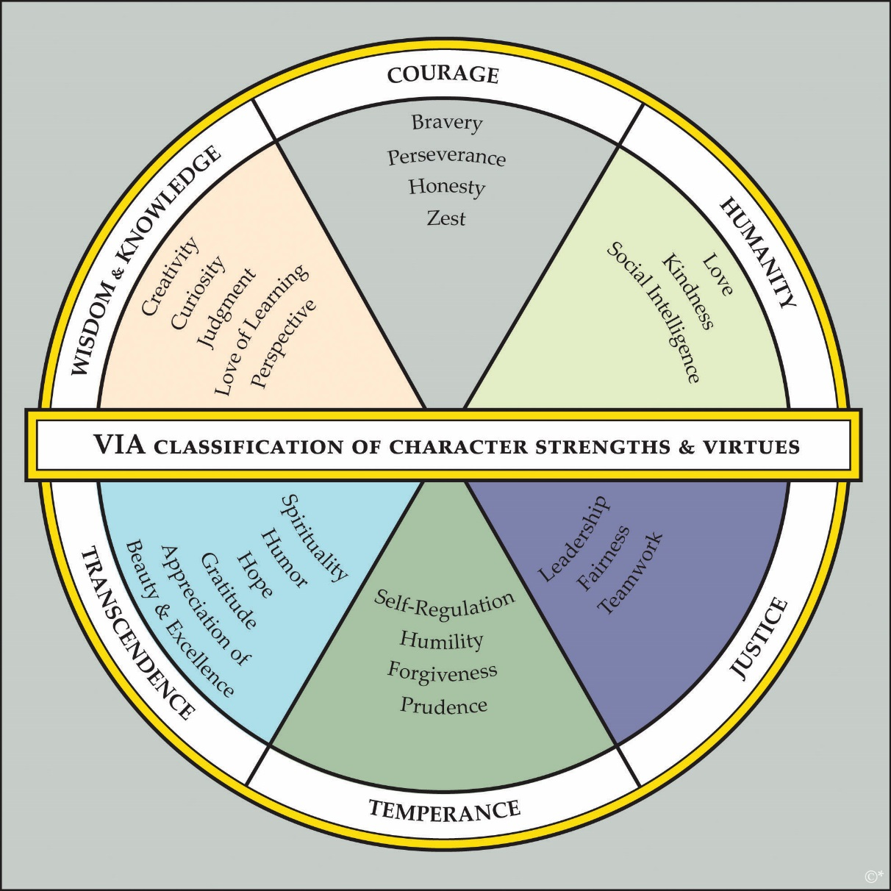
Positive Introductions
Key point: Wield your strengths – they are paths to engagement and enjoyment.

Slide 7
Health & Wellbeing @ UTS
Graphics created by Ullupta conecum re volupta evelignis pe et doluptuam.
Anna Dawson
Health and Wellbeing Partner
Human Resources Unit

Slide 8
What is a mentally healthy workplace?
Human resources unit
“Is a place where people can work smart, contribute their best effort, be recognised for their work, and go home at the end of the day with energy left over.”
- Guarding Minds@Work

Slide 9
What is a mentally healthy workplace?
Human resources unit
Psychological
Relationship
General Health
Physical
Financial
Career and Beyond
Community
The key objectives of our Health & Wellbeing Strategies are:
Maintain the health and wellbeing of staff through early interventions
Supporting the recovery of staff with health conditions and symptoms
Building a better mentally healthy work culture.

Slide 10
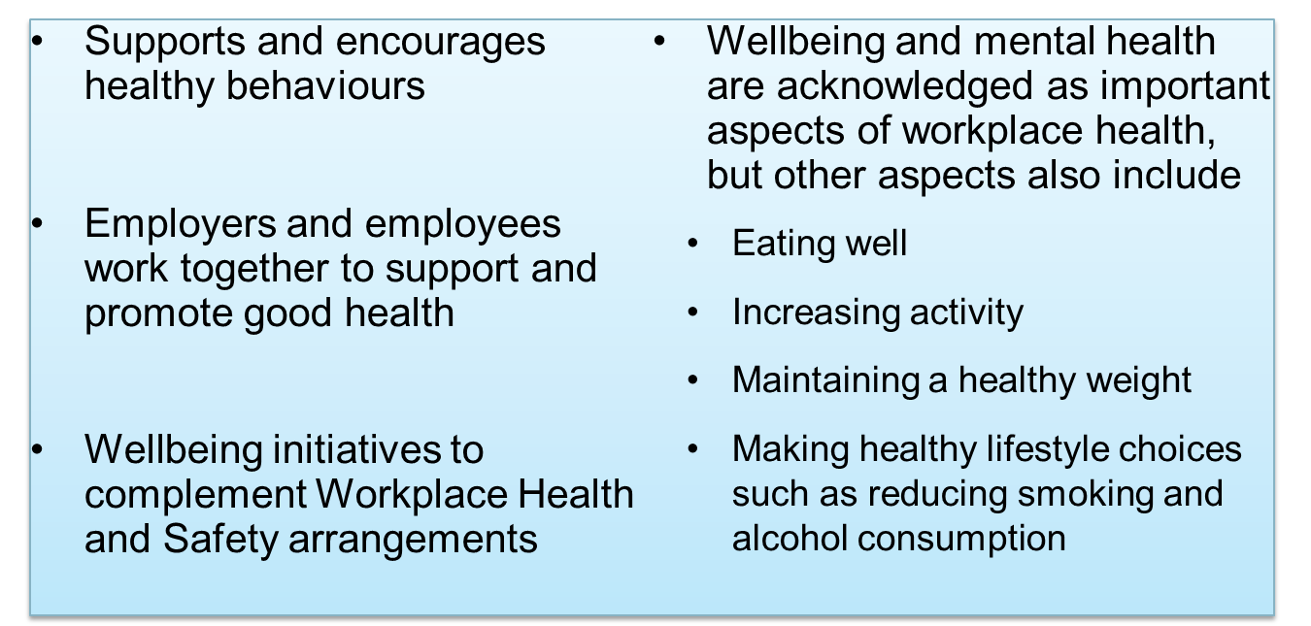
Health and Wellbeing @ UTS
Human resources unit

Slide 11
Health and Wellbeing Team
Anna Dawson Health and Wellbeing Partner Registered Psychologist
Mental health strategy Wellbeing Program Health management
Liz Baker Return to Work Coordinator
Workers Compensation and Injury management Ergonomics and workstation assessments

Slide 12
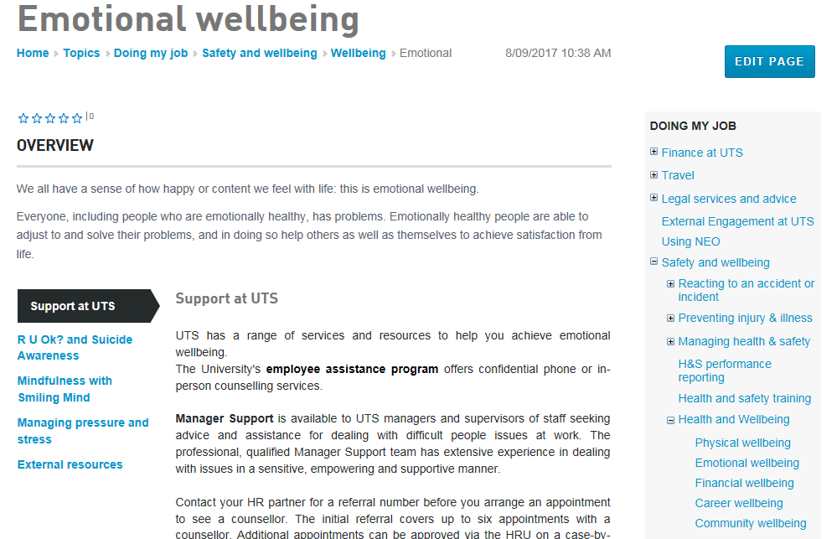
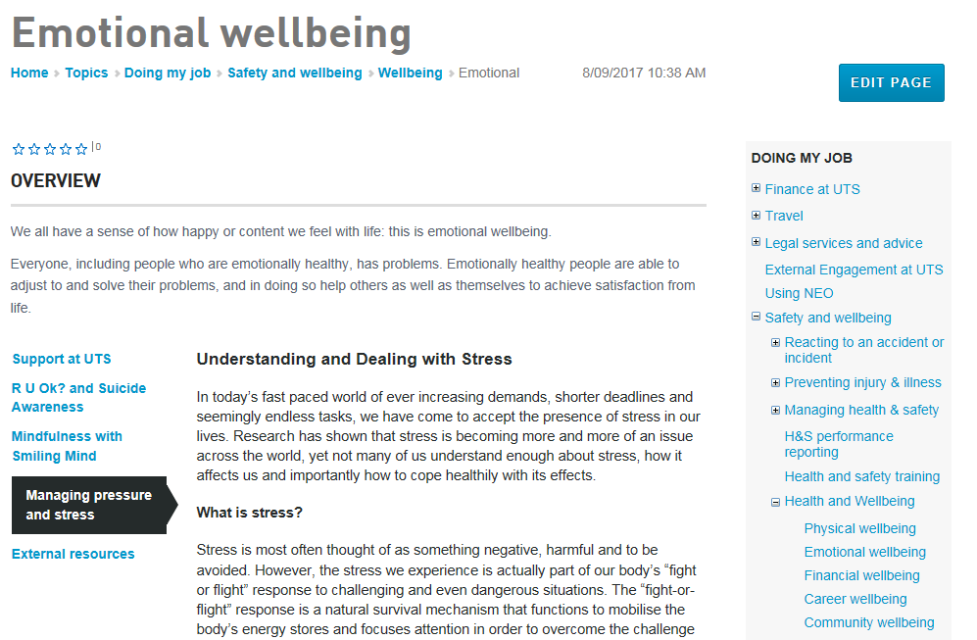
Human resources unit

Slide 13
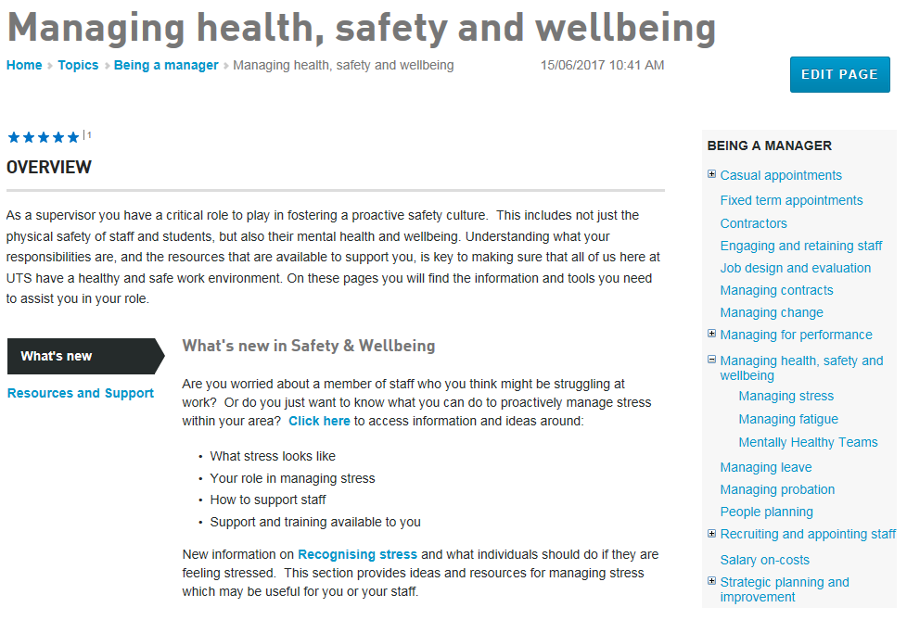
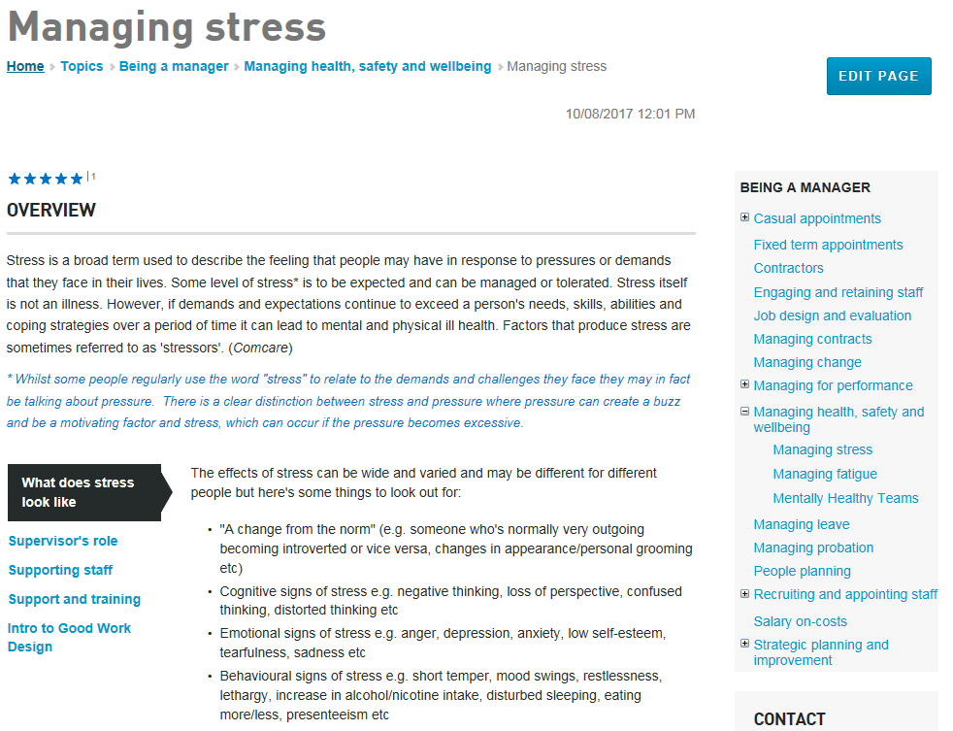
Human resources unit

Slide 14
2018 and beyond
Human resources unit
Mentally healthy workplace strategy
Suite of workshops to enhance personal resilience and recovery
Wellbeing online portal

Slide 15
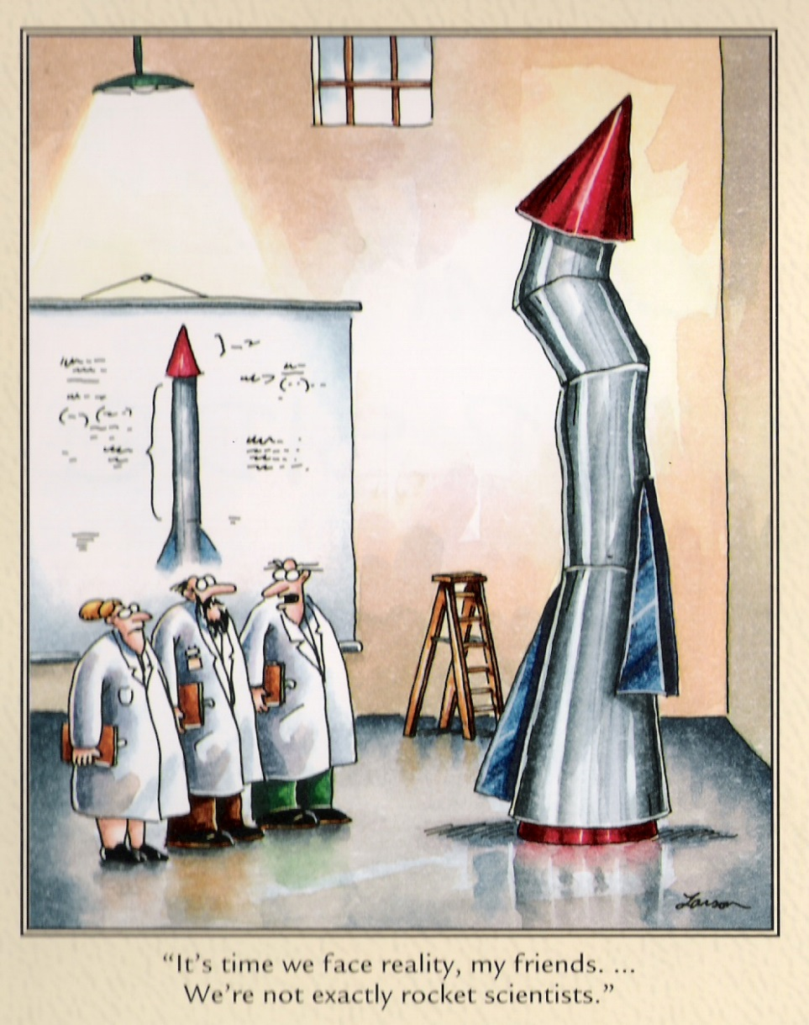
What is wellbeing?
I'm no expert on your wellbeing
In addition, “happiness is not a spectator sport” - (Chris Peterson).
Hard work required.
One healthy meal or one gym session will not impact much.

Slide 16
Aaron’s view
The good life
The good life is best construed as a matrix that includes happiness, occasional sadness, a sense of purpose, playfulness, and psychological flexibility, as well autonomy, mastery, and belonging / connection.
It’s not just about learning to be more positive – it’s about using scientifically-informed tools and strategies to make our thinking more flexible, accurate, clear, and expansive. This thinking will lead to happiness and more healthy behaviours.

Slide 17
Killer questions?
Ask away…
Before I go much further, does anyone have any killer questions they would either like me to muse on now, or address at some stage?

Slide 18
What is wellbeing?
What is wellbeing, wellbeing science, positive psychology?
"There are two complementary strategies for improving the human condition. One is to relieve what is negative in life; the other is to strengthen what is positive. Mainstream psychology focuses largely on the first strategy; Positive Psychology emphasizes the second" - Martin Seligman
"Positive psychology is the scientific study of what enables individuals and communities to thrive" - International Positive Psychology Association.

Slide 19
What is wellbeing?
What is wellbeing, wellbeing science, positive psychology?
Positive psychology is a branch of psychology that conducts scientific inquiry into the factors that help individuals, communities and organisations thrive by building on their strengths and virtues.
Positive psychology is the study of topics as diverse as happiness, optimism, hope, flow, meaning, subjective wellbeing and personal growth.
Positive psychology aims to expand psychology from its focus on repairing the negatives in life to also promoting the positives in life.
Positive psychological interventions (empirically validated techniques and strategies to increase wellbeing) have been used effectively in schools to improve academic outcomes, in businesses to improve work relationships and engagement, and in communities to improve health.
What is optimal human functioning?, and What makes life worth living?

Slide 20
What is wellbeing?
Video
https://www.youtube.com/watch?v=1qJvS8v0TTI

Slide 21
What is wellbeing?
Positive psychology (PP)
Previous focus on pathology; disease model (what’s going wrong) – World Wars and trauma, and yet some great progress in treatment!
PP aims to improve quality of life (what’s going right) – for individuals and various groups to flourish…
A science of positive psychology – it’s not self help, or life coaching… Humanistic psychology did not have much of an empirical base…. PP is providing an empirically sound vision of the good life (what makes life worth living)…
Positive psychology interventions (PPI’s) work – roughly about d = .3 effect size (increasing good & reducing bad):
Sin, N. L., & Lyubomirsky, S. (2009). Enhancing well-being and alleviating depressive symptoms with positive psychology interventions: A practice-friendly meta-analysis [Meta-Analysis]. Journal of clinical psychology, 65(5), 467-487.

Slide 22
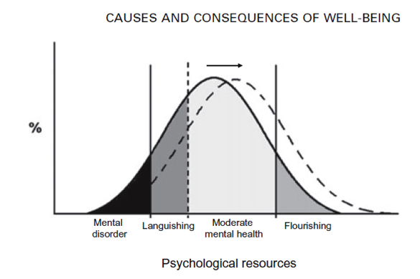
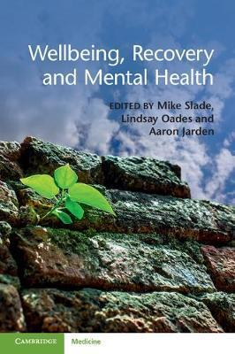
What is wellbeing?
Positive psychology (PP)
PPI’s aim:
Fordyce pioneering work showed it was possible to significantly boost happiness levels among non-clinical populations using a package of interventions (Fordyce, 1977, 1983).
Past 15 years has seen rapid growth in interest and research in positive mental health.
Considerable positive outcomes associated with happiness (for a review see Lyubomirsky, King, & Diener, 2005).
Positive psychology’s academic output is growing proportionately faster than psychological research as a whole (Rusk & Waters, 2013).

Slide 23
What is wellbeing?
Positive psychology (PP)
Positive psychology related documents account for between 10% and 36% of research in the fields of counselling, education, organisational science, behavioural medicine, and health psychology (Rusk & Waters, 2013).
Various sub-fields:
Positive Education
Positive Health
Positive Assessment
Positive Psychotherapy
Positive Organisations
Positive Aging

Slide 24
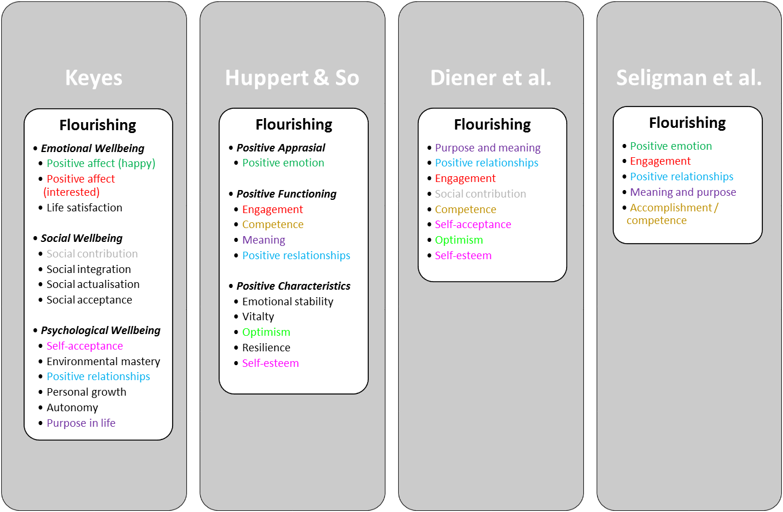
Models of Wellbeing
Some random points
Wellbeing spreads through social networks:
About 15%.
To 3 degrees of separation.
We need to understand the context, not individual behaviour alone.
Different theories and recipes of wellbeing, flow into different public health messages.

Slide 25
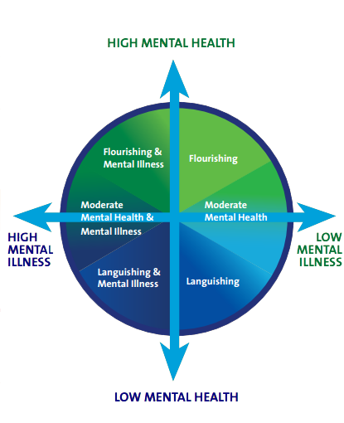
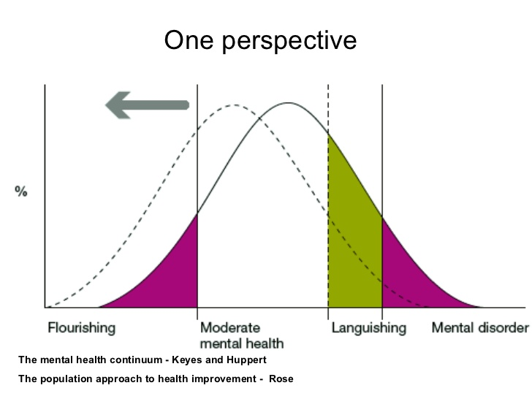
Models of Wellbeing

Slide 26
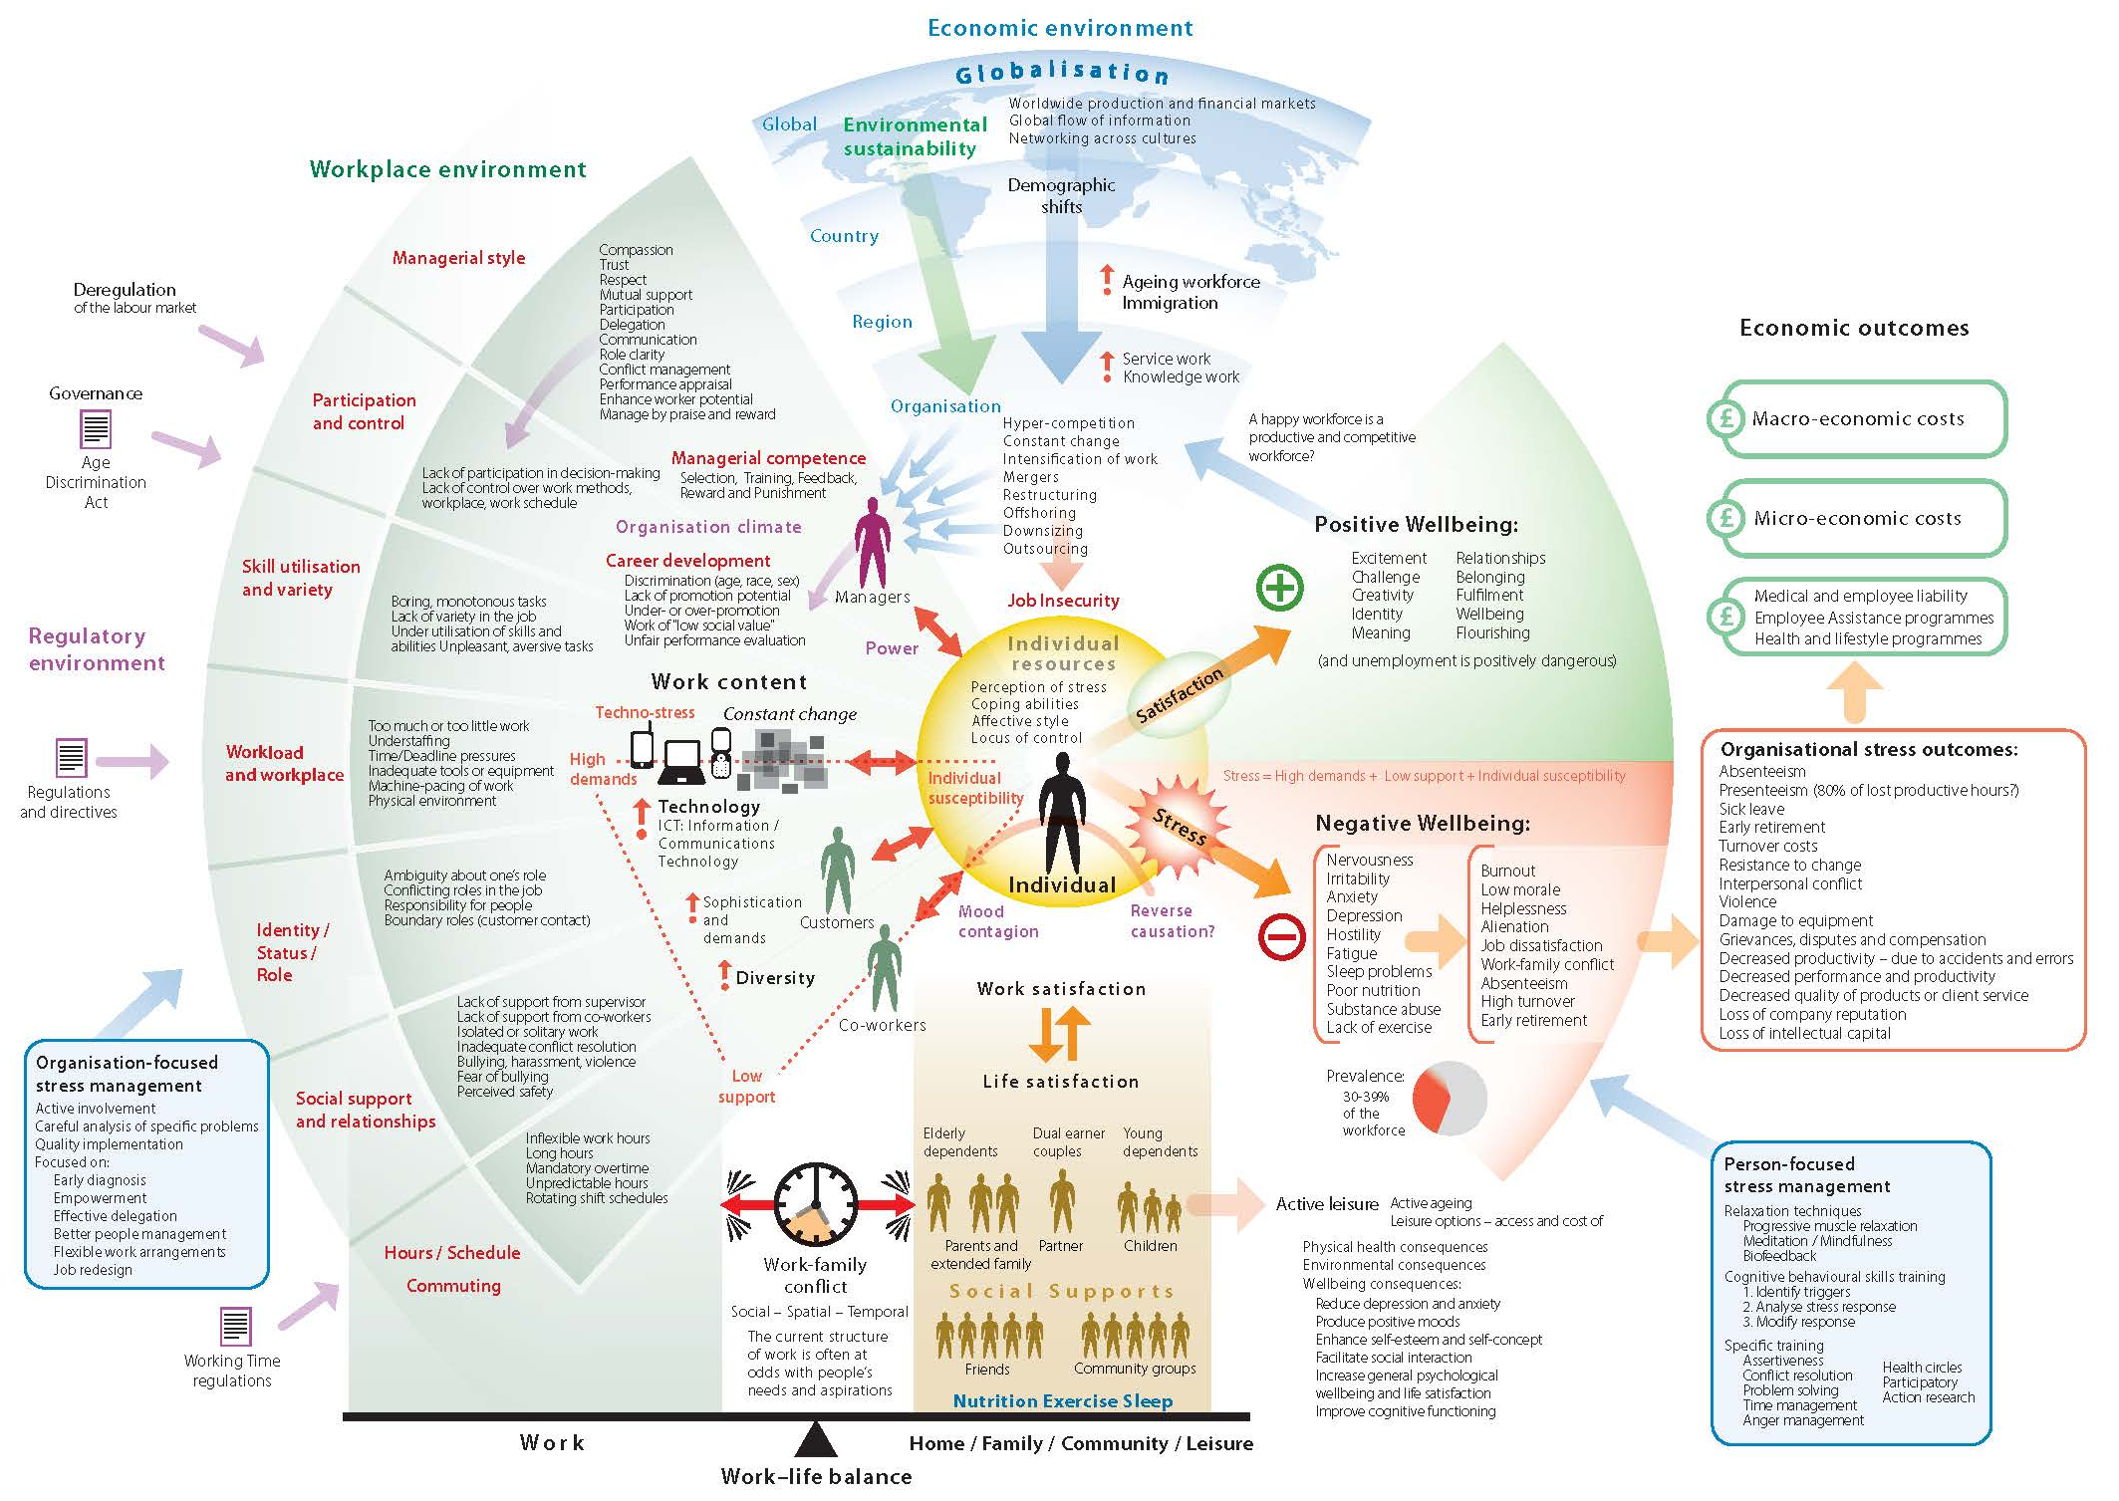
Framework 1: Me, We, Us

Slide 27
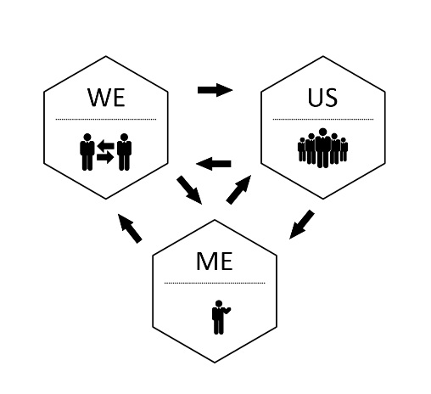
Framework: Me, We, Us
A framework to locate activities
The individual level (Me)
The group level (We)
The organisational level (Us)
Jarden, A., & Jarden, R. (2016). Positive psychological assessment for the workplace. In L. Oades et al. (Eds.), The Wiley-Blackwell Handbook of Positive Psychology at Work, pp. 415-437. Published Online: 19 Nov 2016: DOI: 10.1002/9781118977620.ch22

Slide 28
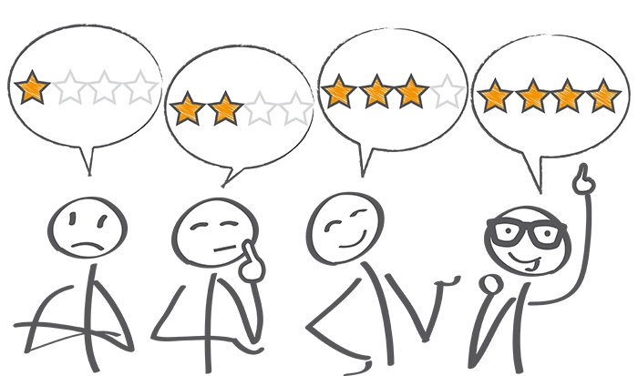
Wellbeing assessment
Assessment
How happy are you right now?
What would you pay / give / do / sacrifice / commit to in order to be, on average, one point happier?
10 - Extremely happy
9 - Very happy
8 - Pretty happy
7 - Mildly happy
6 - Slightly happy
5 - Neutral
4 - Slightly unhappy
3 - Mildly unhappy
2 - Pretty unhappy
1 - Very unhappy
0 - Extremely unhappy

Slide 29
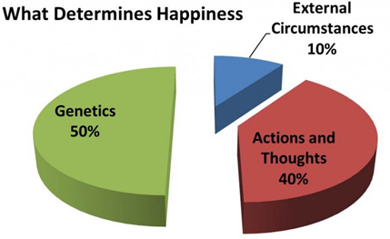
Context, processes, and guiding questions
Some points
I usually say: “This is an opportunity to make some changes, get renewed, re-energized, revitalized! It’s time to create change here in your own life – but realise that all change is hard and stressful, even positive change”.
It’s not just about learning to be more positive – it’s about using scientifically-informed tools and strategies to make your thinking more flexible, accurate, clear, and expansive. This thinking will lead to more healthy behaviours.
It’s not all about the positive and happiness, joy, joy... Accept the negative; it’s functional.
40% within your control, 10% circumstance, 50% genetic - so it is about choice.

Slide 30
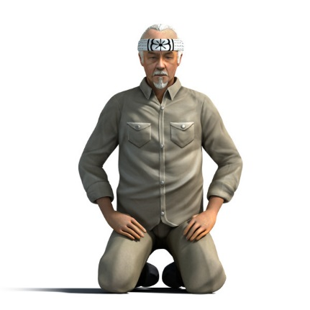
Questions
Questions
What's the best thing that has happened today?
“Answer not important, unless ask the right question”
What questions are you asking?
What's right?
What's good?
What works? What doesn’t?
What should I focus on? (what we focus on, grows…)
In which ways do I accept myself, and which ways don’t I accept myself?
What are my greatest strengths and competencies?, and how do I use them, capitalise on them?
Who are my most cherished relationships? How do they support me?
What would I like to learn?
What would I like to accomplish?

Slide 31
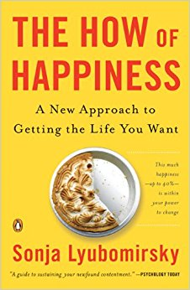
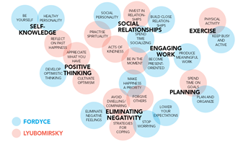
State of the research and findings
Some random points
Fordyce lists 14 techniques as fundamentals:
Keep busy and be more active.
Spend more time socializing.
Be productive at meaningful work.
Get better organized and plan things out.
Stop worrying.
Lower your expectations and aspirations.
Develop positive, optimistic thinking.
Become present oriented.
Work on a healthy personality.
Develop an outgoing, social personality.
Be yourself.
Eliminate negative feelings and problems.
Close relationships are the number one source of happiness.
Put happiness as your most important priority.

Slide 32
State of the research and findings
This study quantitatively assessed the size, disciplinary reach, impact, and topic breadth of positive psychology (PP),
in order to provide a comprehensive evaluation of the growth and significance of the field.
“Tracing the size, reach, impact, and breadth of positive psychology”

Slide 33
State of the research and findings
This study quantitatively assessed the size, disciplinary reach, impact, and topic breadth of positive psychology (PP),
in order to provide a comprehensive evaluation of the growth and significance of the field.
“Tracing the size, reach, impact, and breadth of positive psychology”

Slide 34
State of the research and findings

Slide 35
Efficacy vs effectiveness
In the real world…
Hone et al (2015) – “…synthesizing efficacy trials of PPIs reveals little evidence that these interventions translate into sustained programmes of behaviour change when applied beyond the tightly controlled conditions of the laboratory or psychology classroom setting”.
Parks et al (2012) - “...researchers have yet to offer persuasive evidence that happiness activities, as they are actually used in real-world settings, are beneficial”.
Hone, L., Jarden, A., & Schofield, G. (2015). An evaluation of positive psychology intervention effectiveness trials using the re-aim framework: A practice-friendly review. Journal of Positive Psychology, 10(4), 303-322.

Slide 36
Intervention 1 - Three breaths
The Geelong Three Breaths Exercise
Breath One. Take a deep breath. Notice your physical body and any points of pain or tension. Breath out slowly and release any tension away.
Breath Two. Take a deep breath. As you breathe out think about what you are grateful for right at this very moment. Say to yourself "Right now I am grateful for... ".
Breath Three. Take a deep breath. As you breathe out think what intentional state you want to be in right now. Say to yourself "My intention right now is to be (kind, open minded, relaxed, critical, curious etc)... ".
Developed by Justin Robinson at Geelong Grammar.

Slide 37
Intervention 2 - Savouring
Savouring involves being “in the moment” and “taking in” all that an experience has to offer. Think of it as wringing the pleasure juice out of life by giving attention to the pleasures of the moment.
Savouring can be used in a wide variety of circumstances – one can savour a sensory experience, a social experience, a feeling, or even a memory.
There are ten different types of savouring strategies - sharing with others, memory building, self-congratulation, sensory-perceptual sharpening, comparing, absorption, behavioural expression, temporal awareness, counting blessings, and kill-joy thinking.
We are going to try a combo of “sensory-perceptual sharpening” and “absorption”.

Slide 38
Intervention 2 - Savouring
Step 1: Get another almond.
Step 2: Take a close look at it – inspect it, examine it! What does it look like? Is it symmetrical?
Step 3: Close your eyes for the rest of this experience and feel it in your hand – what does the texture feel like?
Step 4: Smell it. What does it smell like?
Step 5: Put the almond into your mouth but do not bite or suck it – just let it rest on your tongue. Explore the almond with your tongue and teeth, noticing as much as you can.
Step 6: Bite slowly into it and focus on the taste. Swirl the contents of the almond around in your mouth.
Step 7: Swallow the almond and open your eyes.
Was it easy to stay focused as you became absorbed in the sensory experience?
What was it like to pay attention to each individual detail of the experience?
Was this almond more enjoyable than the previous almond?

Slide 39
Intervention 3 – Job crafting
It’s a bottom-up, employee led, approach about redesigning your job to better suit your values, strengths, and passions.
Objective is a more optimal fit between you and your job, boosting your happiness and effectiveness at work.
Connections go up, self-image goes up, sense of autonomy goes up (SDT).
Work with your manager:
What tasks can you change in your job? – add some, take some away, swap?
What relationships can you change in your job?
Can you change the perception of your job and the tasks you do? – create meaning?
Think about your values, strengths, and passions in your job specifically and the tasks you do. How can you change your tasks to better reflect your values, strengths, and passions?

Slide 40
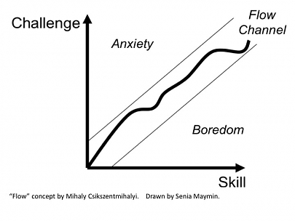
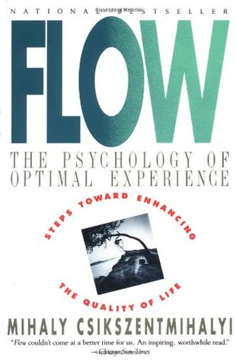
Intervention 3 – Job crafting
Craft for ‘flow’.
Mihaly Csikszentmihalyi
“Chick-sent-me-hi-ly”
Pair up, one person be a line manager and the other person initiate a conversation about job crafting during a performance appraisal.

Slide 41
Intervention 4 – Communication x 3
Active constructive responding (ACR)
There are four ways of responding, and active constructive responding has been shown to build solid, strong and lasting relationships the best.
ACR is a good way to convey understanding, validation and caring, and to increase the wellbeing of your existing friends, make new friends, and to encourage closer relationships.
Active Constructive Response involves expressing enthusiastic positive support = “That’s really great. Your wife will be pretty proud of you. I know how important that promotion was to you. We should go out and celebrate”. Maintaining eye contact, displaying positive emotion (smiling).
Active Destructive Response involves expressing a derogatory or critical response = “That sounds like a lot of responsibility to take on. More stress in the new position and longer hours at the office”. The person is displaying negative emotions, such as frowning or anxiety.
Passive Constructive Response involves showing benign disinterest = “That’s good news”. The person is displaying little nonverbal communication.
Passive Destructive Response involves distancing or failing to respond = “What are we doing Friday afternoon? ” Does not acknowledge good news, not in eye contact, turning away or leaving.

Slide 42
Intervention 4 - Communication x 3
DEAR
From Marsha M. Linehan’s - Dialectical Behaviour Therapy (DBT).
Describe the situation.
Express an Emotion.
Request an Action.
Reinforce the consequences of the action happening.

Slide 43
Intervention 4 - Communication x 3
High Quality Connections (HQC)
When was the last interaction at work that “lit you up” – that was a HQC.
People feel attuned and a sense of worth.
Benefits of HQC form page 12 of ‘how to be a positive leader’ book.
Type of actions or pathways to HQC’s:
Respect others – show them they are important. A good way is through being present. Effective listening – micro skills. Empathy.
Task enable others – facilitate others successes. Encourage, guide, support.
Trust others – don’t over monitor and control.
Play – team building, volunteering.
Let’s talk about exemplars of the above 4 types of actions you have seen?
What can you do?

Slide 44
Embedding and behaviour change
Some good exemplars…
CEO Friday lunch.
Cape of Awesomeness.
10/2 rule - Ritz-Carlton.
Gratitude walls.
Entrance door activities and messaging.
Team meetings – start with ‘what went well’, walking meetings.
Gamification (leader boards, points, etc.).
Visual things

Slide 45
Embedding and behaviour change
Essential elements
Wellbeing conversations, via:
Assessments.
Pre-existing events (xmas drinks, awards).
Specific wellbeing events and projects: AI.
Positive leadership and a clear co-developed vision.
Wellbeing champions – who start and keep projects going.
Budget and resources, policy impacts.
All three of Me, We and Us is the goal.
Celebrating success – regularly.

Slide 46
Embedding and behaviour change
More essential elements
Clear, minimal, communication (no long docs, less email).
Autonomy supportive.
Sense of meaning and job-crafting.
Transparency about what’s planned – trust.
Endorse things officially.
No one-size model – scientifically informed practice, trial and error.
Create time and space for wellbeing.
On-boarding is key!

Slide 47
Embedding and behaviour change
Even more essential elements
Timing important (when to introduce, when to embed).
Play is much underrated. As is simplification.
Utilisation of strengths.
Have an implementation plan.
Linking wellbeing metrics to KPI’s.
Informing all stakeholders of the wellbeing change – so they know what is, and has, changed.
Pull them into a better future, rather than push from the past.

Slide 48
Embedding and behaviour change
Big risks
Overpromise, under deliver – selling false hope.
Bad advice, poor program logic.
Low ROI, look bad to those above.
Bad apples and win-lose power struggles.
Enabling the lower ranks = look bad.
Expecting fast change – wellbeing is hard work.
A lack of leadership and top level support is the main reason for the failure to sustain changes in an organisation.

Slide 49
Embedding and behaviour change
An informed literature
Change must have a clear strategic mandate and be linked to a compelling rationale. Organisations are made up of individuals and we all respond to change differently. Some people like to move towards pleasure and others to move away from pain.
Organisations must bring to life the compelling rationale for the change they wish to drive through. A compelling vision must either represent the dire consequences of failing to act or a sufficiently exciting and motivating future state.
A vision alone is not sufficient to capture the hearts and minds of everyone but it is a good start. People must be able to make the link with what is important to them personally.

Slide 50
Embedding and behaviour change
An informed literature
The change must be driven top-down and bottom-up. The old adage of leading from the front is true but, for change to really stick, it must be driven throughout the organization.
In every company there are influential and dynamic individuals throughout the hierarchy; it is imperative that these individuals are ‘on side’ and championing the change from the bottom up and inside out. However, these individuals must still be supported by great leadership; it does not matter how galvanised the troops are, the change will fail if there is insufficient direction, support and drive from the top.

Slide 51
Embedding and behaviour change
An informed literature
The approach to embedding change must be holistic and systemic. All organizations are complex and dynamic systems, not simple and linear. As a result, a simple cause-and-effect approach to embedding change will not work – “I say change… you change” just does not wash in such a complex world.
There are a number of organizational ‘levers’ that need attention. For example, objectives, leadership, recruitment, promotion and training. Not all need to be ‘yanked’ but all need to be at least tweaked and nudged so they support each other and are all lined up.

Slide 52
Embedding and behaviour change
An informed literature
Focus should be on changing actual behaviours, not just rhetoric and enthusiasm. It is more effective to change what we can see - we can see how people behave.
The hardest organizational change to effect is that which requires people to think and feel differently, often referred to as ‘culture change’. Too often these change programmes fail because they are not grounded in what people are being asked to do that is different. Focus on what you want people to be ‘doing’.
Be prepared to ‘course correct’. Very few change programmes end up exactly where they predicted at the outset, for many reasons. Ensure you have checkpoints that enable you to see where progress is being made and where progress is not; redefining the course you are following as a consequence is vital to success.

Slide 53
Next steps
Wellbeing in higher education
http://www.wellbeinginhighereducation.com/

Slide 54
Ending…
Peak-end throey
Peak-end theory states that people’s judgments of their overall experience (like of this talk) is greatly influenced by the peak of their experience, and how it ends.
The research indicates that we judge our past experiences almost entirely on how they were at their peak and how they ended…
It has to do with our memory of experiences.

Slide 55
A quick overview
Invest time and effort in family connections.
We are social creatures so be enmeshed in a community of friends - deep and meaningful relationships.
Know your personal values and live by them. Similarly, know your purpose and what derives meaning for you.
Know you personal strengths and find ways to exercise them every day.
Develop and optimistic thinking style.
Invest your money in experiences rather than things.
Be in work, and work that you enjoy.
Be grateful.
Savour the now regularly – rather than the past or future.
Slow down – perhaps meditate?
Be curious.
Look after your health (the below 5 can make approximately 14 years difference to your life expectancy - the quality of both your current life and those extra 14 years):
Eat real food – not too much, and mostly plants.
Exercise regularly – and different types: aerobic, resistance, flexibility, balance.
Drink alcohol in moderation.
Don’t smoke.
Get enough quality sleep.

Slide 56
General discussion

Slide 57
Academic Wellbeing: “What does a good day at work look like for an academic?”
^{27th} October 2017
Dr Aaron Jarden
Wellbeing and Resilience Centre

