Slide 1
Positive Psychology & Rehabilitation
Dr Aaron Jarden
31st July 2015

Slide 2
Outline
What is positive psychology?
Ways to wellbeing
Positive Health

Slide 3
Positive introductions
Step 1: Pair up.
Step 2: In 2 minutes (1 minute each), tell a story – a thoughtful narrative with a beginning, middle and end – that illustrates when you are at your best.
Note: Swap when you hear the bell the first time after 1 minute, and then stop completely when you hear the bell the second time after 2 minutes.
Key point: Wield your strengths – they are paths to engagement and enjoyment.

Slide 4
What is positive psychology?
"There are two complementary strategies for improving the human condition. One is to relieve what is negative in life; the other is to strengthen what is positive. Mainstream psychology focuses largely on the first strategy; Positive Psychology emphasizes the second" - Martin Seligman
"Positive psychology is the scientific study of what enables individuals and communities to thrive" - International Positive Psychology Association.

Slide 5
What is positive psychology?
4 minute video animation

Slide 6
What is positive psychology?
Previous focus on pathology; disease model (what’s going wrong) – World Wars and trauma, and yet some great progress in treatment!
PP aims to improve quality of life (what’s going right) – for individuals and various groups to flourish…
A science of positive psychology – it’s not self help, or life coaching… Humanistic psychology did not have much of an empirical base…. PP is providing an empirically sound vision of the good life (what makes life worth living)…
Positive psychology interventions (PPI’s) work – roughly about d = .3 effect size (increasing good & reducing bad):
Sin, N. L., & Lyubomirsky, S. (2009). Enhancing well-being and alleviating depressive symptoms with positive psychology interventions: a practice-friendly meta-analysis [Meta-Analysis]. Journal of clinical psychology, 65(5), 467-487. doi:10.1002/jclp.20593
Bolier, L., Haverman, M., Westerhof, G. J., Riper, H., Smit, F., & Bohlmeijer, E. T. (2013). Positive psychology interventions: a meta-analysis of randomized controlled studies. BMC Public Health, 13(1), 119.

Slide 7
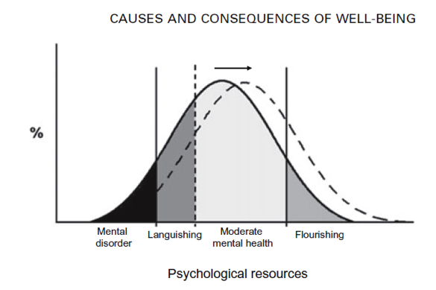
What is positive psychology?
PPI’s aim:
Fordyce pioneering work showed it was possible to significantly boost happiness levels among non-clinical populations using a package of interventions (Fordyce, 1977, 1983)
Past 15 years has seen rapid growth in interest and research in positive mental health.
Considerable positive outcomes associated with happiness (for a review see Lyubomirsky, King, & Diener, 2005).
Positive psychology’s academic output is growing proportionately faster than psychological research as a whole (Rusk & Waters, 2013).
Positive psychology related documents account for between 10% and 36% of research in the fields of counselling, education, organisational science, behavioural medicine, and health psychology (Rusk & Waters, 2013).

Slide 8
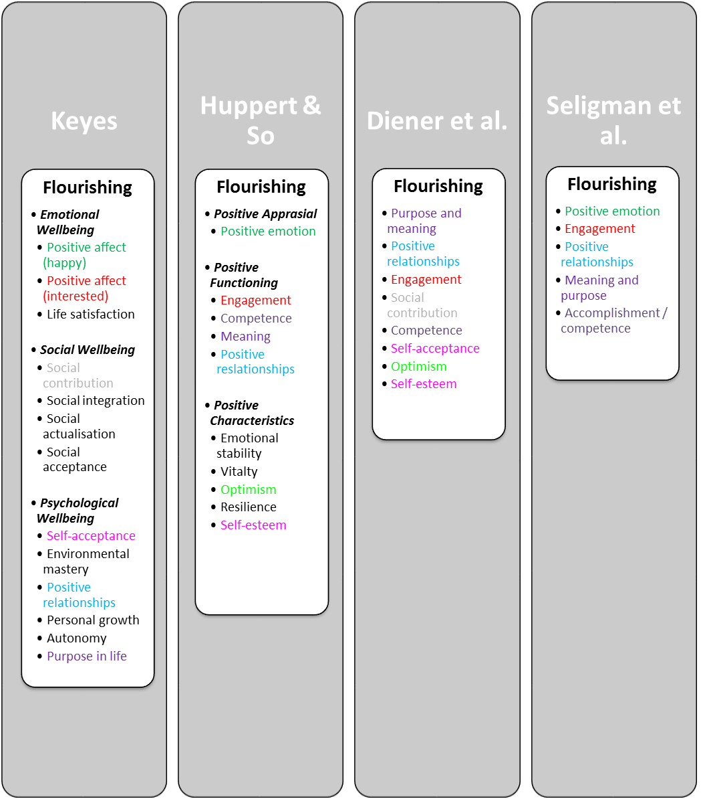
What is positive psychology?
Positive Education
Positive Health
Positive Assessment
Positive Psychotherapy
Positive Organisations

Slide 9
Five ways to wellbeing
Step 1: Pair up with a different partner, get a pen ready, as well as a blank A4 page…
Step 2: Raise a hand in the air when you're ready…
Step 3: Without looking down at your blank page, and ONLY looking at your partner’s face, you have 1 minute to draw a portrait of your partner, starting on the bell!
Step 4: Sign your name, date it, and swap pictures with your partner…

Slide 10
Five ways: connect, be active, take notice, keep learning, give
Connect – Make connections with friends, family, colleagues and neighbours. When you build these connections they help enrich your life with new experiences and opportunities. Be Active – Get moving. Walk, skip, run, dance – move your muscles. Exercise not only makes you feel good, it keeps you healthy. Pick a physical activity that you enjoy. Take Notice – Be mindful. Be curious. Like a child, see the wonder and beauty of the world. Notice the things around you – the weather, the landscape, the mood and feelings of the people around you. In noticing you learn to appreciate the things that matter. Keep Learning – We never stop learning. Keep trying something new – a new course you’ve been wanting to do or a more challenging task at work. Challenges keep us on our toes and increase our confidence and excitement in our day. Give – Be generous with your time, your knowledge and your talents, giving to friends, family and even strangers. Be thankful, smile at people, and volunteer. Sharing to a wider audience gives you a greater reward than just doing things for yourself.

Slide 11
Positive Health
The absence of disease is often taken to be equivalent to health. However, when disorders or illness ends, health or mental health is not always evident.

Slide 12
Positive Health
Positive Health is an interdisciplinary effort from cardiology, psychiatry, psychology, epidemiology, exercise science, and public health to examine what it means to be healthy above-and-beyond the absence of symptoms and diseases.
The field of positive health overlaps with other fields like disease prevention, health promotion, and wellness but has its own signature provided by its explicit focus on health assets.

Slide 13
Positive Health
Positive health is the scientific study of health assets: factors that produce longer life, lower morbidity, lower health care expenditure, better prognosis when illness strikes, and/or higher quality of physical health - over and above the usual suspect risk factors like hypertension, obesity, and a sedentary lifestyle.
Positive Health: http://positivehealthresearch.org/

Slide 14
Positive Health: 3 classes of assets
Positive Health focuses on promoting people’s positive health assets—strengths that can contribute to a healthier, longer life.
These assets might include:
biological factors such as high heart rate variability.
subjective factors such as optimism.
functional factors such as a stable marriage.
Positive health = excellent status on 3 assets.

Slide 15
Health Assets
Biological assets | Functional assets | Subjective (psychological) assets
high heart rate variability | notable sensory acuity | zest
high HDL/LDL ratio | exceptional central nervous system function (e.g., balance, coordination, cognition, and memory). | hope
high VO₂ max | social integration | life satisfaction
greater telomere length | marriage / relationships | happiness
low BMI |  | positive emotion
high levels of neuropeptide Y |  | curiosity
low levels of fibrinogen |  | optimism

Slide 16
Positive Health: Benefits
Increased longevity.
Decreased health costs.
Better mental health (esp in aging).
Better prognosis when ill.
Higher achievement.

Slide 17
Impact of Subjective Wellbeing on Health
Likelihood of contracting an illness.
Higher levels of positive emotions protect against various illness:
Heart disease.
Winter colds.
Length of life after contracting illness.
Longer, but:
A positive and optimistic viewpoint can hinder help seeking and adoption of medical advice.

Slide 18
Impact of Subjective wellbeing on Health
Persons life span.
Happier people live longer.

Slide 19
Predicting good health
So the point is that factors such as life satisfaction, happiness, positive emotions, optimism, self-regulation, meaning and purpose, engagement, and social support indeed predict good physical and mental health.
high optimism = low cardiovascular dieses.
optimism and positive emotion linked to better recovered after cardiac events.

Slide 20
Why care about Positive Health?
If we can identify potential health assets we can see if they may reveal a variety of potent, low-cost approaches to enhance wellbeing (a good in itself) and help protect against physical and mental illness.
If health assets can be scientifically linked to positive health outcomes, we can design interventions that can help build and sustain these assets to help people increase their chances of living a healthier, longer, happier life.

Slide 21
What is positive psychology?
14 minute video

Slide 22
Peak-end theory
Peak-end theory states that people’s judgments of their overall experience (like of this talk) is greatly influenced by the peak of their experience, and how it ends.
The research indicates that we judge our past experiences almost entirely on how they were at their peak and how they ended…
It has to do with our memory of experiences.

Slide 23
A wellbeing overview
Invest time and effort in family connections
We are social creatures so be enmeshed in a community of friends - deep and meaningful relationships
Know your personal values and live by them. Similarly, know your purpose and what derives meaning for you
Know you personal strengths and find ways to exercise them every day
Develop and optimistic thinking style
Invest your money in experiences rather than things
Be in work, and work that you enjoy
Be grateful
Savour the now regularly – rather than the past or future
Slow down – perhaps meditate?
Be curious
Look after your health (the below 5 can make approximately 14 years difference to your life expectancy - the quality of both your current life and those extra 14 years)
Eat real food – not too much, and mostly plants
Exercise regularly – and different types: aerobic, resistance, flexibility, balance
Drink alcohol in moderation
Don’t smoke
Get enough quality sleep
Caveat: Genetics and upbringing also make a slight bit of difference, but since you can’t do too much about those, don’t worry about them…
Notes:
Use simple and effective wellbeing boosts
Add a dose of science and gather better data to inform your own personal change – quantify your reflections

Slide 24
Free Association
New Zealand Association of Positive Psychology
List of further resources for learning more about positive psychology on this website:
http://www.positivepsychology.org.nz/

