Slide 1
An invitation to notions related to positive health
Dr Aaron Jarden & Matt Iaseillo
aaron.jarden@sahmri.com
5th December 2017
Copy of these slides at: www.aaronjarden.com

Slide 2
Overview
Positive psychology and positive psychotherapy (5 mins).
Positive health (15 mins).
Research (10 mins).
Positive life events and depression.
Strengths and goal obtainment.
Gratitude over the lifespan.
Resilient futures.
Complete mental health (Matt Iaseillo) (10 mins).
The Wellbeing and Resilience Centre (5 mins).
Questions (15 mins).
Applause or ridicule.

Slide 4
Positive psychology
What is positive psychology?
"There are two complementary strategies for improving the human condition. One is to relieve what is negative in life; the other is to strengthen what is positive. Mainstream psychology focuses largely on the first strategy; Positive Psychology emphasizes the second" - Martin Seligman
"Positive psychology is the scientific study of what enables individuals and communities to thrive" - International Positive Psychology Association.
Positive psychology is the study of topics as diverse as happiness, optimism, hope, flow, meaning, subjective wellbeing and personal growth.
Positive psychology is a branch of psychology that conducts scientific inquiry into the factors that help individuals, communities and organisations thrive.

Slide 5
Positive psychology
What is positive psychology?
Positive psychology aims to expand psychology from its focus on repairing the negatives in life to also promoting the positives in life.

Slide 6
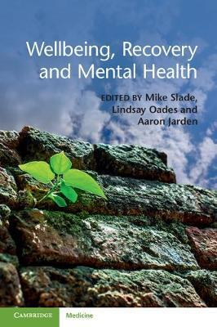
Positive psychotherapy
What is positive psychotherapy?
Also called positive clinical psychology.
Positive Psychotherapy (PPT) is a therapeutic endeavour within positive psychology to broaden the scope of traditional psychotherapy. Its central premise is to address positive resources of clients such as positive emotions, character strengths and meaning - in addition to treating symptoms - in treating psychopathology.
Accentuating positive resources may serve clients best not when life is easy, but when life is difficult.
(http://tayyabrashid.com/pdf/ppt.pdf) or

Slide 7
Positive psychotherapy
What is positive psychotherapy?
Positive psychotherapy is based on three assumptions (Rashid & Seligman, 2013).
First, clients inherently desire growth, fulfillment and happiness instead of just seeking to avoid misery, worry and anxiety.
Second, positive resources such as strengths are authentic and as real as symptoms and disorders.
Third, effective therapeutic relationships can be formed through the discussion and manifestation of positive resources, not only thorough lengthy analysis of weaknesses and deficits.

Slide 8
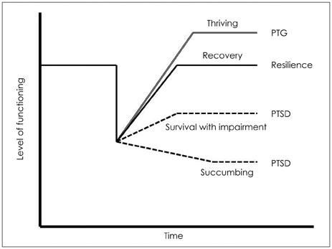
Positive psychotherapy
What is post-traumatic growth?
PTG is positive change experienced as a result of the struggle with a major life crisis or a traumatic event.
Meaning and purpose
Can cope, have strengths
Ask for help

Slide 9
Positive health
What is positive health?
Positive Health is an interdisciplinary effort from cardiology, psychiatry, psychology, epidemiology, exercise science, and public health to examine what it means to be healthy above-and-beyond the absence of symptoms and diseases.
The newly developing field of positive health overlaps with other fields like disease prevention, health promotion, and wellness but has its own signature provided by its explicit focus on health assets - factors that produce longer life, lower morbidity, lower health care expenditure, better prognosis when illness strikes, and/or higher quality of physical health.
These assets might include:
biological factors such as high heart rate variability.
subjective factors such as optimism.
functional factors such as a stable marriage.
Positive health = excellent status on 3 assets.

Slide 10
Positive health
What is positive health?
Health assets:
Biological assets | Functional assets | Subjective (psychological) assets
high heart rate variability | notable sensory acuity | zest
high HDL/LDL ratio | exceptional central nervous system function (e.g., balance, coordination, cognition, and memory). | hope
high VO₂ max | social integration | life satisfaction
greater telomere length | marriage / relationships | happiness
low BMI |  | positive emotion
high levels of neuropeptide Y |  | curiosity
low levels of fibrinogen |  | optimism

Slide 11
Positive health
What is positive health?
An example, kindness and heart health:
Oxytocin causes the release of nitric oxide in blood vessels, which dilates the blood vessels. This reduces blood pressure and therefore oxytocin is known as a ‘cardioprotective’ hormone because it protects the heart by lowering blood pressure.
We know that acts of kindness can produce oxytocin and therefore kindness can be said to be cardioprotective. Other similar notions, like compassion training, also have the same effect…

Slide 12
Positive health
What is positive health?
Another example, optimism and cardiovascular disease (CVD)
In the mid-1980s, 120 men from San Francisco had their first heart attacks, and they served as the untreated control group in the MR FIT study. This study disappointed many psychologists and cardiologists by ultimately finding no effect on CVD by training to change these men’s personalities from type A (aggressive, time urgent, and hostile) to type B (easygoing).
So much was known about their first heart attacks: Extent of damage to the heart, blood pressure, cholesterol, body mass, and lifestyle - all the traditional risk factors for cardiovascular disease. In addition, the men were all interviewed about their lives: Family, job, and hobbies.
Seligman: We took every single “because” statement from each of their videotaped interviews and coded it for optimism and pessimism.

Slide 13
Positive health
What is positive health?
Within eight and a half years, half the men had died of a second heart attack, and we opened the sealed envelope.
Could we predict who would have a second heart attack?
None of the usual risk factors predicted death: Not blood pressure, not cholesterol, not even how extensive the damage from the first heart attack.
Only optimism, eight and a half years earlier, predicted a second heart attack: Of the sixteen most pessimistic men, fifteen died. Of the sixteen most optimistic men, only five died.

Slide 14
Positive health
What is positive health?
All studies of optimism and CVD converge on the conclusion that optimism is strongly related to protection from cardiovascular disease. This holds even correcting for all the traditional risk factors such as obesity, smoking, excessive alcohol use, high cholesterol, and hypertension. It even holds correcting for depression, correcting for perceived stress, and correcting for momentary positive emotions. It holds over different ways of measuring optimism.
However, note that an optimistic viewpoint can hinder help seeking and adoption of medical advice.

Slide 15
Positive health
Benefits of positive health?
Increased longevity.
Better mental health (esp in aging).
Better prognosis when ill.
Higher achievement.
Decreased health costs.
Higher levels of positive emotions protect against various illness:
Heart disease (not just protective, better recovery).
Winter colds (rhinovirus).

Slide 16
Positive health
Why care?
If we can identify potential health assets we can see if they may reveal a variety of potent, low-cost approaches to enhance wellbeing (a good in itself) and help protect against physical and mental illness.
If health assets can be scientifically linked to positive health outcomes, we can design interventions that can help build and sustain these assets to help people increase their chances of living a healthier, longer, happier life.

Slide 17
Positive health
Take home messages.
Factors such as life satisfaction, happiness, positive emotions, optimism, self-regulation, meaning and purpose, engagement, and social support indeed predict good physical and mental health.
If you are interested in good physical and mental health, you should be interested in these things which impact health.
http://positivehealthresearch.org
Next step, Sarah Pressman TED Talk: Why doctors should care about happiness.

Slide 18
Research
Moving on now to some of our research…

Slide 19
Research example: 1
Positive life events and depression.
Research has shown that positive life events contribute to the remission and recovery of depression; however, it is unclear how positive life events are generated…
Our aim: could personality strengths predict positive life events that aid in the alleviation of depression?
We focused on the personality strengths of gratitude and meaning in life.
International Wellbeing Study sample of 797 adults, 43 countries, 13 languages, completed assessment battery every 3 months for a year (5 times).
Depression (CES-D, 20 items). Positive Life Events (5 items).
Gratitude (GQ-6, 6 items). Meaning in Life (MLQ-P, 5 items)

Slide 20
Research example: 1
Positive life events and depression.
Hypotheses:
H1 = personality strengths predicting positive life events.
H2 = positive life events predicting depression.
H3 = greater initial depression would weaken the impact of personality strengths on positive life events.
H4 = greater initial depression would make the impact of positive life events stronger on depression.

Slide 21
Research example: 1
Positive life events and depression.
Hypotheses:
H1 = personality strengths predicting positive life events.✓
H2 = positive life events predicting depression. ✓ (3 months only)
H3 = greater initial depression would weaken the impact of personality strengths on positive life events. X
H4 = greater initial depression would make the impact of positive life events stronger on depression. ✓

Slide 22
Research example: 1
Take home message.
Regardless of initial level of depression, in the short term (3 months, not 6 months) both gratitude and meaning increase positive life events, which impact depression.

Slide 23
Research example: 2
Strengths and goal obtainment.
We examined if 10 different personality strengths predicted goal obtainment (H1), and as moderators of goal obtainment effects upon boosted subjective wellbeing (H2).
International Wellbeing Study sample of 755 adults, 40 countries, completed assessment battery every 3 months for a year (5 times).
Grit
Gratitude
Curiosity
Savouring
Control beliefs
Meaning in life – presence
Strengths use
Orientations to happiness - Engagement
Orientations to happiness - Pleasure
Orientations to happiness - Meaning

Slide 24
Research example: 2
Strengths and goal obtainment.
The main conclusions of our study are that:
Grit gets you the most goal attainment,
that Curiosity gets you the most SWB bang for your goal-striving buck (3 months),
and that developing an enhanced Meaning orientation, while striving, may best serve to prolong one’s SWB gains (6 months).

Slide 25
Research example: 2
Take home messages.
We don’t know really how to make someone “gritter” (yet), but it’s very easy to increase trait curiosity, and likewise move someone towards a meaning orientation…
Use curiosity to help obtain goals, as not only will it allow greater goal obtainment, but it allows greater enjoyment of the goal obtainment process, and then make some meaning of the goals obtained in order to wring the pleasure juices out of the wellbeing effects…

Slide 26
Research example: 3
Gratitude over the lifespan.
There is a strong link between gratitude and wellbeing, and also gratitude and health outcomes (particularly with older adults).
Most of the research on gratitude has been on the measurement of it, how to increase it, it’s impacts, and has used mostly student samples.
Questions remain as to whether the presence and benefits of gratitude are consistent from young adulthood to old age.
We examined the magnitude and direction of age differences in gratitude in three samples (combined N = 31,206), measured three different ways, controlling for gender (women usually higher in gratitude).
We also examined whether gratitude was associated with greater/lesser wellbeing at different periods in the life course.

Slide 27
Research example: 3
Gratitude over the lifespan.
We found that the experience of gratitude was greatest in older adults and least in middle aged and younger adults.
We also found that the associations between gratitude and subjective wellbeing remained relatively constant across the lifespan – near-zero effect size (i.e., no particular age more or less strongly associated with gratitude/wellbeing link).

Slide 28
Research example: 3
Take home messages.
Gratitude increases with age, but the data is a little shaky past 70+.
Gratitude is always important, regardless of age, for health and wellbeing.

Slide 29
Research example: 4
Resilient futures.
Young people living in disadvantage are at elevated risk of a range of negative life outcomes, including social exclusion, impaired health and wellbeing, and low educational or vocational participation.
The Resilient Futures program was conceptualised and developed as a strength-focused intervention whose design was underpinned by a broad interdisciplinary range of scientific evidence.
The program utilises an ecological framework that sought to target key proximal and distal factors associated with youth social exclusion, disengagement and disadvantage.
The target participant group was 850 disadvantaged young South Australians (aged 16 to 21) drawn from multiple educational, mental health and youth justice agencies; who were project partners in co-designing and supporting the implementation.

Slide 30
Research example: 4
Resilient futures.
The intervention was designed to build wellbeing and resilience skills through explicit (direct teaching) and implicit (mentoring, case management) teaching methods, supported by system-focused methods to build the capacity of service providers.
The Resilient Futures program uses a non-prescriptive and flexible delivery method, guided by the implementation science literature, and underpinned by an intentional practice model - operationalised at both the program design and service delivery layers of the program.
There were key challenges in delivering a wellbeing and resilience program across multiple sites for a disadvantaged cohort, and the methods the project team developed to bring focus to implementation quality and rigour was award winning.
Preliminary qualitative evidence supporting the effectiveness of the program is very good.

Slide 31
Research example: 4
Take home messages.
New and novel intervention approaches are needed, beyond efficacy trails, to real world effectiveness trials.

Slide 32
High level of Wellbeing
COMPLETE MENTAL HEALTH
High Mental Illness Symptoms
Low Mental Illness Symptoms
Low level of Wellbeing
(Keyes, 2005)

Slide 33
Jane Smith
Log out
Take the Test
Wellbeing
Receptivity to Intervention types
Mental Illness
Sleep
Demographics / SES
Nutrition
Personality Type
Physical Activity

Slide 34
High level of Wellbeing
COMPLETE MENTAL HEALTH
Wellbeing Intervention
High Mental Illness Symptoms
Low Mental Illness Symptoms
Traditional psychological intervention
GOAL:
To understand who is most likely to benefit from which intervention
Low level of Wellbeing
(Keyes, 2005)

Slide 35
High level of Wellbeing
COMPLETE MENTAL HEALTH
Physical Health
Housing
Employment
High Mental Illness Symptoms
Low Mental Illness Symptoms
Relationships
Purpose
Agency
Low level of Wellbeing
(Keyes, 2005)

Slide 36
High level of Wellbeing
COMPLETE MENTAL HEALTH
High Income
High Mental Illness Symptoms
Low Mental Illness Symptoms
Low Income
Low level of Wellbeing

Slide 37
High level of Wellbeing
COMPLETE MENTAL HEALTH
Stable Housing
High Mental Illness Symptoms
Low Mental Illness Symptoms
Unstable Housing
Low level of Wellbeing

Slide 38
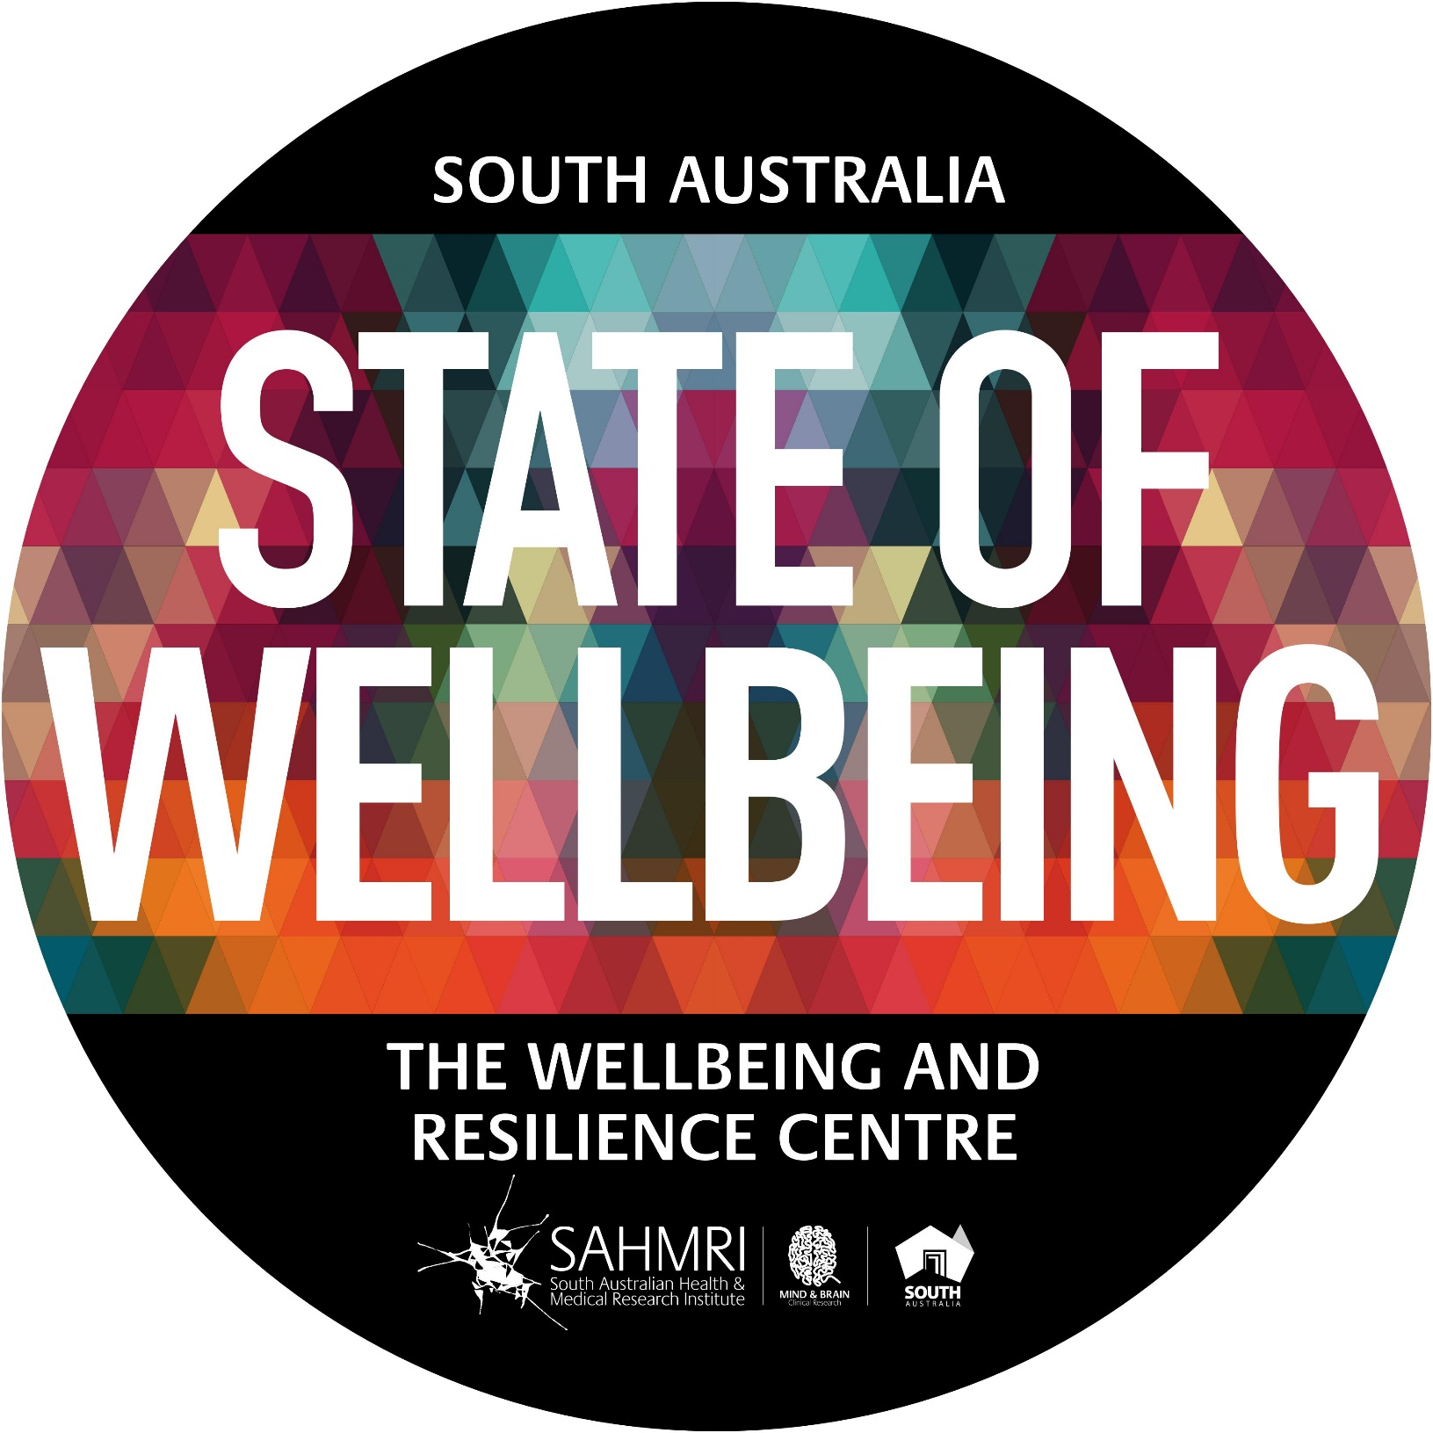
Now
“Wellbeing is measurable, teachable and learnable”

Slide 39
Positive mental health and wellbeing for a resilient society.
Position South Australia as the State of Wellbeing
Measure the wellbeing of all South Australians and beyond
Teach, build and embed wellbeing science
Generate and publish research on how to build wellbeing efficiently, at scale, across the life course
LEAD ➔ INITIATE
MEASURE
BUILD ➔ EMBED
RESEARCH
Organisations, Government, Schools, Ageing, Youth, Community

Slide 40
RESULTS Auto-manufacturing industry
Notes:
Projected that between 14 000 to 25000 will be lost from the departure of the car industry. Our economy is transforming and is creating significant unemployment. It is our belief that the LMBE Model of teaching resilience skills could be useful to manufacturing workers in anticipation of the unemployment tsunami.

Slide 41
Insight into drivers…

Slide 42
Tool
Geelong Breathing
Breath One. Take a deep breath in through your nose and fill your lungs with as much air as possible. As you are doing so, notice your physical body and any points of pain or tension. As you breath out slowly through your mouth, imagine you are pushing or releasing any tension away. Feel yourself sink into your chair or the floor if you are standing.
Breath Two. Take a deep breath in through your nose and fill your lungs with as much air as possible. Now as you breathe out think about what you are grateful for right at this very moment. Not what you are grateful for that has happened in the past, or looking towards the future, but right in this very moment think about one thing you are grateful for and exhale slowly. Say to yourself “Right now I am grateful for...”.
Breath Three. Take a deep breath in through your nose and fill your lungs with as much air as possible. Now as you breathe out think about your frame of reference and what intentional state you want to be in right now. Do you intend to be kind? Do you intend to be open minded? Do you intend to be peaceful? Whatever intention you wish to have at this present moment, cultivate it when you exhale by saying to yourself “My intention right now is to be …”.
Credit: This exercise was developed by Justin Robinson, Head of Positive Education at Geelong Grammer School in Australia

Slide 43
Thank you
Dr Aaron Jarden & Matt Iaseillo
aaron.jarden@sahmri.com
5th December 2017
Copy of these slides at: www.aaronjarden.com

