Slide 1
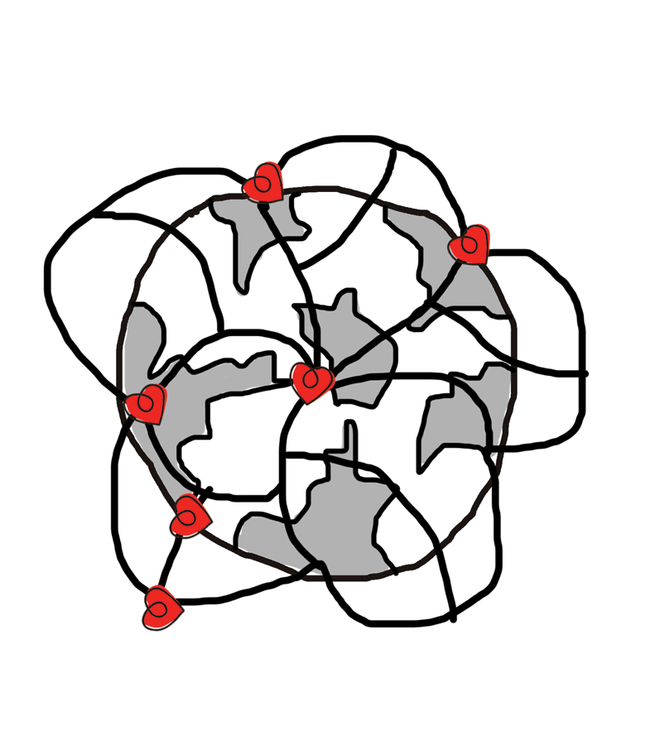
Embedding Positive Psychology Across Organisations
Dr Aaron Jarden
November 2016
www.aaronjarden.com

Slide 2
Outline
Who is Aaron?
Some beautiful questions.
Some exemplars of embedding wellbeing.
What’s essential to making it all work?
The big, bad risks.
What does the literature suggest.
Questions? Own insights?
www.ourpluswellbeing.com

Slide 3
Aaron
Dr Aaron Jarden is a Senior Lecturer at Auckland University of Technology, wellbeing consultant and social entrepreneur. He has multiple qualifications in philosophy, computing, education, and psychology, and is a prolific author and presenter. Dr Jarden consults to many of New Zealand and Australia’s top companies, and both governments. He is also co-founder and co-editor of the International Journal of Wellbeing, president of the New Zealand Association of Positive Psychology, lead investigator for the International Wellbeing Study, co-investigator of the Sovereign New Zealand Wellbeing Index, founder of The Tuesday Program, co-founder of Heart of Wellbeing, and Senior Scientist for to companies Work on Wellbeing, Assessing Wellbeing in Education, and Plus Wellbeing.
www.ourpluswellbeing.com

Slide 4
Some beautiful questions
What’s working?
What has already been embedded within the organisation?
Why is it working?
What (or more likely who) has sustained this embedding?
What are the positive processes? How did it happen?
What has failed?
Why?
Disengaged Health & Safety?
www.ourpluswellbeing.com

Slide 5
Some beautiful questions
How will you know wellbeing has worked?
Types of evidence & triangulating information.
Measuring IV’s and DV’s - Indicators of change.
Pre – post – longer term assessment.
Is the organisation ready and willing for wellbeing? (or more likely ‘who’ in the organisation is ready?).
Is the organisation connected to wellbeing people and knowledge? (support)
www.ourpluswellbeing.com

Slide 6
Some beautiful questions
Why are the employees working there? What do they want out of work? (what does a good day at work look like?)
Is there much point increasing wellbeing, when illbeing is getting worse?
How will the organisation capitalise on other opportunities during the wellbeing change?
www.ourpluswellbeing.com

Slide 7
Some good exemplars…
CEO Friday lunch.
Cape of Awesomeness.
10/2 rule - Ritz-Carlton.
Gratitude walls.
Entrance door activities and messaging.
Team meetings – start with ‘what went well’, walking meetings.
Gamification (leader boards, points, etc.).
Visual things
www.ourpluswellbeing.com

Slide 8
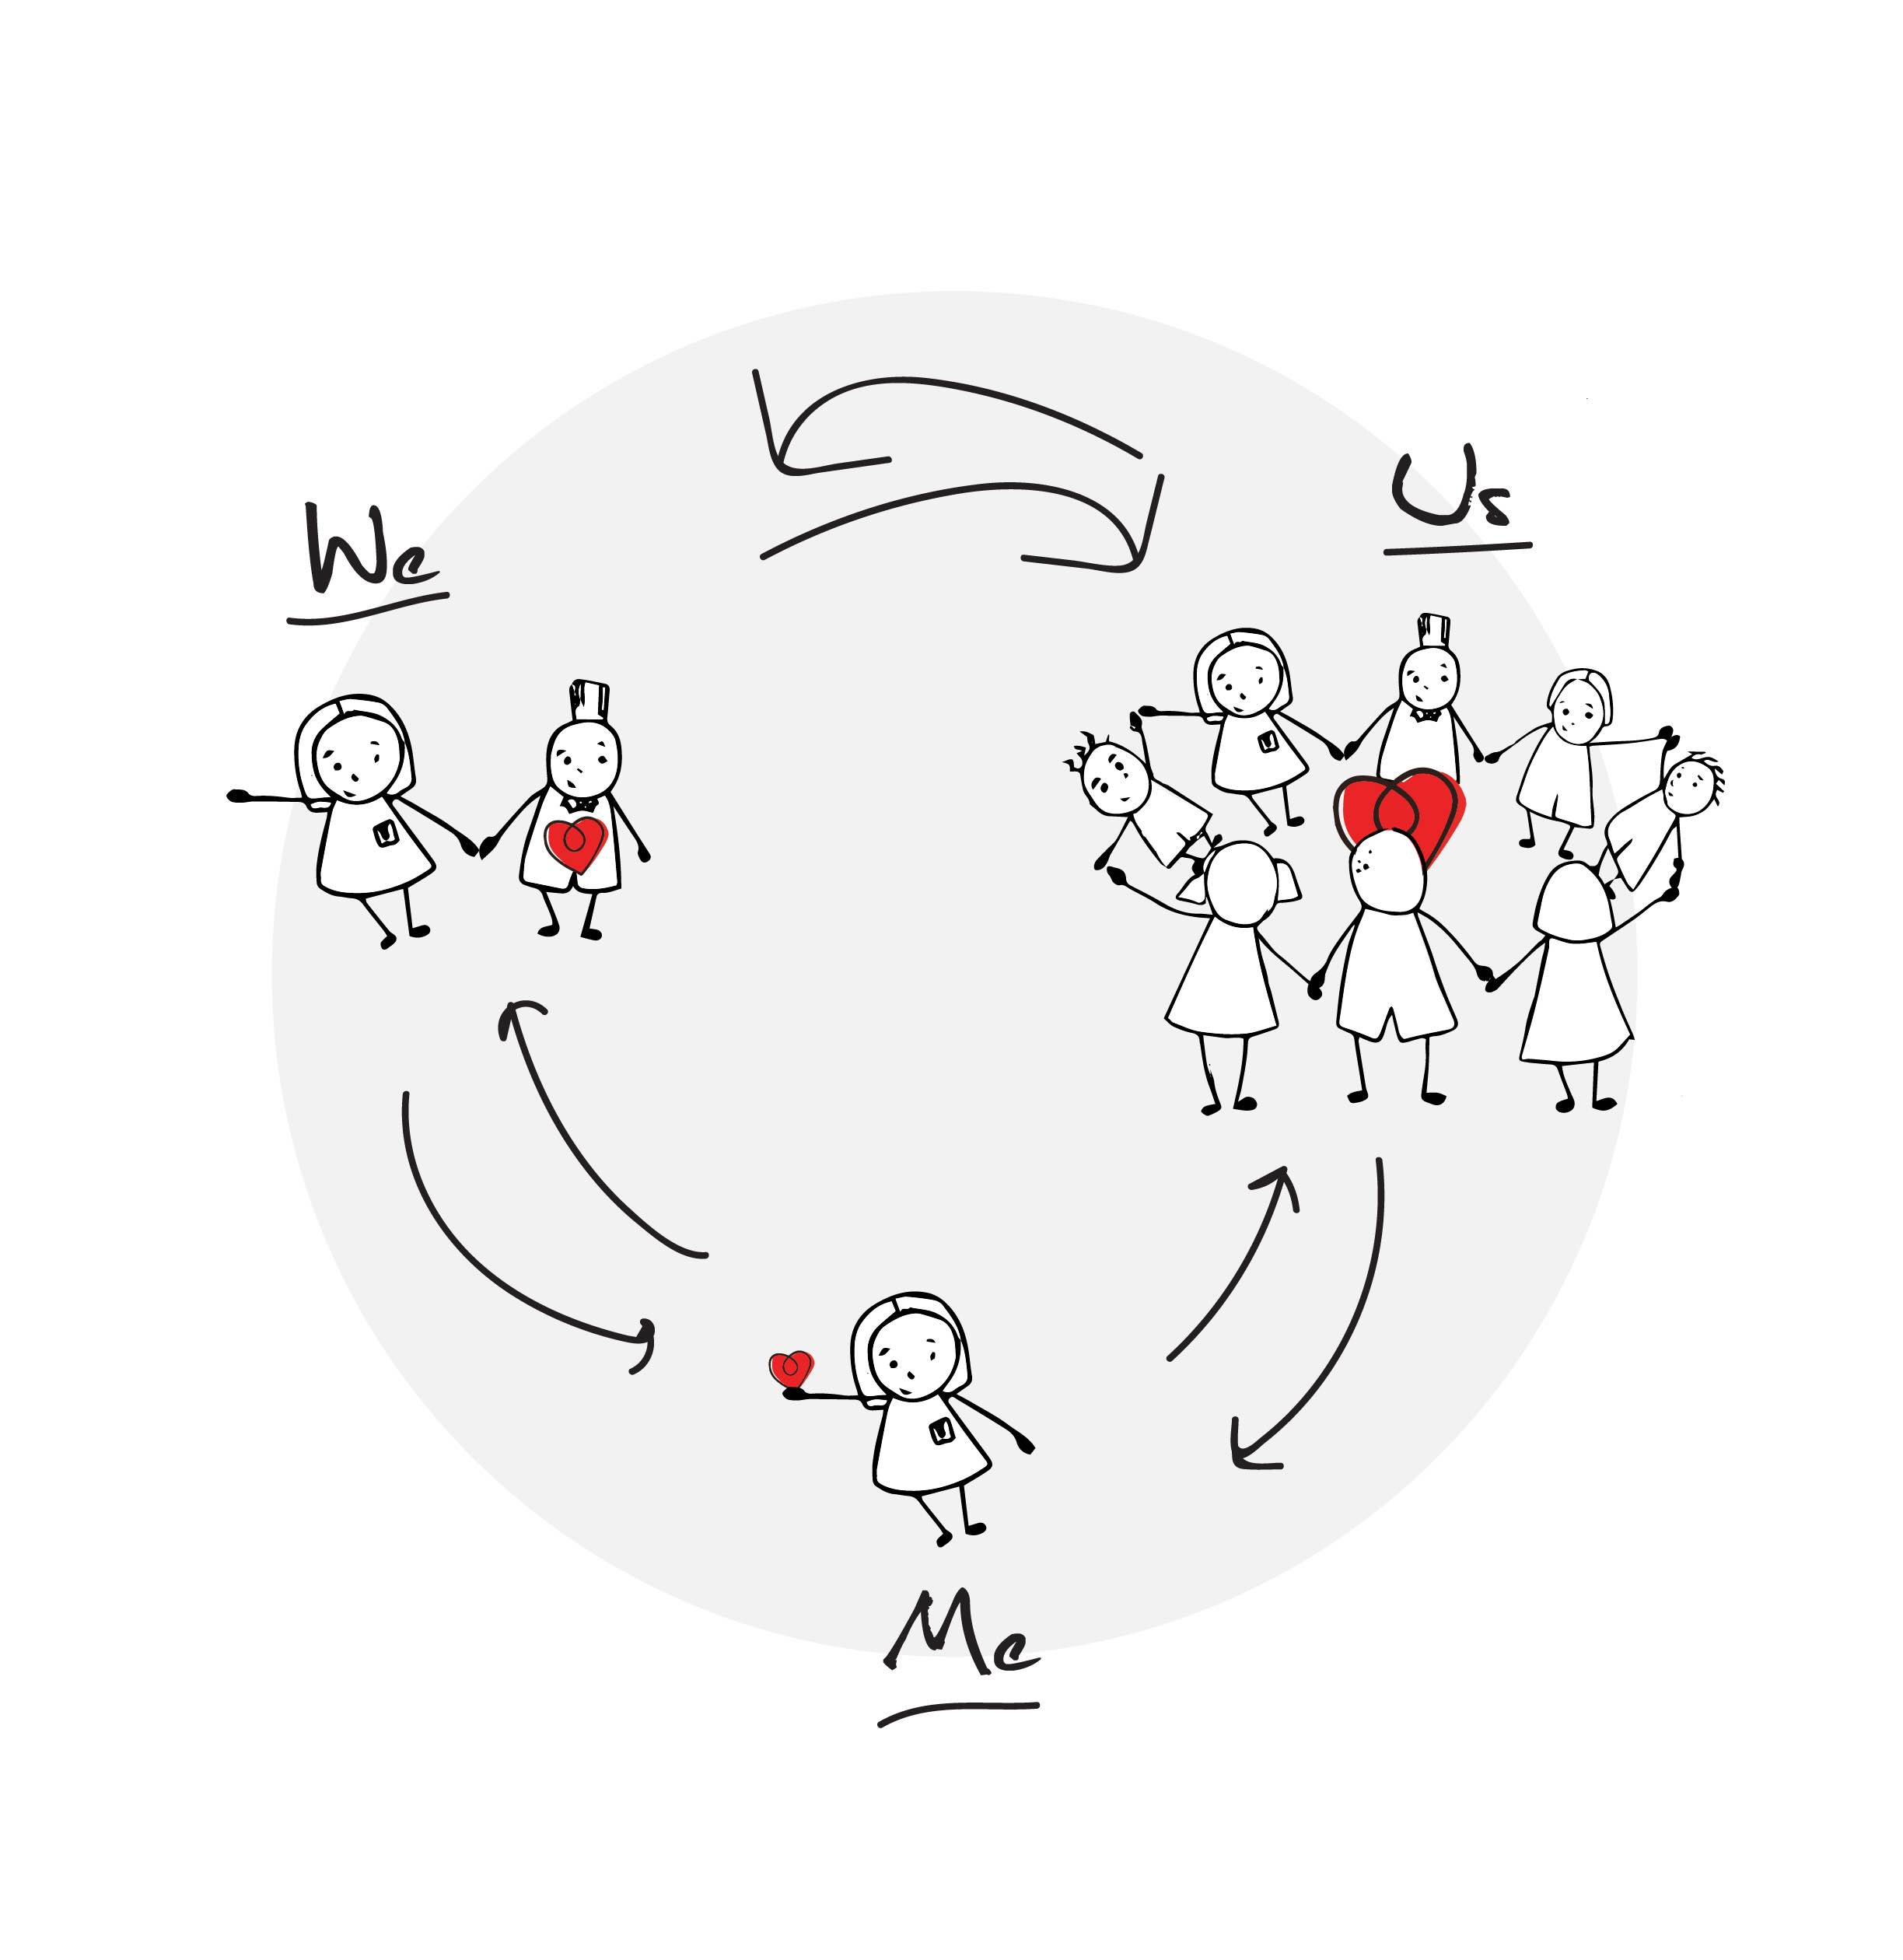
Essential elements…
Wellbeing conversations, via:
Assesments.
Pre-existing events (xmas drinks, awards).
Specific wellbeing events and projects: AI.
Positive leadership and a clear co-developed vision.
Wellbeing champions – who start and keep projects going.
Budget and resources.
All three of Me, We and Us.
Celebrating success – regularly.
www.ourpluswellbeing.com

Slide 9
More essentials…
Clear, minimal, communication (no long docs, less email).
Autonomy supportive.
Sense of meaning and job-crafting.
Transparency about what’s planned – Trust.
Endorse things officially.
No one-size model – scientifically informed practice, trial and error.
Create time and space for wellbeing.
On-boarding is key!
www.ourpluswellbeing.com

Slide 10
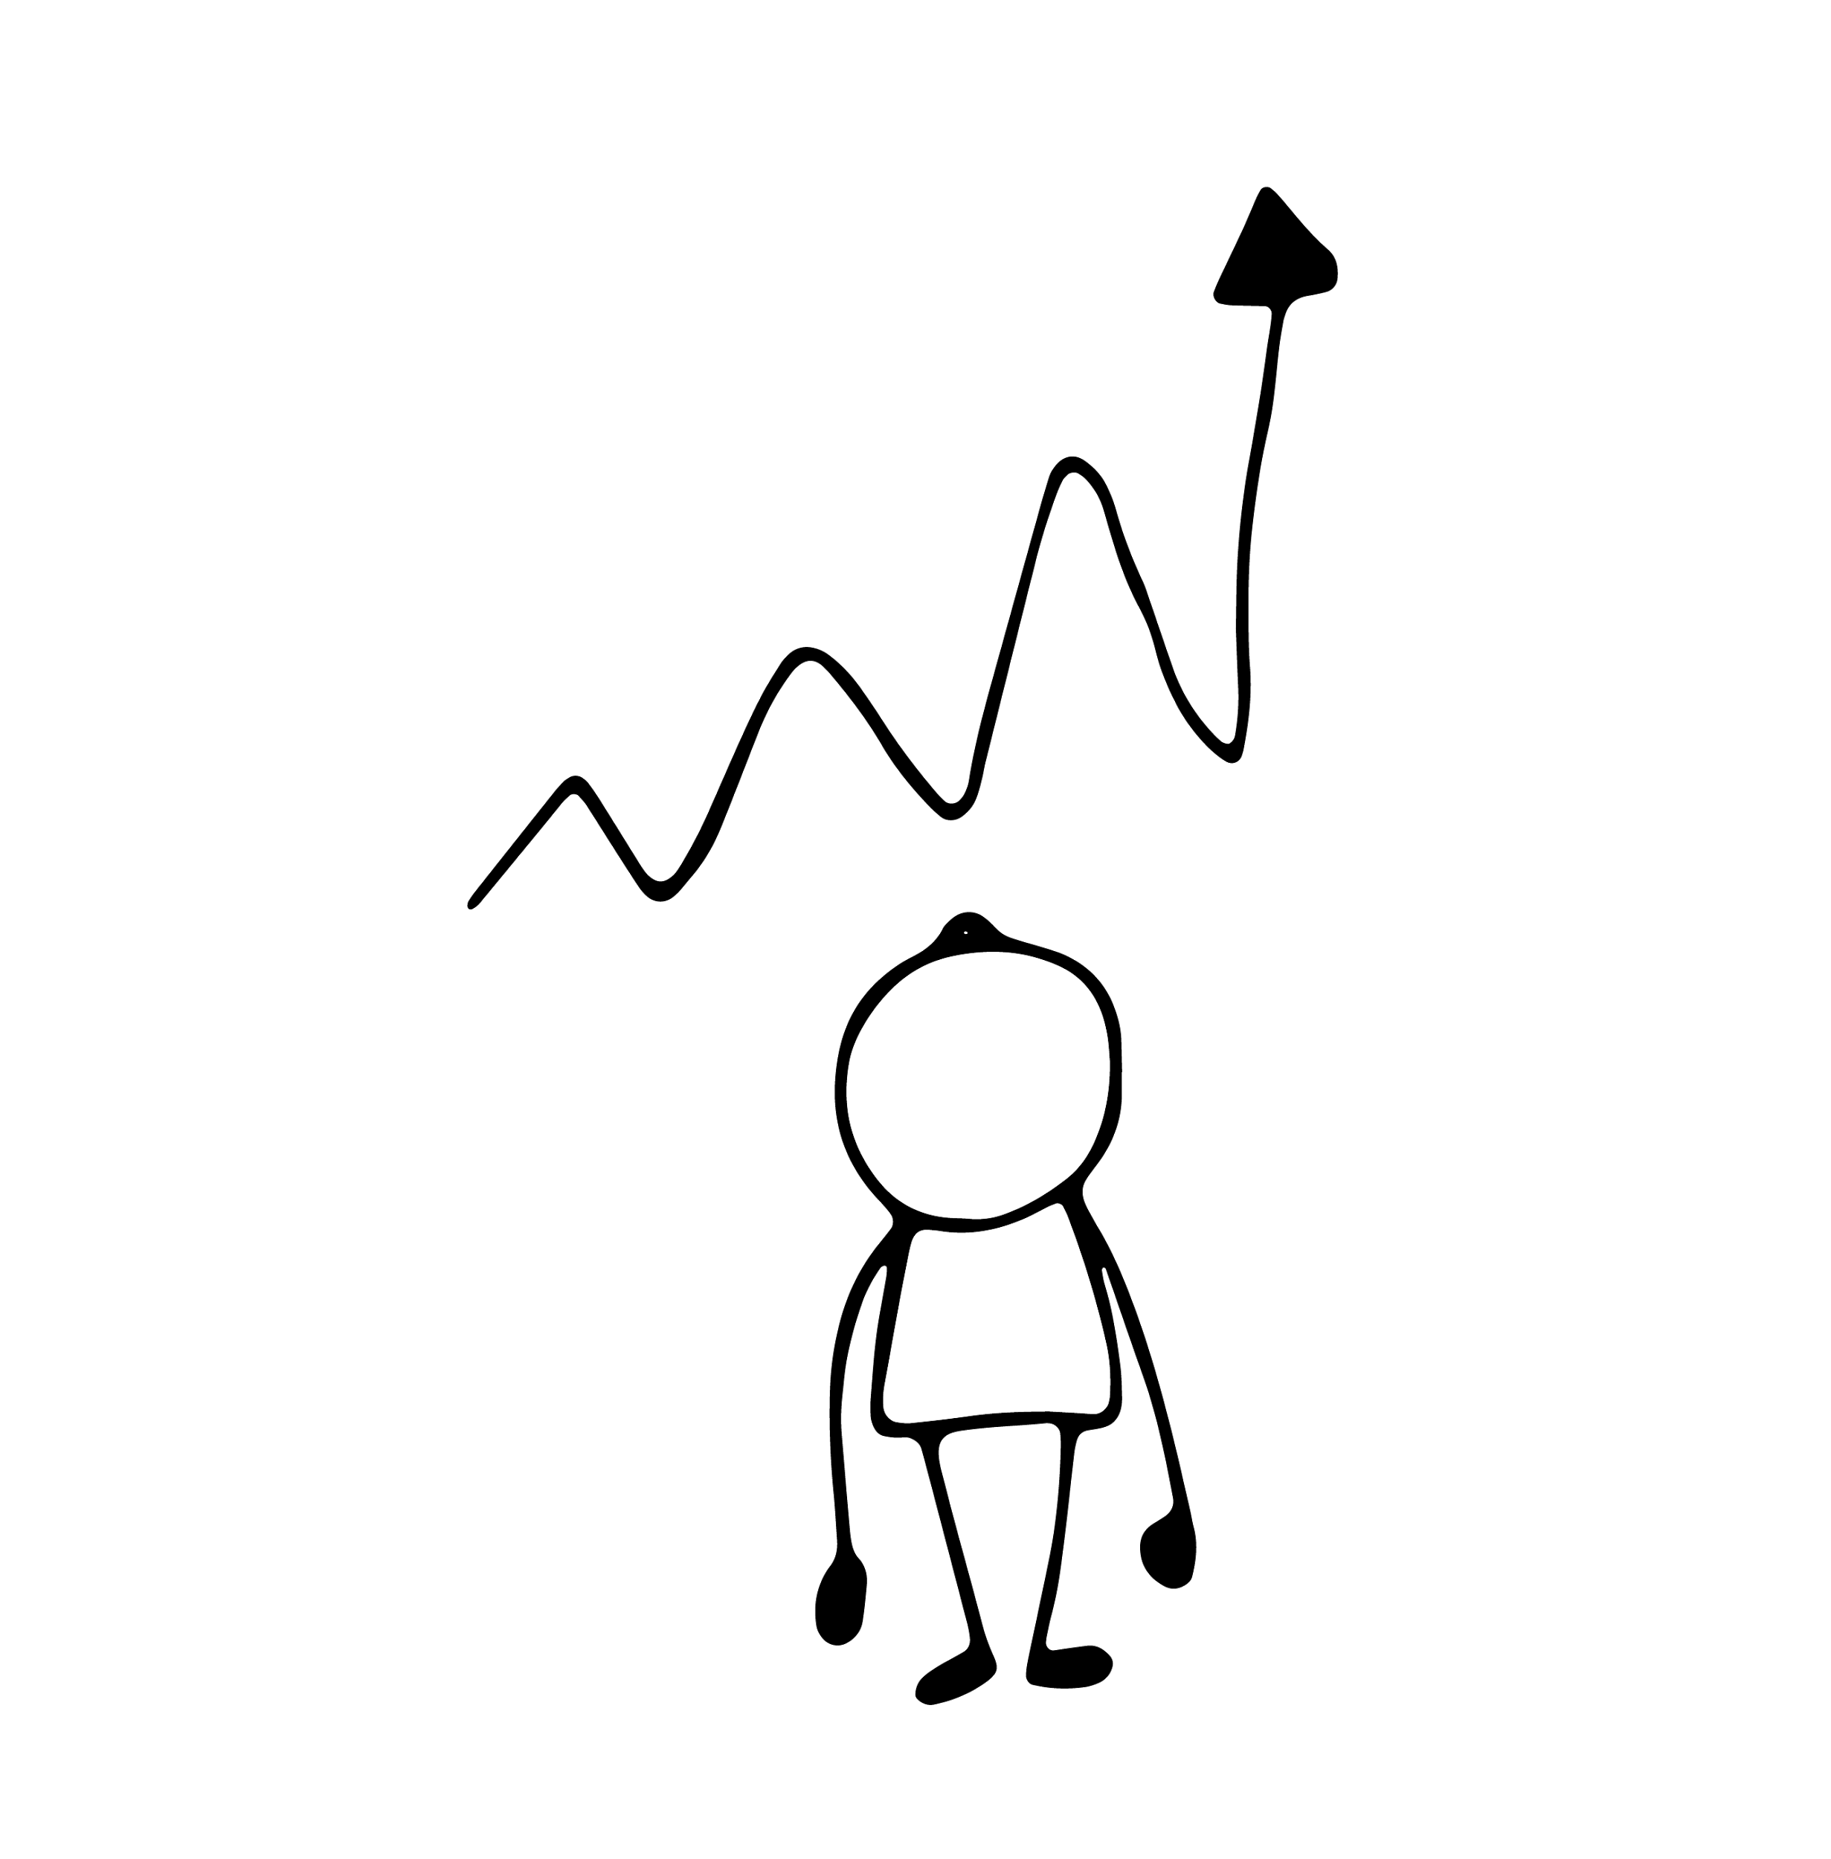
More essentials…
Timing important (when to introduce, when to embed).
Play is much underrated. As is simplification.
Utilisation of strengths.
Have an implementation plan.
Linking wellbeing metrics to KPI’s.
Informing all stakholders of the wellbeing change – so they know what is, and has, changed.
Pull them into a better future, rather than push from the past.
www.ourpluswellbeing.com

Slide 11
Big risks…
Overpromise, under deliver – selling false hope.
Bad advice, poor program logic.
Low ROI, look bad to those above.
Bad apples and win-lose power struggles.
Enabling the lower ranks = look bad.
Expecting fast change – wellbeing is hard work.
A lack of leadership and top level support is the main reason for the failure to sustain changes in an organisation.
www.ourpluswellbeing.com

Slide 12
Checklist
This checklist is another way of saying some of what I have covered:
The workplace has to ‘feel’ good
Play to everyones strengths
Encourage risk and failure
Build social capital
Be grateful and appreciative at all levels
Be authentic at all levels
Create the conditions for change
Create positive practices – e.g., positive forecasting
www.ourpluswellbeing.com

Slide 13
The literature…
Change must have a clear strategic mandate and be linked to a compelling rationale. Organisations are made up of individuals and we all respond to change differently. Some people like to move towards pleasure and others to move away from pain.
Organisations must bring to life the compelling rationale for the change they wish to drive through. A compelling vision must either represent the dire consequences of failing to act or a sufficiently exciting and motivating future state.
A vision alone is not sufficient to capture the hearts and minds of everyone but it is a good start. People must be able to make the link with what is important to them personally.
www.ourpluswellbeing.com

Slide 14
The literature…
The change must be driven top-down and bottom-up. The old adage of leading from the front is true but, for change to really stick, it must be driven throughout the organization.
In every company there are influential and dynamic individuals throughout the hierarchy; it is imperative that these individuals are ‘on side’ and championing the change from the bottom up and inside out. However, these individuals must still be supported by great leadership; it does not matter how galvanised the troops are, the change will fail if there is insufficient direction, support and drive from the top.
www.ourpluswellbeing.com

Slide 15
The literature…
The approach to embedding change must be holistic and systemic. All organizations are complex and dynamic systems, not simple and linear. As a result, a simple cause-and-effect approach to embedding change will not work – “I say change… you change” just does not wash in such a complex world.
There are a number of organizational ‘levers’ that need attention. For example, objectives, leadership, recruitment, promotion and training. Not all need to be ‘yanked’ but all need to be at least tweaked and nudged so they support each other and are all lined up.
www.ourpluswellbeing.com

Slide 16
The literature…
Focus should be on changing actual behaviours, not just rhetoric and enthusiasm. It is more effective to change what we can see, and we can see how people behave.
The hardest organizational change to effect is that which requires people to think and feel differently, often referred to as ‘culture change’. Too often these change programmes fail because they are not grounded in what people are being asked to do that is different. Focus on what you want people to be ‘doing’.
Be prepared to ‘course correct’. Very few change programmes end up exactly where they predicted at the outset, for many reasons. Ensure you have checkpoints that enable you to see where progress is being made and where progress is not; redefining the course you are following as a consequence is vital to success.
www.ourpluswellbeing.com

Slide 17
What I’ve not mentioned
I don’t know too much about embedding wellbeing “across” organisations – esp of different types. I don’t think anybody really does. I don’t think it’s been intentionally tried much. But probably relies on:
Cooperation
Collaboration
Commitment to a common purpose
www.ourpluswellbeing.com

Slide 18
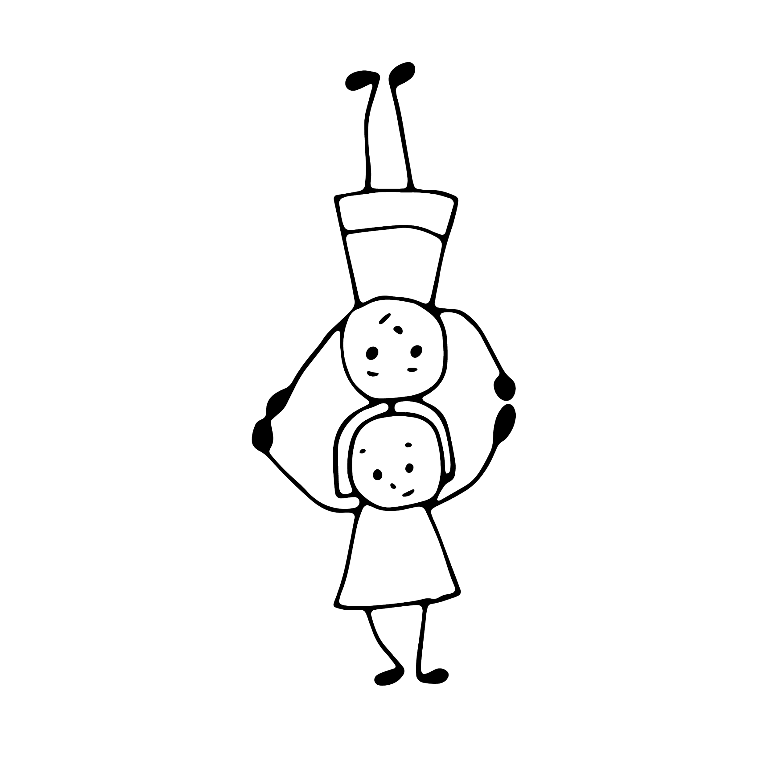
Questions & insights…
www.ourpluswellbeing.com

Slide 19
Thanks
I hope there was a pearl of wisdom in there somewhere…
“Get a good chair”
www.ourpluswellbeing.com

