Slide 1
Dr Aaron Jarden
Wellbeing Simplified
aaron.jarden@sahmri.com
Happiness and Its Causes, Sydney, 22-23 June 2017

Slide 3
What if our approach to increasing wellbeing is almost completely wrong?

Slide 5
Could we be creating harm?
Could our efforts be wasted?
Could there be a better way?

Slide 6
My answer is: Maybe.
Potentially at least…

Slide 7
An idea
Simplifying life may be a path to wellbeing.

Slide 8
Two ideas
Can doing less and simplifying in itself positively impact wellbeing?
Can doing less and simplifying increase the benefits of current wellbeing activities?

Slide 9
Terms
Positive Psychology Interventions (PPI’s) are strategies, exercises and activities designed to promote happiness and wellbeing.
Examples:
Strengths.
Savouring.
Flow.
Gratitude.
Purpose and meaning.
Optimism.
Forgiveness.
Kindness.
Mindfulness.
Compassion.

Slide 10
Terms
Wellbeing and happiness activities mostly work.
Wellbeing activities add to life – they ask people to do more, be more.
It seems people stop these activities because they become “too busy” – not because they don’t work.

Slide 11
The science
Hone et al (2015) – “…synthesizing efficacy trials of PPIs reveals little evidence that these interventions translate into sustained programmes of behaviour change when applied beyond the tightly controlled conditions of the laboratory”.
Parks et al (2012) - “...researchers have yet to offer persuasive evidence that happiness activities, as they are actually used in real-world settings, are beneficial”.

Slide 12
Terms
“to make less complex or complicated; make plainer or easier”.
A commonly cited definition of simplifying: “paring down to the essentials of life, what is important to you” (Mazza, 1997).
By simplifying I mean:
Make things less complicated by:
Doing less (in quantity) – e.g., to-do list from 8 things to 5 things.
Prioritising (in quality) – e.g., ordering those 8 things by importance.

Slide 13
The context
In Western Society there is a growing movement towards simplifying.
The underlying trend related to:
time - too busy: slow living.
space - too much stuff: simple living, decluttering.

Slide 14
The scale
2016 NZ Survey of 12,000 - Two-thirds said life is busy, there are “not enough hours in the day” = 67% (was 59% in 2012).
A 2014 Euromonitor study lists “simplifying” as one of the top 10 consumer trends.
A 2013 Global Consumer Trends Survey found that a majority of consumers are looking for a simpler life: Two-thirds say they are actively trying to simplify their current lives.
Alexander and Ussher (2012), approximately 200 million active participants in the global simplifying movement.

Slide 15
The scale
So extrapolating from these findings, one could conclude:
A lot of people are very busy (two-thirds).
A lot of people desire simplicity (two-thirds).
A lot of people currently trying to simplify (two-thirds or 200 million).

Slide 17
Simplifying and wellbeing
The research base:
Very limited.
A Web of Science search, “exact phrase in title”, of academic publications, June 15th 2017:
“Voluntary simplicity” (34 articles), “Simple Living” (13 articles), “Slow Living” (6 articles).
All environmental or consumer focused; not wellbeing.
The literature on “simplifiers” focuses on who they are, why they became simplifiers, and how they practice simplicity.

Slide 18
Simplifying and wellbeing
Four empirical studies:
Alexander & Ussher (2012), 2268 participants, English speakers.
Pierce (2000), with 211 participants, English speakers.
Brown & Kasser (2005), 400 participants, English speakers.
Boujbel & d’Astous (2012), 611 participants, English speakers.

Slide 19
Simplifying and wellbeing
Alexander, S., & Ussher, S. (2012). The voluntary simplicity movement: A multi-national survey analysis in theoretical context. Journal of Consumer Culture, 12(1), 66-86.
What they did:
Survey of 2,268 participants, English speakers, already “simplifiers”.
50 questions – lifestyle, behaviour, motivations, values, income, community, politics, and happiness.
No control – so a “description of the movement”.

Slide 20
Simplifying and wellbeing
What they found:
Happier now living more simply, 87% happier now than before:
46% much happier.
41% somewhat happier.
13% about as happy.
Only 0.3% less happy.

Slide 21
Simplifying and wellbeing
Wellbeing was not a motivator, but a consequence.

Slide 22
Simplifying and wellbeing
Pierce, L. B. (2000). Choosing simplicity: Real people finding peace and fulfillment in a complex world (1st ed.). Carmel, CA: Gallagher Press.
What she did:
Largely a book of case studies (40 interviews).
Three-year online exploratory study of 211 people from 40 USA states and eight countries.
Covered: Work life, accommodation, material possessions, leisure time, relationships, environment, community, health, spiritual, nature, transport, etc.

Slide 23
Simplifying and wellbeing
What she found:
Spent their leisure time on relationships.
Watched much less TV than average.
Good diets.
Deeper relationships.
Owned less material possessions.
Many practiced mindfulness.
In short, they reported doing what we know is related to increased psychological wellbeing.

Slide 24
Simplifying and wellbeing
But remember:
These studies between simplifying and wellbeing:
Only ask people to recall their wellbeing before they simplified their lives (long memory recall).
Do not compare simplifiers to a control group.
We don’t know how “simple” their lives are.
Use only basic wellbeing outcome measures.

Slide 25
How to simplify
Simple messaging.
Stop, do less.
Slow down.
Use technology: checklists, reminders.
Prioritise, so ‘no’ more.

Slide 26
How to simplify
Simple messaging:
Parenting: Love them, teach them stuff, keep them safe.
Positive Psychology: Make life better (Tim Lomas).
They are conceptual shortcuts that make things less complicated.

Slide 27
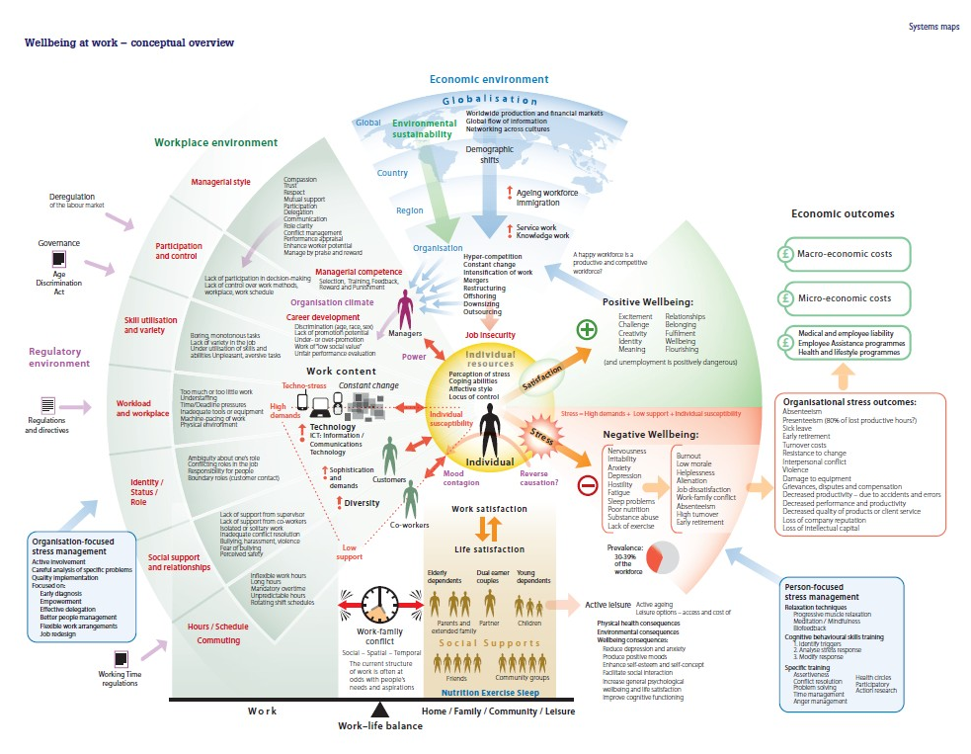
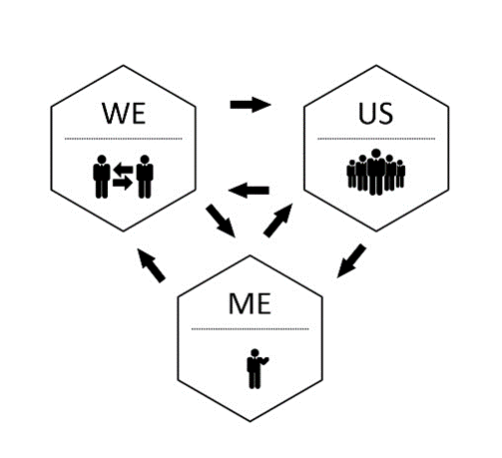
How to simplify
Jarden, A., & Jarden, R. (2016). Positive psychological assessment for the workplace. In L Oades et al. (Eds.), The Wiley-Blackwell Handbook of Positive Psychology at Work, pp. 415-437.

Slide 28
Knowledge gaps
Which types of wellbeing are impacted? Eudaimonic (meaning), Hedonic (pleasure)?
How much simplifying is needed?
Which aspects of life to simplify provide the best wellbeing return?
Is simplifying always beneficial?

Slide 29
Knowledge gaps
How long do simplifying benefits last?
Cross-cultural aspects of simplifying?
Lifespan development and simplifying?
Faith and simplifying? (monks, nuns)

Slide 30
Knowledge gaps
There is work to be done…

Slide 31
So, I have argued that:
Simplifying is a novel and largely unexplored pathway to wellbeing.

Slide 32
The notion of simplifying challenges the very essence of the existing PPI paradigm.

Slide 33
We need to know if our approach to increasing wellbeing is wrong.
It’s possible that people don’t want to add extra activities to a life that is already busy, but are longing to simplify.

Slide 34
Is doing less and simplifying a better use of our efforts, a more effective pathway to sustainable wellbeing, and could it make our PPI’s more effective?

Slide 35
I think these are empirical questions worth testing.

Slide 36
Thank you.

Slide 37
Dr Aaron Jarden
Wellbeing Simplified
aaron.jarden@sahmri.com
Slides at: www.aaronjarden.com

