Slide 1
What is positive psychology?
Dr Aaron Jarden & Jonathan Bartholomaeus
aaron.jarden@sahmri.com & jonathan.bartholomaeus@sahmri.com
16th November 2017
Copy of these slides at: www.aaronjarden.com

Slide 2
The Positive Psychology Paradigm
“There are two complementary strategies for improving the human condition. One is to relieve what is negative in life; the other is to strengthen what is positive. Mainstream psychology focuses largely on the first strategy; Positive Psychology emphasizes the second”
Martin Seligman

Slide 3
What is Positive Psychology?
Positive psychology is a branch of psychology that conducts scientific inquiry into the factors that help individuals, communities and organisations thrive by building on their strengths and virtues.
“Positive psychology is the scientific study of what enables individuals and communities to thrive”
International Positive Psychology Association

Slide 4
What is Positive Psychology?

Slide 5
Positive Psychology
Positive psychology is the study of topics as diverse as:
Happiness / wellbeing
Resilience
Optimism
Hope
Flow
Meaning in life
Grit
Growth

Slide 6
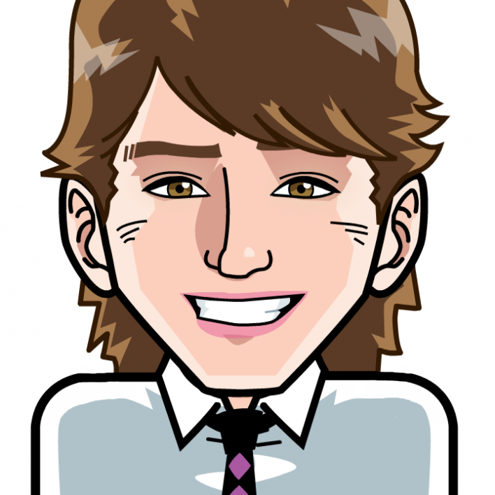
Positive psychology applications across organisations, community programs, interventions, and electronic platforms.
Dr Aaron Jarden & Jonathan Bartholomaeus
aaron.jarden@sahmri.com & jonathan.bartholomaeus@sahmri.com
16th November 2017
Copy of these slides at: www.aaronjarden.com

Slide 7
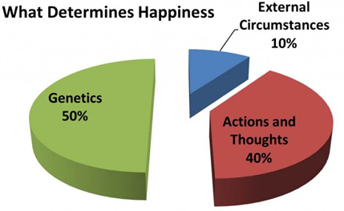
Progress to date…
Positive psychology progress to date...
Positive neuroscience.
Positive education.
Positive health.
Military (PTSD, resilience).
Positive organisations.
National accounts of wellbeing.
Culture and wellbeing.
Many new pathways are unappreciated…
New areas emerging:
Discomfort.
Strategic laziness.
Play.
Slowness.
Nature.
Wellbeing technology.
The most disadvantaged.
Physical health and wellbeing.
Positive failure.
Wellbeing improvement is hard work – like losing weight.

Slide 8
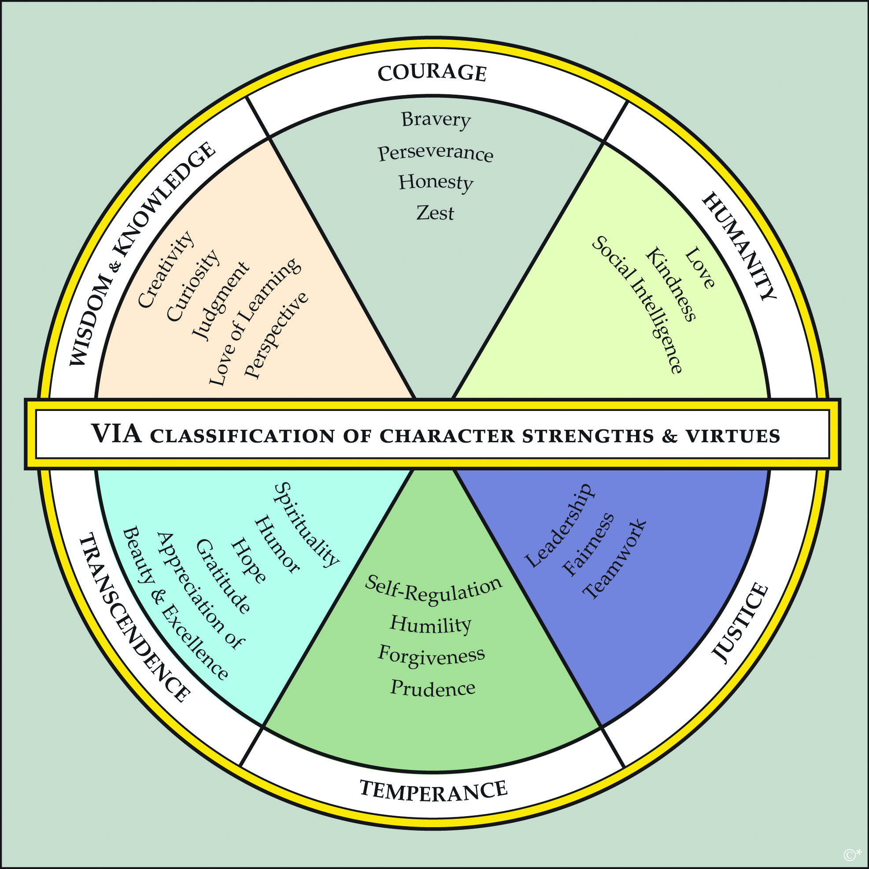
Positive introduction
First up, let’s taste it…
Step 1: Pair up.
Step 2: In 2 minutes (1 minute each), tell a story – a thoughtful narrative with a beginning, middle and end – that illustrates when you are at your best (at work, in life).
Note: Swap when you hear the bell the first time after 1 minute, stop completely when you hear the bell the second time after 2 minutes.

Slide 9
Overview
Positive psychology interventions.
Organisational wellbeing.
Digital wellbeing.
Community wellbeing programs.

Slide 10
Positive Psychology Interventions
What are positive psychology interventions?
Strategies, exercises and activities designed to promote happiness and wellbeing.
Positive Psychology Interventions vs. Positive Psychological Interventions.
Positive Psychology Intervention = (Bolier et al., 2013; Sin & Lyubomirsky, 2009).
Since the start of the Positive Psychology movement (1998). Target positive phenomena and outcomes.
Positive Psychological Intervention = (Schueller, Kashdan, & Parks, 2014).
Include studies that use the same intervention strategies and target the same outcomes but do not explicitly reference “positive psychology” – e.g., could be social psychology or clinical psychology interventions that promote happiness.
Examples: Three good things (gratitude), use your strengths, develop purpose, active constructive responding (relationships), flow, savouring, job crafting...

Slide 11
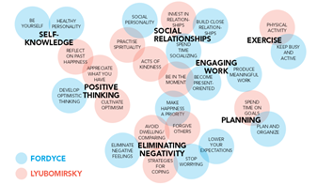
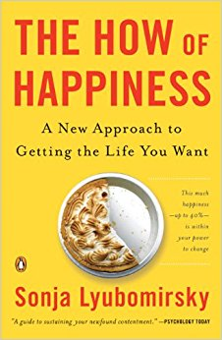
Ways to wellbeing…
Fordyce lists 14 techniques as fundamentals:
Keep busy and be more active.
Spend more time socializing.
Be productive at meaningful work.
Get better organized and plan things out.
Stop worrying.
Lower your expectations and aspirations.
Develop positive, optimistic thinking.
Become present oriented.
Work on a healthy personality.
Develop an outgoing, social personality.
Be yourself.
Eliminate negative feelings and problems.
Close relationships are the number one source of happiness.
Put happiness as your most important priority.

Slide 12
Efficacy vs effectiveness
In the real world…
Hone et al (2015) – “…synthesizing efficacy trials of PPIs reveals little evidence that these interventions translate into sustained programmes of behaviour change when applied beyond the tightly controlled conditions of the laboratory or psychology classroom setting”.
Parks et al (2012) - “...researchers have yet to offer persuasive evidence that happiness activities, as they are actually used in real-world settings, are beneficial”.
Hone, L., Jarden, A., & Schofield, G. (2015). An evaluation of positive psychology intervention effectiveness trials using the re-aim framework: A practice-friendly review. Journal of Positive Psychology, 10(4), 303-322.

Slide 13
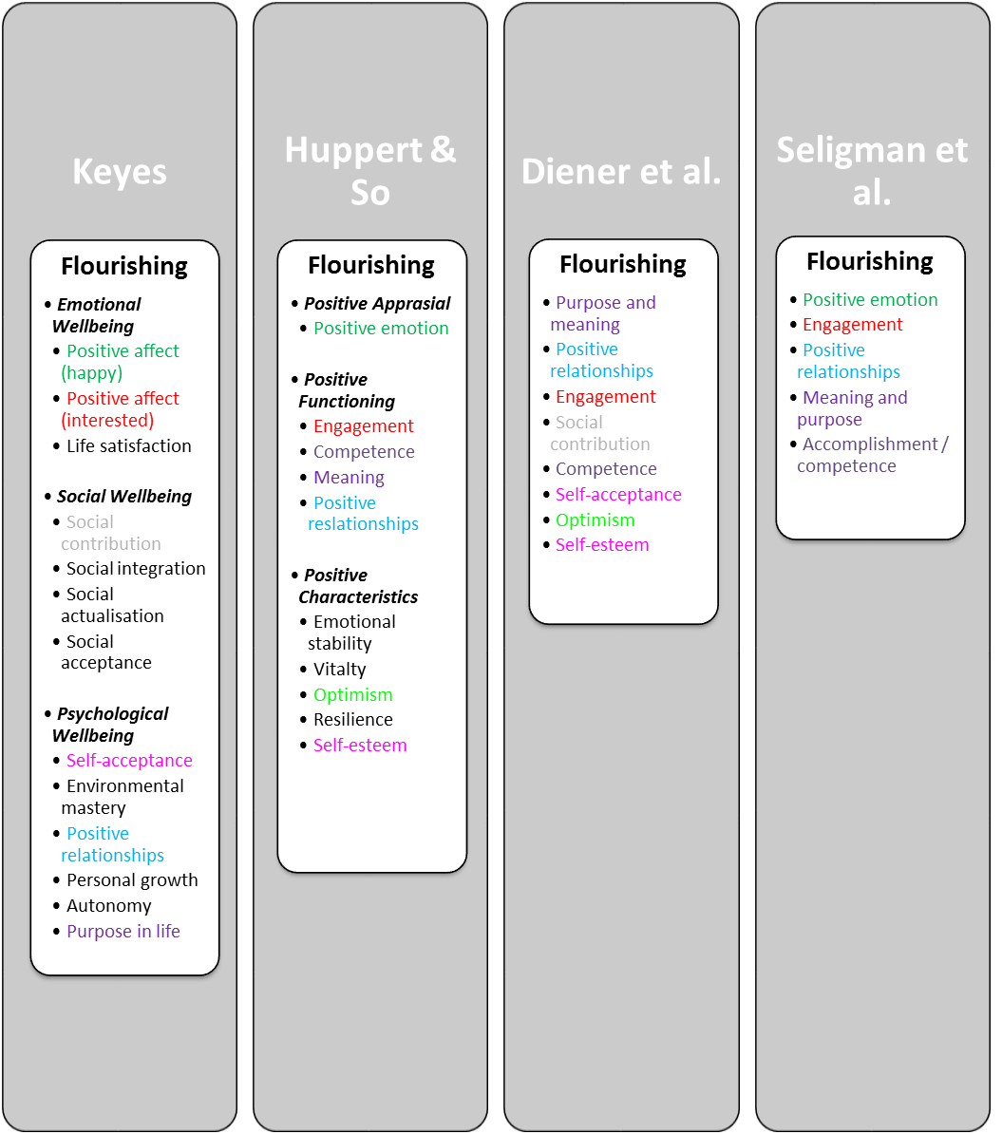
Frameworks and models
Wellbeing frameworks and models
Comparing models.

Slide 14
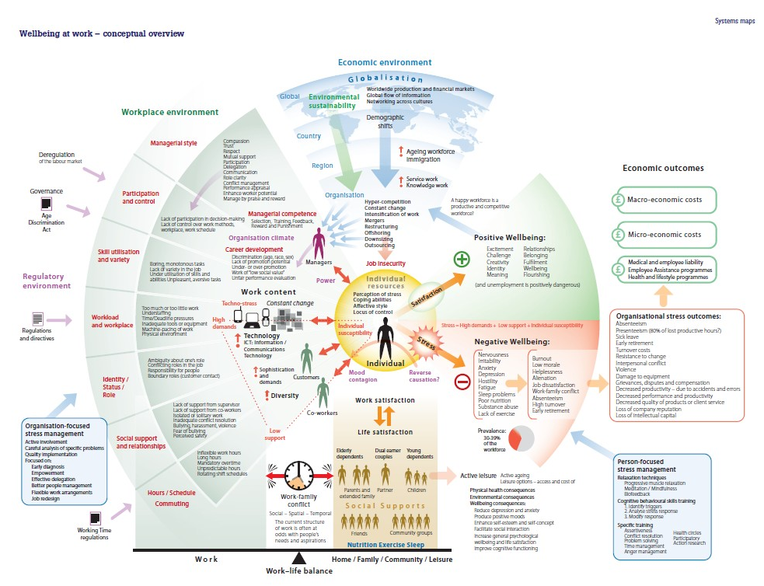
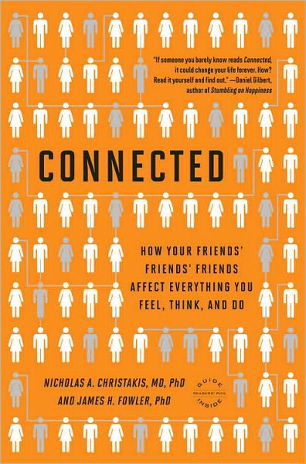
Work wellbeing.
Wellbeing spreads through social networks:
About 15%, to 3 degrees of separation.

Slide 15
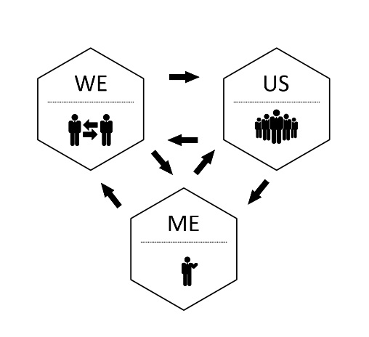
Organisational wellbeing
A framework to locate interventions
The individual level (Me)
The group level (We)
The organisational level (Us)
Jarden, A., & Jarden, R. (2016). Positive psychological assessment for the workplace. In L Oades et al. (Eds.), The Wiley-Blackwell Handbook of Positive Psychology at Work, pp. 415-437. Published Online: 19 Nov 2016: DOI: 10.1002/9781118977620.ch22

Slide 16
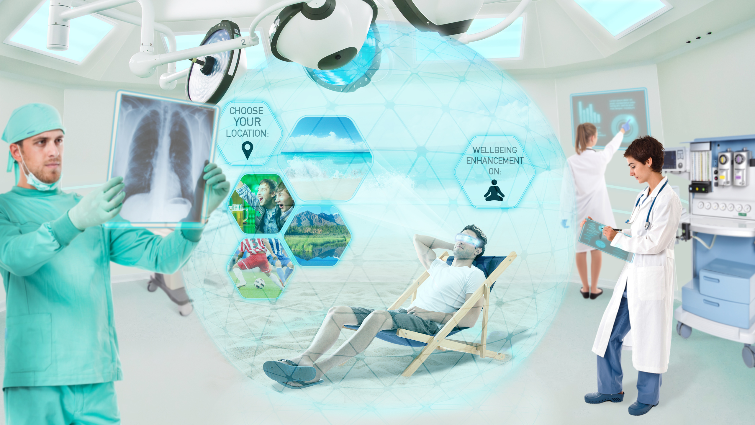
Digital wellbeing

Slide 17
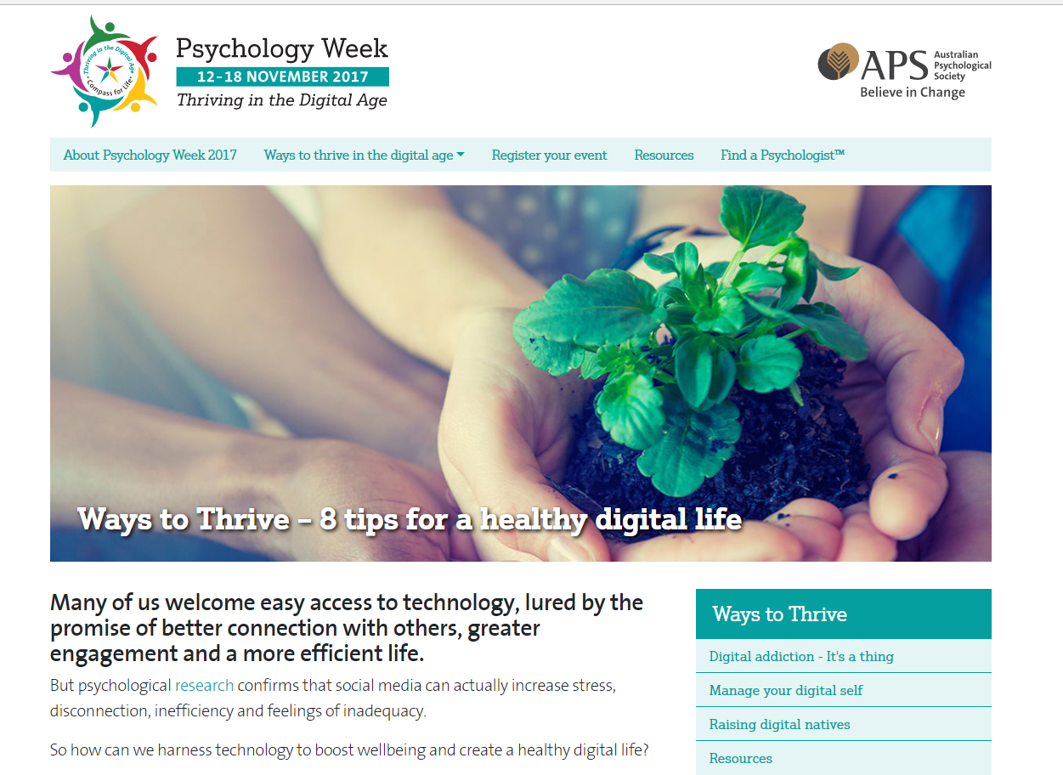
Digital wellbeing
APS advice.
Social media can increase stress, disconnection, inefficiency and feelings of inadequacy.
Strategies to harness technology to boost wellbeing and create a healthy digital life?
Check less (and turn off email notifications).
Take care when posting (avoid anger-laden words, think of others health).
Take an active role (be an active, constructive and respectful contributor – builds positive social connection).
Block the bullies.
Maintain perspective (envy, personal inadequacy).
Set boundaries around work (email out of hours).
Guard your sleep (turn social media off).
Connect offline (engage with people).

Slide 18
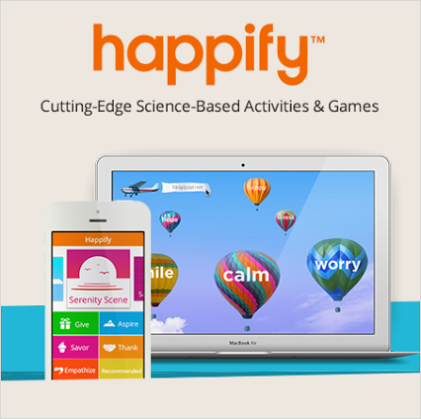
Digital tools
Wellbeing tools: Apps and e-learning.
Make a distinction between “wellbeing skill building tools” and tools that “increase wellbeing” (because they feel good).

Slide 19
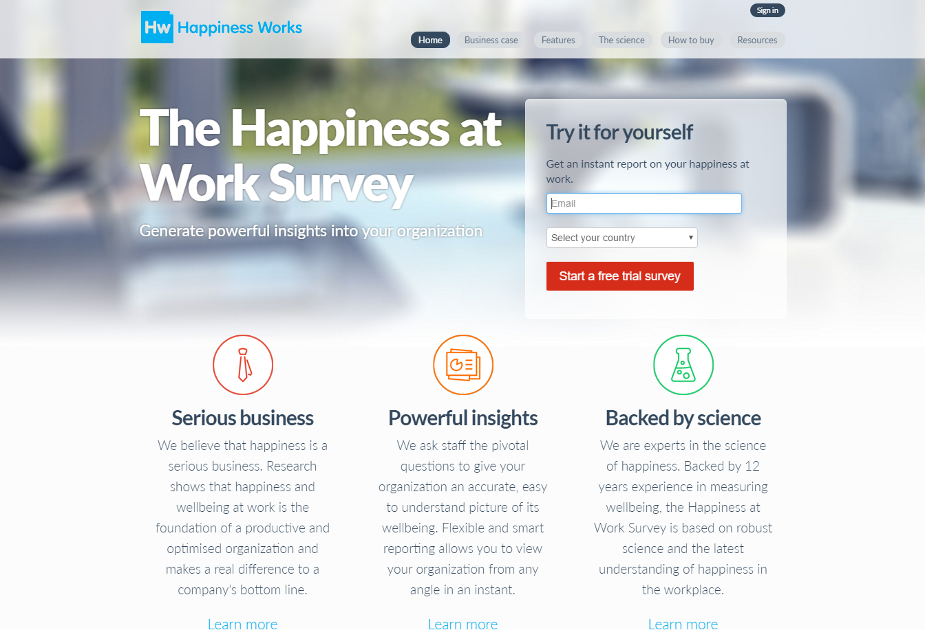
Online assessment
Wellbeing assessment and evaluation.
Assessments create opportunities for conversations, conversations improve wellbeing (also use existing events, and create new wellbeing events to do so).
Assessments allow data-driven decision making.
Many developed by organisational psychologists don’t actually measure wellbeing (but they look shiny and are expensive)…
www.workonwellbeing.com & www.happinessatworksurvey.com

Slide 20
Community wellbeing
Community wellbeing.

Slide 21
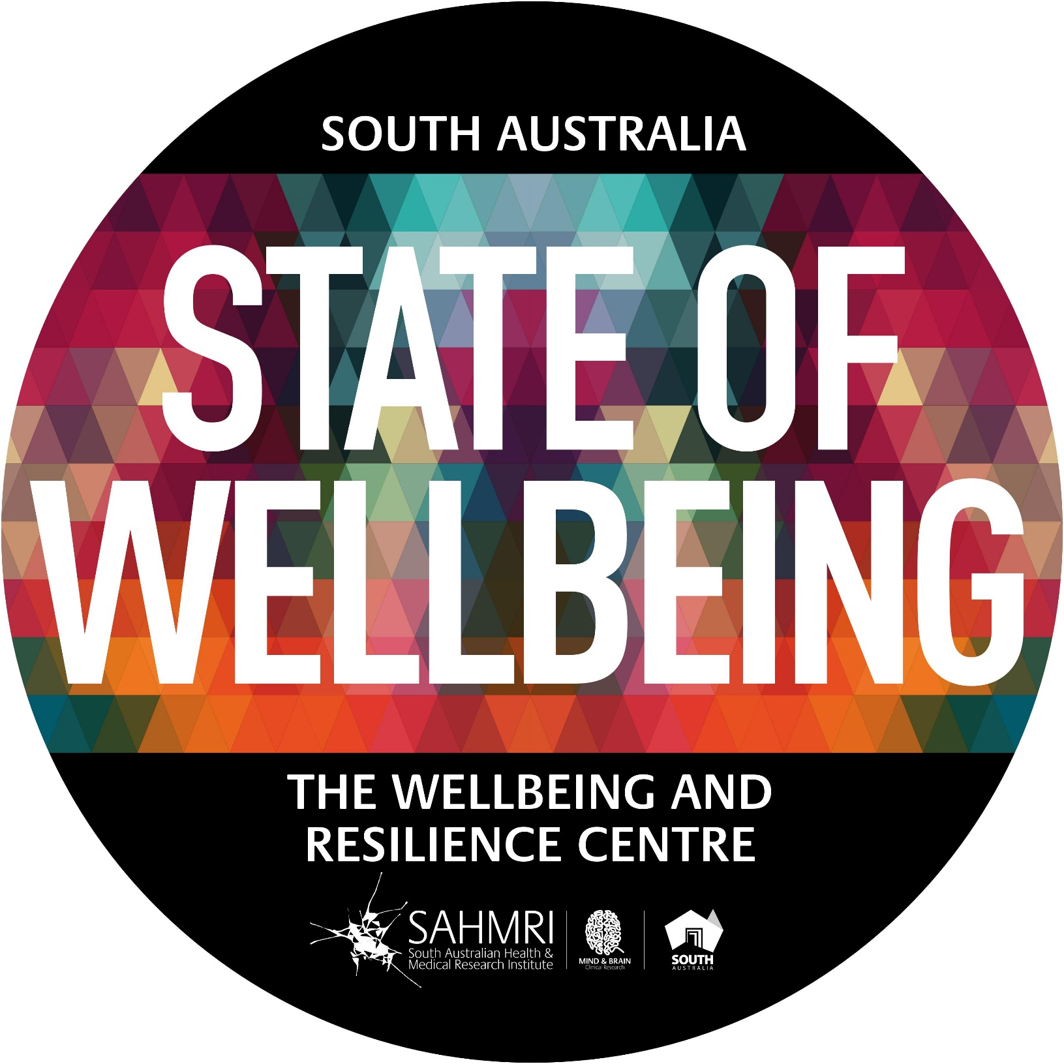
Now
“Wellbeing is measurable, teachable and learnable”

Slide 22
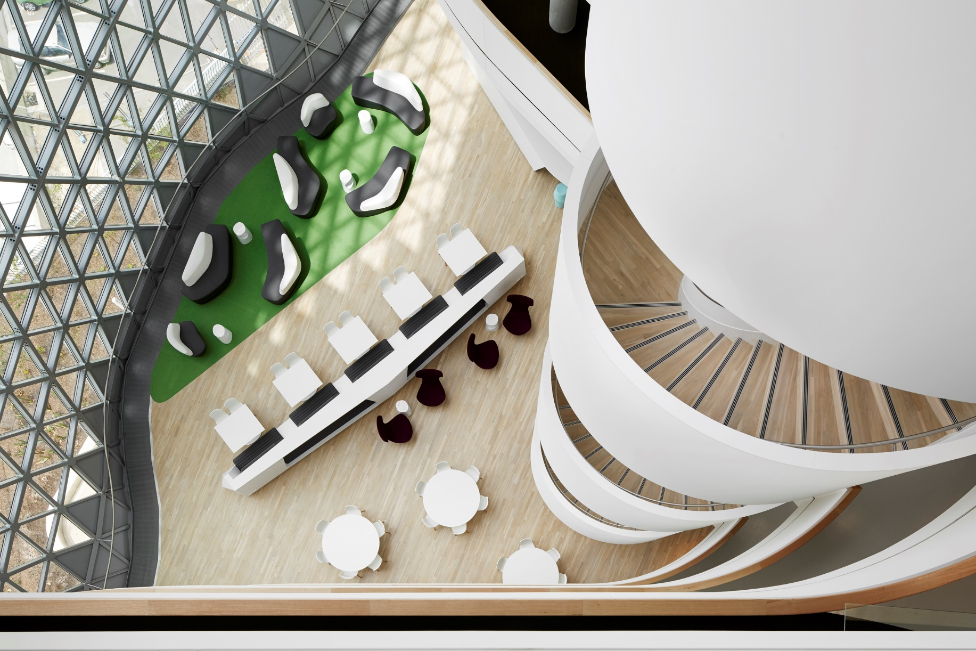
Positive mental health and wellbeing for a resilient society.
Position South Australia as the State of Wellbeing
Measure the wellbeing of all South Australians and beyond
Teach, build and embed wellbeing science
Generate and publish research on how to build wellbeing efficiently, at scale, across the life course
LEAD ➔ INITIATE
MEASURE
BUILD ➔ EMBED
RESEARCH
Organisations, Government, Schools, Ageing, Youth, Community

Slide 23
RESULTS Auto-manufacturing industry
Notes:
Projected that between 14 000 to 25000 will be lost from the departure of the car industry. Our economy is transforming and is creating significant unemployment. It is our belief that the LMBE Model of teaching resilience skills could be useful to manufacturing workers in anticipation of the unemployment tsunami.

Slide 24
Insight into drivers…

Slide 25
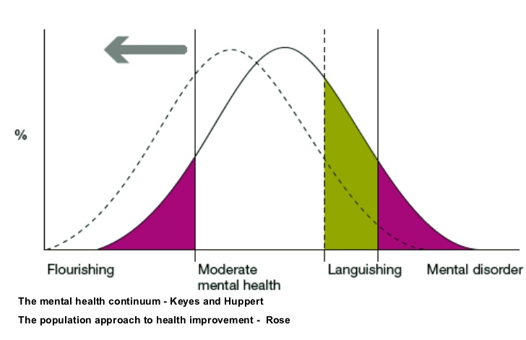
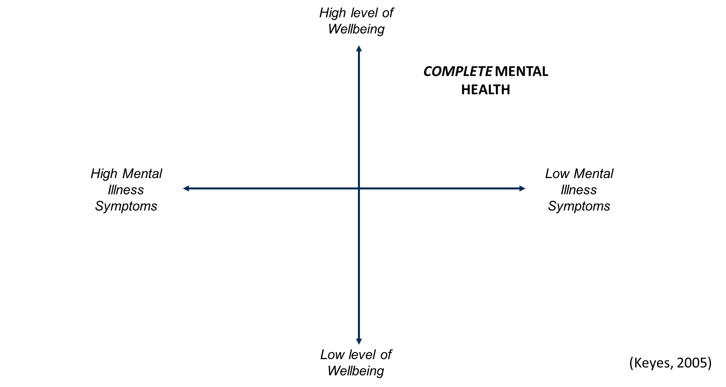
Frameworks and models
Old (current) perspective
What the data show

Slide 26
Last slide
Geelong Breathing
Breath One. Take a deep breath in through your nose and fill your lungs with as much air as possible. As you are doing so, notice your physical body and any points of pain or tension. As you breath out slowly through your mouth, imagine you are pushing or releasing any tension away. Feel yourself sink into your chair or the floor if you are standing.
Breath Two. Take a deep breath in through your nose and fill your lungs with as much air as possible. Now as you breathe out think about what you are grateful for right at this very moment. Not what you are grateful for that has happened in the past, or looking towards the future, but right in this very moment think about one thing you are grateful for and exhale slowly. Say to yourself “Right now I am grateful for...”.
Breath Three. Take a deep breath in through your nose and fill your lungs with as much air as possible. Now as you breathe out think about your frame of reference and what intentional state you want to be in right now. Do you intend to be kind? Do you intend to be open minded? Do you intend to be peaceful? Whatever intention you wish to have at this present moment, cultivate it when you exhale by saying to yourself “My intention right now is to be …”.
Credit: This exercise was developed by Justin Robinson, Head of Positive Education at Geelong Grammer School in Australia

