Slide 1
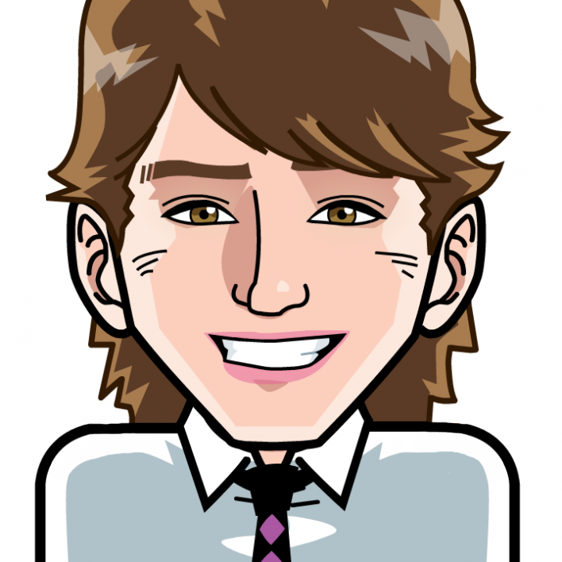
Positive Psychology for Wellbeing November 2015
Dr Aaron Jarden, AUT
www.aaronjarden.com

Slide 2
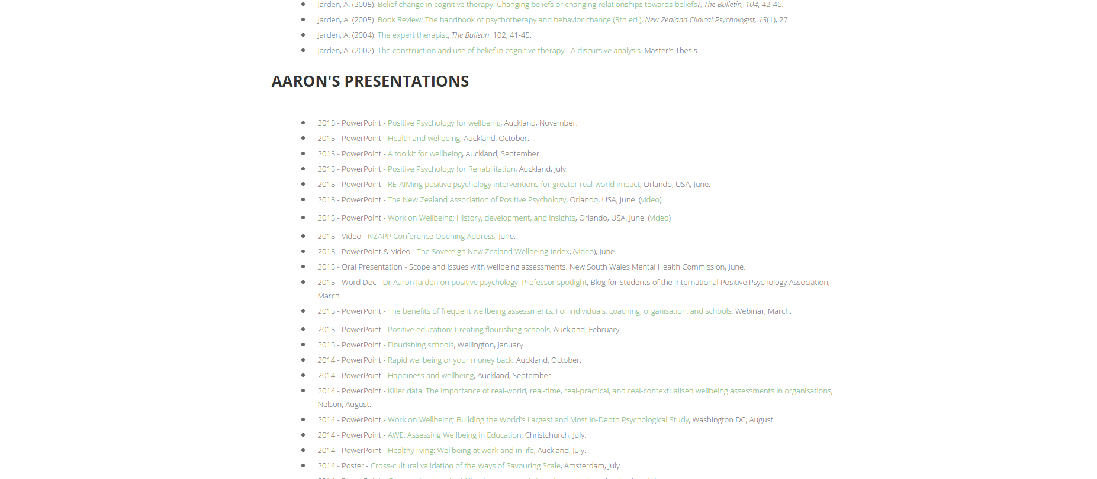
Presentation slides: aaronjarden.com

Slide 3
Killer questions?
Does anyone have any killer questions they would either like me to muse on now, or address at some stage?

Slide 4
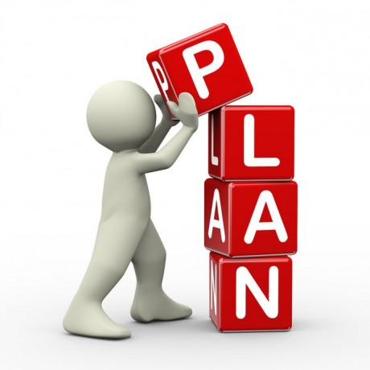
The grand plan
Know stuff + do stuff (knowledge + experience)
Wellbeing science + Positive psychological interventions

Slide 5
Positive assessment
10 - Extremely happy
9 - Very happy
8 - Pretty happy
7 - Mildly happy
6 - Slightly happy
5 - Neutral
4 - Slightly unhappy
3 - Mildly unhappy
2 - Pretty unhappy
1 - Very unhappy
0 - Extremely unhappy
Let’s do a “back of the napkin” assessment.
How happy are you right now, in life?
What would you pay / give / do / sacrifice / commit to in order to be, on average, one point happier?

Slide 6
Positive introductions
Step 1: Pair up.
Step 2: In 2 minutes (1 minute each), tell a story – a thoughtful narrative with a beginning, middle and end – that illustrates when you are at your best in your job/studies.
Note: Swap when you hear the bell the first time after 1 minute, stop completely when you hear the bell the second time after 2 minutes.

Slide 7
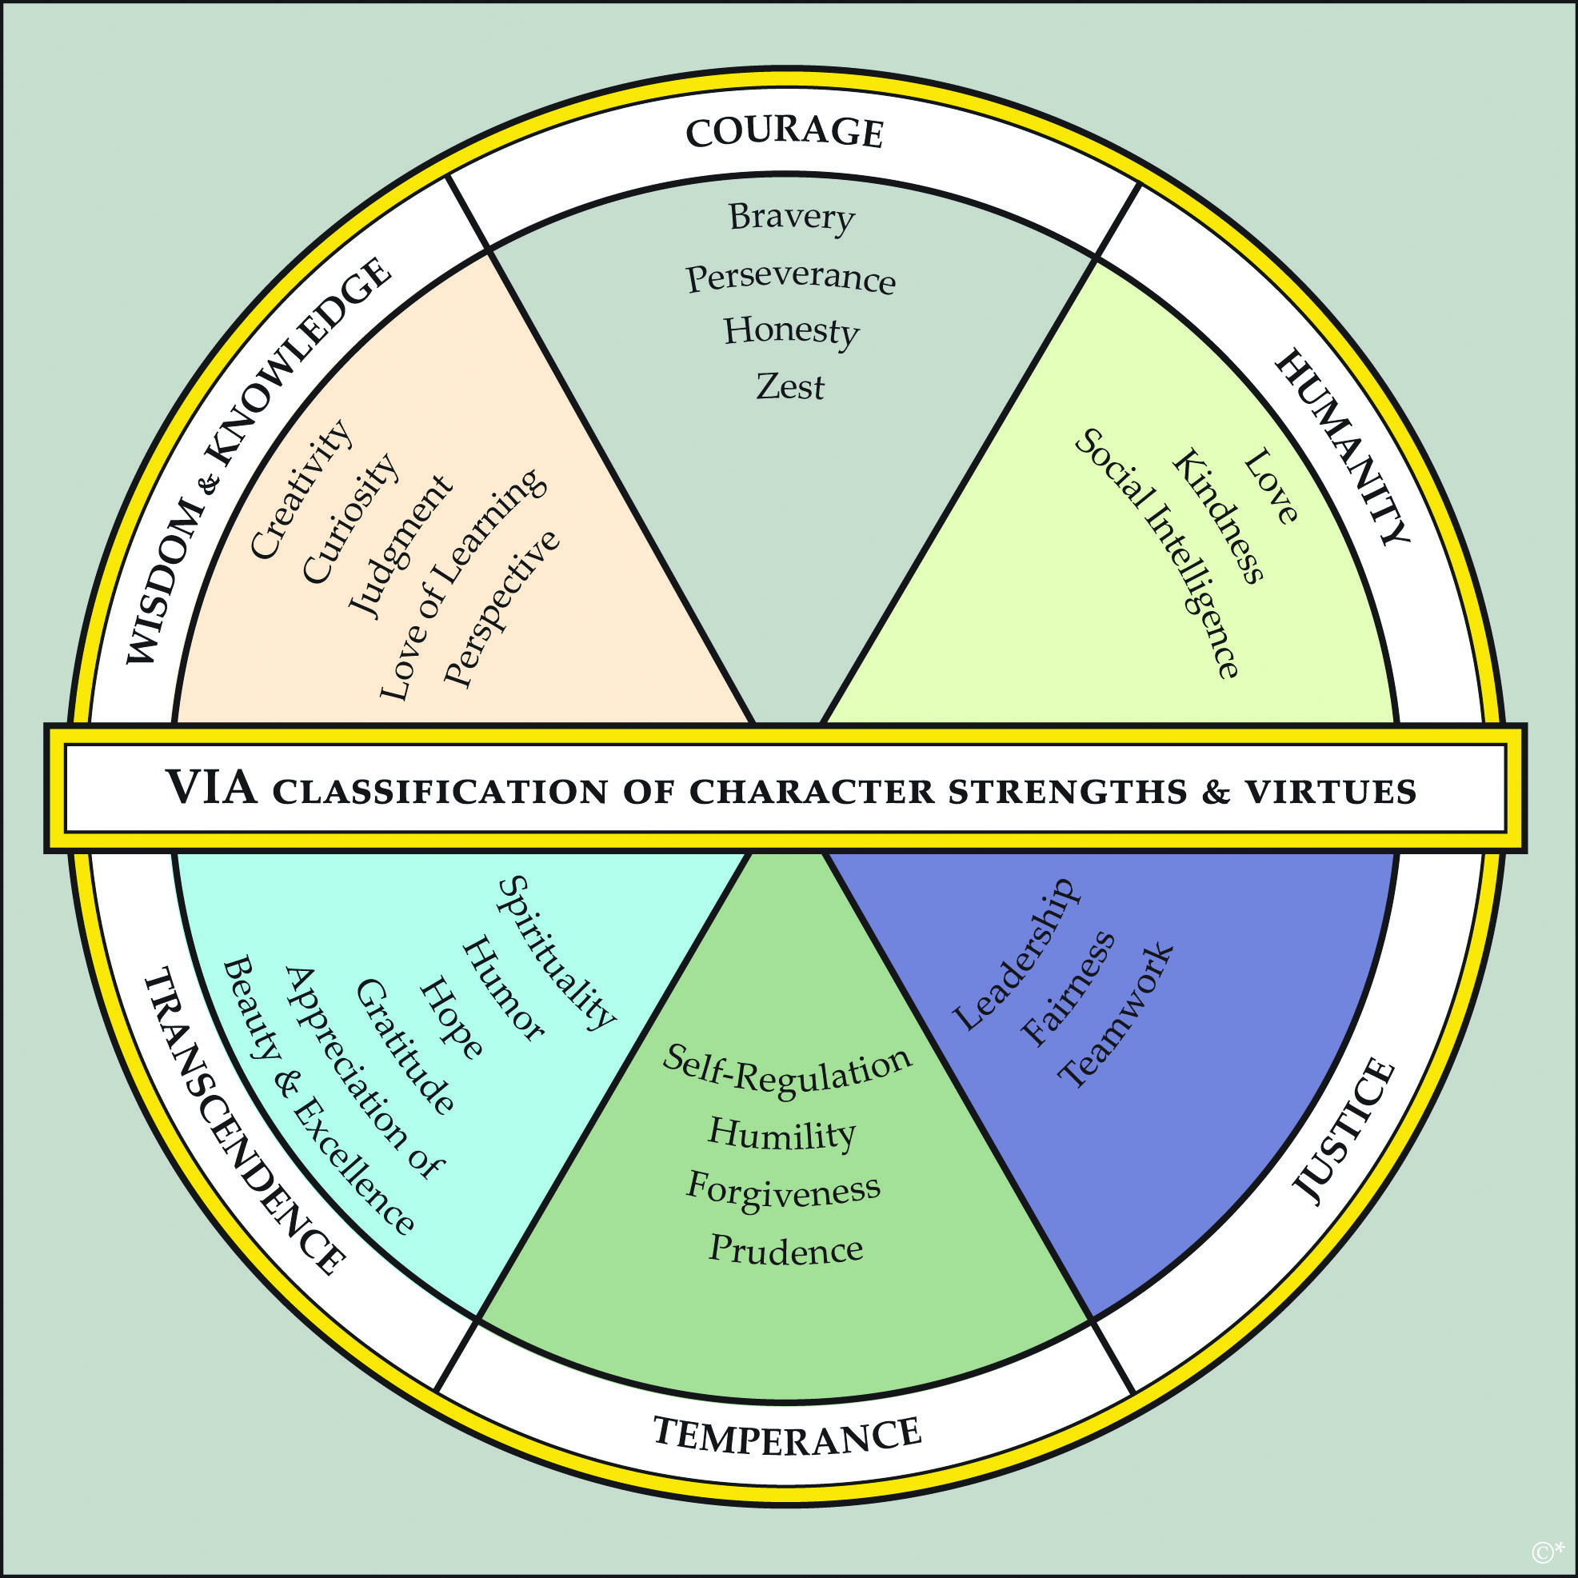
Positive introductions
Key point: Wield your strengths at work, in study, in life – they are paths to engagement and enjoyment.
www.viacharacter.org

Slide 8
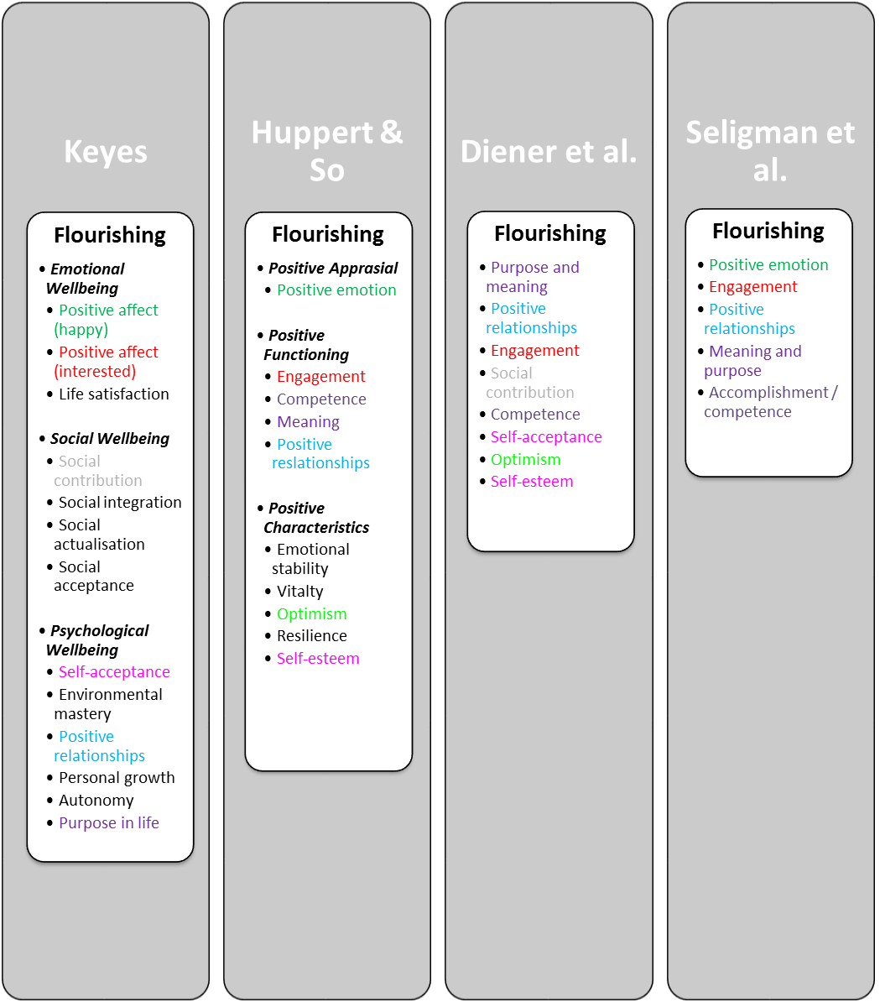
Positive assessment
Different definitions and theories of wellbeing and flourishing – Lucy Hone’s AUT PhD research.

Slide 9
Positive psychology & wellbeing science
Positive psychology is a branch of psychology that conducts scientific inquiry into the factors that help individuals, communities and organisations thrive by building on their strengths and virtues.
Positive psychology is the study of topics as diverse as happiness, optimism, hope, flow, meaning, subjective wellbeing and personal growth.
Positive psychology aims to expand psychology from its focus on repairing the negatives in life to also promoting the positives in life.
Positive psychological interventions (empirically validated techniques and strategies to increase wellbeing) have been used effectively in schools to improve academic outcomes, in businesses to improve work relationships and engagement, and in communities to improve health.
What is optimal human functioning?

Slide 10
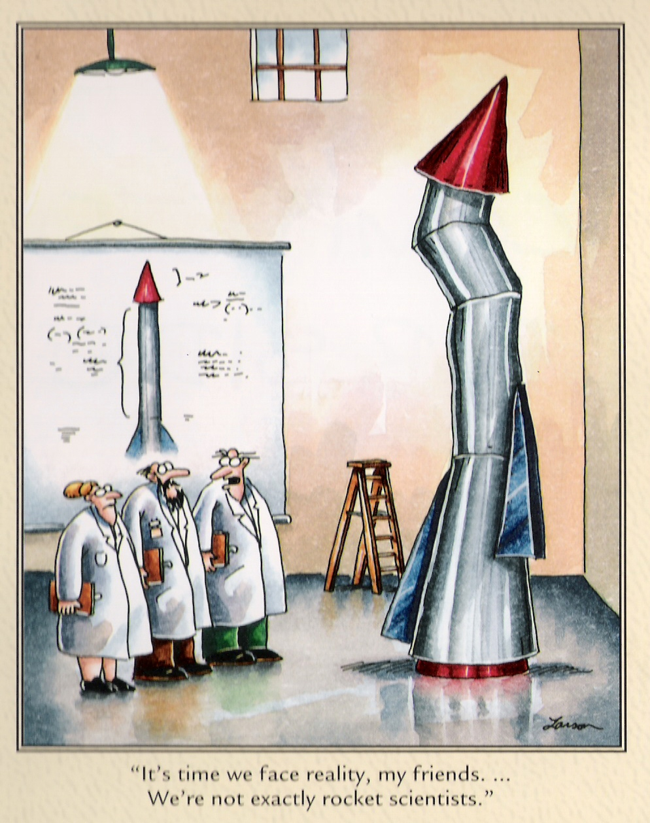
I'm no expert on your wellbeing
In addition, “happiness is not a spectator sport” (Chris Peterson).
Hard work required.
One healthy meal or one gym session will not impact much.
I’m also not currently registered as a psychologist; I'm a lecturer in psychology.

Slide 11
The answers – up front
The good life is best construed as a matrix that includes happiness, occasional sadness, a sense of purpose, playfulness, and psychological flexibility, as well autonomy, mastery, and belonging/connection.
It’s not just about learning to be more positive – it’s about using scientifically-informed tools and strategies to make our thinking more flexible, accurate, clear, and expansive. This thinking will lead to happiness and more healthy behaviours.

Slide 12
Wellbeing
Step 1: Pair up with a different partner, get a pen ready, as well as a blank A4 page…
Step 2: Raise a hand in the air when you're ready…
Step 3: Without looking down at your blank page, and ONLY looking at your partner’s face, you have 1 minute to draw a portrait of your partner, starting on the bell!
Step 4: Sign your name, date it, and swap pictures with your partner…

Slide 13
Five ways to wellbeing

Slide 14
Five ways: connect, be active, take notice, keep learning, give
Connect – Make connections with friends, family, colleagues and neighbours. When you build these connections they help enrich your life with new experiences and opportunities.
Be Active – Get moving. Walk, skip, run, dance – move your muscles. Exercise not only makes you feel good, it keeps you healthy. Pick a physical activity that you enjoy.
Take Notice – Be mindful. Be curious. Like a child, see the wonder and beauty of the world. Notice the things around you – the weather, the landscape, the mood and feelings of the people around you. In noticing you learn to appreciate the things that matter.
Keep Learning – We never stop learning. Keep trying something new – a new course you’ve been wanting to do or a more challenging task at work. Challenges keep us on our toes and increase our confidence and excitement in our day.
Give – Be generous with your time, your knowledge and your talents, giving to friends, family and even strangers. Be thankful, smile at people, and volunteer. Sharing to a wider audience gives you a greater reward than just doing things for yourself.

Slide 15
Positive assessment – work An overview of workplace wellbeing

Slide 16
Or a simpler wellbeing framework

Slide 17
Is happiness within your control?
The way we choose to act, and the way we choose to think have a substantial impact on our personal wellbeing.
Yes genetics play a big role, but turns out our external circumstances don’t necessarily have to have a big hold on our wellbeing.
Wellbeing is a CHOICE: daily practices in life have a big impact on wellbeing.

Slide 18
Relationships - communication
There are essentially four ways of responding, and active constructive responding has been shown to build solid, strong and lasting relationships the best:
Active Constructive Response involves expressing enthusiastic positive support = “That’s really great. Your wife will be pretty proud of you. I know how important that promotion was to you. We should go out and celebrate”. During such communication the person is maintaining eye contact and displaying positive emotion, such as laughing or smiling.
Active Destructive Response involves expressing a derogatory or critical response = “That sounds like a lot of responsibility to take on. There will probably be more stress involved in the new position and potentially longer hours at the office”. The person is displaying negative emotions, such as frowning or anxiety.
Passive Constructive Response involves showing benign disinterest = “That’s good news”. The person is displaying little nonverbal communication.
Passive Destructive Response involves distancing or failing to respond = “What are we doing Friday afternoon?” The person does not acknowledge the good news, is not in eye contact, and may be turning away or leaving the room.
Using active constructive responding is a good way to convey understanding, validation and caring, and to increase the wellbeing of your existing friends, as well as to make new friends and to encourage closer, more trusting relationships with them.

Slide 19
Positive assessment: www.workonwellbeing.com

Slide 23
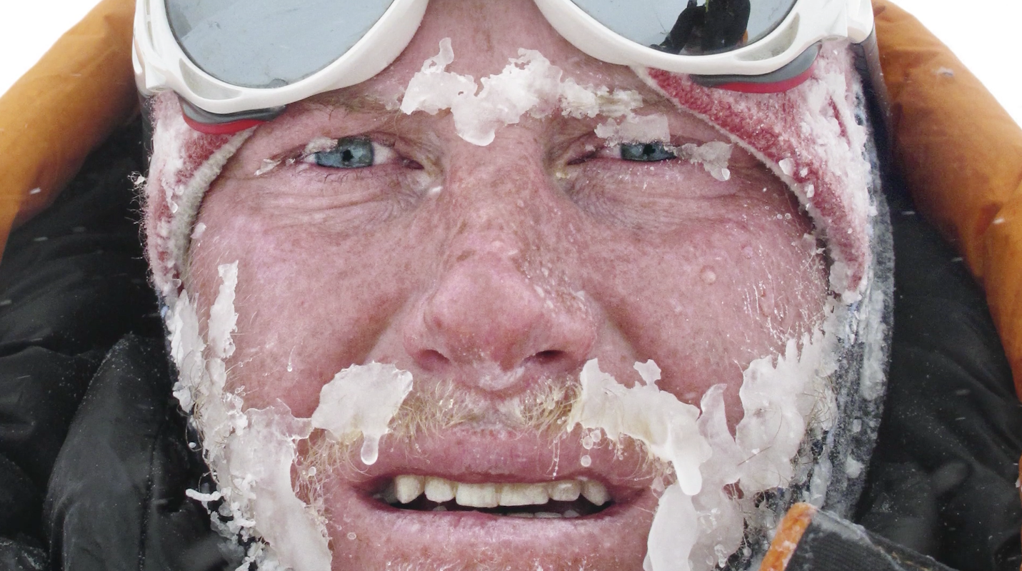
Discomfort as a pathway
Embrace and utilise negative emotions.
Embrace discomfort.

Slide 24
Savour your experiences
Savouring involves being “in the moment” and “taking in” all that an experience has to offer. I think of it as wringing the pleasure juice out of life by giving attention to the pleasures of the moment.
Savouring can be used in a wide variety of circumstances – one can savour a sensory experience, a social experience, a feeling, or even a memory.
There are ten different types of savouring strategies - sharing with others, memory building, self-congratulation, sensory-perceptual sharpening, comparing, absorption, behavioural expression, temporal awareness, counting blessings, and kill-joy thinking.
We are going to try a combo of “sensory-perceptual sharpening” and “absorption”.

Slide 25
Savour your experiences
Step 1: Hold your almond.
Step 2: Take a close look at it – inspect it, examine it! What does it look like? Is it symmetrical?
Step 3: Close your eyes for the rest of this experience and feel it in your hand – what does the texture feel like?
Step 4: Smell it. What does it smell like?
Step 5: Put the almond into your mouth but do not bite or suck it – just let it rest on your tongue. Explore the almond with your tongue and teeth, noticing as much as you can.
Step 6: Bite slowly into it and focus on the taste. Swirl the contents of the almond around in your mouth.
Step 7: Swallow the almond and open your eyes.
Was it easy to stay focused as you tapped your senses and became absorbed in the sensory experience?
What was it like to pay attention to each individual detail of the experience?

Slide 26
Peak-end theory
Peak-end theory states that people’s judgments of their overall experience (like of this 50 minute talk) is greatly influenced by the peak of their experience, and how it ends.
The research indicates that we judge our past experiences almost entirely on how they were at their peak and how they ended…
It has to do with our memory of experiences…

Slide 27
A wellbeing overview
Invest time and effort in family connections.
We are social creatures so be enmeshed in a community of friends - deep and meaningful relationships.
Know your personal values and live by them. Similarly, know your purpose and what derives meaning for you.
Know you personal strengths and find ways to exercise them every day.
Develop and optimistic thinking style.
Invest your money in experiences rather than things.
Be in work or study, and work or study that you enjoy.
Be grateful.
Savour the now regularly – rather than the past or future.
Slow down and do less – perhaps meditate?
Be curious.
Look after your health (the below 5 can make approximately 14 years difference to your life expectancy - the quality of both your current life and those extra 14 years).
Eat real food – not too much, and mostly plants (LCHF).
Exercise regularly – and different types: aerobic, resistance, flexibility, balance.
Drink alcohol in moderation.
Don’t smoke.
Get enough quality sleep.
Caveat: Genetics and upbringing also make a slight bit of difference, but since you can’t do too much about those, don’t worry about them…
Notes:
Use simple and effective wellbeing boosts
Add a dose of science and gather better data to inform your own personal change – quantify your reflections

Slide 28
Dr Aaron Jarden, AUT
aaron.jarden@aut.ac.nz
www.aaronjarden.com

