Slide 1
The International Wellbeing Study:
New and stronger paths to wellbeing
Aaron Jarden
aaron.jarden@openpolytechnic.ac.nz
www.aaronjarden.com
www.wellbeingstudy.com

Slide 2
People involved: Core researchers
Dr. Aaron Jarden New Zealand
Professor Ormond Simpson United Kingdom
Dr. Kennedy Mclachlan China
Dr. Alexander MacKenzie New Zealand
Associate Professor Todd Kashdan USA
Associate Professor Paul Jose New Zealand

Slide 3
People involved: Language facilitators
Portuguese - Dr. Carla Crespo Spanish - Dr. Margarita Tarragona
Norwegian - Jens Leo Iversen German - Christoph Huelsmann
Russian - Evgeny Osin Finnish - Dr. Sanna Malinen
Italian - Lara Bellardita Chinese - Jingping Xu
Persian - Roya Rad French - Alain Robiolio
Dutch - Hein Zegers Hungarian - Tamás martos
Czech - Alena Slezackova Slovene - Andreja Avsec
Slovak - Alena Moravcikova / Miroslava Bruncková

Slide 4
People involved
Research assistants
  Karena Ring Anna Peacey Katrina Mirams Gemma Ellis Simon Beuse Carolina Alfonso
Research collaborators
Kristine Hodsdon (USA)
Trish Lui (NZ)
Jon Simonnæs (Norway)
Russell Warden (USA)
Alexandra Davidson (USA)
Janet McLeod (NZ)
Meredith Rayner (NZ)
Jens Leo Iversen (Norway)
Thomas Switch (Sweeden)
Coriander Dawn (USA)
Claire Dunston (USA)
Bridget Grenville-Cleave (UK)
John Sanderson (Norway)
Carla Crespo (Portugal)
Shanmukh Kamble (India)
Melissa Rowthorn (NZ)
Jon Stoddart (NZ)
Cheng Qian (NZ)
Merima Isakovic-Cocker (NZ)
Kerstin Karin Bannert (Germany)
John Schinnerer (USA)
Rual Rojas (USA)
Maria del Rocio Hernandez Pozo (Mexico)
Margarita Tarragona (Mexico)
Paul Silvia (USA)
Ana Martins (Portugal)
Dan Turton (NZ)
Christian Vernon Mogol (Philippines)
Cicilia Chettiar (India)
Kevin Moore (NZ)
John Schinnerer (USA)
Stuart Leske (Australia)
Jingping Xu (China)
Ruth Velsvik (Norway)
Suzie Green (Australia)
Gaga Barnes (USA)
Andreja Avsec (Slovenia)
Alena Slezáčková (Czech Republic)
Tamás Martos (Hungary)
Johanna Lake (Canada)
Regina Fanjul de Marsicovetere (Guatemala)
Nazar Soomro (Pakistan/UK)
NaJaM ul HaSaN AbBaSi (Pakistan/China)
Nor Ba'yah Abdul Kadir (Malaysia)
Kirsi Tirri (Finland)

Slide 5
People involved
Participants

Slide 6
Study details
Looks in depth at peoples’ wellbeing from around the world, particularly psychological aspects that contribute to wellbeing, and how wellbeing changes over time.
  208 questions (18 main scales); average 29 min’s
  Five consecutive online assessments; every third month for a year, then yearly…
  16 languages (English, Chinese, Spanish, Italian, Russian, Persian, French, Norwegian, Finnish, Portuguese, German, Dutch, Slovak, Hungarian, Czech and Slovene); more coming hopefully (Maori, Japanese)…
  Participants (16+years)
  Three participant benefits
    Draws for vouchers, online wellbeing courses, wellbeing report

Slide 7
Study details
Three interconnected projects:
  Assessment study (The International Wellbeing Study)
  Online wellbeing intervention studies (savouring, general wellbeing interventions)
  Further assessment study (values, CAPP strengths, height, weight, sleep, A & D, exercise, nutrition, health problems, children, pets, technology, commuting, religion, accommodation, trust, crime, travel, etc)

Slide 8
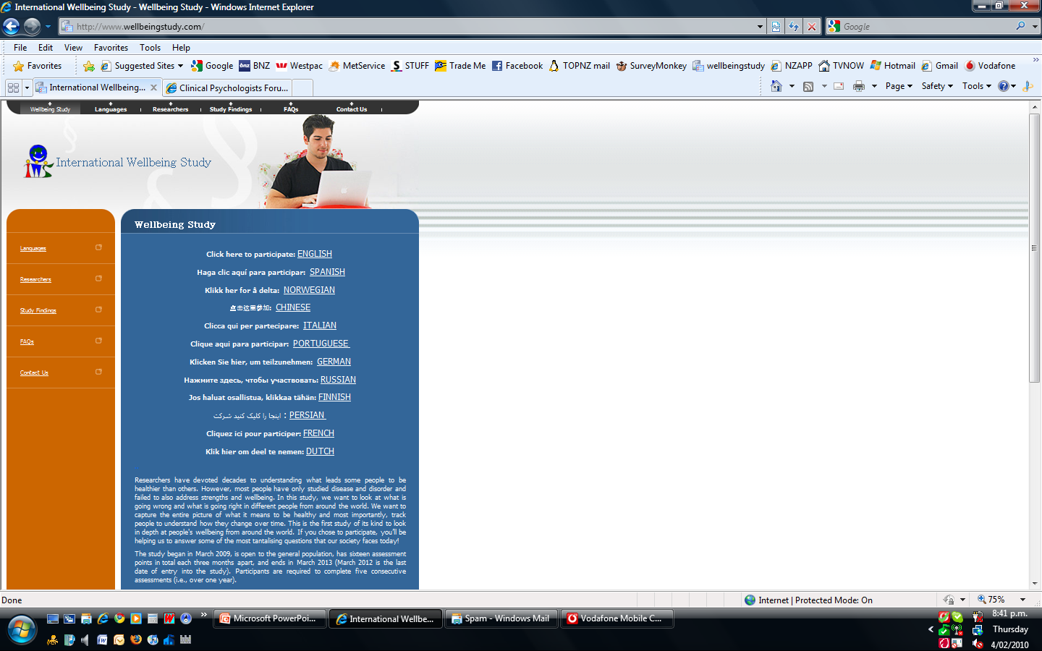

Slide 9
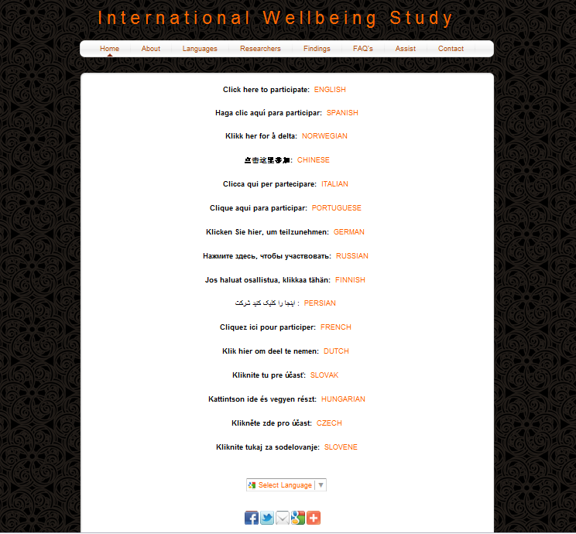

Slide 10
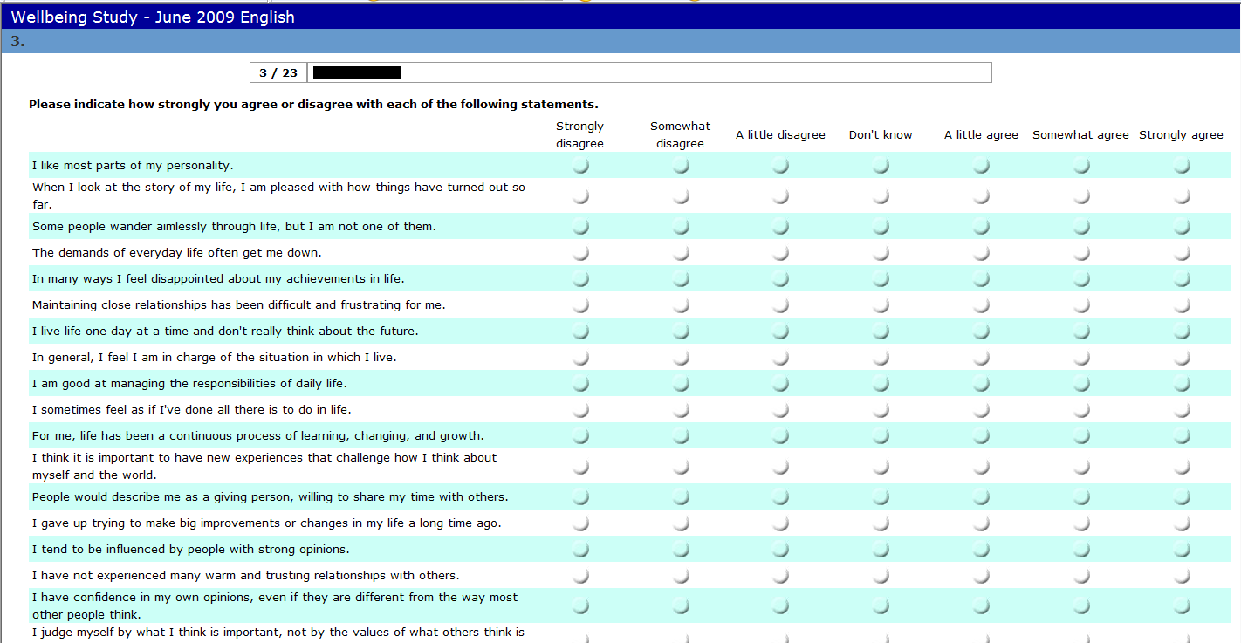

Slide 11
Study details
Measures: n = 208
  Scales of Psychological Wellbeing 18
  Temporal Satisfaction with Life Scale 15
  Strengths Use and Current Knowledge Scale 10
  Subjective Happiness Scale 4
  Orientations to Happiness 18
  Adult Hope Scale 12
  Happiness Measures 4
Gratitude Survey 6
Curiosity and Exploration Inventory – II 10
Grit scale 17
Meaning in Life Questionnaire 10
Positive Life Events 5
Ways of Savouring Scale 20
Savouring Beliefs Scale 5
Control Beliefs Scale 4
Negative Life Events 5
Rumination 6
CESD - Depression Scale 20
Other Questions (flow, mindfulness, values, time use, etc) 12
Demographic Questions 7

Slide 12
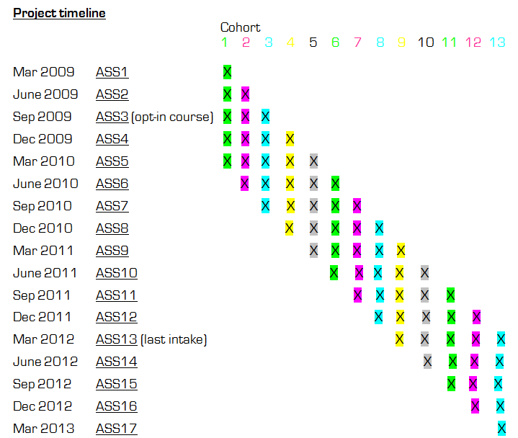

Slide 13
Study details
Some (relatively) unique aspects:
  Collaborative nature (specific cohorts: e.g., yoga, philosophers, migrants, dentists, gym members, mental health support workers)
  Cheap cost
  Use of technology - scalability
  Longitudinal design
  Controls for + & - events
  Open source data
  Evolving/expanding research (further assessment study)
  Norm new scales (SUCK, CAPP Implicit, etc)
  For others to test new intervention programs

Slide 14
Development
Core researchers (6), and a team of strengths:
  Positive psychology wiz kid, longitudinal analysis guru, funding genius, experienced old research head, comedian & sceptic, and me…
A little helps from your friends…
  Dianne Vella-Brodrick
  Denise Quinlan
  Many others provided valuable input during developmet…

Slide 15
Challenges
Languages
  Developing a good method via trail and error
    Back translations, expectations across cultures
    Google translate
Collaborating
  Win-win’s via democratic decisions, compromise, & frequent communication
  Be clear on ownership of intellectual property, data access, sharing, and authorship

Slide 16
Challenges
Design
  Participant engagement (long questionnaire), and reducing drop out
  To control for major confounders or modifiers of psychological wellbeing – such as physical health
Moving forward
  Gain representative samples (i.e., non self-selecting)
  More males
  More representative languages
  More of various country samples
  Automation
  Funding

Slide 17
Feedback
Negative Feedback
  “I just now started the questionnaire but have given up deciding there are too many better things to do in life, like filling in my tax return, than completing this marathon task”
  “Never in the history of social science have so may questions been asked in such a long and such a boring questionnaire; and then to have to it again! (psychology professor)”
  “The sample of people who complete this questionnaire twice must surely be drawn from a population of people whose mental lives are so impoverished they can find no more stimulating way of occupying their time”

Slide 18
Feedback
Positive Feedback
  “This is an impressive study: it is a) international, b) longitudinal, c) uses 20 scales of known reliability & validity, and d) invites interesting sub-samples. Giving those who recruit sub-samples the opportunity to analyze their data opens up avenues of discovery no single team of researchers could anticipate. Anyone who would criticize this study simply because it relies a lot on self-report does not appreciate the sophistication of what you are undertaking”
  “One of the most ambitious endeavours to understand the trajectories of wellbeing in meaningful contexts around the globe”

Slide 19
Initial findings
Mountainous data-set
  Intake One (March 2009) had 980 English participants, * 208 questions = 203,840 data points.
  About 8,000 participants * 208 questions = 1,644,000 data points for their Time One assessment.

Slide 20
Example findings: General
Example findings:
  What is the best predictor of wellbeing? (Strengths, meaning in life, hope, gratitude, curiosity, grit, values, time use, savouring, positive events, friendships, purpose, growth mindset, being in flow, etc?)
  The questions themselves may be an intervention?
  Depressed - dissatisfied with time use (-.500**), and not living in alignment with their values (-.549**) – (stronger than hope)

Slide 21
Example findings: Specific
Example strengths findings:
  Strengths Use, not Strengths Knowledge, correlates positively with wellbeing, and negatively with depressed mood (-.346**)
  % time using strengths associated with self-acceptance (.459**), happiness (.456**), % time happy (.425**), grit (.477**), meaning in life (.420**), being in flow (.465**), satisfaction with time use (.455**), and living alignment with values (.450**).
  Strengths use associated with self-acceptance (.502**), control of the environment (.437**), present life satisfaction (.417**), future life satisfaction (.411**), happiness (.492**), engagement (.425**), hope agency (.653**), hope pathways (.568**), % time happy (.404**), being curious – stretching (.469**), grit (.514**), meaning in life (.474**), flow (.470**), satisfaction with time use (.441**), and living alignment with values (.438**).
  Strengths knowledge associated with autonomy (.409**)

Slide 22
Example findings: Specific
Example strengths findings:

Slide 23

www.internationaljournalofwellbeing.org

Slide 24
Thank You!
&
Join Us?
Aaron Jarden
aaron.jarden@openpolytechnic.ac.nz
www.wellbeingstudy.com

