Slide 1
The Science of Wellbeing
16th October 2017
Dr Aaron Jarden
Wellbeing and Resilience Centre
Department of Environment, Water and Natural Resources Parks and Regions Group Mangers Forum

Slide 2
Outline
Three Breaths (exercise)
Wellbeing assessment
A useful wellbeing framework
Some points about context and processes
Questions
Efficacy vs effectiveness
Savouring (exercise)

Slide 3
Three breaths
The Geelong Three Breaths Exercise
Breath One. Take a deep breath. Notice your physical body and any points of pain or tension. Breath out slowly and release any tension away.
Breath Two. Take a deep breath. As you breathe out think about what you are grateful for right at this very moment. Say to yourself "Right now I am grateful for... ".
Breath Three. Take a deep breath. As you breathe out think what intentional state you want to be in right now. Say to yourself "My intention right now is to be (kind, open minded, relaxed, critical, curious etc)... ".
Developed by Justin Robinson at Geelong Grammar.

Slide 4
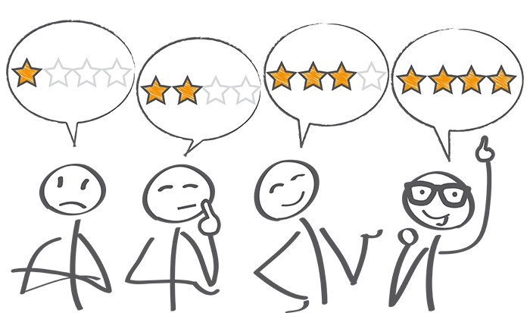
Assessment
Assessment
How happy are you right now?
What would you pay / give / do / sacrifice / commit to in order to be, on average, one point happier?
10 - Extremely happy
9 - Very happy
8 - Pretty happy
7 - Mildly happy
6 - Slightly happy
5 - Neutral
4 - Slightly unhappy
3 - Mildly unhappy
2 - Pretty unhappy
1 - Very unhappy
0 - Extremely unhappy

Slide 5
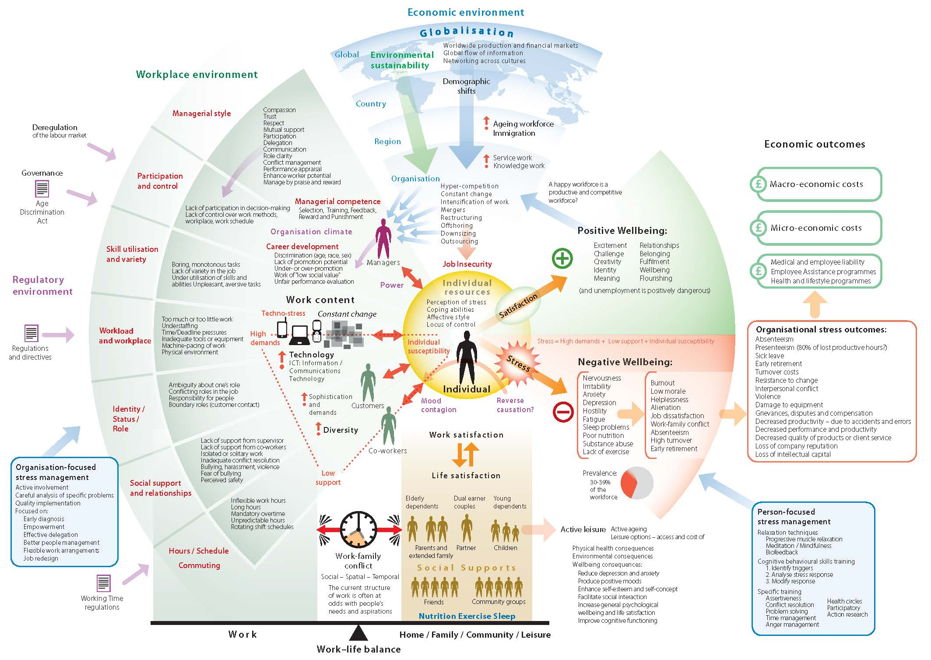
Framework 1: Me, We, Us

Slide 6
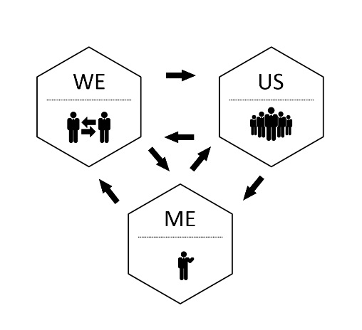
Framework: Me, We, Us
A framework to locate activities
The individual level (Me) - mindfulness
The group level (We) - leadership
The organisational level (Us)
Jarden, A., & Jarden, R. (2016). Positive psychological assessment for the workplace. In L. Oades et al. (Eds.), The Wiley-Blackwell Handbook of Positive Psychology at Work, pp. 415-437. Published Online: 19 Nov 2016: DOI: 10.1002/9781118977620.ch22

Slide 7
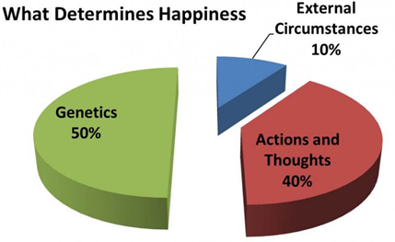
Context and processes
Some points
I’m no expert in your wellbeing and wellbeing improvement is hard work – like losing weight. This is not therapy, and I'm no longer a practicing psychologist.
I usually say: “This is an opportunity to make some changes, get renewed, re-energized, revitalized! It’s time to create change here in your own life – but realise that all change is hard and stressful, even positive change”.
It’s not just about learning to be more positive – it’s about using scientifically-informed tools and strategies to make your thinking more flexible, accurate, clear, and expansive. This thinking will lead to more healthy behaviours.
It’s not all about the positive and happiness, joy, joy... Accept the negative; it’s functional.
40% within your control, 10% circumstance, 50% genetic - so it is about choice.

Slide 8
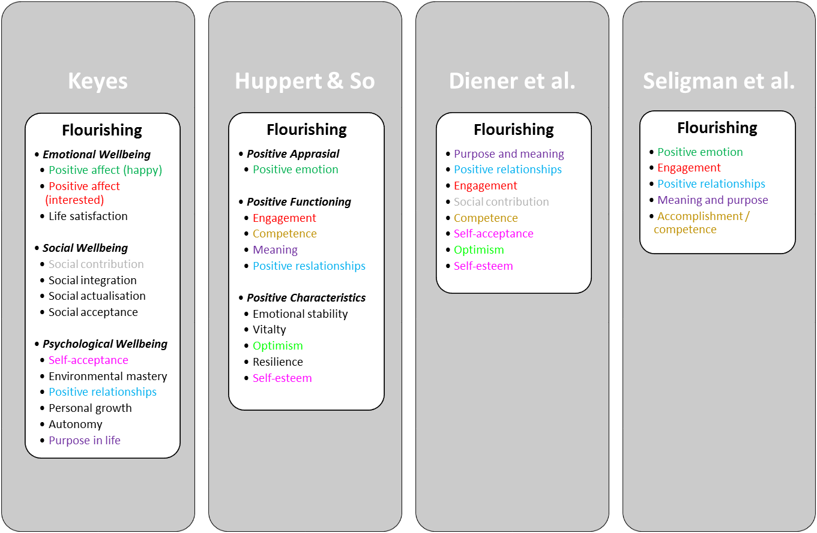
Context and processes
Some random points
Wellbeing spreads through social networks:
About 15%.
To 3 degrees of separation.
What is optimal human functioning?
We need to understand the context, not individual behaviour alone.
Different theories and recipes of wellbeing, flow into different public health messages.

Slide 9
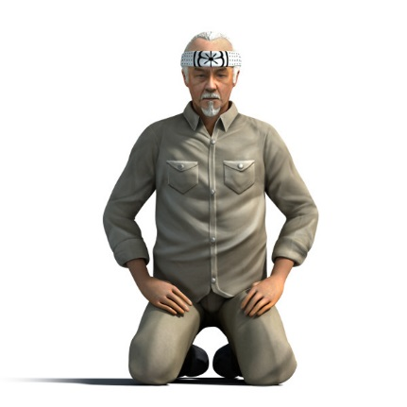
Questions
Questions
What's the best thing that has happened today?
“Answer not important, unless ask the right question”
What questions are you asking?
What's right?
What's good?
What works? What doesn’t?
What should I focus on? (what we focus on, grows…)
In which ways do I accept myself, and which ways don’t I accept myself?
What are my greatest strengths and competencies?, and how do I use them?
Who are my most cherished relationships? How do they support me?
What would I like to learn?
What would I like to accomplish?

Slide 10
Efficacy vs effectiveness
In the real world…
Hone et al (2015) – “…synthesizing efficacy trials of PPIs reveals little evidence that these interventions translate into sustained programmes of behaviour change when applied beyond the tightly controlled conditions of the laboratory or psychology classroom setting”.
Parks et al (2012) - “...researchers have yet to offer persuasive evidence that happiness activities, as they are actually used in real-world settings, are beneficial”.
Hone, L., Jarden, A., & Schofield, G. (2015). An evaluation of positive psychology intervention effectiveness trials using the re-aim framework: A practice-friendly review. Journal of Positive Psychology, 10(4), 303-322.

Slide 11
Many links to wellbeing
Slow down
Discomfort
Nature
Simplify
Gratitude
Communication
Strengths
Optimism
Physical health
etc

Slide 12
Not only building
It’s not just about building wellbeing!

Slide 13
Savouring
Savour your experiences
Savouring involves being “in the moment” and “taking in” all that an experience has to offer. Think of it as wringing the pleasure juice out of life by giving attention to the pleasures of the moment.
Savouring can be used in a wide variety of circumstances – one can savour a sensory experience, a social experience, a feeling, or even a memory.
There are ten different types of savouring strategies - sharing with others, memory building, self-congratulation, sensory-perceptual sharpening, comparing, absorption, behavioural expression, temporal awareness, counting blessings, and kill-joy thinking.
We are going to try a combo of “sensory-perceptual sharpening” and “absorption”.

Slide 14
Savouring
Savour your experiences
Step 1: Hold your almond.
Step 2: Take a close look at it – inspect it, examine it! What does it look like? Is it symmetrical?
Step 3: Close your eyes for the rest of this experience and feel it in your hand – what does the texture feel like?
Step 4: Smell it. What does it smell like?
Step 5: Put the almond into your mouth but do not bite or suck it – just let it rest on your tongue. Explore the almond with your tongue and teeth, noticing as much as you can.
Step 6: Bite slowly into it and focus on the taste. Swirl the contents of the almond around in your mouth.
Step 7: Swallow the almond and open your eyes.
Was it easy to stay focused as you tapped your senses and became absorbed in the sensory experience?
What was it like to pay attention to each individual detail of the experience?

Slide 15
The Science of Wellbeing
16th October 2017
Dr Aaron Jarden
Wellbeing and Resilience Centre
Department of Environment, Water and Natural Resources Parks and Regions Group Mangers Forum

