Slide 1
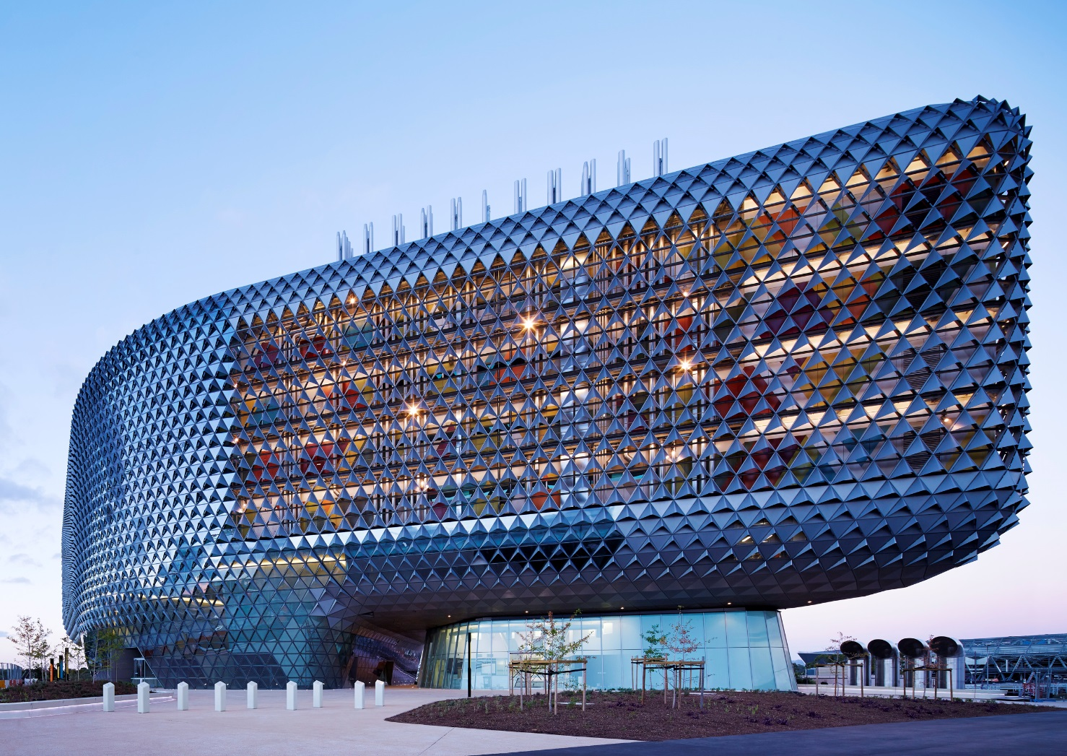
The Value of Wellbeing Measurement
15th September 2017
Dr Aaron Jarden, Head of Research, Wellbeing and Resilience Centre

Slide 2
What do we mean by wellbeing?
“Wellbeing” is used in many places and in many different ways.
Wellbeing is not a static concept - it exists on a continuum where starting points differ and movement is part of a dynamic process (some elements more stable them others).
Some definitions emphasise feeling good, while others stress meaning, purpose or functioning well. The terms wellbeing, quality of life and happiness are often used interchangeably.
The OECD suggests three main groups into which the huge range of wellbeing definitions can be grouped:
General or global definitions.
Component definitions (e.g., range of components; PERMA).
Focused definitions (e.g., financial wellbeing).

Slide 3
What do we mean by wellbeing?
There are many established definitions of wellbeing drawn from a range of disciplines including economics, social policy, psychology and philosophy in particular.
An established definition is one that has been published previously in scientific, scholarly or policy documents (e.g., “”).
Wellbeing:
“Wellbeing can be understood as how people feel and how they function both on a personal and social level, and how they evaluate their lives as a whole.”
“How well someone’s life is going for them”.

Slide 4
What do we mean by wellbeing?
Eudaimonic wellbeing “focuses on meaning and self-realisation and defines wellbeing in terms of the degree to which a person is fully functioning”. Hedonic wellbeing “focuses on happiness and defines wellbeing in terms of pleasure attainment and pain avoidance”.
Social and Emotional Wellbeing:
Social and emotional wellbeing (SEWB) is a complex and multifaceted concept that has particular resonance and meaning for Aboriginal and Torres Strait Islanders.
Aboriginal concept of health is holistic, encompassing mental health and physical, cultural and spiritual health.
Connection to country is a fundamental basis for Aboriginal concepts of physical, cultural and spiritual health.

Slide 5
What do we mean by wellbeing?
Mental Health:
“A state of wellbeing in which every individual realises his or her own potential, can cope with the normal stresses of life, can work productively and fruitfully, and is able to make a contribution to her or his community.”
“A syndrome of symptoms of positive feelings and positive functioning in life.”
Resilience:
“Resilience is the process of adapting well in the face of adversity, trauma, tragedy, threats or significant sources of stress - such as family and relationship problems, serious health problems or workplace and financial stressors.”
A very detailed literature review – definitional overlaps.

Slide 6
What do we mean by wellbeing?
Happiness or Subjective Wellbeing (SWB):
Subjective wellbeing (SWB) “is most often interpreted to mean experiencing a high level of positive affect, a low level of negative affect, and a high degree of satisfaction with one’s life… The concept of SWB, assessed in this way, has frequently been used interchangeably with ‘happiness’”.
Flourishing / Thriving:
“High levels of wellbeing”.
“To be flourishing in life, individuals must exhibit a high level… of emotional wellbeing and high levels… of positive functioning”.

Slide 7
What do we mean by wellbeing?
Health:
The World Health Organisation defines health as “a state of complete physical, mental and social wellbeing and not merely the absence of disease or infirmity”.

Slide 8
What do we mean by wellbeing?
Domains of Wellbeing
The term wellbeing will often be applied to certain domains, components or aspects of life – e.g., social wellbeing, spiritual wellbeing.
Psychological Wellbeing:
Authors have presented “a multidimensional approach to the measurement of PWB [psychological wellbeing] that taps six distinct aspects of human actualisation: autonomy, personal growth, self-acceptance, life purpose, mastery and positive relatedness. These six constructs define PWB both theoretically and operationally and they specify what promotes emotional and physical health”.

Slide 9
What do we mean by wellbeing?
Cognitive Wellbeing:
“Cognitive wellbeing is associated with achievement and success. It includes how information is processed and judgments are made. It is also informed by motivation and persistence to achieve. Cognitive wellbeing is important for attaining knowledge and experiencing positive learning.”
Mental Wellbeing:
“Mental wellbeing is a dynamic state in which people are able to develop their potential, work productively and creatively, build positive and respectful relationships with others, and meaningfully contribute to the community”.

Slide 10
What do we mean by wellbeing?
Emotional Wellbeing:
Emotional wellbeing refers to the ratio of positive to negative affect (affect balance) or more generally to the construal of one’s wellbeing in the emotional domain.
It is sometimes used in reference to emotional self-regulation - how well one regulates emotions and uses them to understand the world.
It is often related to emotional intelligence also: self-awareness and self-management of emotions.

Slide 11
What do we mean by wellbeing?
Social Wellbeing:
Social wellbeing has been described as having five components: “social integration, social contribution, social coherence, social actualisation and social acceptance. These five elements, taken together, indicate whether and to what degree individuals are overcoming social challenges and are functioning well in their social world (alongside neighbours, co-workers and fellow world citizens)”.
Physical Wellbeing:
A sense of wellbeing related to the physical aspects of one self.
Financial Wellbeing:
Economic wellbeing is often synonymous with material living conditions “which determine people’s consumption possibilities and their command over resources”.

Slide 12
What do we mean by wellbeing?
Spiritual Wellbeing:
Spiritual wellbeing is defined as an “ability to experience and integrate meaning and purpose in life through connectedness with self, others, art, music, literature, nature and/or a power greater than oneself”.
Environmental Wellbeing:
“Environmental wellbeing includes trying to live in harmony with the Earth by understanding the impact of your interaction with nature and your personal environment, and taking action to protect the world around you. Protecting yourself from environmental hazards and minimising the negative impact of your behaviour on the environment are also central elements”.
Also: Relationships, Family, Education, Community Life, Physical Health, Fun and Leisure, and others…

Slide 13
What do we mean by wellbeing?
Population Wellbeing
Some definitions of wellbeing explicitly refer to the wellbeing of groups of people. In these contexts wellbeing is often measured as an aggregate of individual subjective wellbeing ratings or may be measured via a collection of objective indicators such as unemployment, health status, educational attainment or economic output.
Community Wellbeing:
“Community wellbeing is the combination of social, economic, environmental, cultural and political conditions identified by individuals and their communities as essential for them to flourish and fulfil their potential”

Slide 14
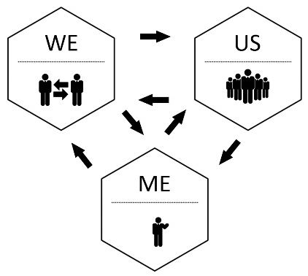
What do we mean by wellbeing?
Workplace Wellbeing:
The wellbeing of a group of workers in a work setting as often measured by worker-rated indicators such as organisational culture, civility, respect and workload management, and objective measures such as absenteeism, turnover and injuries.
Population Wellbeing:
Population wellbeing may be based on the concept of population health. “The health outcomes of a group of individuals, including the distribution of such outcomes within the group… a hallmark of… population health is significant attention to the multiple determinants of such health outcomes.”

Slide 15
What do we mean by wellbeing?

Slide 16
What do we mean by wellbeing?
Important points:
The array of wellbeing evaluation and measurement resources and tools grow as the science of wellbeing continues to develop.
Definitions can be very important for evaluation.
Many wellbeing concepts can be measured by existing measurement tools – both subjective and objective.
Definitions and corresponding tools for measurement need to be tested among stakeholders for appropriateness (wellbeing literacy).

Slide 17
Different lenses, different perspectives
How others have thought about and utilised measurement:
Sovereign New Zealand Wellbeing Index:
http://www.mywellbeing.co.nz/mw/
10,000 people, pegged to NZ census, 2 years apart, 4,500 T1 & T2, about 160 questions, 1/3 psychological wellbeing, 1/3 physical health, 1/3 demographic / social / economic / public health – subjective and objective.
NZ Treasury Living Standards Framework:
http://www.treasury.govt.nz/abouttreasury/higherlivingstandards
Ordinally a wellbeing framework.
Australia’s:
https://treasury.gov.au/publication/economic-roundup-issue-3-2012-2/economic-roundup-issue-3-2012/treasurys-wellbeing-framework/

Slide 18
Different lenses, different perspectives
National Accounts of Wellbeing:
http://www.nationalaccountsofwellbeing.org/
Although economic indicators have reigned within policy debates, the purpose of the economic indicators is ultimately to enhance “happiness” - subjective wellbeing.
National measures of wellbeing that are collected systematically at periodic intervals will not only help focus attention on wellbeing as a major goal of societies, but can give information to leaders about policy alternatives, and thus inform policy debates in a way that complements economic analyses.
Although global wellbeing measures such as life satisfaction are useful, measures that are focused on certain target populations, on current policy questions, and on specific activities and life domains often will be most informative for policy debates.
Since Jan 2009

Slide 19
Different lenses, different perspectives
Objectives:
A new way of assessing societal progress: how people feel and experience their lives, help to redefine our notions of national progress.
A cross-cutting and more informative approach to policy-making: provide policy-makers with a better chance of understanding the real impact of their decisions on people’s lives by capturing population wellbeing across areas of traditional policy-making, and looking beyond narrow, efficiency-driven economic indicators.
Better engagement between national governments and the public: provide opportunities for national governments to reconnect with their citizens taking in account what people care about.
Feelings, functioning and psychological resources: national accounts moves beyond a conception of wellbeing as experiencing good feeling and making positive judgments about life, to also measure how people are doing, in terms of functioning and the realization of their potential.

Slide 20
Different lenses, different perspectives
Four ONS UK questions:
Overall, how satisfied are you with your life nowadays?
Overall, to what extent do you feel that the things you do in your life are worthwhile?
Overall, how happy did you feel yesterday?
Overall, how anxious did you feel yesterday?
Part of the SAMSS (South Australian monitoring and surveillance system) data.

Slide 21
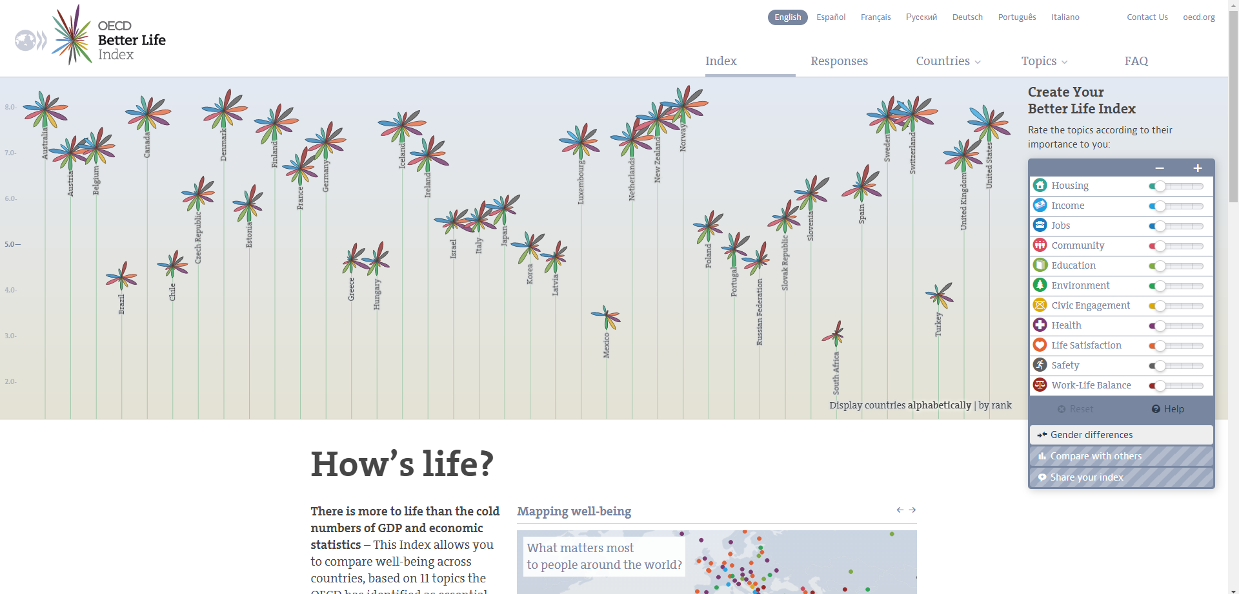
Different lenses, different perspectives
OECD Better Life Index
http://www.oecdbetterlifeindex.org/#/11111111111
Based on 11 topics (different dimensions of life) the OECD has identified as essential, in the areas of material living conditions and quality of life.

Slide 22
Different lenses, different perspectives
ANDI
http://www.andi.org.au/
The Australian National Development Index is a holistic measure of national progress and wellbeing. The index reflects the values and priorities of Australians and tells us how we are doing as people, as communities and as a nation.
​Informed by experts but defined by Australians, ANDI promotes democracy and citizen voice.
Using a set of social, health, economic, and environmental factors, twelve domains provide a complete picture of national wellbeing.

Slide 23
Different lenses, different perspectives
Community Indicators Victoria
http://www.communityindicators.net.au/measuring_wellbeing
The framework is based on a set of approximately 80 community wellbeing indicators.

Slide 24
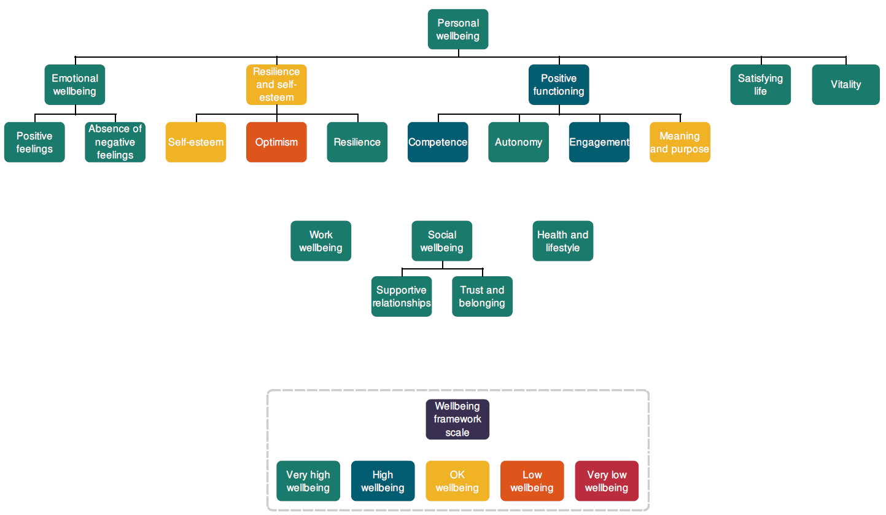
Different lenses, different perspectives

Slide 25
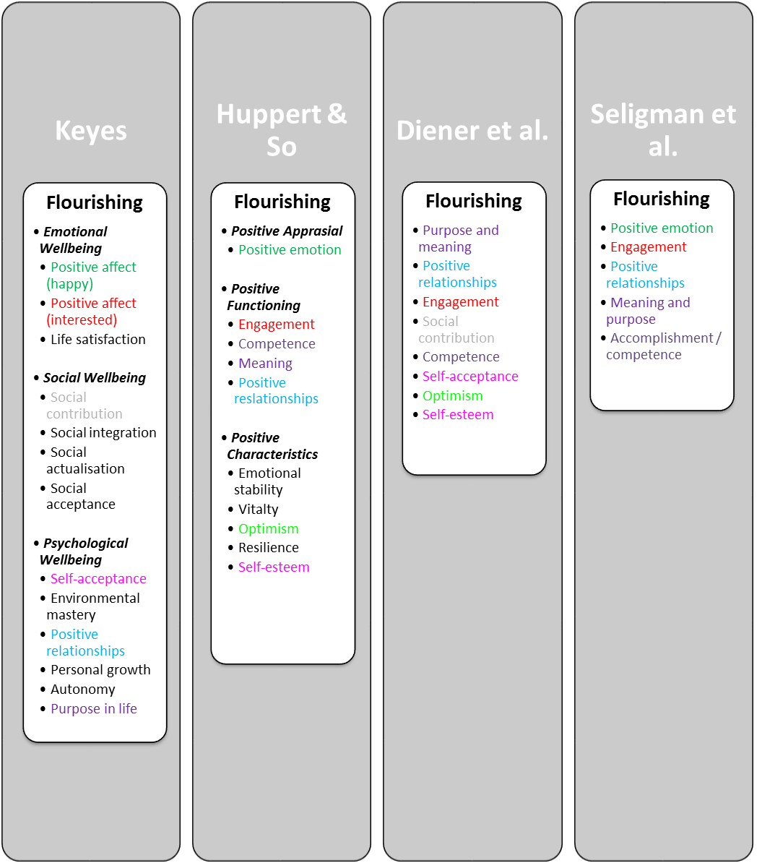
Different lenses, different perspectives

Slide 26
Individual and population level measurement
What domains are important?
What components of wellbeing are important? (e.g., A in PERMA)
What levels of wellbeing are important?
Is comparison to other datasets important?
Do we need to reinvent the wheel?
Can we make a better wheel?
Population level usually focuses on the global outcome level, not drivers…
OECD guidelines on measuring wellbeing a gold standard in my view…

Slide 27
The utility of wellbeing measurement
From data to intervention - The importance of measurement.
You can only manage what you measure – better measurement data allows better management. Assessments allow data-driven decision making.
Many ways of assessment.
Tests / Surveys (Paper based and online).
Self-monitoring.
Observation.
Physiological measures (heart rate, skin conductivity, etc).
Interview.
Existing records.
Experience Sampling Method (ESM) & Day Reconstruction Method (DRM).

Slide 28
The utility of wellbeing measurement
Tracking change over time is important and where the action is in my view as a pragmatist.
It’s not just the change in wellbeing outcome, it’s understanding the drivers of wellbeing change!
Assessments and frameworks create opportunities for conversations, conversations improve wellbeing…

Slide 29
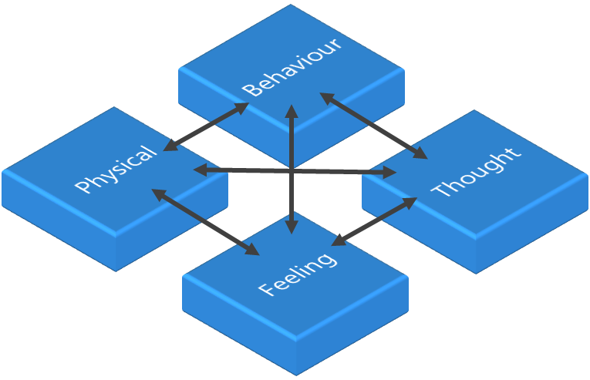
Challenges
More work needed on how others have thought about and utilised measurement… Who to build off?
More sophisticated individual level measurement.
The SA Mental Health Strategic Plan.
Which collection of objective indicators?
Untangling processes indicators and outcomes…
What does a good life / society look like? (outcome)
Acknowledgment:
Many of the definition in the first section were taken from: Mental Health Commission of NSW (2017), Wellbeing language and definitions guide 2017. Sydney, Mental Health Commission of NSW

