Slide 1
The Tuesday Program:
A free online program for increasing wellbeing
Aaron Jarden
aaron.jarden@openpolytechnic.ac.nz
www.aaronjarden.com
www.thetuesdayprogram.com

Slide 2
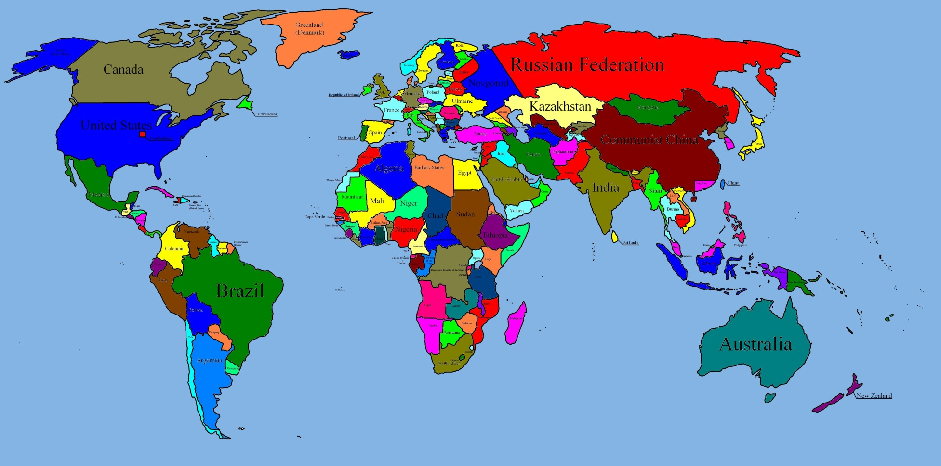
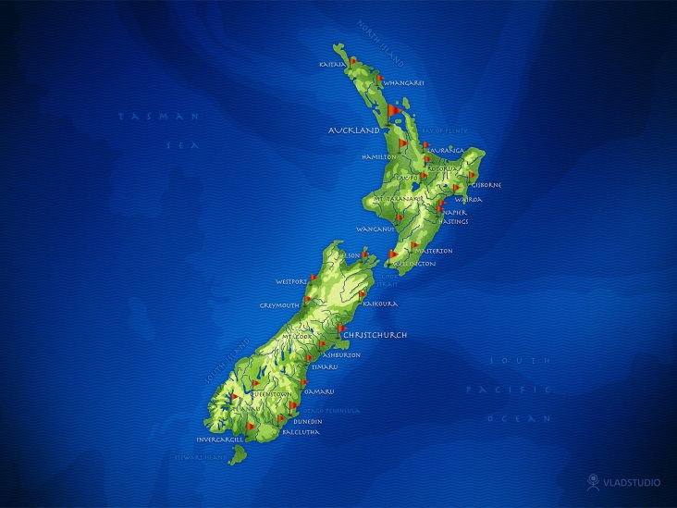

Slide 3
People involved
Dr. Aaron Jarden
Dr. Jo Mitchell
Dr. Alexander MacKenzie
Dr. Jacolyn Norrish
Ravi Iyer
Dr. Kennedy McLachlan
Chelsea Todd
Denise Quinlan
Dr. Kathryn Page

Slide 4
Outline
Description of The Tuesday Program
The development and challenges of the program
Initial results

Slide 6
What is The Tuesday Program?
A free program
An online program
A short program - seven consecutive weeks, 15 minutes a week
Pareto principle: roughly 80% of the effects from 20% of the causes
Seven topics
Strengths (VIA)
Growth mindsets (Dweck’s work)
Purpose and values
Gratitude
Communication (active constructive responding)
Relaxation
Mindfulness

Slide 7
What is The Tuesday Program?
Aims to increase general wellbeing
Uses already empirically validated approaches and techniques
Participants watch a short 4-6 minute animation
Download a short 2-3 page .pdf document which summaries what they have watched and provides instructions on implementing these new skills

Slide 8
The old animations

Slide 9
The new animations

Slide 10
The .pdf’s

Slide 11
Evaluating The Tuesday Program

Slide 12
Initial results
Pretty much no promotion…
1,837 unique visits to site; mostly from NZ, but also Hungary, USA and Australia – 27 countries in total, since Dec 2010
Using for pre-study engagement (retention and completion)
Via participant feedback and Google Analytics, participants do on average 4 of the 7 topics: Fit
Most popular are: Strengths, Purpose and Values, Communication, and Gratitude

Slide 13
Some feedback
Average effort put in (0 = no effort, 10 = max possible effort) = 5.4/10
Average impact on life (0 = none, 10 = a lot) = 5.7/10
Small sample, but seems to:
Increase strengths use and time using strengths
Increase happiness (from ‘mildly happy’ to ‘pretty happy’)
Increase present and future life satisfaction
Decrease depressed mood
No change in gratitude or grit?

Slide 14
Some feedback
“I found the strengths video amazing, even though most of us know we have these strengths they are often forgotten. Using the skills I learnt in the videos has strengthened my relationship with not only my partner, but also my children and friends”.
“I found the techniques excellent. I had a little difficulty staying on track, but got there in the end”.
“I thought they were good- what was interesting for me was that it made me focus on things I wouldn't normally. When your mind is full of positives you are less likely to focus on -ves. I learnt a lot!”

Slide 15
Thank You
Aaron Jarden
aaron.jarden@openpolytechnic.ac.nz
www.aaronjarden.com
www.thetuesdayprogram.com

