Slide 1
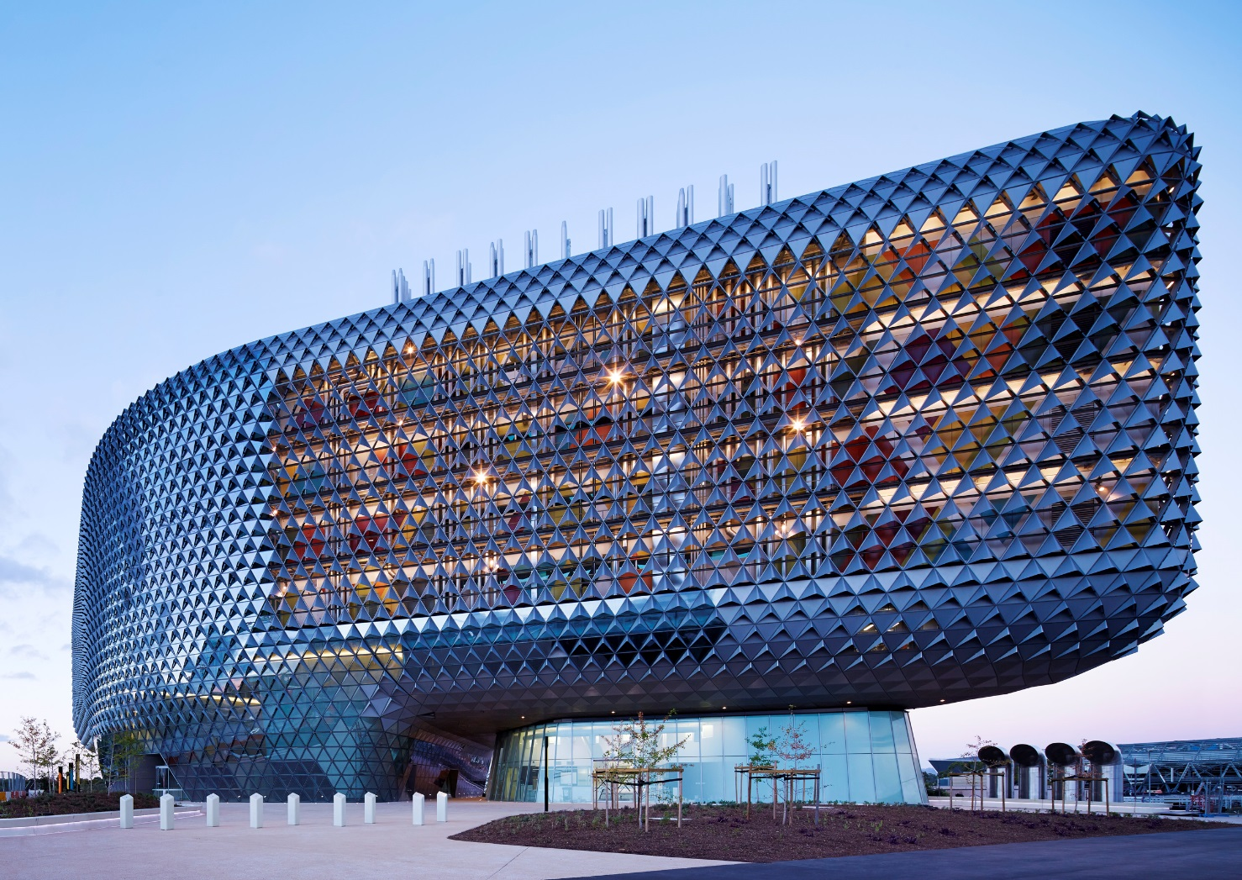
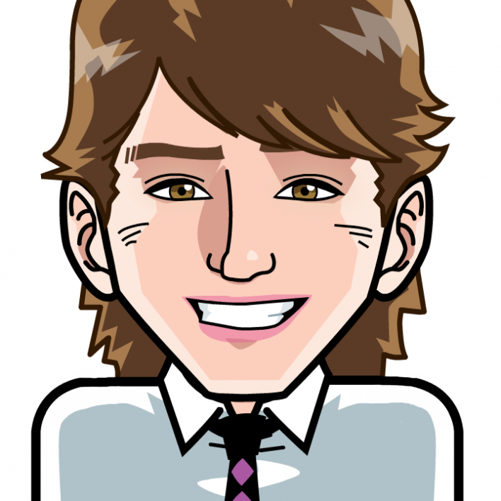
WELLBEING 101: MAKING WELLBEING PROGRAMS SUCCESSFUL
Dr Aaron Jarden
aaron.jarden@sahmri.com
28th November 2017
Corporate Health and Wellbeing Summit Sydney
Copy of these slides at: www.aaronjarden.com
www.aaronjarden.com
www.wellbeingandresilience.com

Slide 3
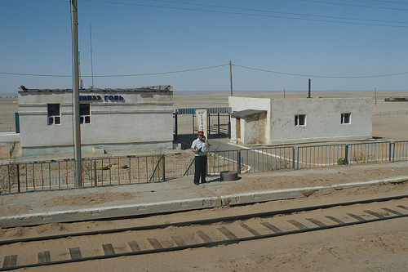

Slide 7
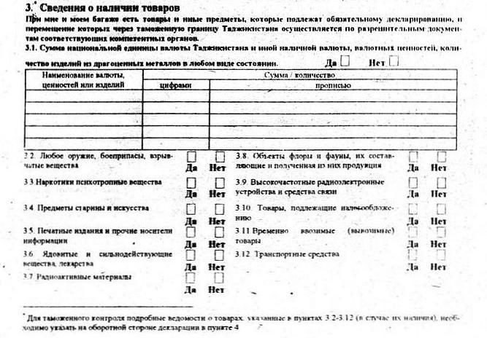

Slide 8
Perspectives
My goal
“My goal is simple. It is complete understanding of human wellbeing, why it is as it is and how it can be improved.”
Within an organisational setting, it’s to enable organisations to invest in creating more rewarding, happier jobs for their people. To create positive workplaces where people are able to do meaningful and enjoyable work that taps into their greatest strengths and their most important goals. To capitalise on the unique intellectual and personal strengths of each employee by focusing less on getting employees to do their work and fixing problems and into promoting excellence by enabling them to do good work; their best work.
Wellbeing ⇨ Engagement ⇨ Productivity ⇨ Business success
Wellness 
Your goal
What’s your goal?

Slide 9
Overview
Overview
Positive psychology and wellbeing science.
Some essential ingredients to a successful wellbeing program.
Case studies.
Applause or ridicule.

Slide 10
What is wellbeing?
What is positive psychology?
"There are two complementary strategies for improving the human condition. One is to relieve what is negative in life; the other is to strengthen what is positive. Mainstream psychology focuses largely on the first strategy; Positive Psychology emphasizes the second" - Martin Seligman
"Positive psychology is the scientific study of what enables individuals and communities to thrive" - International Positive Psychology Association.

Slide 11
Positive psychology & wellbeing science
Positive psychology and wellbeing science
Positive psychology is a branch of psychology that conducts scientific inquiry into the factors that help individuals, communities and organisations thrive by building on their strengths and virtues.
Positive psychology is the study of topics as diverse as happiness, optimism, hope, flow, meaning, resilience, grit, growth...
Positive psychology aims to expand psychology from its focus on repairing the negatives in life to also promoting the positives in life.

Slide 12
Positive psychology & wellbeing science
What is optimal human functioning?

Slide 13
The good life
Aaron on wellbeing science
The good life is best construed as a matrix that includes happiness, occasional sadness, a sense of purpose, playfulness, and psychological flexibility, as well autonomy, mastery, and connection.

Slide 14
Progress to date
Wellbeing science to date
Progress
Positive neuroscience
Positive education
Positive health
Military
Positive organisations
National accounts of wellbeing
Culture and wellbeing
Many new pathways are unappreciated…
New areas emerging
Discomfort
Strategic laziness
Play
Slowness
Nature
Wellbeing technology
The most disadvantaged (little samples)
Physical health and wellbeing
Positive failure

Slide 15
Positive introduction
First up, let’s taste it
Step 1: Pair up.
Step 2: In 2 minutes (1 minute each), tell a story – a thoughtful narrative with a beginning, middle and end – that illustrates when you are at your best at work.
Note: Swap when you hear the bell the first time after 1 minute, stop completely when you hear the bell the second time after 2 minutes.

Slide 16
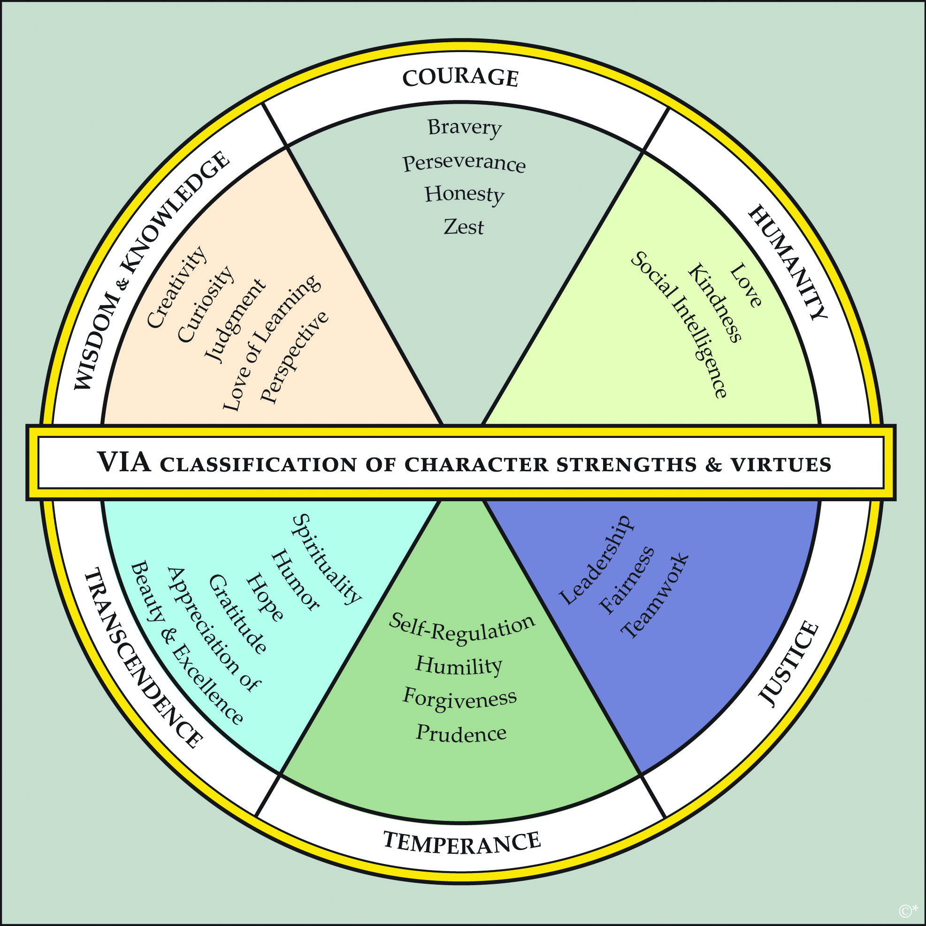
Positive introduction
Key point:
Wield your strengths at work – they are paths to engagement and enjoyment.

Slide 17
Essential ingredients
Recipe of essential ingredients to a successful wellbeing program
Beautiful questions.
Wellbeing assessment and evaluation.
Wellbeing frameworks and models.
Positive leadership and champions.
Tools and programs.
Risks.
A whole bunch of other stuff if we have time, like:
Onboarding and communications and simplifying messages.
Time and money.
Timing and readiness for change – wellbeing is hard work and takes time.
Program scope and focus.

Slide 18
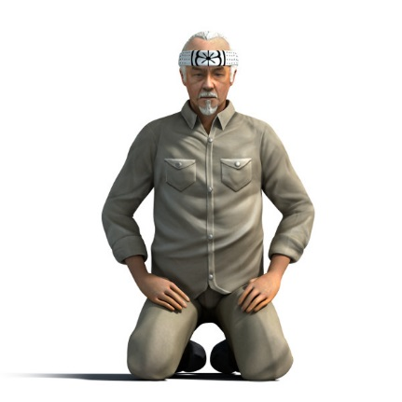
Questions
Example beautiful questions
What’s working?
What has already been embedded within the organisation?
Why is it working?
What (or more likely who) has sustained this embedding?
What are the positive processes? How did they happen?
What has failed?
Why? (what was the learning…)
Disengaged health & safety?
How will you know wellbeing has worked?
Types of evidence and triangulating information.
Measuring IV’s and DV’s - indicators of change. DV’s are so last year…
Pre – post and longer term assessment.
Is the organisation ready and willing for wellbeing? (or more likely ‘who’ in the organisation is ready?, and for what?).
Is the organisation connected to wellbeing people, expertise and knowledge? (support)
Why are the employees working there? What do they want out of work? What does a good day at work look like?
Is there much point increasing wellbeing, when illbeing is bad or getting worse?
How will the organisation capitalise on other opportunities during the wellbeing change?
How do you celebrate success?
“Answer not important, unless ask the right question”

Slide 19
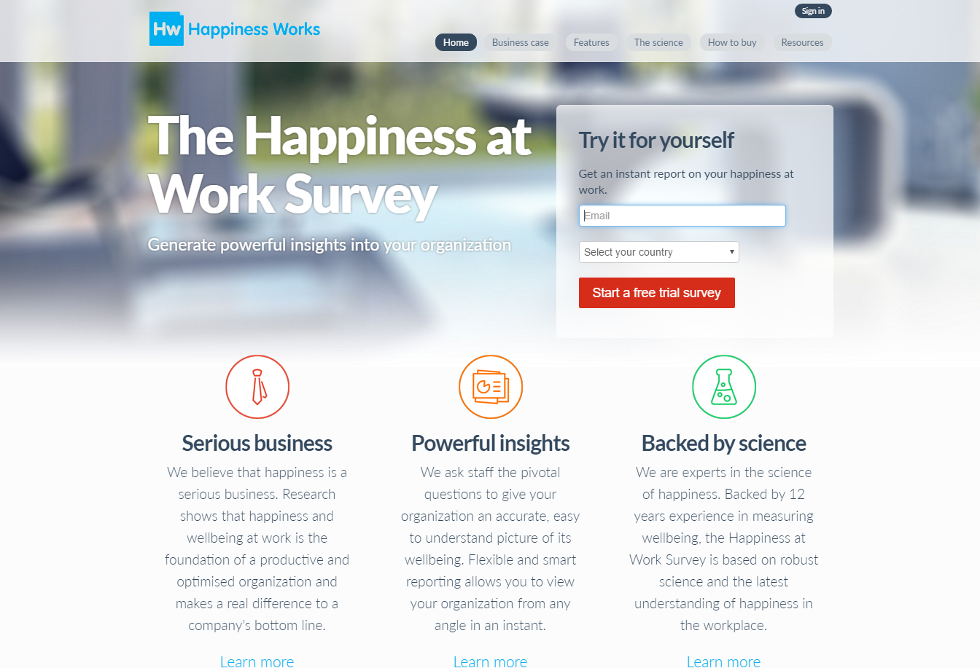
Assessment
Wellbeing assessment and evaluation
Assessments create opportunities for conversations, conversations improve wellbeing (also use existing events, and create new wellbeing events to do so).
Assessments allow data-driven decision making.
Many developed by organisational psychologists don’t actually measure wellbeing (but they look shiny and are expensive)…
www.workonwellbeing.com & www.happinessatworksurvey.com

Slide 20
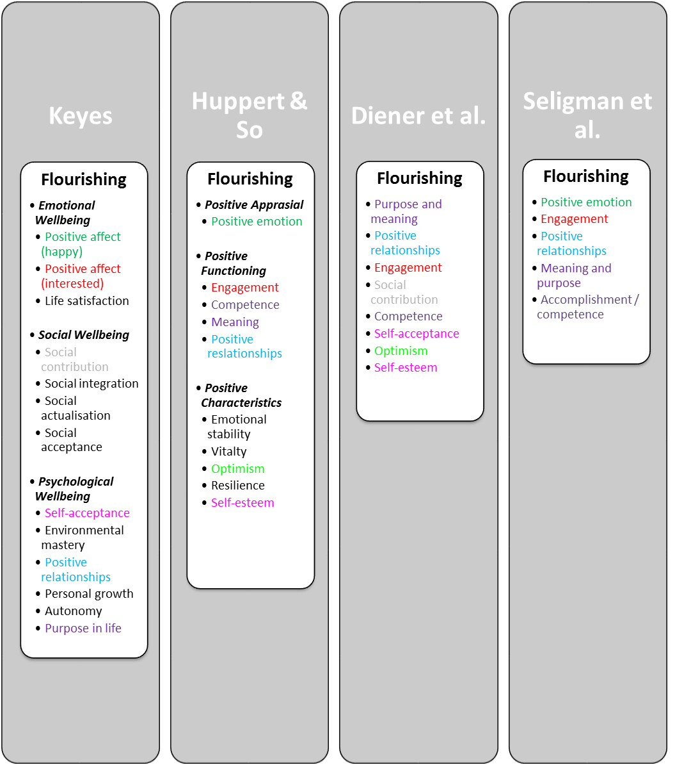
Frameworks and models
Wellbeing frameworks and models
Comparing models

Slide 21
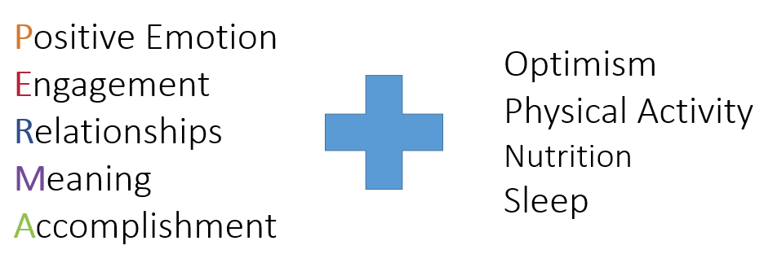
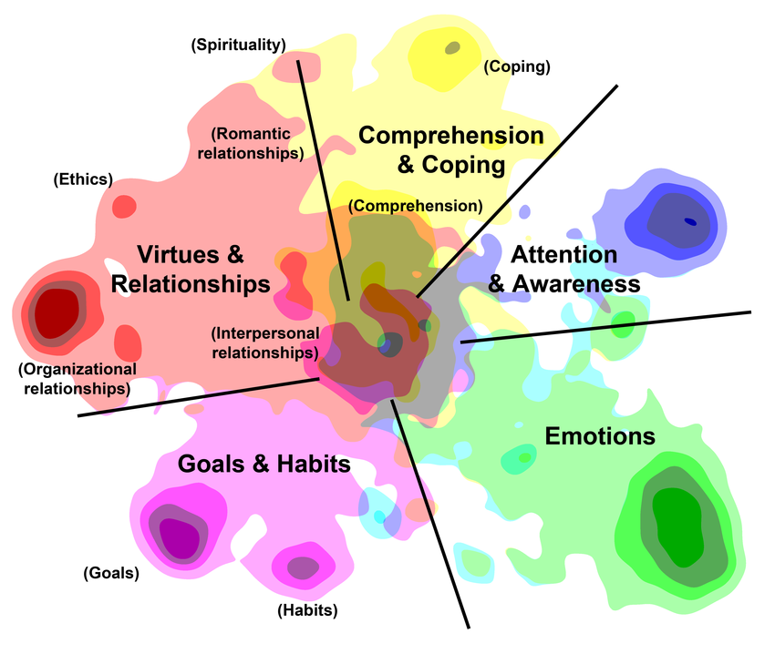
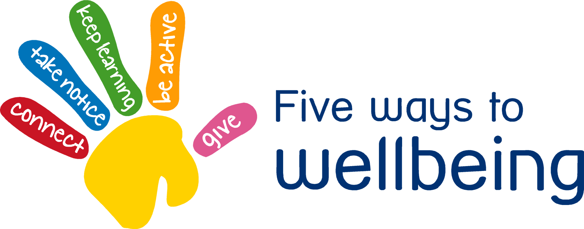
Frameworks and models
Wellbeing frameworks and models
PERMA+
5 ways to wellbeing
Ten keys to happier living
5 domains of functioning

Slide 22
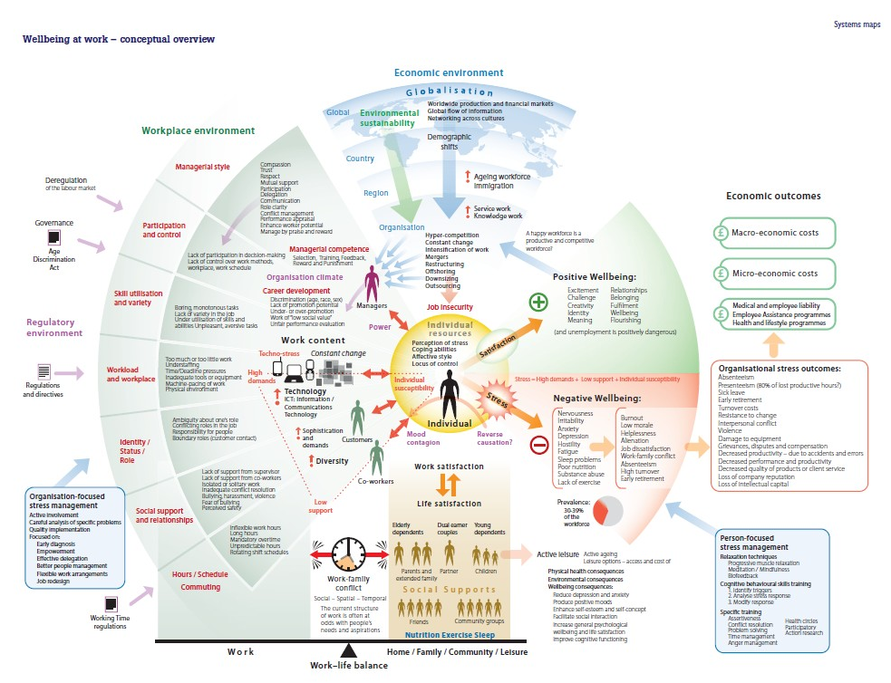
Frameworks
Wellbeing frameworks and models
Work wellbeing

Slide 23
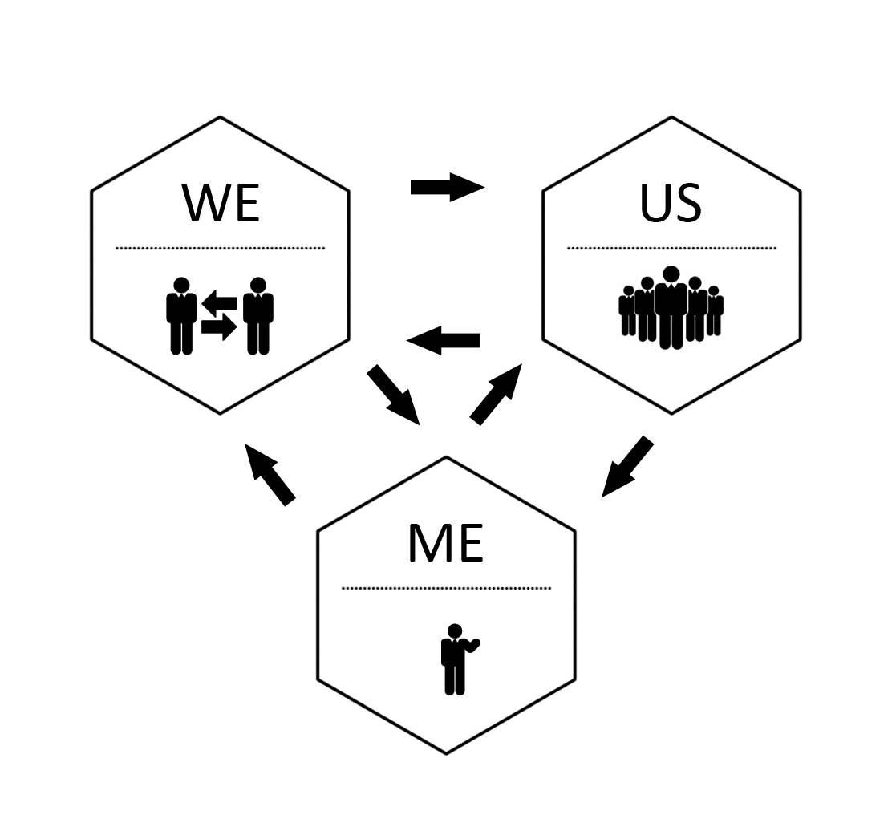
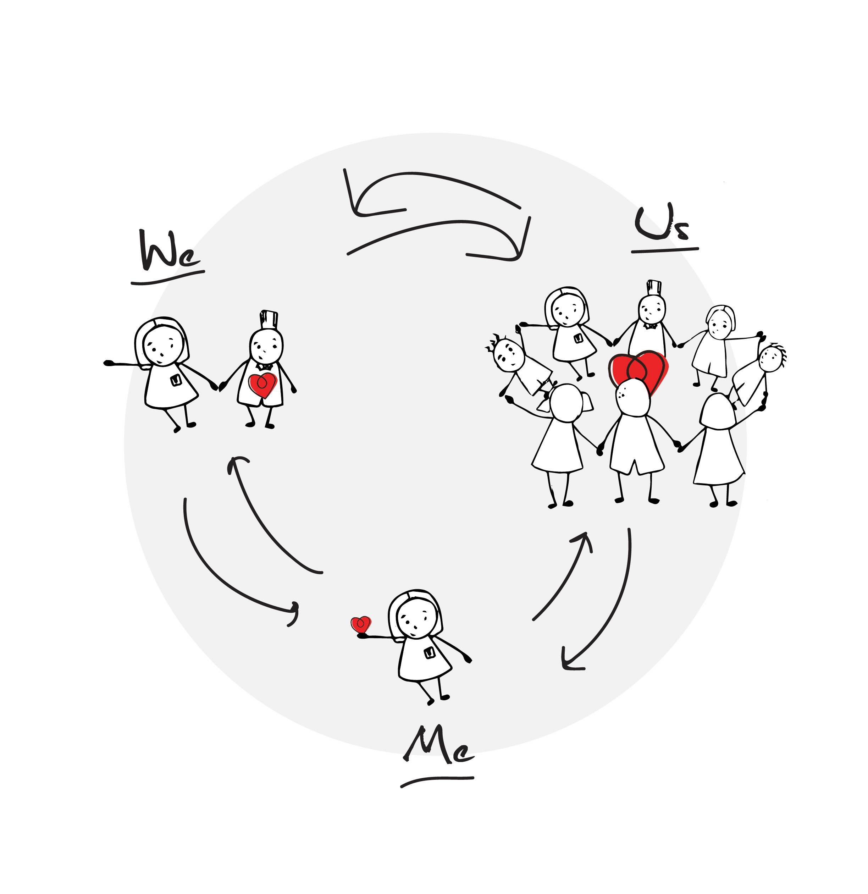
Frameworks and models
A wellbeing framework and models
Me, We, Us
Jarden, A., & Jarden, R. (2016). Positive psychological assessment for the workplace. In L. Oades et al. (Eds.), The Wiley-Blackwell Handbook of Positive Psychology at Work, pp. 415-437. Published Online: 19 Nov 2016: DOI: 10.1002/9781118977620.ch22
Embedding change must be holistic and systemic. All organizations are complex and dynamic systems, not simple and linear. As a result, a simple cause-and-effect approach to embedding change will not work.

Slide 24
Frameworks and models
But really it’s about scientifically informed process
WRC LIMBER Framework
Lead → Initiate → Measure → Build → Embed → Research

Slide 25
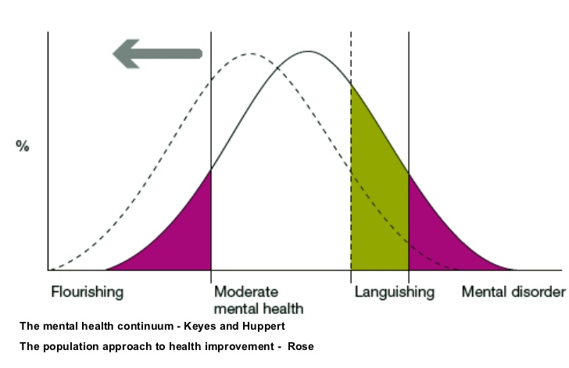
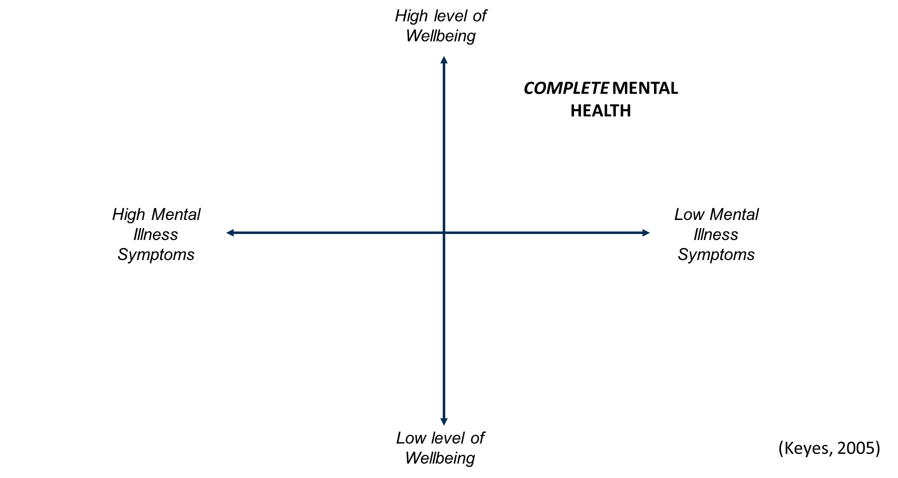
Frameworks and models
Old (current) perspective
What the data show

Slide 26
Efficacy vs effectiveness
In the real world…
Hone et al (2015) – “…synthesizing efficacy trials of PPIs reveals little evidence that these interventions translate into sustained programmes of behaviour change when applied beyond the tightly controlled conditions of the laboratory or psychology classroom setting”.
Parks et al (2012) - “...researchers have yet to offer persuasive evidence that happiness activities, as they are actually used in real-world settings, are beneficial”.
Hone, L., Jarden, A., & Schofield, G. (2015). An evaluation of positive psychology intervention effectiveness trials using the re-aim framework: A practice-friendly review. Journal of Positive Psychology, 10(4), 303-322.

Slide 27
Quick break
Geelong Breathing
Breath One. Take a deep breath in through your nose and fill your lungs with as much air as possible. As you are doing so, notice your physical body and any points of pain or tension. As you breath out slowly through your mouth, imagine you are pushing or releasing any tension away. Feel yourself sink into your chair or the floor if you are standing.
Breath Two. Take a deep breath in through your nose and fill your lungs with as much air as possible. Now as you breathe out think about what you are grateful for right at this very moment. Not what you are grateful for that has happened in the past, or looking towards the future, but right in this very moment think about one thing you are grateful for and exhale slowly. Say to yourself “Right now I am grateful for...”.
Breath Three. Take a deep breath in through your nose and fill your lungs with as much air as possible. Now as you breathe out think about your frame of reference and what intentional state you want to be in right now. Do you intend to be kind? Do you intend to be open minded? Do you intend to be peaceful? Whatever intention you wish to have at this present moment, cultivate it when you exhale by saying to yourself “My intention right now is to be …”.
Credit: This exercise was developed by Justin Robinson, Head of Positive Education at Geelong Grammer School in Australia

Slide 28
Leadership and champions
Positive leadership and champions
Champions start wellbeing programs and keep them going. You want them championing the change from the bottom up and inside out.
Positive leaders have a simple clear co-developed vision that is idealist, visual, long-term, challenging and realistic.
Change must have a clear strategic mandate and be linked to a compelling rationale.
Positive leadership is crucial:
Leadership involvement was cited as the most effective factor for a successful wellbeing program by 59 percent of employer respondents. (State of Workplace Wellbeing Survey).

Slide 29
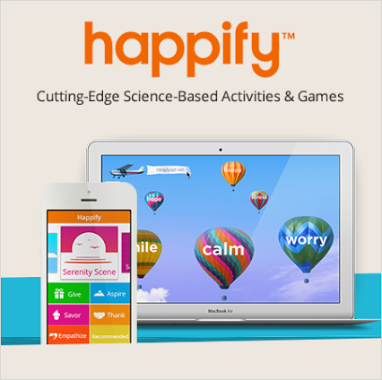
Digital tools
Wellbeing tools: Apps and e-learning
Make a distinction between “wellbeing skill building tools” and tools that “increase wellbeing” (because feel good).

Slide 30
Risks
Risks
Overpromise, under deliver – selling false hope.
Bad advice, or poor program logic.
Low ROI, look bad to those above.
Bad apples and win-lose power struggles.
Expecting fast change – wellbeing is hard work.
A vision alone is not sufficient to capture the hearts and minds of everyone but it is a good start. People must be able to make the link with what is important to them personally.
Be prepared to ‘course correct’. Very few change programmes end up exactly where they predicted at the outset, for many reasons. Ensure you have checkpoints.
A lack of leadership and top level support is the main reason for the failure to sustain changes in an organisation.

Slide 31
More essentials
Other stuff:
Clear, minimal, transparent, communication (no long docs, less email) – builds trust.
Sense of meaning, being autonomy supportive, and job-crafting.
Endorse things officially.
No one-size model – scientifically informed practice, trial and error.
Create time and space for wellbeing, and timing important (when to introduce, when to embed).
Play is much underrated. As is simplification.
Use of strengths.
Have an implementation plan (i.e., LIMBER).
Linking wellbeing metrics to KPI’s.
Pull people into a better future, rather than push them from the past.

Slide 32
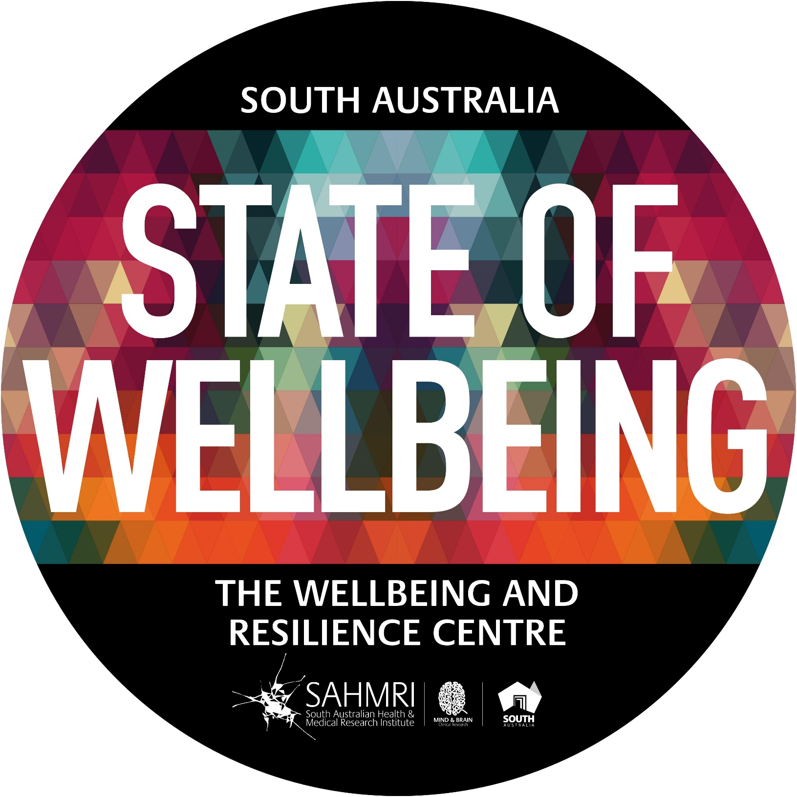
Now
“Wellbeing is measurable, teachable and learnable”

Slide 33
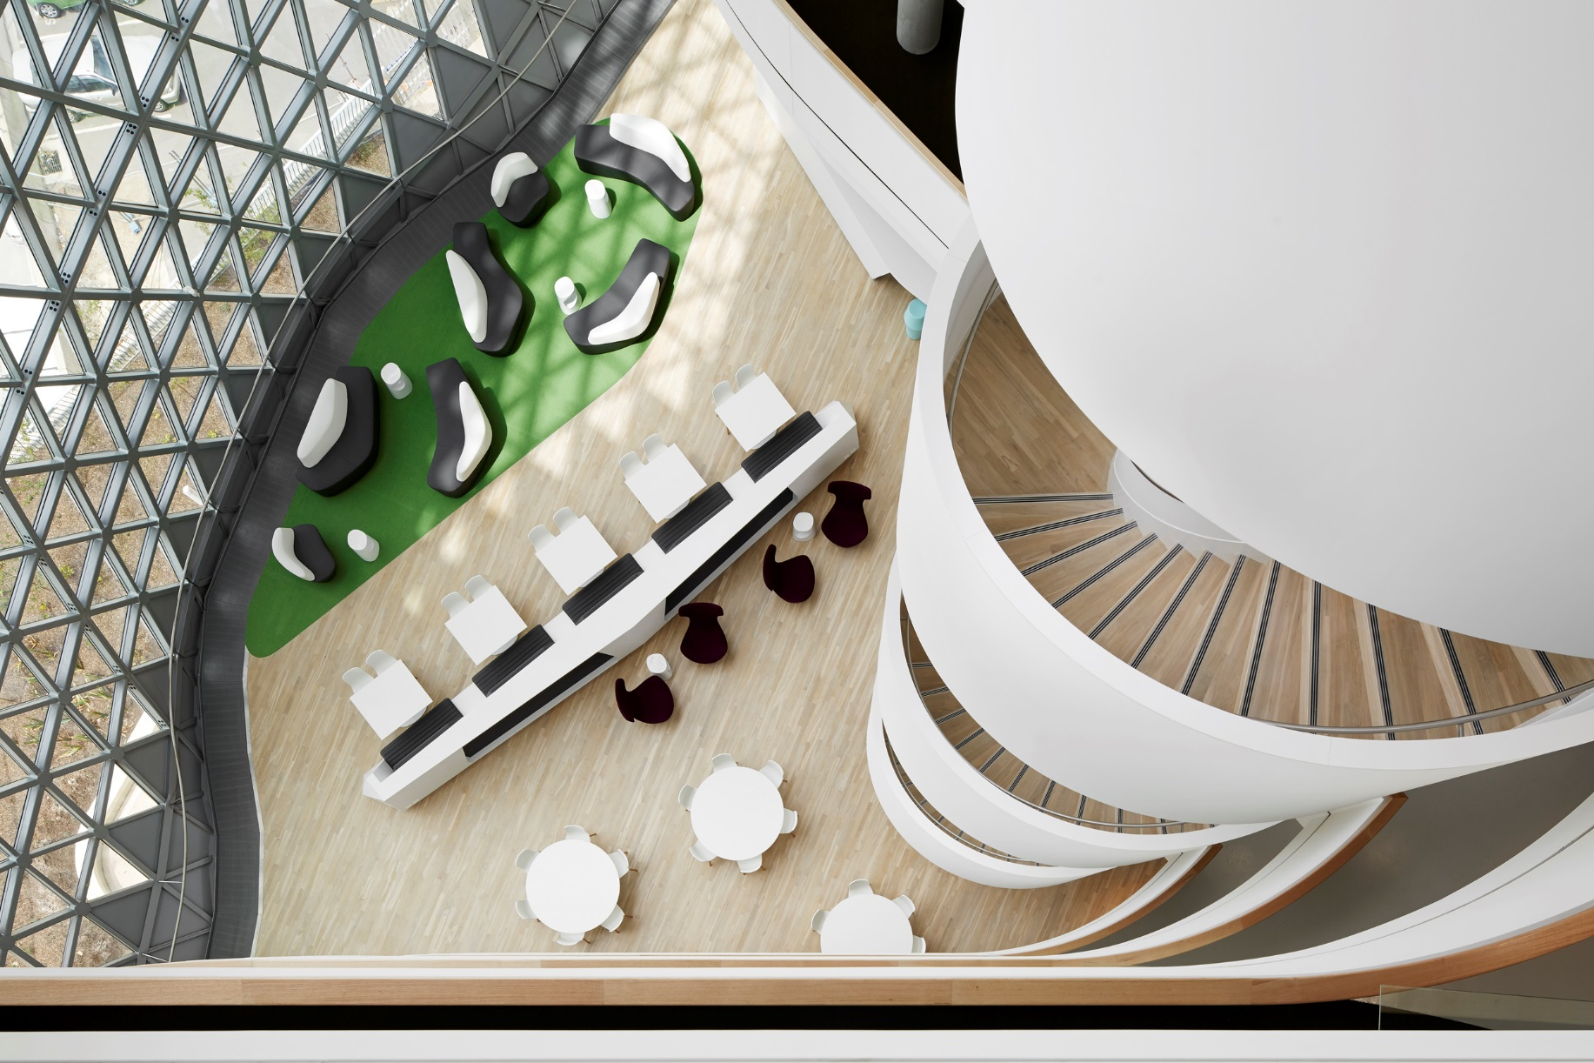
Positive mental health and wellbeing for a resilient society.
Position South Australia as the State of Wellbeing
Measure the wellbeing of all South Australians and beyond
Teach, build and embed wellbeing science
Generate and publish research on how to build wellbeing efficiently, at scale, across the life course
LEAD ➔ INITIATE
MEASURE
BUILD ➔ EMBED
RESEARCH
Organisations, Government, Schools, Ageing, Youth, Community

Slide 34
RESULTS Auto-manufacturing industry
Notes:
Projected that between 14 000 to 25000 will be lost from the departure of the car industry. Our economy is transforming and is creating significant unemployment. It is our belief that the LMBE Model of teaching resilience skills could be useful to manufacturing workers in anticipation of the unemployment tsunami.

Slide 35
Insight into drivers…

Slide 36
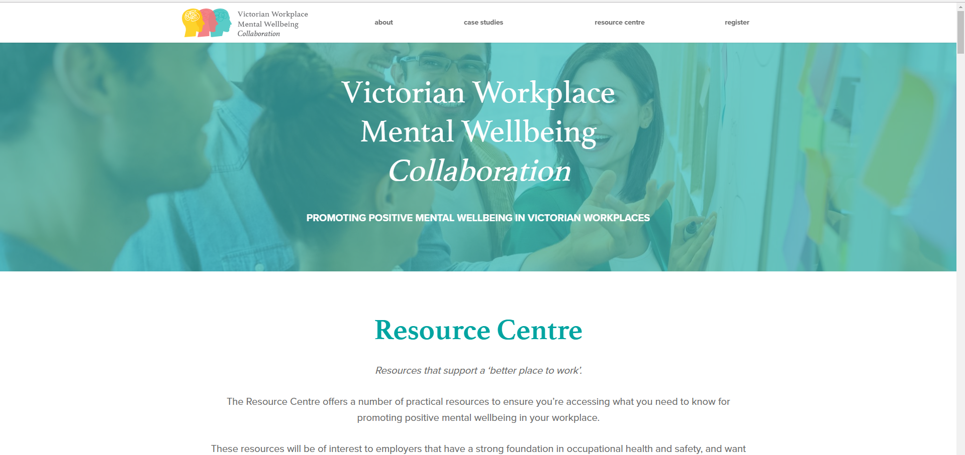
Case studies
More case studies…

Slide 37
Case examples
Some good examples
CEO Friday lunch.
10/2 rule - Ritz-Carlton.
Gratitude walls.
Entrance door activities and messaging.
Team meetings – start with ‘what went well?’, walking meetings.
Gamification (leader boards, points, etc.).
Visual things

Slide 38
Quick recap
Some key points
Be careful filling in customs forms.
You have to taste it, live it, to believe in it…
Positive psychology is the scientific study of what enables individuals and communities to thrive.
You are at your best, you’re deploying your strengths.
Geelong three breaths is portable.
Select tools wisely, adopt a model and place it in a framework.
Assessment and leadership are crucial to longer term change.
Do you need to focus more on what success looks like for your organisation at an employee level? Start by asking people: “What does a great day at work look like?”

Slide 39
Dr Aaron Jarden
aaron.jarden@sahmri.com
www.aaronjarden.com
Copy of these slides at: www.aaronjarden.com

