Slide 1
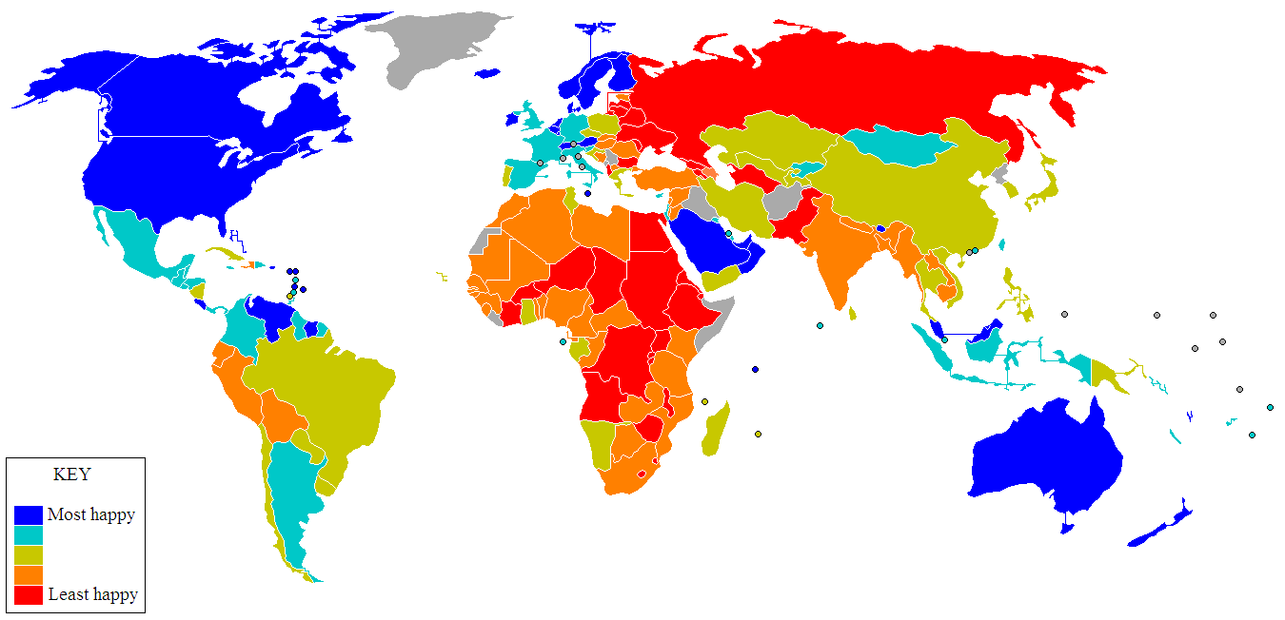
Wellbeing across the lifespan and globe
Dr Aaron Jarden
21st May 2016

Slide 2
Rough plan
Happiness and subjective wellbeing across nations
Wellbeing across the lifespan
Outcomes:
discuss issues relating to measuring happiness / wellbeing, and across the different life stages and cultures
examine how culture influences wellbeing
discuss the wellbeing of people at different life-stages
Direction from Lindsay:
“there is broad scope to make it your own”
Credit to Dianne Vella-Brodrick (many of these slides)

Slide 3
What is wellbeing?
Defining happiness and Subjective Wellbeing (SWB)
Humans have always struggled to define ‘happiness’
Also no consensus on ‘wellbeing’ (or ‘flourishing’ – high levels of wellbeing)
Across countries, the term varies: happiness, wellbeing, welfare, quality of life, etc.
Academic base - Simon Chappell
For example, what does flourishing mean?

Slide 4
What is wellbeing?
Subjective Wellbeing (SWB)
SWB = Satisfaction with life + high positive affect + low negative affect (Ed Diener)
Life satisfaction is a cognitive component – discrepancy between present situation and ideal situation
Affect – moods and emotions associated with experience of events (most challenging question I will ask today, “what is an emotion?”)
High levels of SWB are associated with a host of positive outcomes:
Higher creativity, task persistence, optimism, longevity, helpfulness, trust, etc…
One criticism of SWB is that it focuses on pleasure, and not on what is meaningful, and pleasure may not be enough for human fulfillment – Nozick’s experience machine

Slide 5
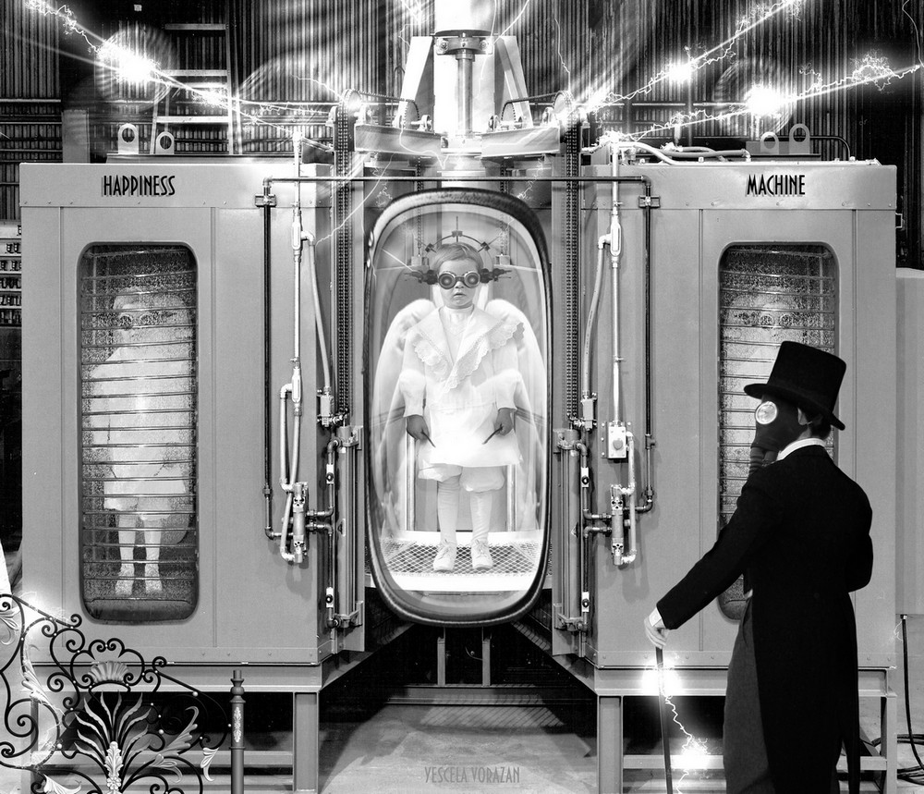
Would you plug in?
“Suppose there was an experience machine that would give you any experience you desired. Super-duper neuropsychologists could stimulate your brain so that you would think and feel you were writing a great novel, or making a friend, or reading an interesting book. All the time you would be floating in a tank, with electrodes attached to your brain. Should you plug into this machine for life, pre-programming your life experiences? [...] Of course, while in the tank you won't know that you're there; you'll think that it's all actually happening [...] Would you plug in?”

Slide 6
Measurement
Measuring Subjective Wellbeing (SWB)
Majority of tools are single occasion, self-report tools:
SWLS, PANAS, SHS (google: Aaron + positive psychological assessment workbook)
The tools generally have good psychometrics (but a few crap ones)
Moods can influence cognitive judgments (e.g., of life satisfaction, cup of coffee)
Time spans are usually short (memory bias)
Experience Sampling Methods (ESM) and Day Reconstruction Methods (DRM) have been used
Improving SWB measurement will rely on more and combined methods and targets (e.g., physiology, behaviour, cognitions), and experimental and longitudinal designs (but also reliant on conceptual agreement of terms like happiness / wellbeing)

Slide 7
Measurement issues
So how relevant are existing wellbeing measures for younger or older populations, and people from different cultural backgrounds?
Length of scale and completion time (engagement)
Comprehension (6 year olds, dementia)
Relevance (different cultures have different conceptions of wellbeing – Fear of Happiness, some more social)
Interpretation (norms: research base sometimes limited)
Response biases (order effects)
Various validity and reliability issues, and practical issues
For the best general summary of all psychometric issues, see OECD guide.
Notes:
Ask students to examine the OTH and Psychological Well-Being Scale.
They should also be familiar with the Satisfaction with Life Scale and the PANAS.
Indicate that there are new versions coming out for a limited range of scales for younger people (e.g., PANAS-C and VIA Youth survey).
Park and Peterson (2006) made an effort to examine strengths in young children. They attempted to get around measurement issues by involving parent ratings and observations instead.
Details and abstract below:
Journal of Happiness Studies (2006) 7:323–341
DOI 10.1007/s10902-005-3648-6
NANSOOK PARK and CHRISTOPHER PETERSON
CHARACTER STRENGTHS AND HAPPINESS
AMONG YOUNG CHILDREN: CONTENT ANALYSIS
OF PARENTAL DESCRIPTIONS
ABSTRACT. Parents’ written descriptions (average length = 211 words) of
children between the ages of 3 and 9 years were collected on a passwordprotected
website (n=680). The presence of the 24 character strengths in the
VIA Classification and the level of child’s happiness were coded with content
analysis. Descriptions were rich in character language (average strengths
mentioned per description=3.09), and coding was reliable. Consistent with
previous research with youth and adults, the character strengths of love, zest,
and hope were associated with happiness; gratitude was associated with happiness
among older children. The early development of character strengths and
possible ways of fostering them are discussed.

Slide 8
Conceptual confusion
To aid in addressing these challenges, we propose the following terminology and classification for discussing conceptual and operational definitions:
degree of centrality—differentiating concepts that are core (i.e., definitional), close-to-core (i.e., given some attention but not central), and major correlates;
category of analysis—identifying which of the following categories a definition represents: (a) orientations (orientations, values, motives, and goals), (b) behaviors (behavioral content, activity characteristics), (c) experiences (subjective experiences, emotions, cognitive appraisals), (d) functioning (indices of positive psychological functioning, mental health, flourishing); and
level of measurement—identifying whether a definition is used for trait and/or state comparisons.
(Huta & Waterman, 2013) - Eudaimonia and Its Distinction from Hedonia: Developing a Classification and Terminology for Understanding Conceptual and Operational Definitions
Notes:
Eudaimonia and Its Distinction from Hedonia: Developing a Classification and Terminology for Understanding Conceptual and Operational Definitions
To aid in addressing these challenges, we propose the following terminology and classification for
discussing conceptual and operational definitions: (1) degree of centrality—differentiating
concepts that are core (i.e., definitional), close-to-core (i.e., given some attention but not central), and major correlates; (2) category of analysis—identifying which of the following categories a definition represents: (a) orientations (orientations, values, motives, and goals),
(b) behaviors (behavioral content, activity characteristics), (c) experiences (subjective experiences, emotions, cognitive appraisals), (d) functioning (indices of positive psychological functioning, mental health, flourishing); and (3) level of measurement—identifying whether a definition is used for trait and/or state comparisons.

Slide 9
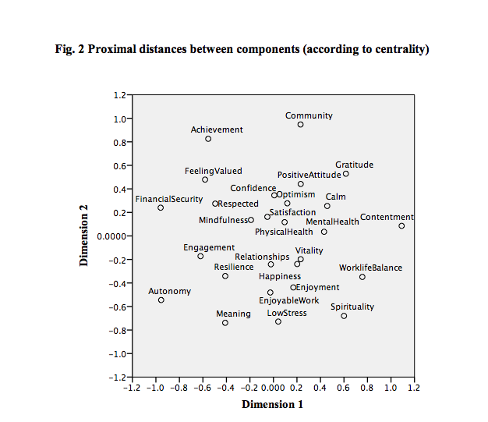
Multidimensional Scaling
Notes:
To aid in
addressing these challenges, we propose the following terminology and classification for
discussing conceptual and operational definitions: (1) degree of centrality—differentiating
concepts that are core (i.e., definitional), close-to-core (i.e., given some attention but not central), and major correlates; (2) category of analysis—identifying which of the following categories a definition represents: (a) orientations (orientations, values, motives, and goals),
(b) behaviors (behavioral content, activity characteristics), (c) experiences (subjective experiences, emotions, cognitive appraisals), (d) functioning (indices of positive psychological functioning, mental health, flourishing); and (3) level of measurement—identifying whether a definition is used for trait and/or state comparisons.

Slide 10
Who is happy?
Who is happy?
Most people are happy – “somewhat satisfied” set-point
Not so happy are people in hospital, alcoholics, inmates, therapy clients, politically suppressed, recently divorced, recently unemployed, or those taught by Lindsay
Control over happiness – 50% genetic, 10% life circumstances, 40% control over
How does this finding feel to you?

Slide 11
Correlates and causes of happiness
Income:
People who live in higher income countries (GDP) are slightly happier
Money can buy happiness if spent on experiences rather than things
Super rich are no happier than average (or not much more) – Depression rate equal
Stronger relationship with income for men – higher value
Hedonic treadmill undermines income
Short story is you need enough income to cover basic needs – more will not make you much happier

Slide 12
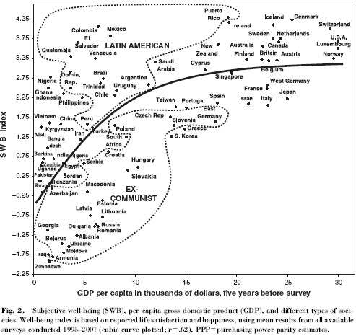
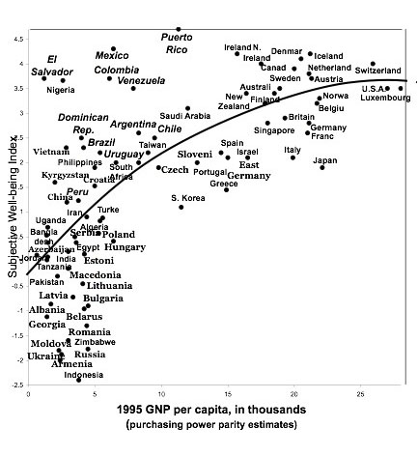
Happiness and GDP/GNP

Slide 13
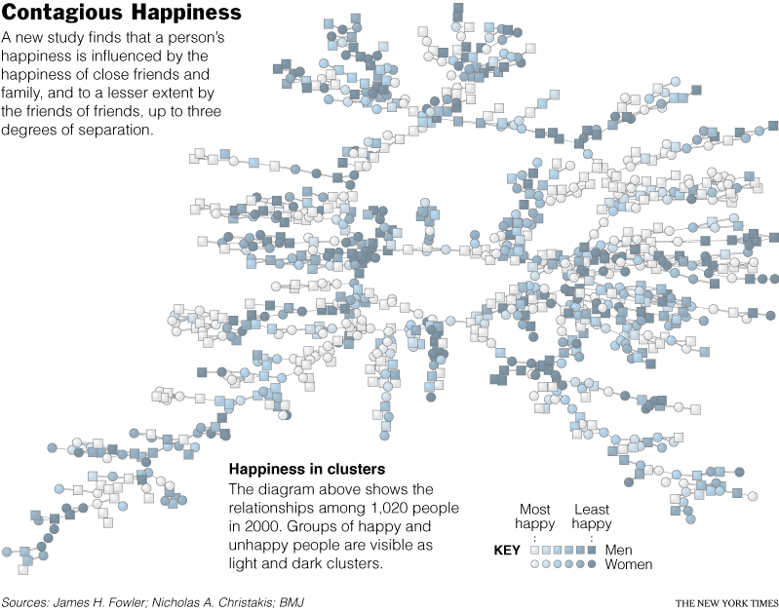
Other people matter…
Relationships:
Social settings increase wellbeing
People most happy when with others (experience sampling)
Happiness is contagious
Married happier
Children impact happiness negatively,
but meaning positively
VIDEO: Nicholas Christakis

Slide 14
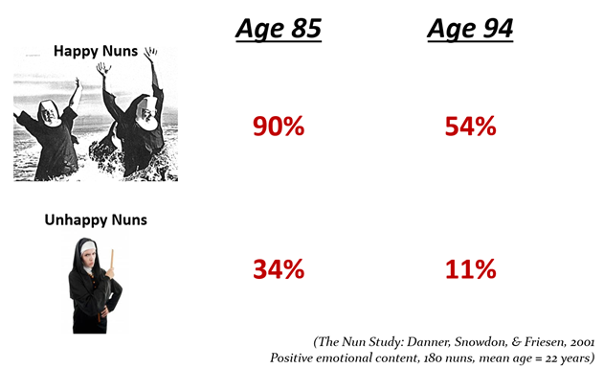
More…
Work:
Being in work is good for happiness
How you perceive work important – a job, career, a calling? (meaning)
Personality profile and occupation can impact life satisfaction if incongruent
Health:
Positive emotions are protective of health (catch a cold less)
But, happy people can also be too optimistic, and delay help seeking
Happy people live longer (nun study)

Slide 15
More…

Slide 16
But what else?
Religion:
Spiritual and religious slightly happier (mainly if attend church though)
SWB up via meaning, values and connection in particular
Age, gender and education:
Age – slight dip in midlife (U-Shape) – varies a lot by country; younger and older slightly happier
Gender – no big difference (why?)
Education: greater education = greater SWB
What else is related to wellbeing?

Slide 17
More about positive emotion
High PA prior to meeting with a stranger induces more self-disclosure (Vittengl & Holt, 2000)
PA leads to greater sociability and quality interactions (e.g., more likely to initiate a conversation with a stranger). Sociability also leads to higher PA
Notes:
Physical resources
Social resources
Psychological resources
Intellectual resources
Theories:
Isen (2002) PA activates the dopaminegic system of the brain which is responsible for executive control and flexible thinking. In relationships this may result in flexible perspective-taking and closeness.
Forgas (1995, 2002) Affect Infusion Model
Open and close personal interactions will lead to high PA which will trigger positive memories, interactions and interpretations, thus leading to prosocial behaviour.
Waugh and Fredrickson (2006)
Feelings of PA will over time be associated with a feeling of self-other overlap and “oneness” (a broadened sense of self).

Slide 18
Positive Emotions trigger an upwards spiral
Create Positive Change and Upward Spirals
Build Enduring
Personal Resources (social support, resilience, skills & knowledge)
Broaden Momentary
Thought-Action
Repertoires (novel thougths, activities and relationships)
Experiences of
Positive Emotions
Adapted from Boniwell and Ryan (2012) and Cohn and Fredrickson (2009).

Slide 19
Positive emotions and coping
“You will give
a speech”
Assigned to a
mood enhancing
condition
Measure time it takes for blood pressure
to return to normal
Adapted from Boniwell and Ryan, 2012
Notes:
thus a coping resource

Slide 20
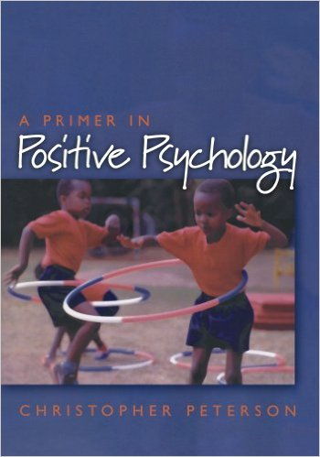
A quick summary of the research...
Source: Peterson (2006) - Zero to small correlation with happiness and life satisfaction:
Age
Gender
Social class
Income
Having children
Ethnicity
IQ
Physical attractiveness
Lectures from Lindsay

Slide 21
A quick summary of the research…
Moderate to large correlation with happiness and life satisfaction:
Gratitude
Optimism
Being employed
Frequency of sexual intercourse
Self-esteem
Number of friends
Being married
Religiousness
Level of leisure activity
Physical health (Sovereign Index)
Personality (conscientiousness, extraversion)
Internal locus of control

Slide 22
Baumeister et al. (2013)
The correlates of happiness and meaningfulness are different:
Happiness: (doing things for one-self)
satisfying needs and wants
being present oriented
being a taker
Meaningfulness: (doing things for others)
integrating past, present, and future
being a giver rather than a taker
higher levels of worry, stress, and anxiety
concerns with personal identity and self expression
Notes:
Our main source of data was a series of surveys. A national sample of 397 adults (68% female; ages 18–78;
M = 35.5 years old; 48.1% were parents) participated in this online study. The study consisted of three surveys,
and participants received $10 for completing the first survey and $5 for each subsequent survey completed.
Happiness was measured with three items (with 7- point scales): ‘In general I consider myself happy;’ ‘taking
all things together, I feel I am happy;’ ‘compared to most of my peers, I consider myself happy.’ Meaningfulness
was identified by three parallel items: ‘In general I consider my life to be meaningful;’ ‘compared to most
of my peers, my life is meaningful;’ and ‘taking all things together, I feel my life is meaningful.’

Slide 23
Make a list
Half of class - imagine being in a (Anger/Joy) emotional state and to generate a list of activities you “would like to do right then”.
“take a moment to imagine being in a situation yourself in which this particular emotion would arise (the one you wrote on the previous page). Concentrate on all the emotion you would feel and live it as vividly and as deeply as possible. Given this feeling, please list all the things you would like to do right now.” p. 320
Notes:
Our main source of data was a series of surveys. A national sample of 397 adults (68% female; ages 18–78;
M = 35.5 years old; 48.1% were parents) participated in this online study. The study consisted of three surveys,
and participants received $10 for completing the first survey and $5 for each subsequent survey completed.
Happiness was measured with three items (with 7- point scales): ‘In general I consider myself happy;’ ‘taking
all things together, I feel I am happy;’ ‘compared to most of my peers, I consider myself happy.’ Meaningfulness
was identified by three parallel items: ‘In general I consider my life to be meaningful;’ ‘compared to most
of my peers, my life is meaningful;’ and ‘taking all things together, I feel my life is meaningful.’

Slide 24
(Fredrickson & Branigan, 2005)
Positive emotions and no. of items listed
Joy
Contentment
Neutral
Fear
Anger
5
10
15
Number of items listed
Notes:
Fredrickson and Branigan showed 104 uni students (66% female) brief film clips designed to elicit different emotions:
Joy (Penguins)
Contentment (Nature)
Neutral (Sticks)
Anger (Witness)
Fear (Cliffhanger)
Asked participants to imagine being in a similar emotional state to the emotion experienced in the film clip and to generate a list of activities they “would like to do right then”.
“take a moment to imagine being in a situation yourself in which this particular emotion would arise (the one you wrote on the previous page). Concentrate on all the emotion you would feel and live it as vividly and as deeply as possible. Given this feeling, please list all the things you would like to do right now.” p. 320
Those in the positive conditions produced longer lists compared to the neutral and negative emotion conditions.

Slide 25
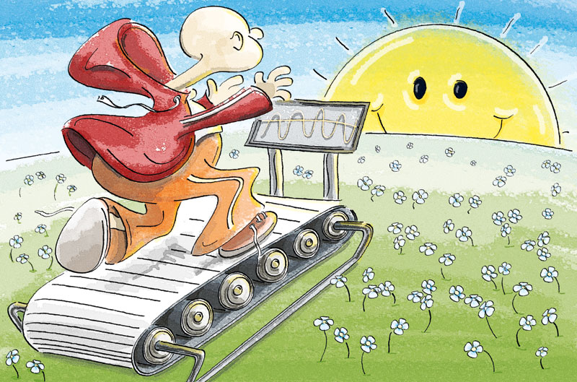
Why are we happy?
What causes SWB? (Theories of SWB)
what variables (age, gender, genetics, etc) cause SWB
SWB produces certain outcomes
Genetics
Dynamic Equilibrium Theory: personality determines baseline emotional response
50% of SWB genetic
Adaption theory
We have a set point, and bounce back to it generally after 3 months (hedonic adaption / hedonic treadmill)

Slide 26
Theories of SWB
Adaption theory
Lotto winners no happier, spinal injury patients only slightly sadder
HAP (Hedonic Adaption Prevention) model, change and variety important to sustained wellbeing
Affective forecasting (Dan Gilbert) – we get it wrong...
Impact bias = overestimate impact (intensity) negative emotions from negative events, overestimate impact (intensity) of positive emotions from positive events. We also overestimate the duration, e.g., think positive and negative events will last longer…
Events which have long term negative impacts = death of a spouse (5 to 7 years), long term unemployment, work restructure

Slide 27
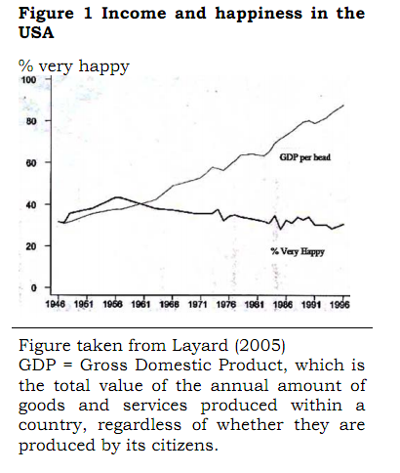
Theories of SWB
Discrepancy theories
The American paradox – wealth has increased, but SWB has remained stable
Social comparisons – upward (bad) and downward (good)
Placing high importance on money lowers SWB
Affluenza – materialism causes low SWB
$50K a year and others $25K, or $100K and others $250K?
Paradox of choice – more choice negatively impacts SWB
Satisficers = choice based on obtaining minimum criteria
Maximizers = look at all options for best possible choice
VIDEO: Barry Schwartz
Goal theories and SWB
SWB a result of obtaining valued and self-congruent goals (Ken Sheldon)

Slide 28
Theories of SWB

Slide 29
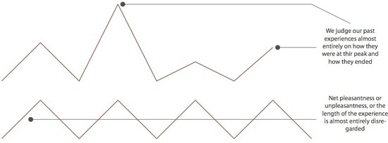
Theories of SWB
AIM approach
For creating a positive mindset, we need to engage:
Attention – attend to both positive and negative (what is going right, and what is going wrong)
Interpretation – Avoid destructive thinking patterns
Memory – Recall and savour past positive experiences
Peak-end theory

Slide 30
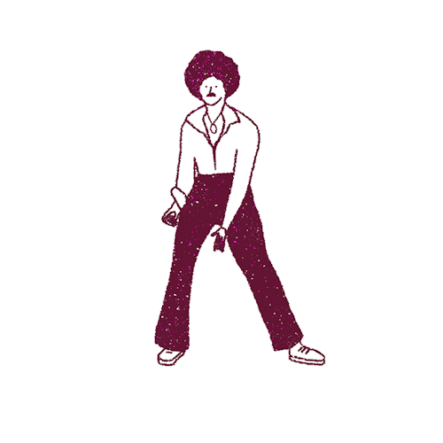

Slide 31
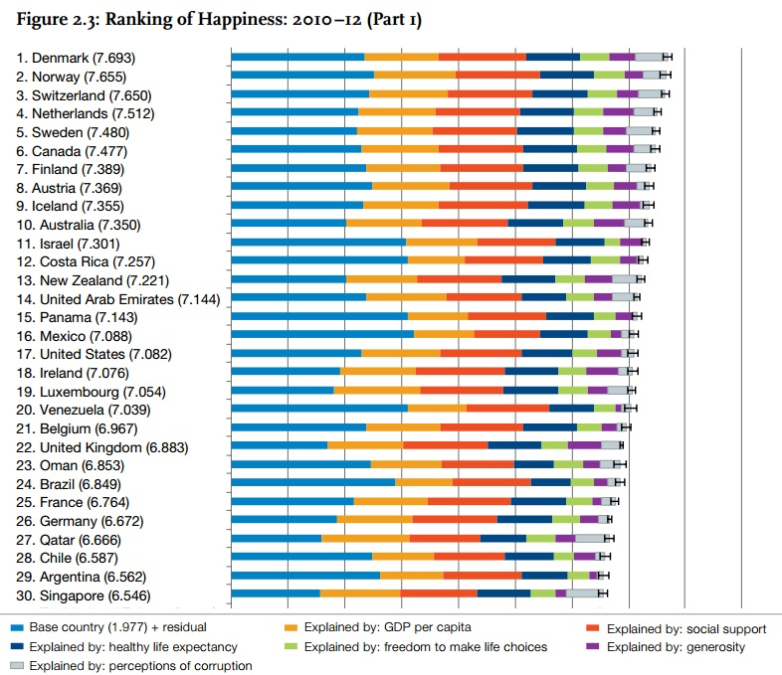
Happiness across nations
Happy places
Difference between happy (emotion) places and satisfied (cognitive judgment) places
For detailed data, see “World Happiness Report”

Slide 32
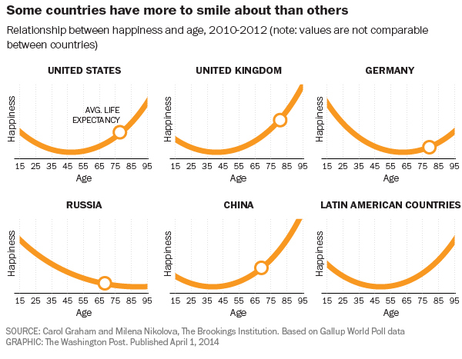
Differences across nations, over time
Happy places
Age differently
Why could this be so?

Slide 33
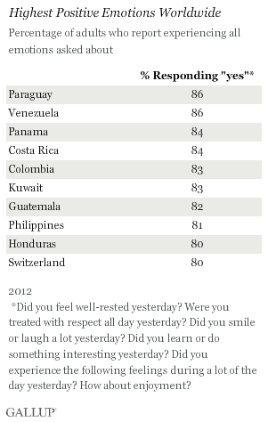
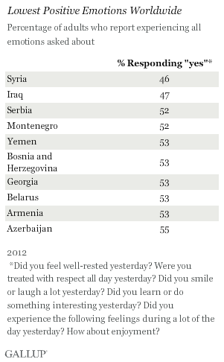
Latin Americans still most positive
Jon Clifton
September 30, 2013
http://www.gallup.com/poll/164615/syrians-iraqis-least-positive-worldwide.aspx?version=print
Notes:
Syrians, Iraqis Least Positive Worldwide
Latin Americans still most positive
On average, 73% of adults worldwide say they experienced enjoyment "a lot of the day" yesterday. Seventy-two percent smiled and laughed a lot, 85% felt treated with respect, and 71% felt well-rested. Fewer adults, 45%, reported that they learned or did something interesting "yesterday."
Since Gallup started tracking positive emotions in 2006, global positive emotions have not fluctuated much. In fact, between 2011 and 2012, only four countries experienced double-digit increases or decreases on the Positive Experience Index. The biggest decrease was in Syria, which dropped 14 percentage points. Singapore's index score increased the most, rising 24 points.
Results are based on telephone and face-to-face interviews with approximately 1,000 adults in each country, aged 15 and older, conducted in 2012 in 143 countries and areas.

Slide 34
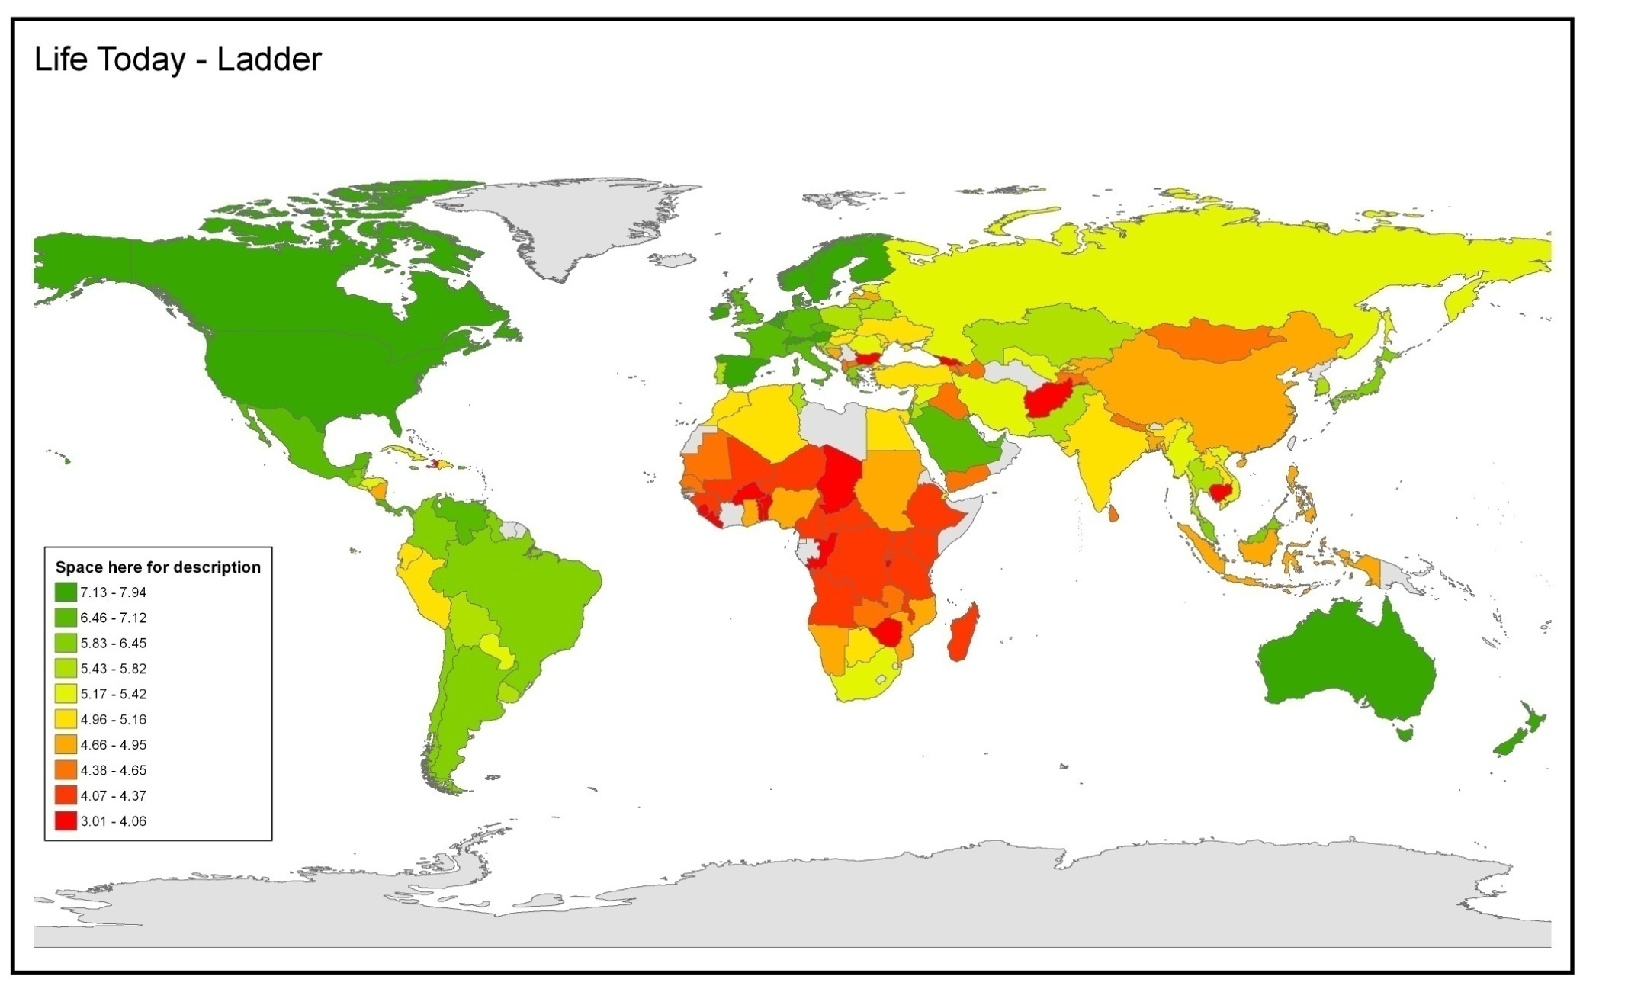
How is your life today?
Mean Response (0 – 10)
http://www.gallup.com/poll/126977/Global-WellBeing-Surveys-Find-Nations-Worlds-Apart.aspx
Data Source: Gallup World Poll 2006-2008 waves
Notes:
(Cantril ladder)
Please imagine a ladder with steps numbered from zero at the bottom to 10 at the top.
The top of the ladder represents the best possible life for you and the bottom of the ladder represents the worst possible life for you.
On which step of the ladder would you say you personally feel you stand at this time? (ladder-present)
On which step do you think you will stand about five years from now? (ladder-future)

Slide 35
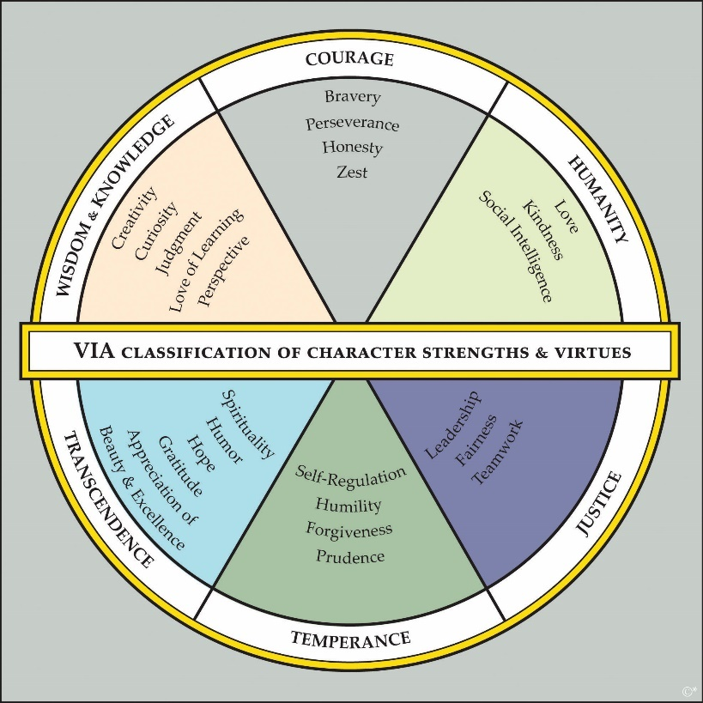
Strengths across nations
Strong places

Slide 36
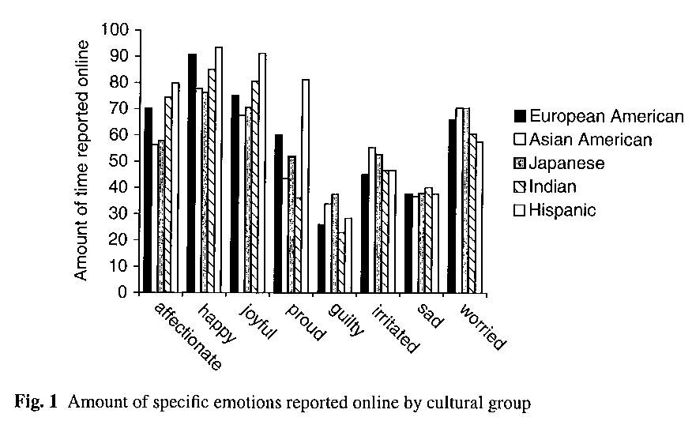
Emotional Experience and Culture Scollon, Diener, Sishi, Biswas-Diener (2009)
Those form Asian cultures less LS, less +ive emotions & more –ive emotions than North Americans.
Notes:
416 participants – higher percentage of females
College students (mean age 21)
Global self report measures – rate on a 7 point scale how much they felt 8 emotions
Plus ESM for one week
Recall of emotions from past week.
Pleasant and Unpleasant emotions surfaced for all 5 cultural groups.
There was barely any cultural variability for sadness.
Hispanic Americans reported the highest levels of pride whereas Indians reported the least. Pride is a highly individualistic emotion that separates individuals from others. The collectivist perspective is not the full reason as Hispanics are also considered a collectivist culture.

Slide 37
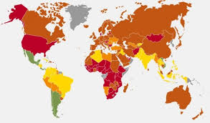
Happy Planet Index New Economics Foundation
GDP is being questioned (Bhutan, UK).
Could also measure:
Subjective life satisfaction
Life expectancy at birth
Ecological footprint
http://www.happyplanetindex.org/data/
Notes:
The exact function is a little more complex, but conceptually it approximates multiplying life satisfaction and life expectancy, and dividing that by the ecological footprint.
Bhutan
UK – Prime Minister Cameron
How much wellbeing do you get for your resources?

Slide 38
Global approaches
What do countries do regarding wellbeing? (some examples)
Bhutan: Gross National Happiness
Venezuela: has a Ministry of Supreme Social Happiness
Canada: a team of researchers compiles and publishes Canadian Index of Wellbeing
Israel, France, United Kingdom: measures a host of “wellbeing indicators”
UAE: a minister devoted to happiness
United States: enshrined the “pursuit of happiness" in its Declaration of Independence, has begun to compile a national index of happiness

Slide 39
World wellbeing
Major global studies
Gallup World Poll: http://www.gallup.com/services/170945/world-poll.aspx
World Database of Happiness: http://worlddatabaseofhappiness.eur.nl/
World Values Survey: http://www.worldvaluessurvey.org/wvs.jsp
Eurobarometer: http://ec.europa.eu/public_opinion/index_en.htm
European Social Survey: http://www.europeansocialsurvey.org/
LatinoBarometro: http://www.latinobarometro.org/lat.jsp
International Wellbeing Study: http://www.wellbeingstudy.com/

Slide 40
What happens in each country?
Public health promotion messages in each country
Five ways to wellbeing
Based on the Foresight Report
Best resource on 5 ways: New Economic Foundation
Connect
Be active
Keep learning
Take notice
Give

Slide 41
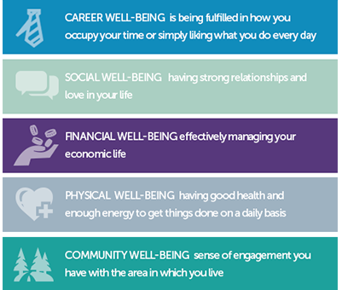
What happens in each country?
Five elements of wellbeing
Need all five to thrive:
Career wellbeing
Social wellbeing
Financial wellbeing
Physical wellbeing
Community wellbeing

Slide 42
Orientations to Happiness Q’s
Peterson, Park and Seligman (2005):
Pleasure
Life is too short to postpone the pleasures it can provide
I love to do things that excite my senses
Engagement
I seek out situations that challenge my skills and abilities
I am always very absorbed in what I do
Meaning
I have a responsibility to make the world a better place
I have spent a lot of time thinking about what life means and how I fit in to its big picture

Slide 43
OTH – 27 nations
Park, Peterson and Ruch (2009): Sample of 24,836 participants from 27 nations.
Generated 3 country clusters:
Low on all 3 OTH (Finland, Italy, Portugal, Minor US Islands, & UK)
High pleasure and engagement (Argentina, Australia, Belgium, Canada, France, Germany, HK, Ireland, Netherlands, NZ, Norway, Spain, & Sweden)
High on engagement and meaning (Austria, Brazil, Denmark, Israel, Singapore, South Africa, South Korea, Switzerland, & USA)
Notes:
South Africans scored highest on Pleasure (reported high levels on all 3 OTH).
Swiss scored highest on Engagement
South Korean scored highest on Meaning
Australia reported high scores on Pleasure and Engagement.
Page 276 from Park et al. (2009) paper.
We computed mean scores of the three orientations
within each nation, and then explored the clustering of
nations in terms of these scores using K-means cluster
analysis. A three-cluster solution was interpretable.
Cluster One consisted of five nations (Finland, Italy,
Portugal, Minor US Islands, and the United Kingdom)
and was defined by relatively low scores on all three
orientations. Cluster Two consisted of 13 nations
(Argentina, Australia, Belgium, Canada, France,
Germany, Hong Kong, Ireland, Netherlands, New
Zealand, Norway, Spain, and Sweden) and was defined
by higher scores on orientations to pleasure and to
engagement. Cluster Three consisted of nine nations
(Austria, Brazil, Denmark, Israel, Singapore, South
Africa, South Korea, Switzerland, and the United
States) and was defined by higher scores on orientations
to engagement and to meaning. Each of the three
orientations figured in the discrimination of nations in
these three clusters: pleasure F=4.35, p<0.03;
engagement F=22.06, p<0.001; and meaning
F=29.63, p<0.001.

Slide 44
Eudaimonic and Hedonic Happiness Investigation
Antonella Delle Fave , University of Milano, Italy.
Hilde E. Nafstad, Erik Carlquist , University of Oslo, Norway.
Alejandro Castro , University of Palermo, Buenos Aires, Argentina.
Rocio Hernandez-Pozo, National Autonomous University of Mexico, UNAM-CRIM, Cuernavaca, Mexico.
Teresa Freire, School of Psychology, University of Minho, Braga, Portugal.
Kamlesh Singh, Department of Humanities & Social Sciences, Indian Institute of Technology, IIT, New Delhi, India.
Ulisses Araujo , University of Sao Paulo (Brazil)
Marié Wissing , North West University: Potchefstroom Campus (South Africa)
Tamas Martos , Semmelweis University (Hungary)
Ingrid Brdar, University of Rijeka, Croatia
Jeanne Nakamura, Claremont Graduate University, USA
Lawrence Soosai-Nathan, Madurai Kamaraj University, India

Slide 45
Method
Sample
2368 participants (49.9% females) living in urban areas.
The sample was balanced by age, gender, country & education.
10 countries:
Age: 30 - 60 (mean age 44.2)
Education level: High school or University
Europe | North America | South America | Asia | Africa
Italy Norway Croatia Hungary | USA Mexico | Argentina Brazil | India | South Africa

Slide 46
Survey
Open ended questions:
What does happiness mean for you?
List 3 most important future goals.
List 3 things that are most meaningful in your life.
Describe 3 situations of intense happiness for you.
Rate 10 life domains and general life domain on meaning and happiness.

Slide 47
Goals, Meaningful things and Intense Moments of Happiness
Notes:
From the paper currently under review:
The prominence of Family as a major goal (32.5% of the answers), a meaningful component of life (39.9%), and a recent source of extreme happiness (47.2%) clearly emerged. Work followed as a goal (18.3%) and a meaningful domain (15.3%), but it was only rarely an occasion for positive emotions (8.7%). Leisure activities were more efficacious in providing intense happiness (15.6%), but they were seldom quoted as goals (6.5%) and meaningful aspects of life (4%). Health and Personal growth showed similar patterns across the three answers: they were both reported as important goals in 10.1% of the answers, as meaningful life domains in 8.9% and 6.8% of the answers respectively, but only in 2.9% and 3.6% respectively as a recent source of happiness. Standard of living was reported as a goal in 11.9% of the answers, but its meaningfulness and efficacy in providing happiness were less frequently quoted (5.1% and 5.6% of the answers respectively). The opposite was true of Interpersonal relations, which were considered more often meaningful (10.5%) and emotionally rewarding (11.3) than relevant as future goals (2.4%).
The low relevance of Education in the three answers can be associated with the demographic features of the sample: the vast majority of participants had completed their formal education courses. Education is not anymore a main concern in their life, either as a goal to be achieved, or as a meaningful thing in the present. The similarly low frequency of answers related to Society and Community issues contrasts with the prominence of Family, showing a clear demarcation line between public and private sphere of commitment. The scarce relevance of Spirituality/Religion is in apparent contradiction with the high percentage of participants who define themselves as members of a religion.

Slide 48
Culture and wellbeing
Johnson and Fredrickson (2005)
Notes:
: Increased “Oneness”
Inducing positive emotion effectively eliminated differences in recognition of Black and White faces.
89 participants
In an experiment replicated several times over, Barbara Fredrickson and her student found that when injected with positivity (as in watching happy movies or seeing positive imagery), racial bias is completely eliminated: people become just as good at recognizing unique features in people of different races as they are of people of the same race (Johnson & Fredrickson, 2005).
During the learning phase of the face recognition task, participants
viewed 28 faces presented in a randomorder. The faces
were presented for 500 ms each, with a 2,000-ms delay between
images. During the testing phase, participants were presented
with 56 faces in a random order. Half of these faces were the
same 28 shown during the learning phase, and the rest were
foils—images not previously viewed. Images used for both
learning and testing were evenly divided by race and gender.
Each image remained on screen until a response had been made.
Participants indicated whether they had seen each face previously
by pressing a labeled ‘‘yes’’ or ‘‘no’’ key on a stimulus
response box; responses were made with the first two fingers of
the dominant hand.

Slide 49
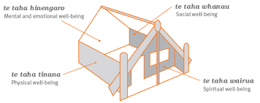
Culture and wellbeing

Slide 50
If you were in charge…
What else, besides happiness and strengths, varies by nation that may be important to wellbeing?
How would you measure a nations wellbeing? – make a plan

Slide 52
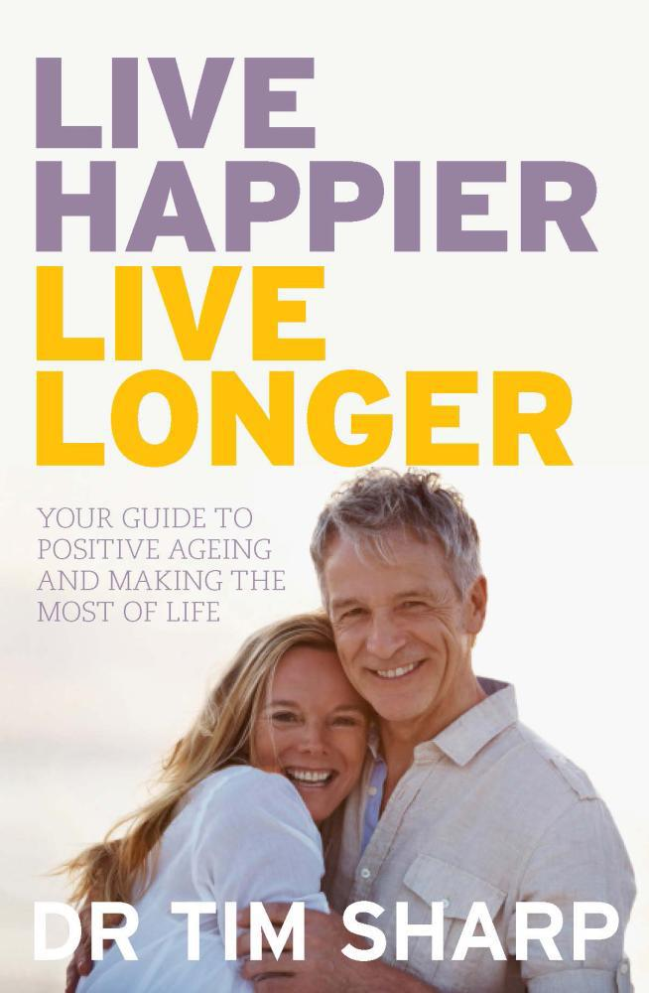
Wellbeing across the lifespan
Positive ageing
“add more life to years, not more years to life” - Vaillant
Fact: We are living longer
Need to stay physically active, mentally sharp, and social
How do you want to die? When do you want to die?

Slide 53
Wellbeing across the lifespan
Tips for successful ageing – meaningful activities, have autonomy, positive attitude, keep learning…
Living longer
Positive self-perceptions can add up to 7.5 years!
Will to live influences longevity
Remember the Nun Study

Slide 54
Your life stage experiences
At what age or life stage have you been at your happiest so far in life? Why?
What life domain has been the happiest for you? Rate each one out of 10 on both happiness and meaning
Work, family, standard of living, relations, health, personal life, leisure, spirituality, society, education.

Slide 55
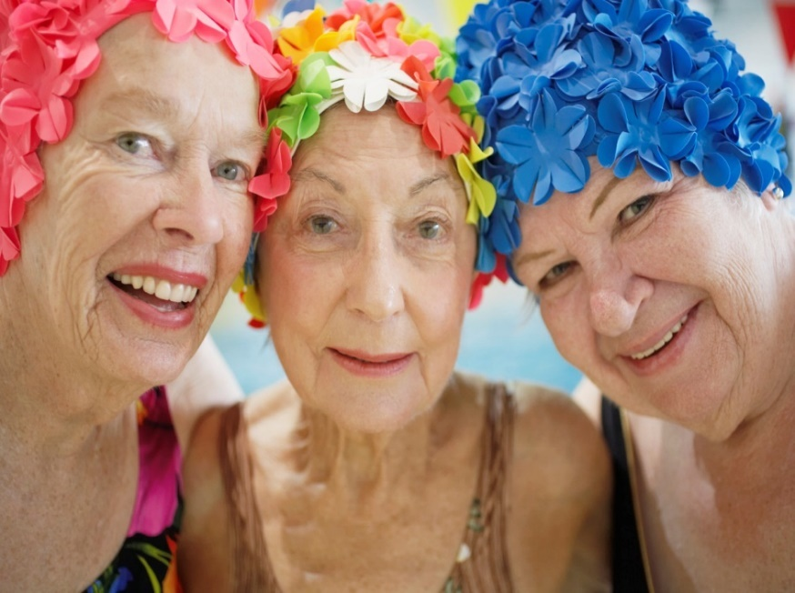
Future debate
Is life as a young adult is better than life as an older adult?
Notes:
Ask students to consider Erikson’s theory of human development and to examine the primary tasks of each life phase.
Ask students to embed theoretical perspectives from PP to their arugments.
Chapter 5 or their textbook will help with this.

Slide 56
Frameworks for addressing the Q
PERMA framework (Seligman, 2011):
Positive Emotions (& life satisfaction – SWB)
Engagement
Meaning
Relationships
Accomplishment
Psychological wellbeing (Ryff, 1989):
Self-acceptance, positive relations, autonomy, environmental mastery, purpose in life, personal growth
Virtues & strengths (Peterson & Seligman, 2004)
Notes:
Is the full life evident at any one life stage or do we cycle through different forms of well-being at different life stages?
Are the results different for males and females?

Slide 57
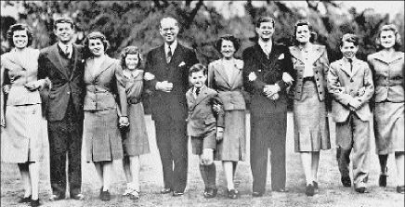
Life satisfaction over the lifespan
German Socio Economic Panel Study (approx. 40,000 participants)
British Household Panel Study (approx. 21,448)
LS does not decrease over most of adulthood (British data show an increase in LS from 40-70)
However, there is quite a marked decrease in LS from the early 70’s – why so? (next page)
Baird, Lucas and Donnellan (2010).
Notes:
Abstract
Two large-scale, nationally representative panel studies (the German Socio
Economic Panel Study and the British Household Panel Study) were used to assess changes
in life satisfaction over the lifespan. The cross-sectional and longitudinal features of these
studies were used to isolate age-related changes from confounding factors including
instrumentation effects and cohort effects. Although estimated satisfaction trajectories
varied somewhat across studies, two consistent findings emerged. First, both studies show
that life satisfaction does not decline over much of adulthood. Second, there is a steep
decline in life satisfaction among those older than 70. The British data also showed a
relatively large increase in satisfaction from the 40s to the early 70s. Thus, age differences
in well-being can be quite large and deserve increased empirical and theoretical attention.
Carstensen (1995) argued that as people move
into their final years of life, they become increasingly conscious of the amount of time they
have left to live. This awareness of impending mortality may lead older individuals to
focus on ways to make their remaining experiences as enjoyable as possible. For instance,
compared to younger individuals, older people tend to place a greater emphasis on emotional
aspects of potential social interactions and are more likely to remember the emotional
content of their experiences (Carstensen et al. 1999). Older people may also be more
adept at regulating their emotions than younger people (Gross et al. 1997). Taken together,
these processes should lead to increases in life satisfaction across the lifespan.
the unique historical context in which a study takes place, rather than the aging
process itself, might account for observed longitudinal changes (Costa and McCrae 1982).
A second problem with longitudinal designs is the potential for participants to be influenced
by repeated testing

Slide 58
How happy are you at present with your life as a whole?
Copied from Baird, Lucas and Donnellan (2010, p. 192).
Notes:
Life Satisfaction was assessed with a single item:
“How happy are you at present with your life as a whole?”
11 point scale 0 totally unhappy to 10 totally happy

Slide 59
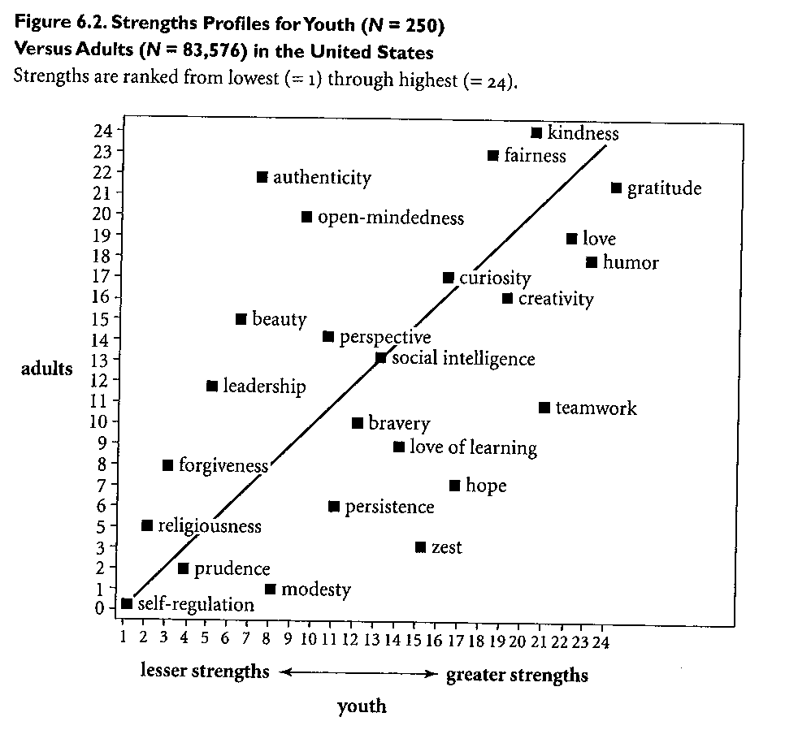
Strengths & Age: Peterson (2006)
Notes:
Youth reported higher levels of hope, teamwork and zest than adults.
Adults reported higher levels of appreciation of beauty, authenticity, leadership and open mindedness than youth.
Do certain character strengths diminish as we get older? – link this point in with last slide.
Can we avoid becoming less zestful as we grow older?
Which strengths improve as we age? Why do you think this is so?

Slide 60
Which strengths improve with age?
Notes:
Youth reported higher levels of hope, teamwork and zest than adults.
Adults reported higher levels of appreciation of beauty, authenticity, leadership and open mindedness than youth.
Do certain character strengths diminish as we get older? – link this point in with last slide.
Can we avoid becoming less zestful as we grow older?
Which strengths improve as we age? Why do you think this is so?

Slide 61
Psychological Wellbeing
Ryff & Burton, 2008
25-39 Young Adults
40-59 Middle Age Adults
60-74 Older Adults
Data from MIDUS national study (Mid Life in the US)
http://midus.wisc.edu/newsletter/MIDUS_Final.pdf
Notes:
http://midus.wisc.edu/newsletter/MIDUS_Final.pdf

Slide 62
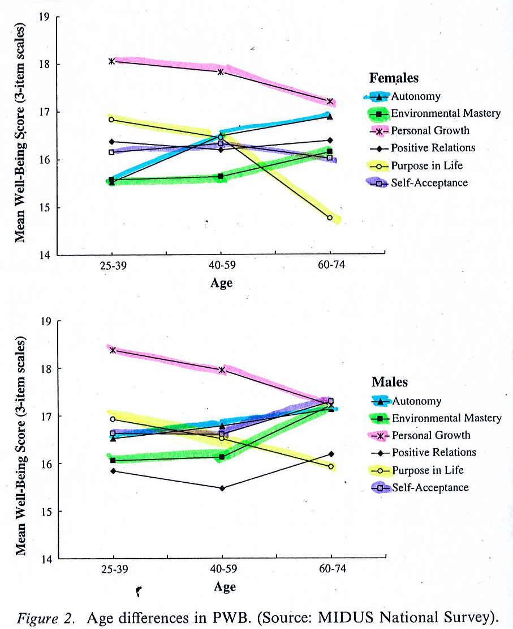

Slide 63
Psychological WellBeing (Ryff, 1989)
Self Acceptance – highest in middle age for females
Positive Relations – decreases in middle age
Autonomy – Lowest in young adults and highest in older adults
Enviro. Mastery – lowest in young adults and highest in older adults
Purpose in Life – lowest in older adults and highest in young adults (BUT...this measure is goal/future focused)
Personal Growth – lowest in older adults and highest in young adults
Notes:
Happiness Is Everything, or Is It? Explorations on the Meaning of Psychological Well-Being
Carol D. Ryff (1989)
Pages 1075 – 1077 in particular.
The findings in relation to Purpose in life and Personal Growth are most surprising – see discussion about search for and presence of meaning in next slide. Listening to music with headphones on might be engaging and pleasurable and depending on the music, meaningful as well.
Beyond the major goal of reexamining the essential meaning
of psychological well-being, this inquiry also addressed the life
course patterning of multiple aspects of positive psychological
functioning. The predictions from life span theories received
only partial support; self-ratings for environmental mastery
were, as expected, high in middle age, but they were also high
in the self-perceptions of aged persons. Self-acceptance, on the
other hand, showed no age variations, and autonomy ratings
were most prominent among middle-aged respondents. The
mixed support for the age predictions may reflect the fact that
each newly constructed dimension of well-being was derived
from the integration of several conceptual frameworks, not just
life span formulations.
When compared with the prior well-being literature, the age
differences reveal points of convergence as well as divergence.
For example, prior studies (some cross-sectional, others longitudinal)
have shown that aged persons are not less happy or do
not suffer from lower self-esteem than younger age groups
(Bengston, Reedy, & Gordon, 1985; Herzog etal., 1982). These
results reinforce such claims, showing no age differences in selfesteem
and even incremental levels of happiness (affect balance)
across age groups. At the same time, the findings reveal
higher levels of depression (although not in the range of clinical
depression) with age, concommitant with lower levels of purpose in life and
personal growth. Thus, within the limitations
of cross-sectional inference, the results point to a highly differentiated
profile of psychological functioning across the adult
life cycle. This mix of possible increments in some aspects of
well-being with aging and decrements in others is particularly
significant given the positive selection bias of the present sample.
It appears that even well-educated, healthy, economically
comfortable older adults face significant challenges in their
efforts to maintain a sense of purpose and self-realization in
later life.

Slide 64
Younger groups
Is the lack of autonomy just a natural part of the life course?
Similarly, does environmental mastery come with greater life experience?
Are there things we can do to assist this process?
What role might older people play with this?
Notes:
I think older people can play important mentoring roles with young people. This approach can equip younger people with better life skills and perceptions of mastery and autonomy whilst providing older people with life purpose and opportunities to grow and learn (learning about the needs of others, particularly those of a very different generation). This concept is linked with the notion of generativity developed by Erik Erikson in 1950 to denote "a concern for establishing and guiding the next generation." It is about trying to "make a difference" with your life, to "give back," to "take care" of others, your community and the environment more broadly.

Slide 65
Middle aged groups
Middle age is a very productive time of life with paid employment and/or child rearing. These roles can be physically and emotionally taxing but high on meaning

Slide 66
Does fatherhood make you happy?
“Our children give us many things, but an increase in our average daily happiness is probably not among them. Rather than deny that fact, we should celebrate it. Our ability to love beyond all measure those who try our patience and weary our bones is at once our most noble and most human quality”.
Daniel Gilbert - (Times Magazine, Sunday June 11, 2006)
Notes:
http://ehis.ebscohost.com.ezp.lib.unimelb.edu.au/eds/detail?sid=ffed4497-136f-4d1b-aef6-dabade5e98f0%40sessionmgr110&vid=3&hid=104&bdata=JnNjb3BlPXNpdGU%3d#db=bth&AN=21193465
Does Fatherhood Make You Happy? Daniel Gilbert Times Magazine Sunday June 11, 2006.
"Psychologists have measured how people feel as they go about their daily activities, and have found that people are less happy when they are interacting with their children than when they are eating, exercising, shopping or watching television. Indeed, an act of parenting makes most people about as happy as an act of housework. Economists have modeled the impact of many variables on people's overall happiness and have consistently found that children have only a small impact. A small negative impact."
A Survey Method for Characterizing
Daily Life Experience: The Day
Reconstruction Method
Daniel Kahneman,1 Alan B. Krueger,1,2 David A. Schkade,3*
Norbert Schwarz,4 Arthur A. Stone5
The Day Reconstruction Method (DRM) assesses how people spend their time
and how they experience the various activities and settings of their lives,
combining features of time-budget measurement and experience sampling.
Participants systematically reconstruct their activities and experiences of the
preceding day with procedures designed to reduce recall biases. The DRM’s
utility is shown by documenting close correspondences between the DRM
reports of 909 employed women and established results from experience
sampling. An analysis of the hedonic treadmill shows the DRM’s potential for
well-being research.

Slide 67
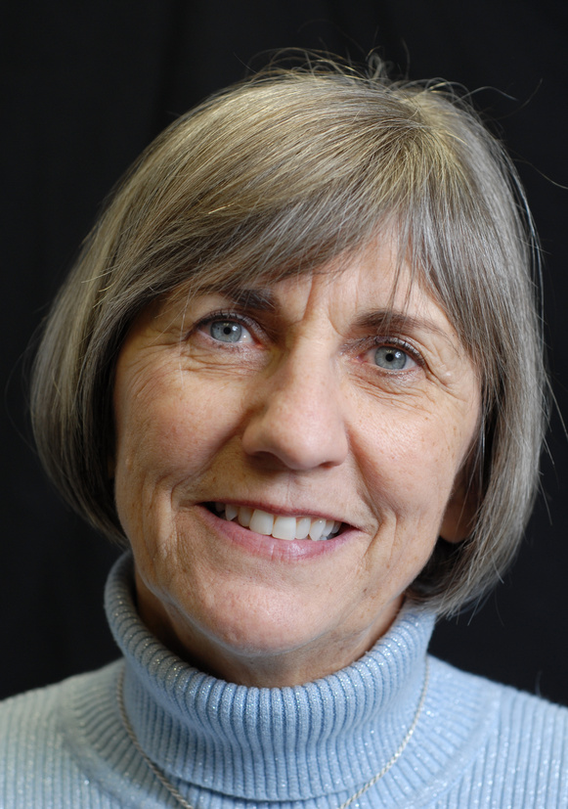
Older groups
There is a general decline in purpose in life and personal growth with age
Does this depend on environmental factors and poor public health planning?
The importance of significant roles and volunteering?
Notes:
Important point copied from Ryff and Burton (pp. 27-28)
With regard to the sharply downward trajectories for purpose in life and personal growth, the two most eudiamonic aspects of well-being, we have emphasized current societal challenges in providing older persons with meaningful roles and opportunities for continued growth. Sociologists have termed this the ‘‘structural lag’’ problem, in which contemporary social institutions lag behind the added years of life that many now experience (Riley et al., 1994). Related to such ideas, Greenfield and Marks (2004), using MIDUS data, focused on older persons who occupied few major roles and found that those who engaged in formal volunteering had higher levels of purpose in life than those lacking both major roles and volunteer experiences.

Slide 68
Steger, Oishi and Kashdan (2009)
8,756 internet users
1,229 Emerging adults (18-24)
3,649 Young adults (25-44)
3,715 Middle age adults (35-64)
163 Older adults (over 65)
Generally meaning in life increases as one gets older
Notes:
Age groups (2-4) were based on Erikson’s (1968) developmental theory of major life stages and the Emerging Adult group corresponded with Arnett’s (2000) concept.

Slide 69
Steger, Oishi and Kashdan (2009)
Search for, versus Presence of, meaning is an important distinction
Younger = higher search
Older = higher presence
The presence of meaning was associated with higher wellbeing than the search for meaning (especially for older adults)
Notes:
Findings using Ryff’s purpose in life subscale indicate that as people get older they experience less meaning. This is contrary to many other findings. However, her purpose in life subscale focuses on having and achieving goals.
Older people set less goals for themselves than younger people, hence are less inclined to be searching for meaning. So while older people may have lower levels of meaning (based on actively searching meaning and pursuing goals), their higher presence of meaning positively affects their well-being.

Slide 70
Cotton Bronk, et al., (2009)
Purpose, hope, life satisfaction and 3 stages of life:
153 adolescents (age; M=14, SD=1.7)
237 emerging adults (age; M=21, SD=2)
416 early to middle adults (age; M=35.5, SD=0.5)
Study Aims:
To clarify the role of purpose in three different age groups and to identify whether hope mediates the relationship between purpose and LS
Notes:
What is the difference between meaning, purpose and hope?
Purpose is meaningful to others as well – it is also voluntary and self-motivated.
Meaning may not necessarily include aspects beyond the self.
Two components are most often used for understanding meaning in life:
forming a coherent understanding of life
pursuing important lifelong aspirations
„Meaning comes from involvement in personally fulfilling goals, the integration of these goals into a coherent self-system, and the integration of these goals into a broader social system” (Emmons, 1996, pg. 333)

Slide 71
Cotton Bronk, et al., (2009)
“Identified purpose” is more strongly correlated with LS than is “search for purpose” for all 3 life stages
.
 | Life Satisfaction |  | Hope (Agency & Pathways)
 | Identified Purpose | Search for Purpose | Identified Purpose | Search for Purpose
Adolescent | .46*** | .31*** | .44*** (A) .21* (P) | .36*** (A) .17* (P)
Emerging Adult | .33*** | .29*** | .46*** (A) .24*** (P) | .34*** (A) .13* (P)
Adult (early to mid) | .66*** | -.23*** | .67*** (A) .42*** (P) | -.16*** (A) -.05^{ns} (P)
Notes:
See Tables 1, 2 and 3.
“Search for purpose” is adversely related to life satisfaction for the adult group only.
Hope (agency) was a mediator of the relationship b/w “identified purpose” LS for all 3 stages (pathways was more complex).
Having the will power to reach their ultimate aim improves LS for adolescent and emergent adults but adults need to have the will power and the know how on how to reach their ultimate aim for LS to occur.

Slide 72
Is the notion of growing old misunderstood?
(Garry & Lohan, 2011)
There is a clear perception by young people that happiness declines with age
For young males there is a positive relationship between holding this negative perception and current binge drinking
One explanation: if happiness declines with age why focus on preserving and nurturing the body for later, when you can enjoy the right now?
Notes:
Discuss Table 1 in Garry and Lohan (2011).
If some young people have a particularly negative view of the
ageing process, this may act as a major disincentive to behave ‘sensibly’ in order to
preserve their bodies and ensure that they do actually reach old age.
It is interesting that participants’ estimation of self and others at 70 is much less favourable in terms of happiness when compared with self and others now and at age 30. This viewpoint is pertinent for both males and females.
A key point on page 48 of this paper:
“The results of this study suggest that it may be worthwhile to emphasise, to young men in particular, the
positive impact on their lives of reducing alcohol. It is proposed that to counter the ‘live
hard, die young’ mentality there is a need to emphasise happiness throughout the lifecourse.
Hence, campaigners may profit from seeing the quite specific aim of informing
men about happiness in old age as part of a larger campaign of reconstructing alternate
versions of hegemonic masculinity and its associated negative health behaviours.”

Slide 73
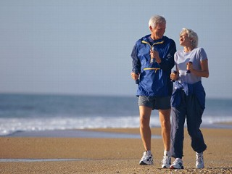
Emotion and aging: Exploding the misery myth
Laura Carstensen
Older people:
Aware of time horizons and impending mortality
More selective about experiences and wanting to filter out the positive aspects
Can regulate emotions better
Notes:
Carstensen (1995) argued that as people move into their final years of life, they become increasingly conscious of the amount of time they
have left to live.
Time horizons.
This awareness of impending mortality may lead older individuals to focus on ways to make their remaining experiences as enjoyable as possible. For instance, compared to younger individuals, older people tend to place a greater emphasis on emotional
aspects of potential social interactions and are more likely to remember the emotional content of their experiences (Carstensen et al. 1999). Older people may also be more adept at regulating their emotions than younger people (Gross et al. 1997). Taken together,
these processes should lead to increases in life satisfaction across the lifespan.

Slide 74
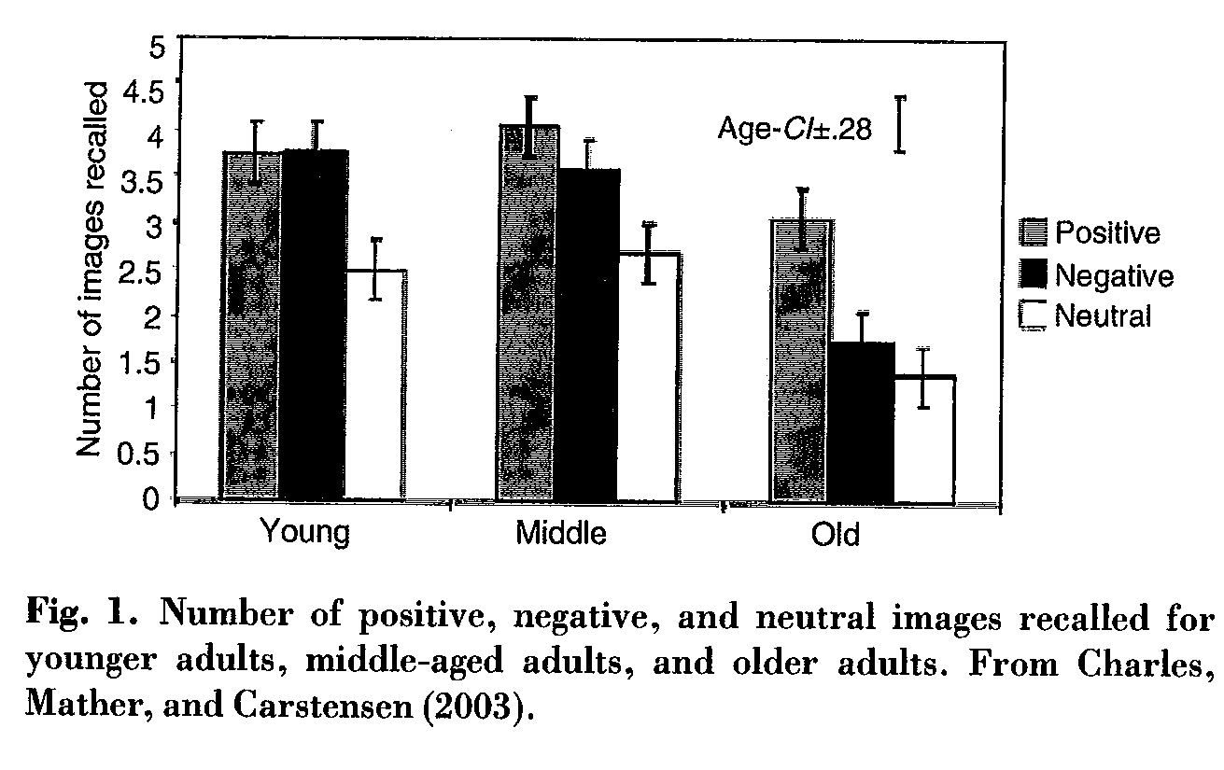
Carstensen & colleagues
Notes:
18-29 Young 41-53 Middle 65-85 Old
Viewed positive, negative and neutral images on a computer screen
Tested for recognition and recall memory
FMRI to examine activation in the amygdala (brain area which co-ordinates the processing of emotion) while viewing the images. Older people demonstrated greater activation for positive images than negative ones. Negative and positive stimuli are processed differently at a basic neural level and that older people have a preference for positive information in both attention and memory processes.
May not be motivated to attend to negative images.
Experiment with 3 faces (negative emotion, neutral, positive emotion), dot beneath the face. Identify which picture had the dot and the reaction time. Took longer with the negative emotion face with age, focused on the positive emotion face.
Older adults demonstrate high level cognitive performance for emotional compared to non-emotional information
Age differences are most notable for positive emotions compared with negative emotions.
Socio-emotional selectivity theory
Place importance on emotionally meaningful goals as they get older

Slide 75
Debate
Is life as a young adult is better than life as an older adult?
Notes:
Ask students to consider Erikson’s theory of human development and to examine the primary tasks of each life phase.
Ask students to embed theoretical perspectives from PP to their arugments.
Chapter 5 or their textbook will help with this.

Slide 76
Some learning messages
A struggle to define ‘happiness’, ‘wellbeing’, and ‘flourishing’
In fact you could say there may be different types of wellbeing, at different ages and in different places
Subjective Wellbeing = Satisfaction with life + high positive affect + low negative affect
Many major global studies of happiness – we have just started…
Most people are happy, looks like we can influence happiness – 50% genetic, 10% life circumstances, 40% personal control
Different mechanisms to promote happiness (five ways, five elements, etc), and different theories of SWB

Slide 77
Some learning messages
SWB related to income, relationships, work, health, religion, etc
Provide young and old people with opportunities…
Engagement and meaning are important for wellbeing at all life stages (but we live in a happiness focused media culture…)

Slide 78
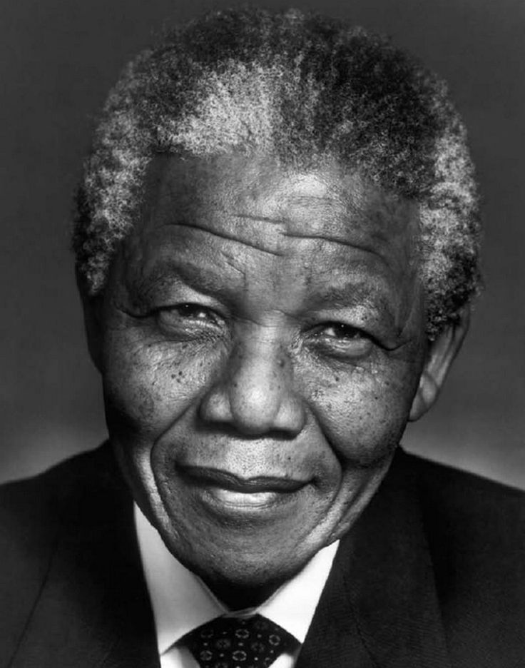
Your challenge
Select a culture that is very different from yours and try and understand more about it (Fear of happiness!!!)
Find people of all ages who are inspiring to you

Slide 79
Go well and keep going!
“Noting great was ever achieved without enthusiasm” - Emerson
Dr Aaron Jarden

