Slide 1
30 minutes to wellbeing and better abs
Dr Aaron Jarden
Or your money wasted…

Slide 2
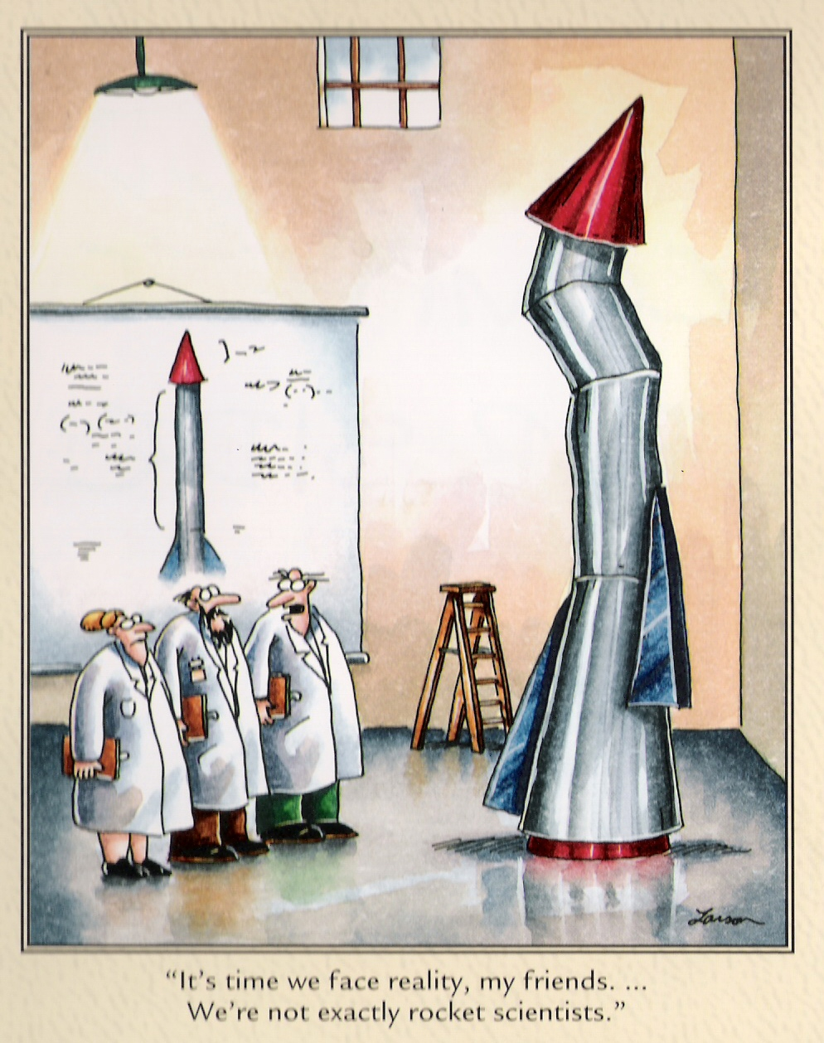
I'm no expert on your wellbeing
But, would you like an almond?

Slide 3
Positive assessment
10 - Extremely happy
9 - Very happy
8 - Pretty happy
7 - Mildly happy
6 - Slightly happy
5 - Neutral
4 - Slightly unhappy
3 - Mildly unhappy
2 - Pretty unhappy
1 - Very unhappy
0 - Extremely unhappy
Let’s do a “back of the napkin” assessment.
How happy are you right now?
What would you pay / give / do / sacrifice / commit to in order to be, on average, one point happier?

Slide 4
Positive introductions
Step 1: Pair up.
Step 2: In 2 minutes (1 minute each), tell a story – a thoughtful narrative with a beginning, middle and end – that illustrates when you are at your best in your job.
Note: Swap when you hear the bell the first time after 1 minute, stop completely when you hear the bell the second time after 2 minutes.
Key point: Wield your strengths – they are paths to engagement and enjoyment.

Slide 5
Five ways to wellbeing
Step 1: Pair up with a different partner, get a pen ready, as well as a blank A4 page…
Step 2: Raise a hand in the air when you're ready…
Step 3: Without looking down at your blank page, and ONLY looking at your partner’s face, you have 1 minute to draw a portrait of your partner, starting on the bell!
Step 4: Sign your name, date it, and swap pictures with your partner…

Slide 6
Five ways: connect, be active, take notice, keep learning, give
Connect – Make connections with friends, family, colleagues and neighbours. When you build these connections they help enrich your life with new experiences and opportunities. Be Active – Get moving. Walk, skip, run, dance – move your muscles. Exercise not only makes you feel good, it keeps you healthy. Pick a physical activity that you enjoy. Take Notice – Be mindful. Be curious. Like a child, see the wonder and beauty of the world. Notice the things around you – the weather, the landscape, the mood and feelings of the people around you. In noticing you learn to appreciate the things that matter. Keep Learning – We never stop learning. Keep trying something new – a new course you’ve been wanting to do or a more challenging task at work. Challenges keep us on our toes and increase our confidence and excitement in our day. Give – Be generous with your time, your knowledge and your talents, giving to friends, family and even strangers. Be thankful, smile at people, and volunteer. Sharing to a wider audience gives you a greater reward than just doing things for yourself.

Slide 7
An overview of workplace wellbeing

Slide 8
Savour your experiences
Savouring involves being “in the moment” and “taking in” all that an experience has to offer. Think of it as wringing the pleasure juice out of life by giving attention to the pleasures of the moment.
Savouring can be used in a wide variety of circumstances – one can savour a sensory experience, a social experience, a feeling, or even a memory.
There are ten different types of savouring strategies - sharing with others, memory building, self-congratulation, sensory-perceptual sharpening, comparing, absorption, behavioural expression, temporal awareness, counting blessings, and kill-joy thinking.
We are going to try a combo of “sensory-perceptual sharpening” and “absorption”.

Slide 9
Savour your experiences
Step 1: get another almond.
Step 2: Take a close look at it – inspect it, examine it! What does it look like? Is it symmetrical?
Step 3: Close your eyes for the rest of this experience and feel it in your hand – what does the texture feel like?
Step 4: Smell it. What does it smell like?
Step 5: Put the almond into your mouth but do not bite or suck it – just let it rest on your tongue. Explore the almond with your tongue and teeth, noticing as much as you can.
Step 6: Bite slowly into it and focus on the taste. Swirl the contents of the almond around in your mouth.
Step 7: Swallow the almond and open your eyes.
Was it easy to stay focused as you tapped your senses and became absorbed in the sensory experience?
What was it like to pay attention to each individual detail of the experience?
Was this almond more enjoyable than the previous almond?

Slide 10
Three good things
The ‘Three Good Things’ exercise is one way of being more aware of the good things that happen to you. It is designed to help you notice and remember positive events that occur throughout your day, and to end your day on a positive note by thinking and writing about those positive events.
Step 1: Write down three things that went well today. The three things you list can be relatively small and unimportant, or relatively large in importance.
Step 2: After each positive event on your list, answer the question “Why did this good thing happen?”
Today’s Three Good Things
First Good Thing:
Why did this good thing happen?
Second Good Thing:
Why did this good thing happen?
Third Good Thing:
Why did this good thing happen?

Slide 11
Peak-end theory
Peak-end theory states that people’s judgments of their overall experience (like of this 30 minute talk) is greatly influenced by the peak of their experience, and how it ends.
The research indicates that we judge our past experiences almost entirely on how they were at their peak and how they ended…
It has to do with our memory of experiences

Slide 12
A wellbeing overview
Invest time and effort in family connections
We are social creatures so be enmeshed in a community of friends - deep and meaningful relationships
Know your personal values and live by them. Similarly, know your purpose and what derives meaning for you
Know you personal strengths and find ways to exercise them every day
Develop and optimistic thinking style
Invest your money in experiences rather than things
Be in work, and work that you enjoy
Be grateful
Savour the now regularly – rather than the past or future
Slow down – perhaps meditate?
Be curious
Look after your health (the below 5 can make approximately 14 years difference to your life expectancy - the quality of both your current life and those extra 14 years)
Eat real food – not too much, and mostly plants
Exercise regularly – and different types: aerobic, resistance, flexibility, balance
Drink alcohol in moderation
Don’t smoke
Get enough quality sleep
Caveat: Genetics and upbringing also make a slight bit of difference, but since you can’t do too much about those, don’t worry about them…
Notes:
Use simple and effective wellbeing boosts
Add a dose of science and gather better data to inform your own personal change – quantify your reflections

Slide 13
Dr Aaron Jarden
aaron.jarden@aut.ac.nz

